Slide 1

Computer Networks
Ing. Vladimír Horák

Slide 2
Review
Computer architecture – the logical structure that a computer is made up of
Hardware – all physical components of a computer
Software – all computer programs and applications
Peopleware – the human factor in technology
Orgware – rules and regulations related to the use of technology

Slide 3
Review
Computer components – computer case, motherboard, CPU, RAM, drive, graphics card, power supply
Input devices – devices used to give the computer instructions
Output devices – devices used by the computer to provide feedback

Slide 4
Today's lecture
Computer networks
Classification of computer networks
Network devices

Slide 5
Computer Network
A “system” created by interconnecting computers
It consists of:
  Stations (computers)
  Network hardware (network cards, cables, ...)
  Network software (programs for working on a network)

Slide 6
Computer Network
Depending on the role a computer performs in the network, computers are divided into:
  Servers
  Workstations (Workstation)

Slide 7
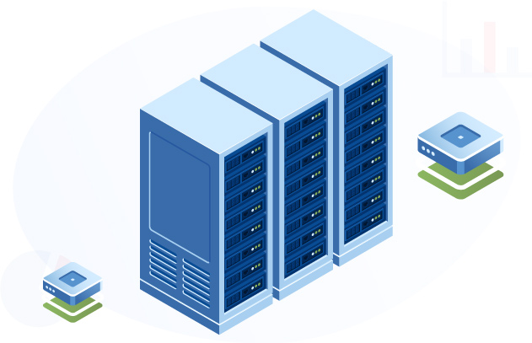
Servers
A computer that provides certain services to others (file, application, mail, ...)
Acts as a control station
There can be an “unlimited” number of servers on the network

Slide 8
Workstation
A computer used by a user
Uses services provided by a server
Generally a more powerful device than a standard PC

Slide 9
Classification of Computer Networks
Based on scope
Based on the relationship between nodes
Based on topology

Slide 10
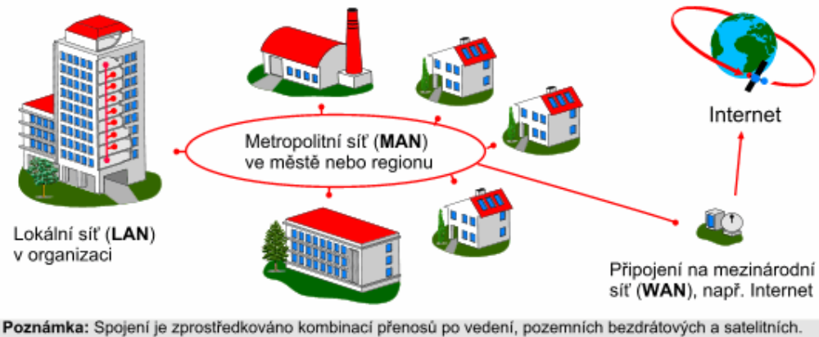
Classification by Scope
PAN - Personal Area Network, personal network (bluetooth)
LAN - Local Area Network, local network (Wi-Fi)
MAN - Metropolitan Area Network, metropolitan networks
WAN - Wide Area Network – wide-area sítě

Slide 11
Classification by Node Relationship
Peer-to-Peer
  “equal to equal”
  A PC connects to a printer and shares it locally with others
Client – Server
  One computer offers its services to others
SAN – Storage Area Network
  Storage network
  Specialized for transferring large amounts of data

Slide 12
Classification by Topology
Physical
  Based on the actual interconnection of devices in the network
  Ring, star, ...
Logical
  Based on the communication of individual elements
  Bus, ring, ...

Slide 13
Network Devices
Enable connections
Extend the network
Modify its properties

Slide 14
Network Card
Facilitates communication between the computer and the cable
Converts data from a form understood by the computer so that it can be transmitted over the medium
Each network card has its own unique MAC address

Slide 15
Repeater
Used for better signal coverage
Receives the signal, amplifies it, and sends it on
It helps extend the signal into previously inaccessible areas

Slide 16
HUB (network hub)
Used to branch the signal
It can both amplify and modify the signal

Slide 17
Bridge
A device that connects networks using different standards
It can be found, for example, in smart-home devices

Slide 18
Router
A device used to distribute the connection
From home use, we know Wi-Fi routers – “boxes” that create a Wi-Fi network and allow individual devices to connect to the internet

Slide 19
Any questions?

Slide 20
Final assignment
We have been talking about networks all this time today. Networks allow us to do many positive things, but there are also negatives associated with them.
Write down at least 10 different types of threats that can attack us over the network.

Slide 21
Thank you for your attention

