Slide 1

Basic Principles of Computer Operation. Computer Hardware Components
Ing. Vladimír Horák

Slide 2
Review
Data – any piece of data
Information – "data in context"
Abstraction – a logical method that hides information that is not important at the given moment
Representation – the way data is stored in a PC
Interpretation – assigning meaning to data
Binary system – (0;1)
Byte < KB < MB < GB < TB

Slide 3
Today's Lecture Content
Computer Architecture
Hardware and Software
Computer Components

Slide 4
Computer Architecture
"Logical structure" of which a computer is formed
Describes what parts a computer must have and how they are interconnected
Dva nejznámější typy
  Von Neumann architecture
  Harvard architecture

Slide 5
Von Neumann Architecture
Control Unit
Arithmetic Logic Unit (ALU)
(Internal) Memory
Input and Output Devices
External Memory

Slide 6
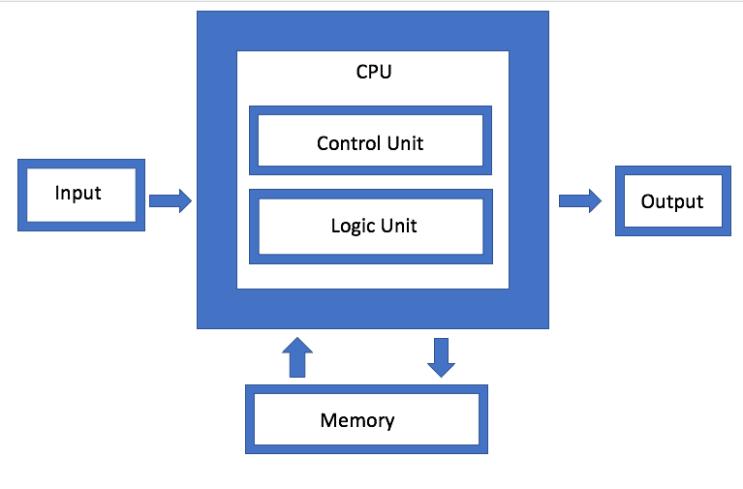
Von Neumann Architecture

Slide 7
Hardware and software
Hardware – all physical computer devices
Software – a series of instructions through which we can connect with the computer and control its hardware

Slide 8
Hardware and software
Peopleware – the human role (factor) in technology, both programmers and users
Orgware – rules and regulations related to the use of Information Systems (IS)

Slide 9
Computer Hardware Components
Individual components that make up a computer…
Computer case, motherboard, processor, RAM, storage drive, graphics card, power supply unit, ports…
Monitor, keyboard, mouse, speakers, microphone, specialized peripherals

Slide 10
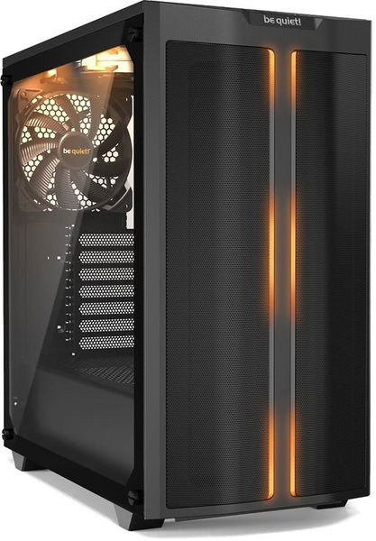
Computer Case
"Enclosure" for components

Slide 11
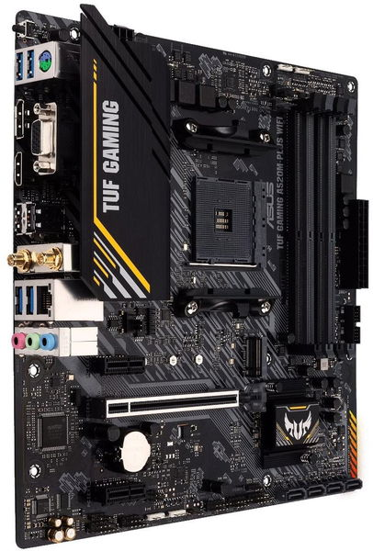
Motherboard
Connects other components together
Provides essential ports
Offers connectivity options

Slide 12
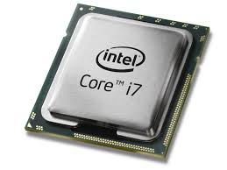
Processor (CPU)
The "brain" of the computer
Key specs:
  Number of cores
  Clock speed

Slide 13
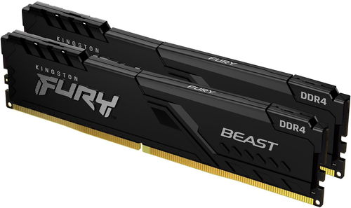
RAM – Operating Memory
Used for current calculations
Key specs:
  Memory capacity
  Clock speed

Slide 14
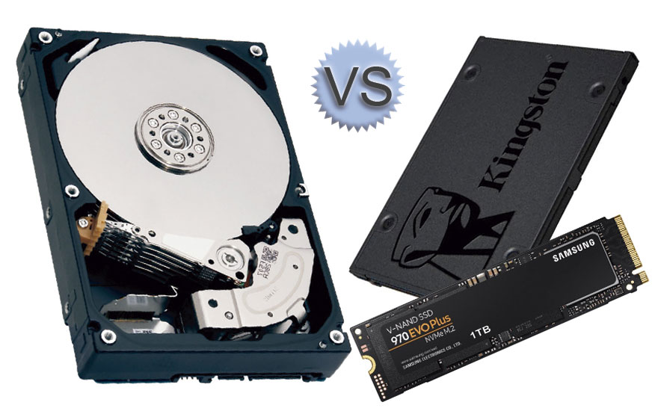
Storage Drive
Storage for user data
HDD vs. SSD
Key specs:
  Capacity
  Read and write speed

Slide 15
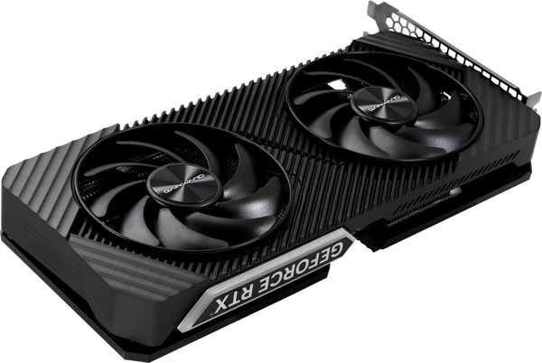
Graphics Card (GPU)
Used to process visual output
Integrated vs. dedicated

Slide 16
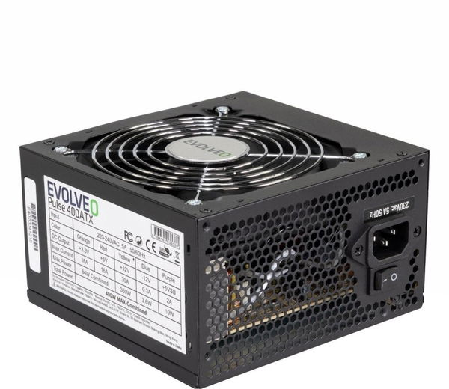
Power Supply Unit (PSU)
Distributes power to the entire PC

Slide 17
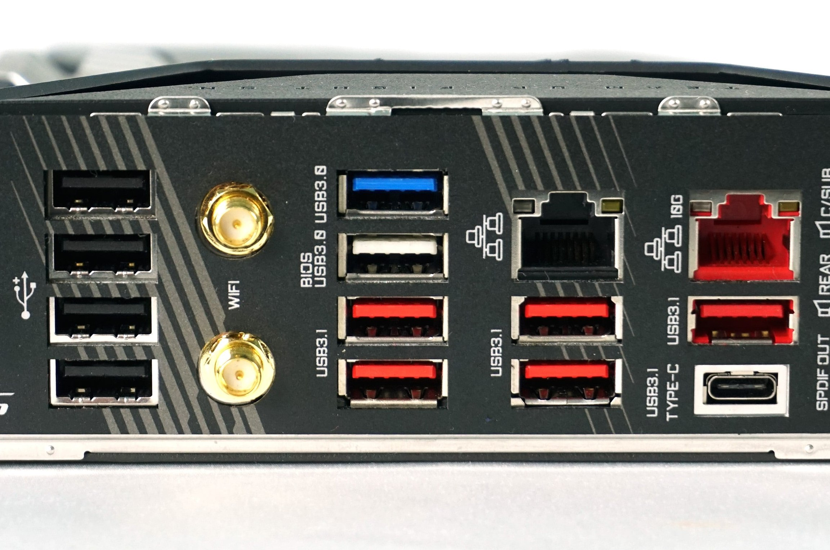
Ports
Connecting the PC with peripherals

Slide 18
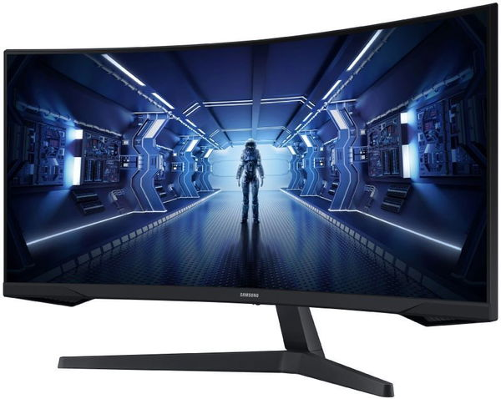
Monitor
Display device
Key specs:
  Screen size / Diagonal
  Resolution

Slide 19
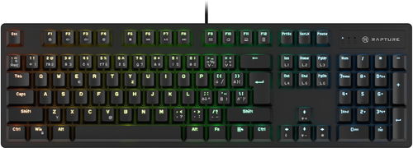
Keyboard
Input device

Slide 20
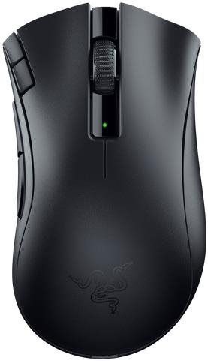
Mouse
Input device

Slide 21
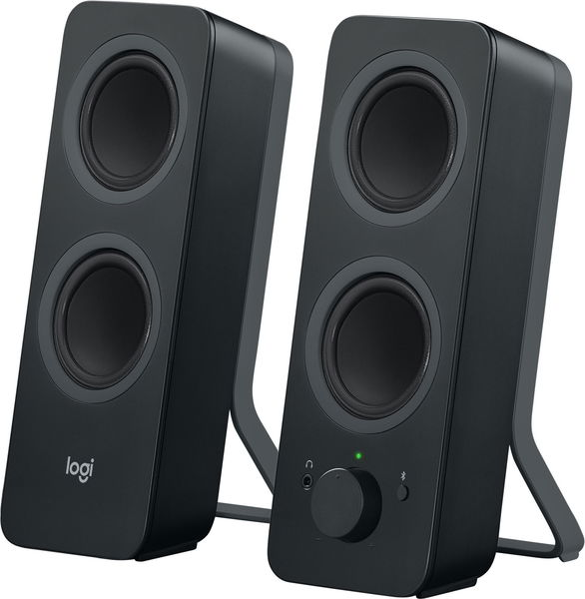
Speaker
Audio output device

Slide 22
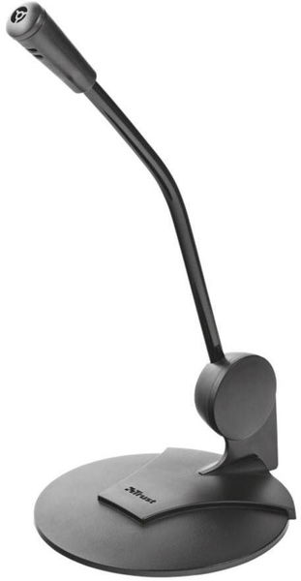
Microphone
Audio input device

Slide 23
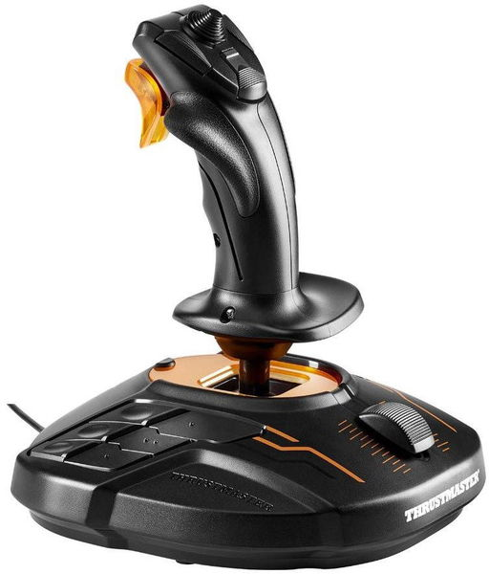
Specialized Peripherals
Input devices for special needs

Slide 24
Any questions?

Slide 25
Thank you for your attention.

