Slide 1
Trh a tržní mechanismus
OPAKOVÁNÍ
2025
Olomouc
Author: doc. Ing. Magdaléna Drastichová, Ph.D.

Slide 2
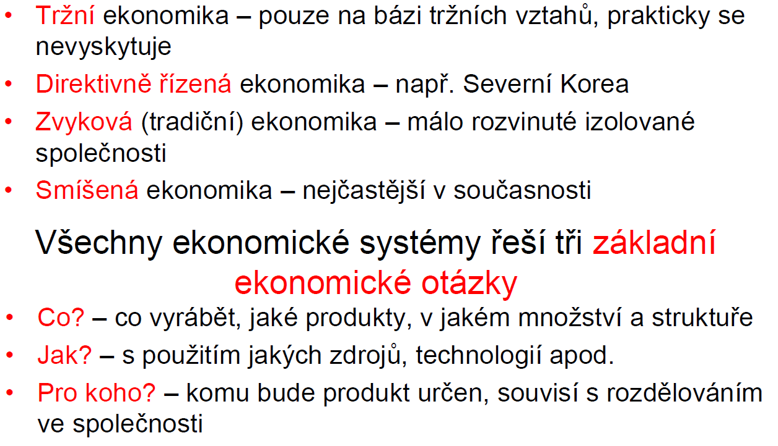
Ekonomické systémy
18/38

Slide 3
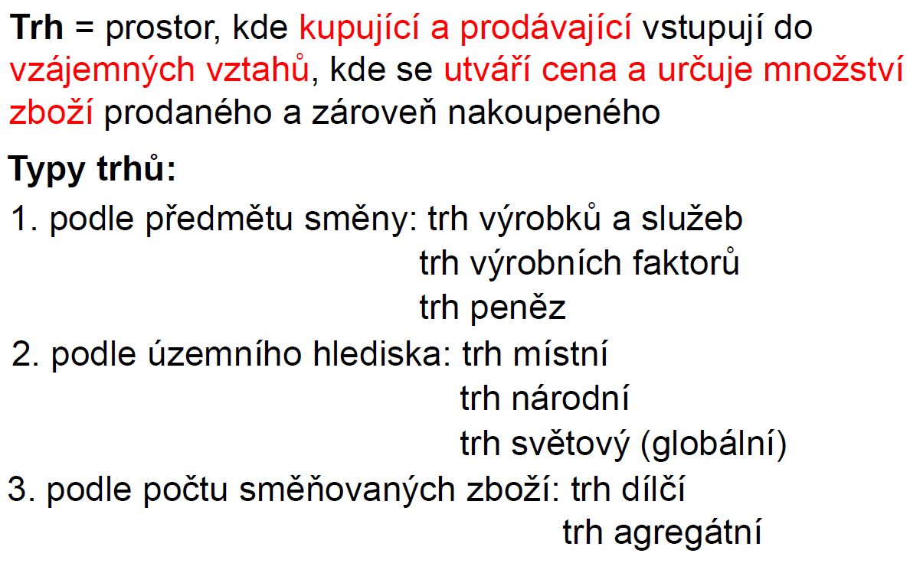
Trh
19/38
Notes:
BEVERIDGE MODEL: Financed through taxation, with public ownership of healthcare facilities. Example: UK.
BISMARCK MODEL: Based on insurance schemes, financed through employer and employee contributions. Example: Germany.
NATIONAL HEALTH INSURANCE MODEL: Combines elements of Beveridge and Bismarck models; a single-payer system financed by taxation or premiums. Example: Canada.
OUT-OF-POCKET MODEL: Individuals pay for services directly. Common in developing countries.
A single-payer system refers to a healthcare financing system where a single public or quasi-public agency organizes health care financing, but the delivery of care may remain largely in private hands. In this model:
Government as the Sole Payer: The government collects taxes and uses the funds to pay for all healthcare services for its population.
Universal Coverage: Everyone is covered under the same plan, ensuring equal access to healthcare services.
Cost Control: Since there is only one payer, administrative costs are reduced, and the government can negotiate prices with providers and pharmaceutical companies.
Examples: Countries like Canada, Taiwan, and South Korea use variations of the single-payer system.

Slide 4
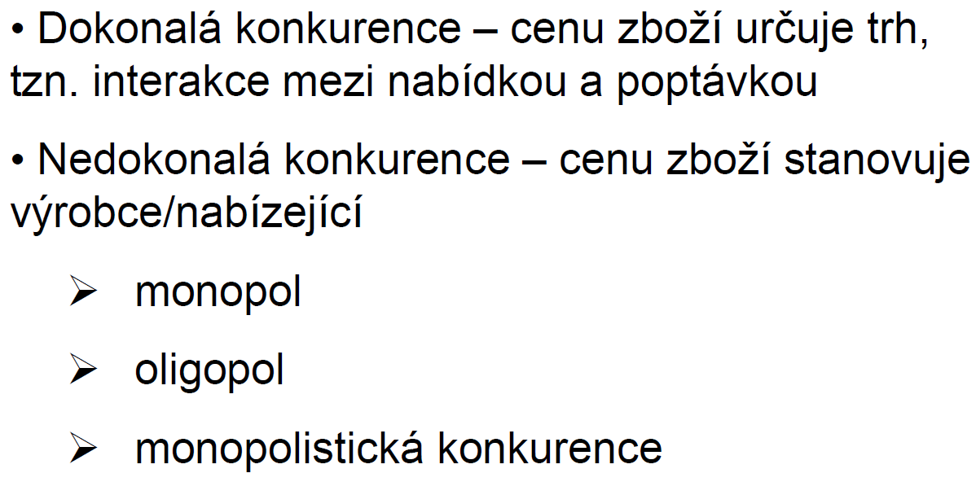
Tržní struktury:
19/38

Slide 5
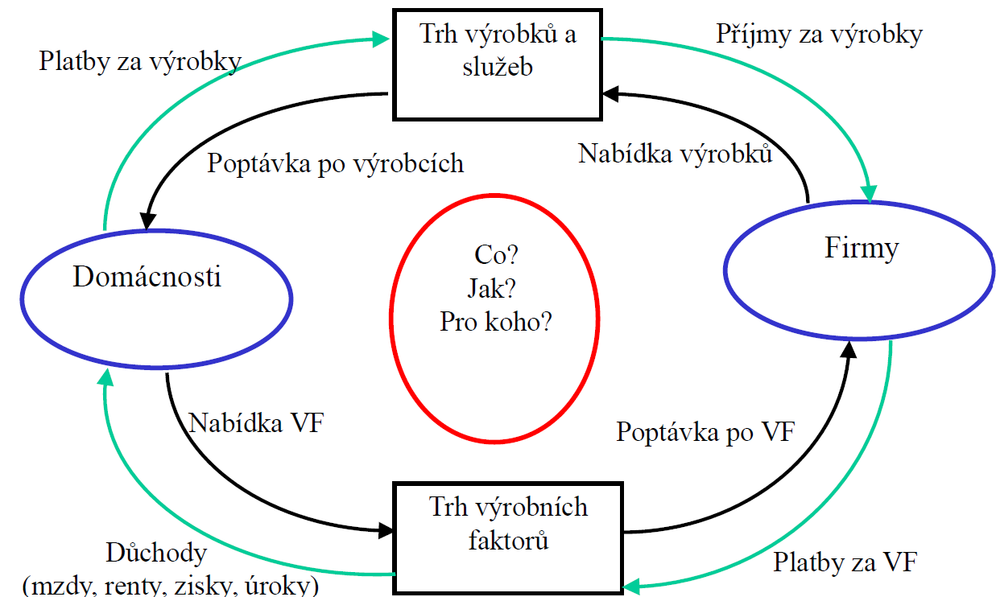
Tržní koloběh
19/38

Slide 6
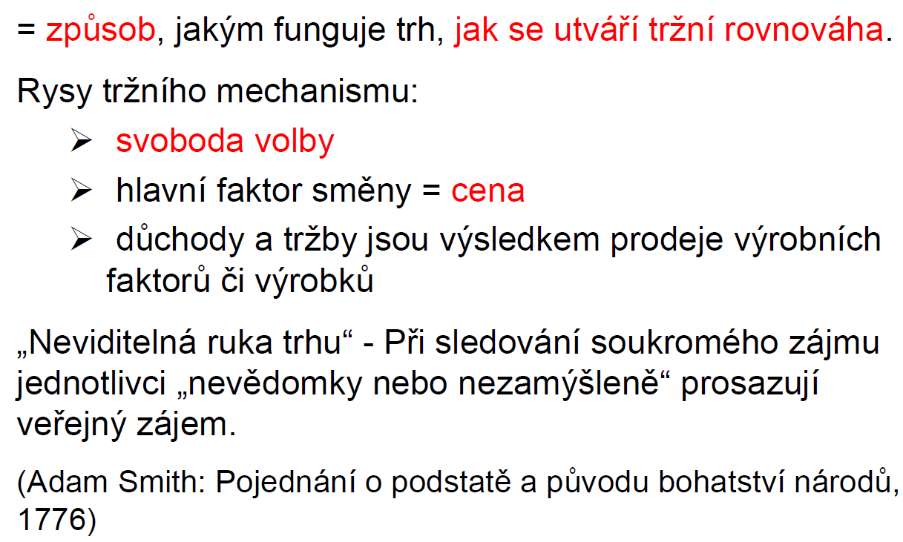
Tržní mechanismus
28/38

Slide 7
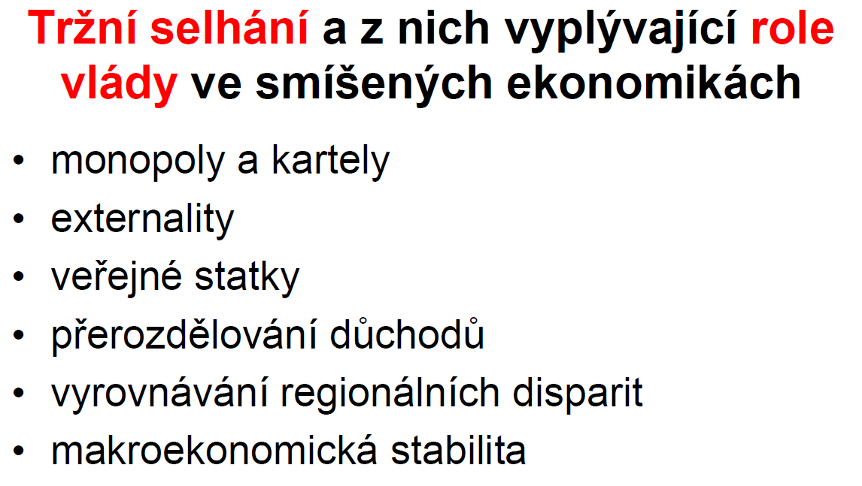
28/38

Slide 8
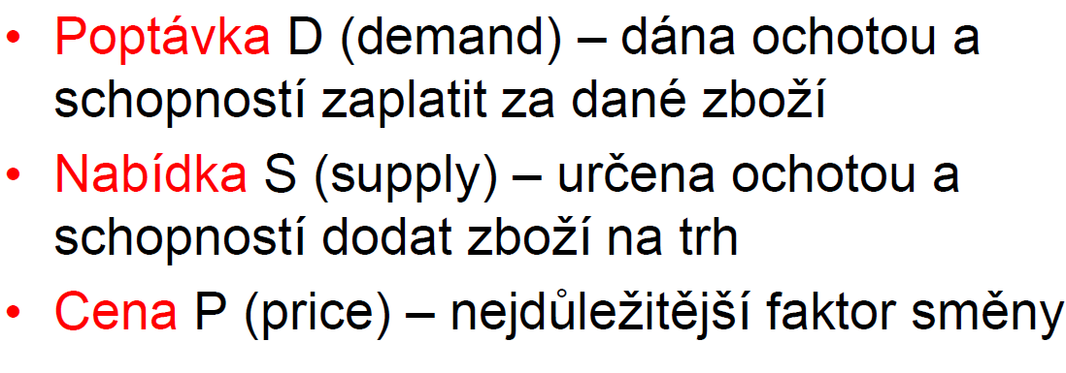
Základní tržní kategorie
28/38
Notes:
https://www.un.org/sustainabledevelopment/news/communications-material/

Slide 9
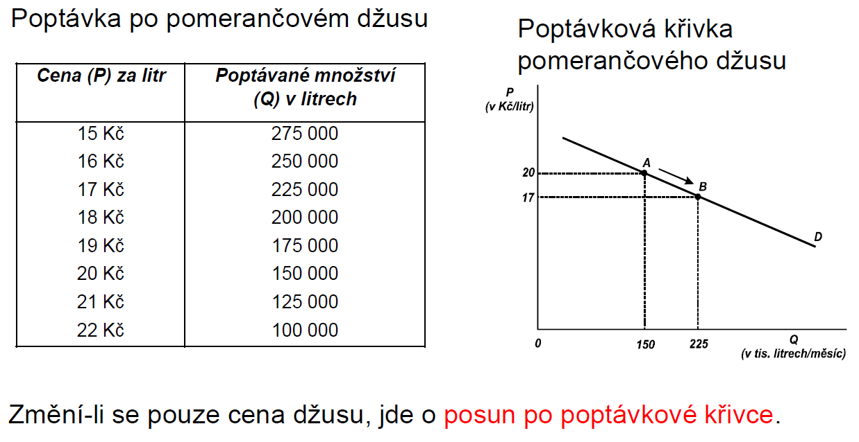
Poptávka, poptávané množství, ZÁKON KLESAJÍCÍ POPTÁVKY
28/38
Notes:
https://www.footprintnetwork.org/our-work/ecological-footprint/

Slide 10
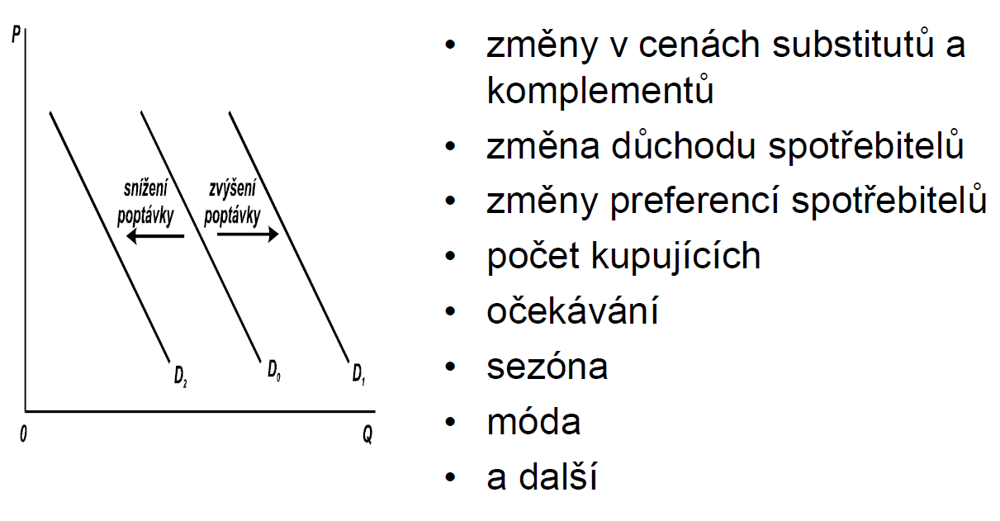
Změny poptávky – posun celé křivky
28/38
Notes:
https://www.footprintnetwork.org/our-work/ecological-footprint/

Slide 11
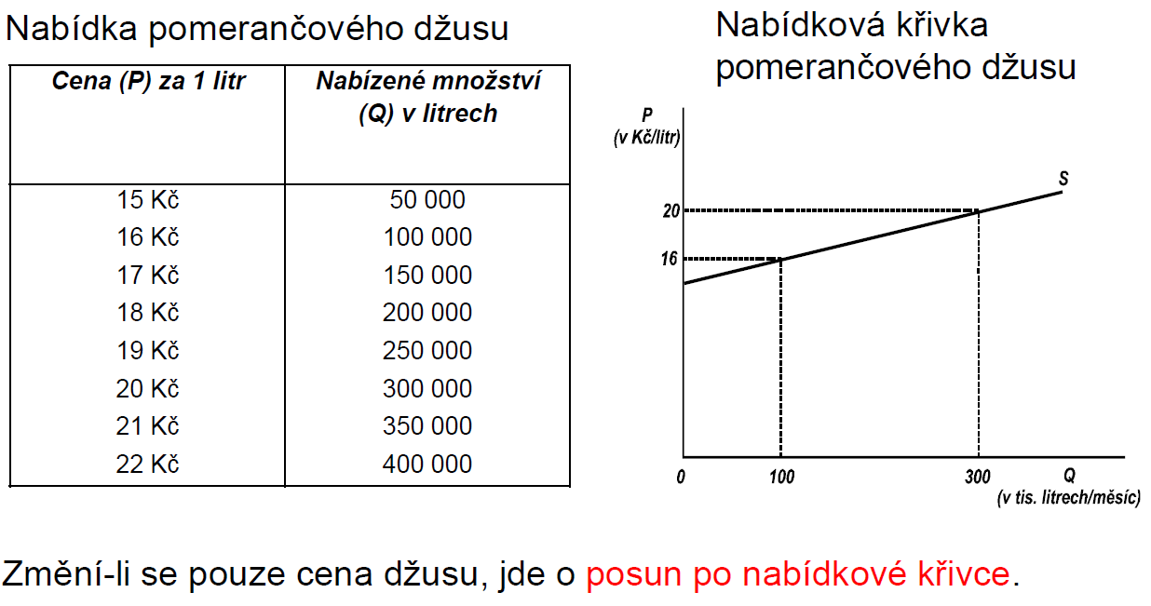
Nabídka, nabízené množství, zákon rostoucí nabídky
28/38
Notes:
https://www.footprintnetwork.org/our-work/ecological-footprint/

Slide 12
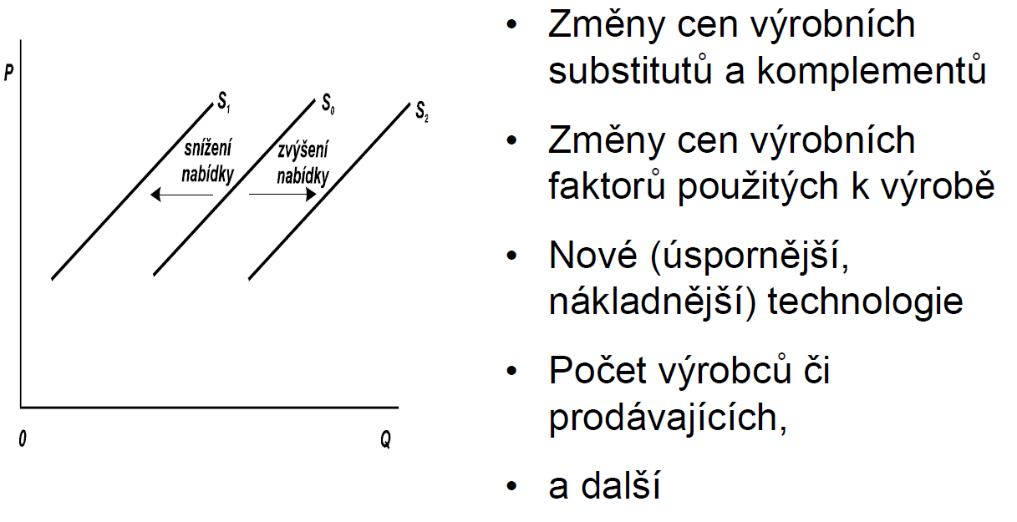
Změny nabídky – posun celé křivky
28/38
Notes:
https://www.footprintnetwork.org/our-work/ecological-footprint/

Slide 13
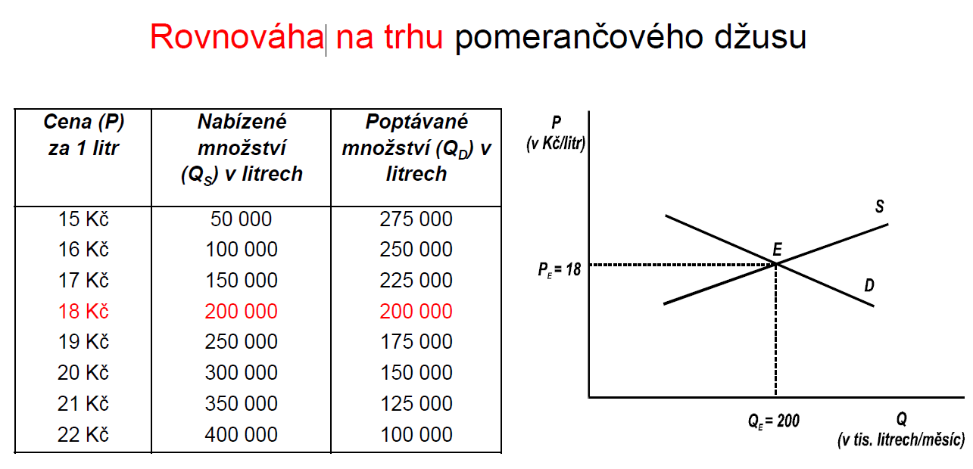
Tržní cena
28/38
Notes:
https://happyplanetindex.org/HPI_2024_report.pdf

Slide 14
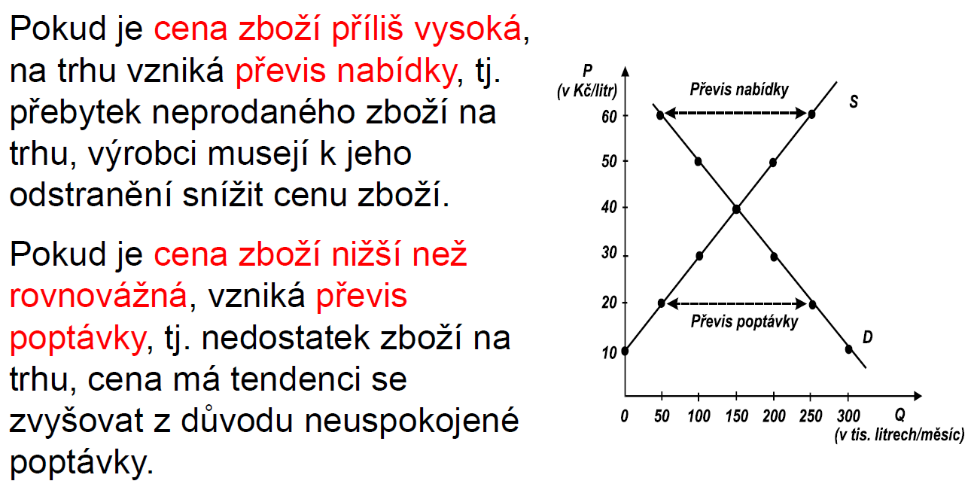
Přebytek a nedostatek zboží při nerovnovážné ceně
28/38
Notes:
https://happyplanetindex.org/HPI_2024_report.pdf
It uses the latest UN Environment Programme estimates for necessary global greenhouse gas emission reductions and defines a fair maximum level of emissions of 3.17 tonnes CO₂e per capita – ceiling for a fair consumption space.

Slide 15
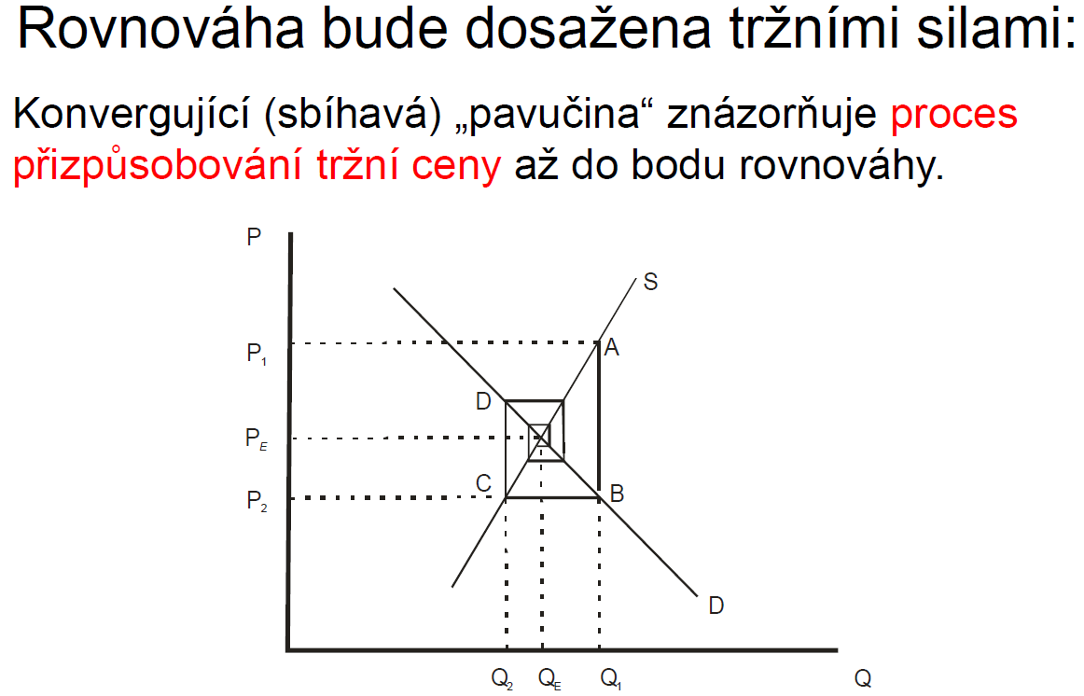
28/38
Notes:
https://happyplanetindex.org/HPI_2024_report.pdf
It uses the latest UN Environment Programme estimates for necessary global greenhouse gas emission reductions and defines a fair maximum level of emissions of 3.17 tonnes CO₂e per capita – ceiling for a fair consumption space.

Slide 16
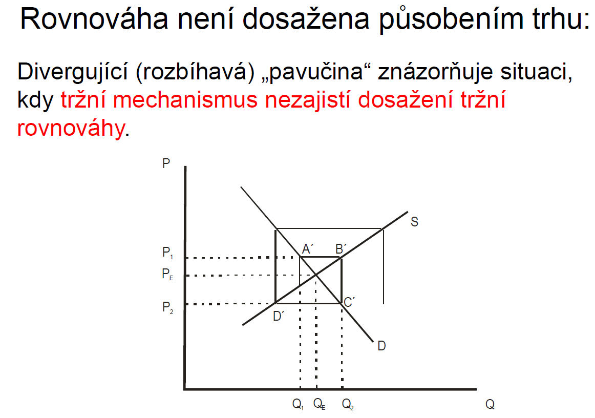
28/38
Notes:
https://happyplanetindex.org/HPI_2024_report.pdf
It uses the latest UN Environment Programme estimates for necessary global greenhouse gas emission reductions and defines a fair maximum level of emissions of 3.17 tonnes CO₂e per capita – ceiling for a fair consumption space.

Slide 17
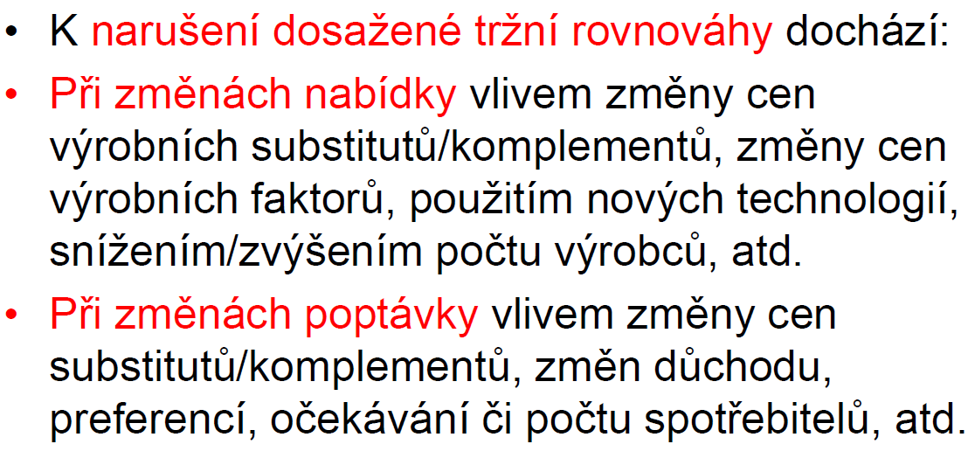
Změny tržní rovnováhy
28/38
Notes:
https://happyplanetindex.org/HPI_2024_report.pdf
It uses the latest UN Environment Programme estimates for necessary global greenhouse gas emission reductions and defines a fair maximum level of emissions of 3.17 tonnes CO₂e per capita – ceiling for a fair consumption space.

Slide 18
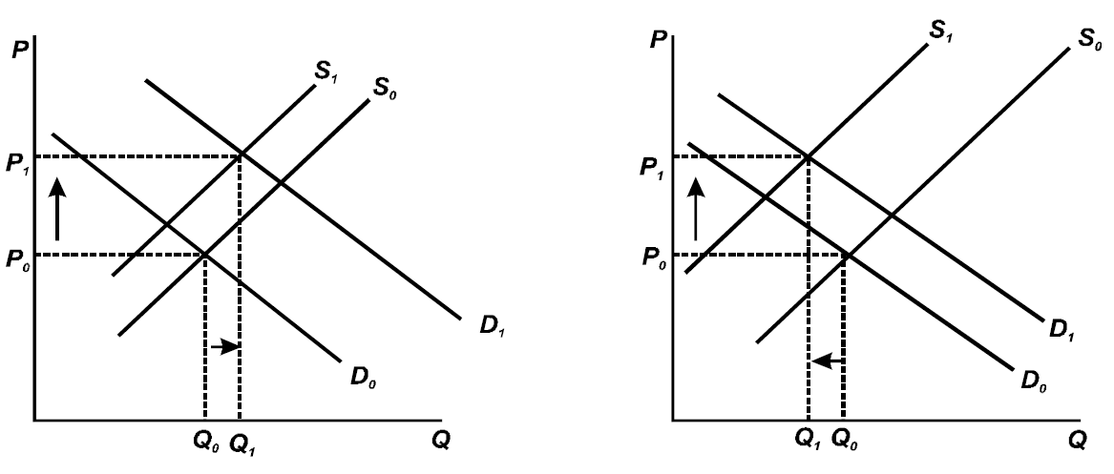
Rozdílné síly změn nabídky a poptávky a jejich vliv na cenu a obchodované množství
28/38
Notes:
https://happyplanetindex.org/HPI_2024_report.pdf
It uses the latest UN Environment Programme estimates for necessary global greenhouse gas emission reductions and defines a fair maximum level of emissions of 3.17 tonnes CO₂e per capita – ceiling for a fair consumption space.

Slide 19
DĚKUJI ZA POZORNOST
DÚ: velká hospodářská deprese a text a obrázky pod tím;

