Slide 1

Quiz about the czech republic

Slide 2
Question for 1 point
Question for 1 point
Question for 1 point
Question for 1 point
Question for 1 point
Question for 2 point
Question for 2 point
Question for 2 point
Question for 2 point
Question for 2 point
Question for 3 point
Question for 3 point
Question for 3 point
Question for 3 point
Question for 3 point
Question for 3 point
Question for 3 point
Question for 3 point
Question for 3 point
Question for 3 point
Question for 4 point
Question for 4 point
Question for 4 point
Question for 4 point
Question for 4 point

Slide 3
What is the name of the capital city of the Czech Republic?
Prague
Correct answer
Back

Slide 4
What is the name of the Czech currency?
            Crown
Correct answer
Back

Slide 5
What drink do czech people love?
A) bear B) wine C) water
A) bear
Correct answer
Back

Slide 6
How many neighbors does the Czech Republic have?
4 neighbors
Correct answer
Back

Slide 7
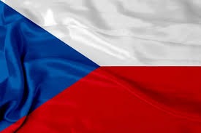
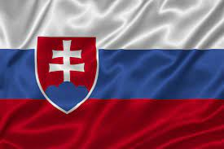
Which is the Czech flag?
A) B)
A)
Correct answer
Back

Slide 8
What are the neighbour states of the Czech Republic?
Poland, Slovakia, Austria, Germany
Correct answer
Back

Slide 9
Who brings present at chrismas in the Czech Republic?
Baby Jesus
Correct answer
Back

Slide 10

This logo belongs to a car company called?
Škoda
Correct answer
Back

Slide 11
In which year was the Czech Republic established?
A) 1989 B) 1991 C) 1993
C) 1993
Correct answer
Back

Slide 12
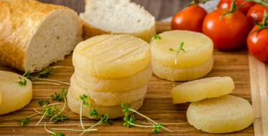
What is the name of this food?
Olomouc chees curds
Correct answer
Back

Slide 13
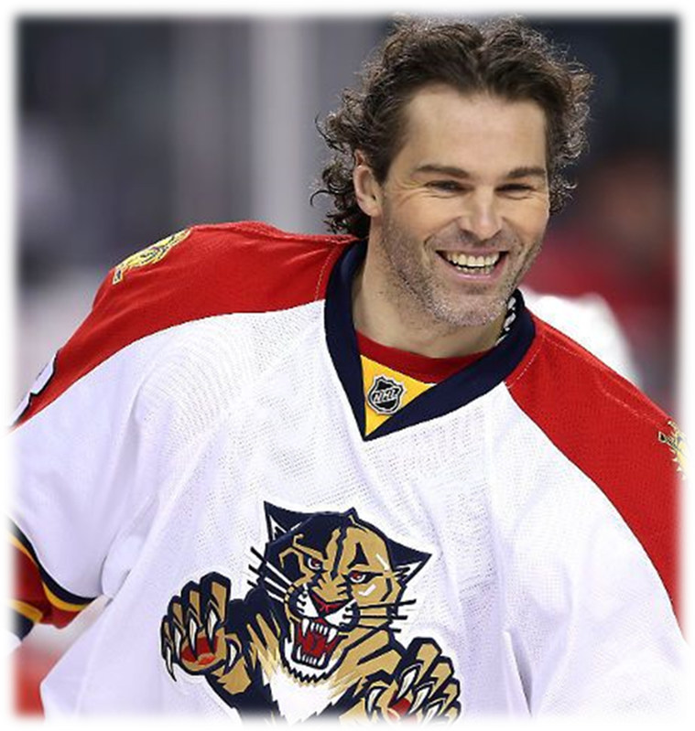
What is the name of the athlete in the picture?
Jaromír Jágr
Correct answer
Back

Slide 14
What is the size of the territory of the Czech Republic?
A) 35 866 B) 78 866 C) 112 866
B) 78 866
Correct answer
Back

Slide 15
How many letters does the longest Czech word have?
A) 15 B) 25 C) 30
C) 30 „nejneobhospodařovávatelnějšími“
Correct answer
Back

Slide 16
How many liters of beer does a person in the Czech Republic drink in 1 year? (on average)
A) 100 liters B) 120 liters C) 135 liters
C) 135 liters
Correct answer
Back

Slide 17
The population of the Czech Republic is about?
A) 8 milions B) 10,5 milions C) 12 milions
B) 10,5 milions
Correct answer
Back

Slide 18
How many public holidays does the Czech Republic have per year?
A) 7 B) 9 C) 13
A) 7
Correct answer
Back

Slide 19
How many national parks does the Czech Republic have?
A) 2 B) 4 C) 6
B) 4
Correct answer
Back

Slide 20
Which of these letters exists only in the Czech alphabet?
A) Č B) Š C) CH D) Ř
D) Ř
Correct answer
Back

Slide 21
Czech language belongs to the family of?
A) slavic language B) german language C) romance language
A) slavic language
Correct answer
Back

Slide 22
How many regions does the Czech Republic have?
A) 8 B) 12 C) 14
C) 14
Correct answer
Back

Slide 23
How many cities in the Czech Republic have more than 100 thousand inhabitants?
A) 5 B) 7 C) 9
A) 5
Correct answer
Back

Slide 24
How many kilometers is the longest river in the Czech Republic?
A) 300 km B) 430 km C) 500 km
A) 300 km
Correct answer
Back

Slide 25
What is the distance from Budapest to Olomouc?
A) 721 km B) 523 km C) 397 km
C) 397 km
Correct answer
Back

Slide 26
What is the phone code in the Czech Republic?
A) + 420 B) +510
A) + 420
Correct answer
Back

Slide 27
What colors are on the Czech flag?
red, white, blue
Correct answer
Back

