Slide 1
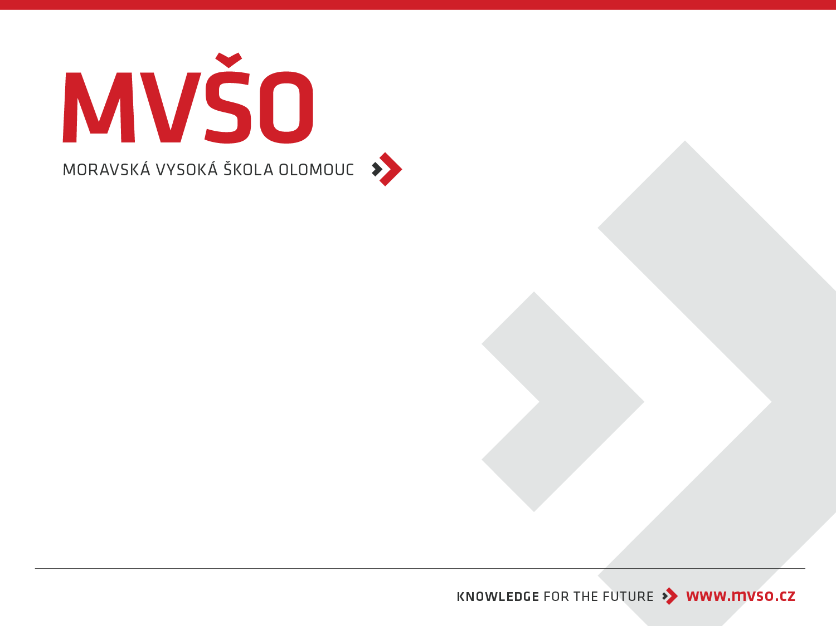
ADVERTISEMENT
Tomáš Jelínek
Olomouc, 2025/2026

Slide 2
Advertisement – goals, functions, types, advertising campaign, internet advertising
definition of the concept of advertising
advertising message
advertising goals
main characteristics of advertising
regulation and self-regulation of advertising
advertising campaign
advertising in the internet environment

Slide 3
Advertising
Any form of impersonal paid presentation and promotion of products, services or ideas of a particular entity
Impersonal mass form of company communication with customers through various media
Provides potential customers with information about the existence of the product, its properties, advantages, quality, etc.
Is directly market-oriented
Usually addresses consumers and has an overt commercial focus
Users encounter it most frequently among all components of the communication mix
Users are daily attacked and influenced by it
The role of advertising is to influence current and potential customers and persuade them to buy the given product (repeatedly) with both factual and emotional arguments

Slide 4
Advertising medium
Serves to transmit the advertising message from the producer, or supplier, to the current or future consumer; its selection is very important
The advertising medium used can determine the success or failure of a product on the market
Printed materials, television and radio spots, outdoor advertising, 3D advertising, etc.

Slide 5
Advertising message
A summary of all desirable or necessary information that the organization wishes to communicate to potential and actual buyers of its products
Samsung smart projector – "The Free of Boundaries" (2022)
Message: Showcases innovation, flexibility, and breaking barriers with their technology.
Tagline: "Unleash the power of technology."
https://www.youtube.com/watch?v=QjXS23O2ubQ
Apple – "Privacy. That’s iPhone." (2021)
Message: Emphasizes Apple's commitment to user privacy and security.
Tagline: "Privacy is a fundamental human right."
https://www.youtube.com/watch?v=fjf7c-O5GyQ
Nike – "You Can’t Stop Us" (2020)
Message: Promotes resilience, unity, and perseverance amid global challenges like the COVID-19 pandemic and social justice movements.
Tagline: "Together we can move forward."
https://www.youtube.com/watch?v=pcXTnyCmQbg

Slide 6
Main characteristics of advertising
Advertising is impersonal, and therefore mutual communication is excluded; communication possibilities per contact are thus smaller than, for example, in personal selling
Advertising enables simultaneous communication with a very large target group through mass media,
Advertising is a relatively inexpensive communication activity per contact, because it simultaneously reaches a very large group

Slide 7
Memory
For advertising as a tool of the communication mix, other characteristics include its necessary repetition for memorization
Memory, as the ability to store and recall information, should be perceived at three levels of its manifestations over time, and thus distinguish memory:
* sensory
* short-term
* long-term

Slide 8
Memory
Memory is a complex psychological phenomenon, and advertising seeks a relationship with it not only through the intensity of its influence over time, but also through the selection of content
In the case of advertising content, it is about working with memory selectivity; here we distinguish 2 components:
  Appeal
  Message itself

Slide 9
Appeal
The purpose of the appeal is to attract attention and enable the addressed message to be received at all, and to improve the conditions for memorization
There is a rich scale of appeals, which can be classified:
  positive appeals
  negative appeals
  emotional appeals
  rational appeals
  moral appeals

Slide 10
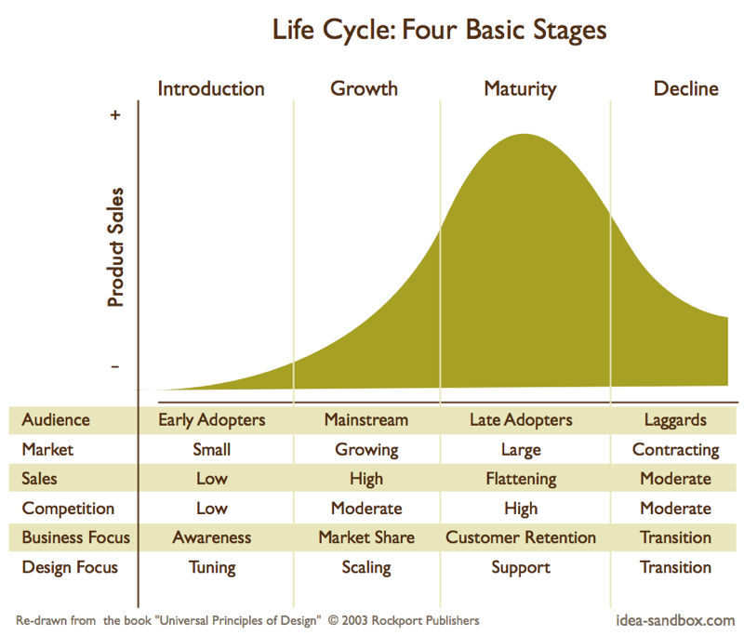
Reklama a životní cyklus produktu

Slide 11
The message itself
is the part of the message that contains its informational essence
this part should be memorized and utilized in subsequent activities – that is, it should manifest itself in changes in behavior

Slide 12
Setting advertising goals
advertising goals must stem from previous decisions about the target market, brand positioning, and marketing strategy
an advertising goal is a specific communication task and a level of its mastery. It should be achieved with a specific audience within a given timeframe.
we divide advertising goals:
  Cognitive – are directly connected with the process of conveying, perceiving, learning, knowing. They are referred to as true communication goals. These goals are a prerequisite for formulating conative goals.
  Conative – can be referred to as commercial goals

Slide 13
Classification of advertising by content/object
1. Product/brand advertising
* i.e., advertising where the product/item is the subject of the message
* has a higher degree of concreteness
* is often linked with other tools of the marketing mix, which are also the subject of the message along with the product
2. Institutional, corporate advertising
* is focused on building a relationship with a company or other institution, or their group
* the subject matter often includes brands that are also presented through advertising without direct reference to a specific product, but in a way that builds, profiles, or strengthens an image
* this type of advertising is also called image advertising

Slide 14
Classification of advertising by goal and relationship to the product life cycle
Informative advertising – (used for the first phase of the product life cycle – introduction of new products to the market. Its task is to provide information, introduce a new solution to a problem, new technology, new point of sale, price, etc., and teach the audience some new activities related to purchase and consumption. It is also used in the maturity phase, when introducing product modifications or during sales).
Persuasive advertising – (the main goal is to persuade and induce a change in the opinion and attitude of the audience regarding the facts related to the company's offer. It usually has goals related to market position ((expressed by a change in preference)) or market share in commercial terms. A specific form of advertising used for persuasion is comparative advertising.)
Reminder advertising – (is typical for the maturity phase; its task is to reinforce already memorized content and solidify established patterns of consumer behavior)

Slide 15
Classification of advertising by type of advertising media
Print advertising
Television spots
Radio spots
Outdoor advertising
Audiovisual advertising
New media

Slide 16
Regulation and self-regulation of advertising
self-regulation should allow regulation of what cannot be directly regulated by law (taste, morality, ethics)
the institution dealing with self-regulation in the Czech Republic is the Advertising Council, which establishes the Arbitration Commission and uses the Code of Ethical Advertising as a basis for its decisions

Slide 17
Regulation and self-regulation of advertising
due to the significant influence of advertising on the public, it is necessary to regulate advertising
basic elements of advertising regulation:
  public law
  private law
  self-regulation

Slide 18
Preparation and management of an advertising campaign
When creating an advertising campaign, marketing managers must start by identifying the target market and consumer motives
subsequently, they must make 5 key decisions, known as 5M:
  Mission - What are the goals of advertising?
  Money - How much money can be spent?
  Message - What message is to be sent?
  Media – What media to use?
  Measure - How to evaluate the results?

Slide 19
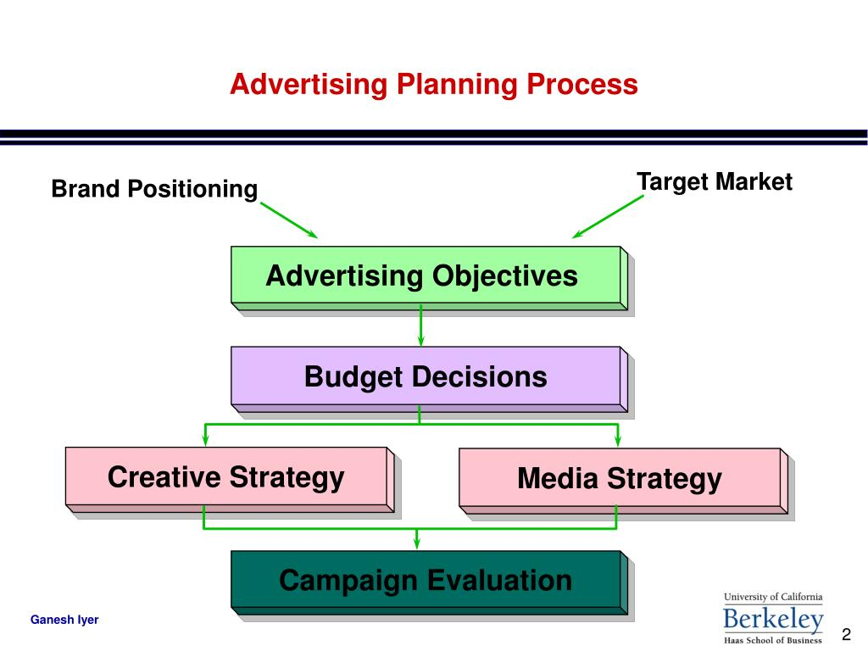
Proces plánování reklamy
cíle, segmentace
rozpočet, kontrola
porealizační test
Výsledky výzkumu (spotřebitel, výrobek, konkurence)
Překážky a neovlivnitelné faktory
Strategická rozhodnutí
Měření efektivnosti
Hodnocení reklamy
Taktická realizace

Slide 20
Decisions on advertising budget
When compiling the advertising budget, 5 specific factors are taken into account:
1. product life cycle stage
2. market share and consumer base
3. competition and message clutter
4. advertising frequency
5. product substitutability

Slide 21
Advertising success
advertising success is determined by three main factors:
  Advertising strategy
  Creativity
  Professionalism of execution

Slide 22
Creation of advertising campaigns
television advertising
radio advertising
print advertising
outdoor advertising
product placement
point of purchase (POP) – refers to the place of sale, place of purchase, sometimes indirectly activities or materials used for communication at the point of sale. They communicate price, influence at the point of sale, support the product and its communication.
alternative media

Slide 23
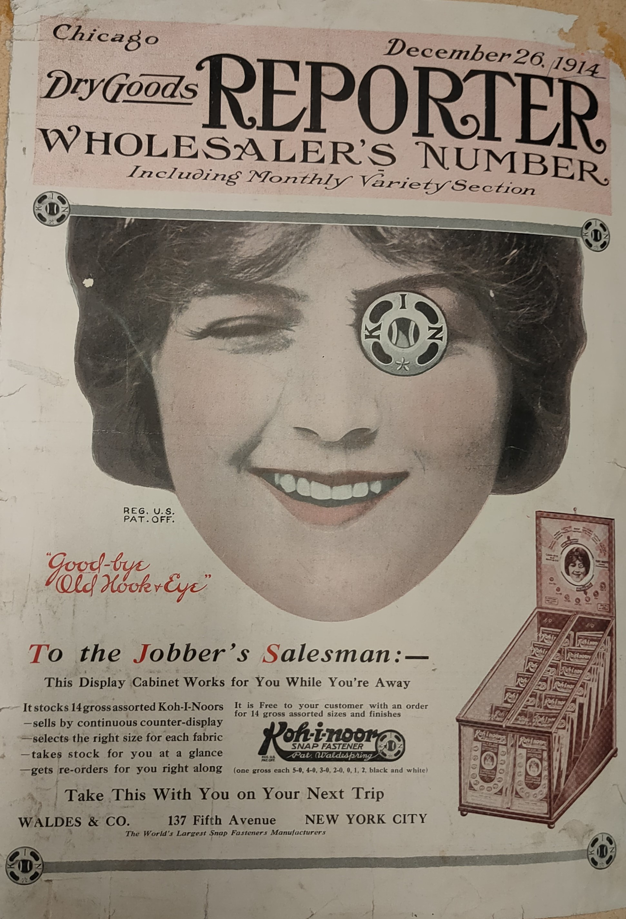
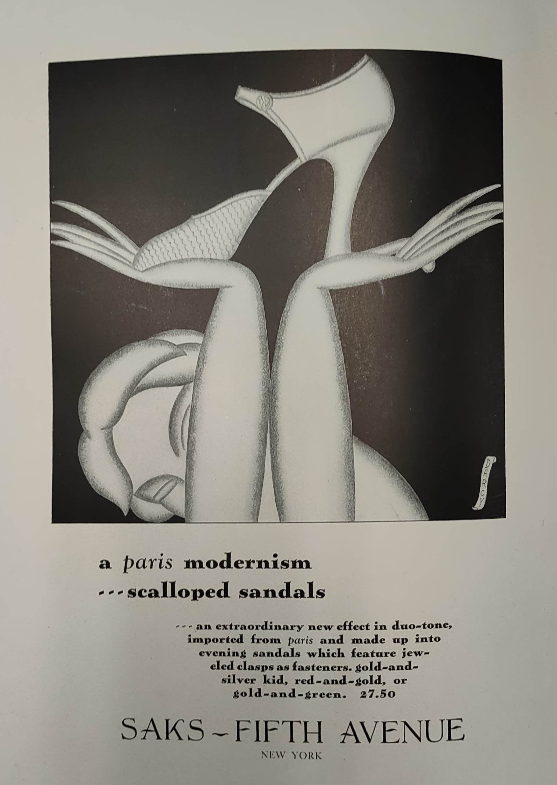
Advertisement USA 1914

Slide 24
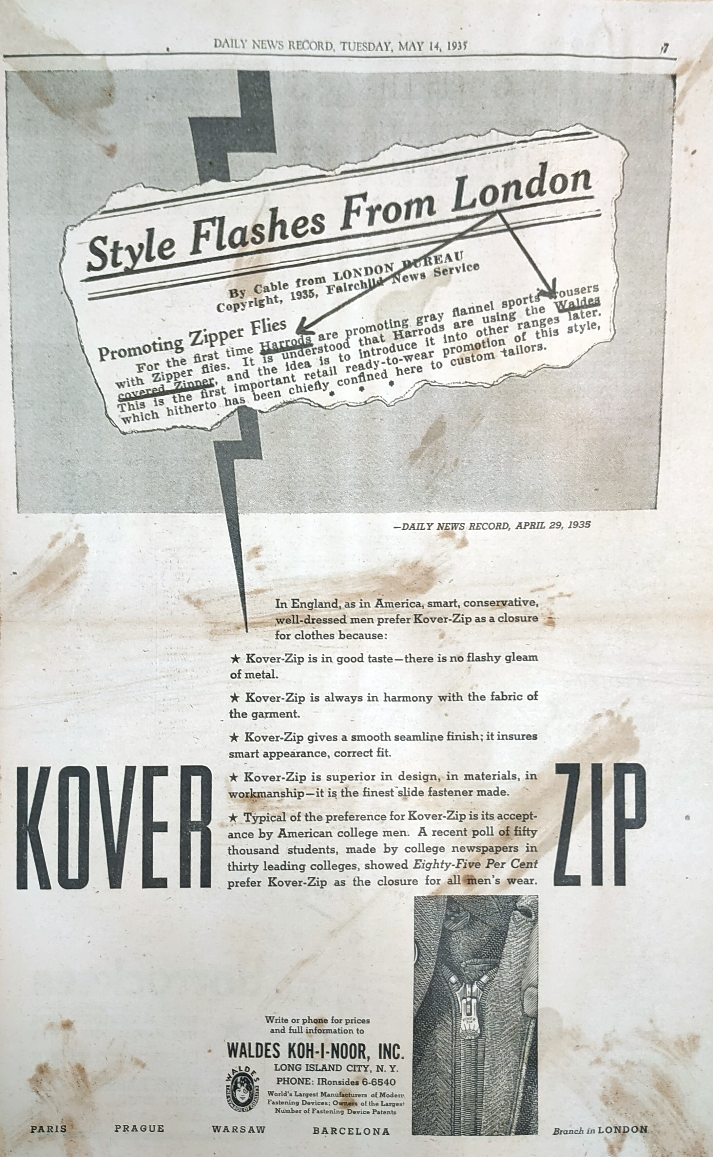

Slide 25
Forms of advertising on the internet
Website creation - (a company that is not on the web today is as if it didn't exist. Its pages are among the basic forms of company presentation on the web. Since 1991, when the first website was created, websites have undergone significant changes. They are more focused on visual display and greater user acceptance.)
SEM (search engine marketing) – (represents gaining website visitors through search engines, among which Google, Yahoo, etc., are the best known and most widespread. Through this optimization, we try to achieve the best possible position on the first page for specific keywords. Research has shown that more than 90% of all visitors finish their search by viewing the first page and do not visit further pages.)
SMM (social media marketing) – (represents contacts with customers through social networks, which offer above-standard opportunities for interaction and communication with them. The problem is to convince a visitor to find and follow our pages on the relevant social network. We have already described the inbound marketing strategy in detail in the preceding text. Its basic principle is simple: offer the visitor something they need, something that solves their problem, or something that entertains them, and that for free.)

Slide 26
Forms of advertising on the internet
4) Cooperation with other websites – is advantageous for all entities that mutually link to the pages of cooperating companies. It is mutually beneficial not only in search engine optimization but also because the entities do not pay for this cooperation.
5) Advertising banners – can be arranged through mutual exchange based on the above cooperation (a banner on the collaborating company's website, clicking on which redirects the visitor to our pages) or it can be a paid matter. These banners are paid either by a lump sum payment, for example for a week or a month. Or the company pays for clicks on the relevant banner.
6) Intext advertising – is advertising that is part of the text of the relevant webpage. Certain words in the text are highlighted in color and underlined, and if the visitor hovers over these words with their mouse cursor, the relevant advertising message appears. Payment is made based on clicks on the relevant word.

Slide 27
Forms of advertising on the internet
7. PPC advertising - or Pay per click (i.e., payment per click) is a very widespread form of marketing communication through the internet. Advertising is offered in the ad field in prominent positions or in the right panel on Google. If a visitor clicks on this ad, the advertiser pays a fee for that click. The budget for this form of advertising can be limited, and if the agreed amount is spent, the ad will no longer be displayed. Prices vary according to the keywords for which we want to display the relevant ad.
8) Viral marketing – is a form of communication where people themselves share our advertisement. This can be a funny video story, useful information, a free promotional product, etc. The content must be interesting and relevant enough to the target group so that visitors voluntarily share it. The advantage is the cost and, in many cases, the high speed of dissemination.

Slide 28
Forms of advertising on the internet
9) Blogs - this can be a blog run directly by the company or a blog run by another entity that brings new visitors to our pages. A blog should address a problem that interests the target group, thus building high traffic that is redirected to the relevant advertised products.
10) Affiliate programs - based on which the website operator, the company, shares a portion of its profit in the form of a commission, a profit achieved because the partner brought customers to its pages that it would not have otherwise acquired. The partner thus offers de facto marketing services, utilizing both its authority, its contacts, and its know-how.
11) PR articles - which are written into some PR catalog to gain backlinks. Writing PR articles is considered one of the effective and efficient forms of link building. This is done by writing and publishing an article containing links to our target pages.

Slide 29
Forms of advertising on the internet
12) Internet auction portals - (Aukro, e-Bay) have a strong base of visitors, and our sales activities on the relevant portal can make us known to customers from the relevant target group.
13) Backlinks - and their exchange. Backlinks pointing to our target pages and their quality are one of the decisive factors for optimized websites to strengthen awareness of our products or company. Especially backlinks on pages with similar focus in terms of services or product category, and especially those considered authorities in the field, are very valuable.
14) Internet catalogs - are websites containing links and information about companies divided into categories according to their focus and geographical location. The advantage of registering in a catalog can be easier acquisition of backlinks.
15) E-mailing – is considered a very effective form of direct marketing on the internet. We understand it as direct communication between a company and its actual or potential customers.

Slide 30
Division of mass media
Periodical press
Radio
Television
Internet

Slide 31
Media indicators
Rating - the number of people in the population or target group who watched a specific medium in a given time interval
Frequency – how many times each person from the target group was exposed to the advertising message
Net Reach - the percentage of the target group reached at least once during the campaig
Gross rating points – the most used media indicator, which expresses the number of views of the advertising message, or the reach of the advertising campaign
OTS (Opportunity to see) - the average probability of exposure for the average customer of the target group

Slide 32
Evaluation of advertising effectiveness
Pre-testing – effectiveness estimation before implementation
Post-implementation test – evaluation after printing, broadcasting ...
3 TIPS FROM PRACTICE:
measures for evaluating the campaign should be implemented before its launch
pre-test the effectiveness of several possible communication variants and creative proposals on a small, but representative sample
evaluating the campaign's benefits is easy using the control group technique

Slide 33
Measuring campaign effectiveness
CONTROL GROUP (DO – NOTHING)
a small but representative part of the target group is randomly selected
these customers are not approached, and their behavior then provides a comparision
PRE-TEST ALTERNATIVES
several different communication variants (different processing, different channel)
limits: influence of external factors, individual testing and artificial conditions, effect of repetition and effect of customer support, short time between exposure and testing

Slide 34

Next time you will report about your projects development.

