Slide 1
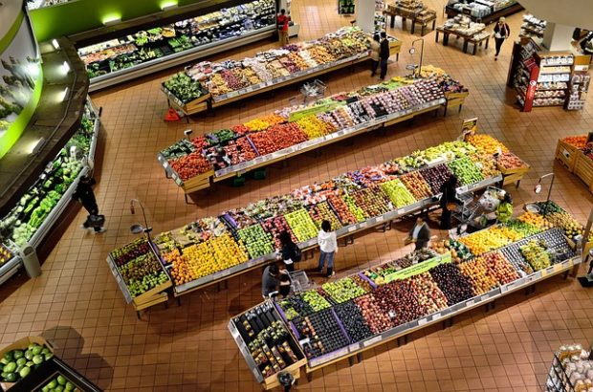
MARKETING IN THE PLACE OF SALE

Slide 2

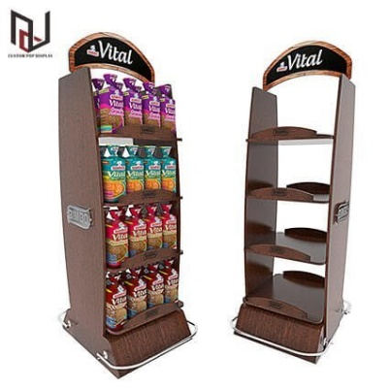
Promotional Strategies
POP/POS

Slide 3
Marketing in the Place of Sale
Point of Sale/POS
Point of Purchase/POP
POP materials guide our steps from the very entrance to the store to the checkout (they are more significant to us), where POS materials often take over their role.
They inform about the price and operate in the sales area.
They are classified as offline advertising.
The goal is to support goods.
Functions include reminding, informing, stimulating, selling, and creating an atmosphere.

Slide 4
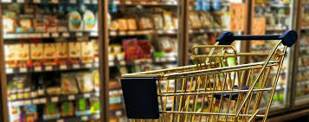
Communication
Within sales promotion, communication between three basic links is important:
* Supplier of the supported product
* Trader/Merchant
* End consumer

Slide 5

Marketing in the Place of Sale
Marketing in the place of sale includes advertising materials and products used in the place of sale (in stores or service establishments) to promote a specific product or a certain type of assortment.
These advertising media are also known as POS/POP materials (point of sale/point of purchase).
POS/POP materials are part of sales promotion, focusing on attracting the attention and influencing the purchasing behavior of potential customers using tools that ensure direct customer contact with the product.
Marketing communication in the place of sale is the most important trigger for impulsive purchasing behavior of consumers.

Slide 6
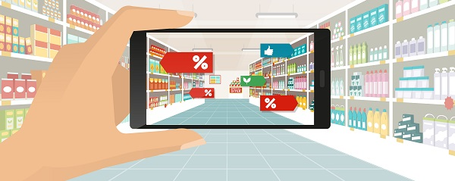
In-store design
An important tool of marketing directly in the place of sale is the so-called in-store design.
It is a set of rules according to which advertising items are placed in the store, which are intended to induce customers to make impulsive purchases.

Slide 7
Categories of POS/POP materials
1. Among the floor POS/POP devices include::
* Stands and displays;
* Floor banners, totems;
* Pallet islands and decorations;
* Floor graphics;
* Overpasses and advertising gates;
* Shop in shop;
* Promotional tables, promo stands and advertising counters;
* Leaflet stands and visual stands.

Slide 8
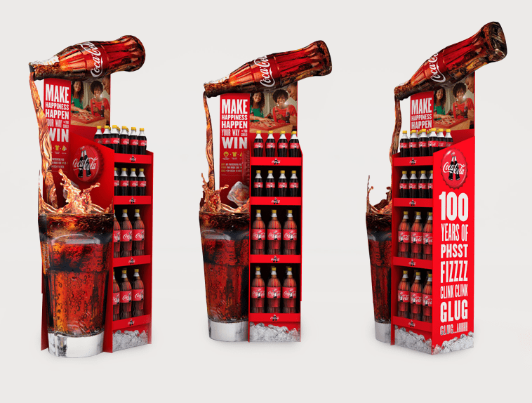
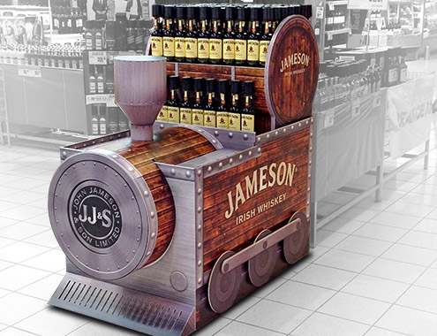

Slide 9
Categories of POS/POP materials
2. Shelf POS/POP Devices are following:
* shelf dividers and delimiters;
* price decorative info strips;
* feeders;
* wobblers;
* stoppers;
* shelf and over-shelf decoration;
* decoration shelvings;
* shelf flags;
* holders of leaflets and coupons.

Slide 10
Categories of POS/POP materials
3. POS/POP tools for to cash register and service desks rank:
* Cash register and countertop racks, displays with products;
* coin;
* racks for leaflets;
* stickers cashier tape;
* divider shopping.

Slide 11
Categories of POS/POP materials
4. To the wall POS/POP devices include:
* poster frames and posters;
* lights advertising.

Slide 12
Categories of POS/POP materials
5. Other POS/POP devices include:
* Leaflets on goods and stickers;
* decoration of shopping trolleys and handles vehicles;
* decoration of security gates;
* shop and window graphics;
* hanging signs;
* digital signage, electronic and interactive media.

Slide 13
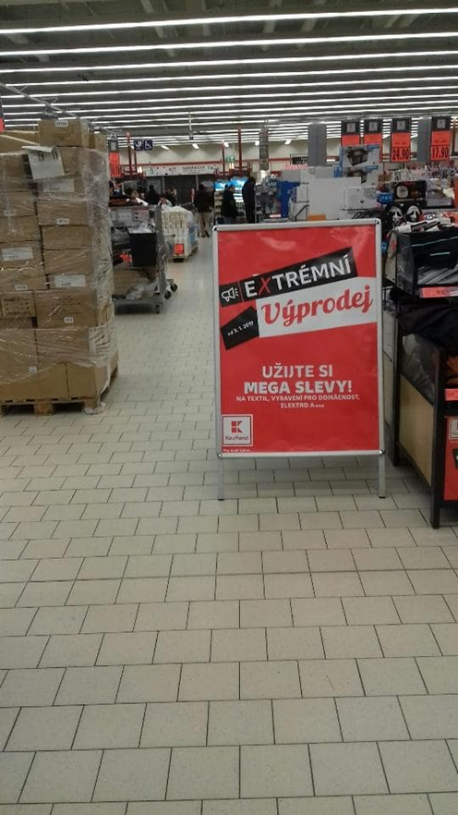
Inappropriate POS/POP
* In place of sale is too much POS/POP devices, and rather interfering with customers when selecting;
* POS/POP devices do not inform, tell something;
* POS/POP materials are not coordinated with overall marketing strategy.

Slide 14
Some Statistics
* 6 out of 10 buyers want to discuss prices for the first call.
* On average we spend 20 minutes in the supermarket.
* More than half of potential customers want to see how the product works during the first contact with him.
* 80% of purchasing behavior is governed by sight.
* Time spent at the point of sale does not directly affect the level of customer spending.
* Customers who buy in stores, visit the store an average of 7.5 times a year. For online customers it is only twice a year.
* 65% of consumers broke off relations with the brand because of one bad customer service.
* 67% of millennials (born 1980-2000) and 56% of Generation X people (born 1965 - 1980) prefer online shopping rather than in stores.
* 76% of purchasing decisions taking place right at the point of sale.
* 68% of customers believe that the brand of the store reliable indicator excellent quality of the product or service.

Slide 15
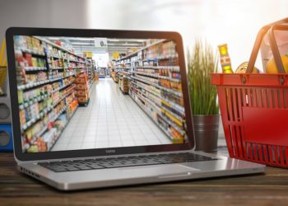
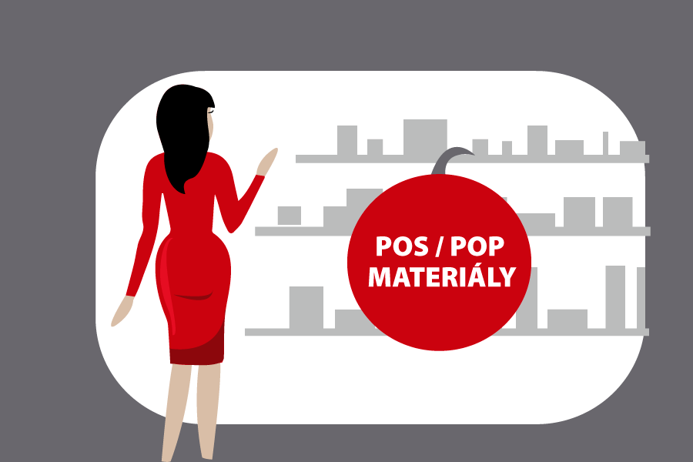
Future of Retail Combines Digital and Physical

Slide 16
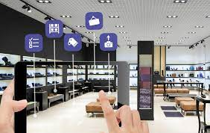
MERCHANDISING
Care for the sales area

Slide 17
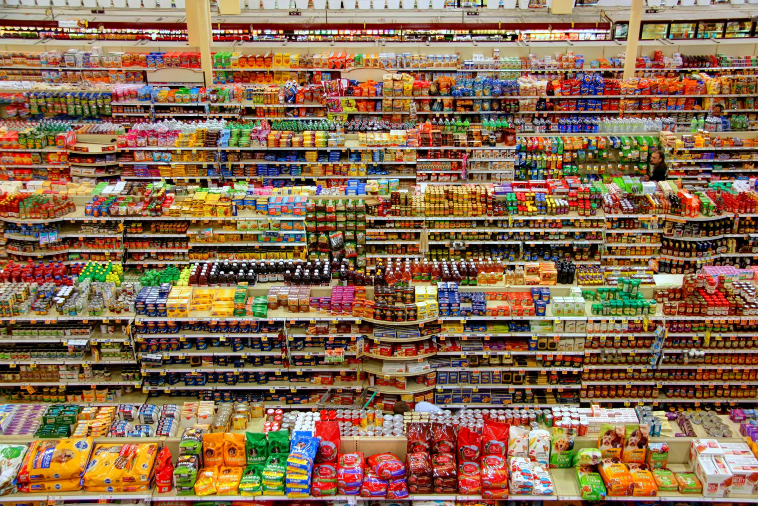

Slide 18
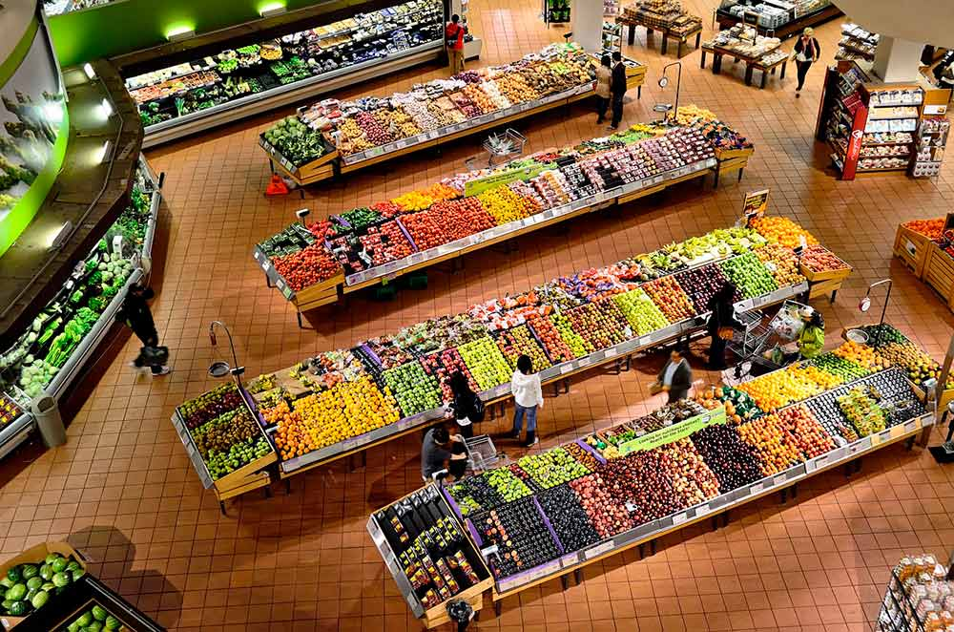

Slide 19
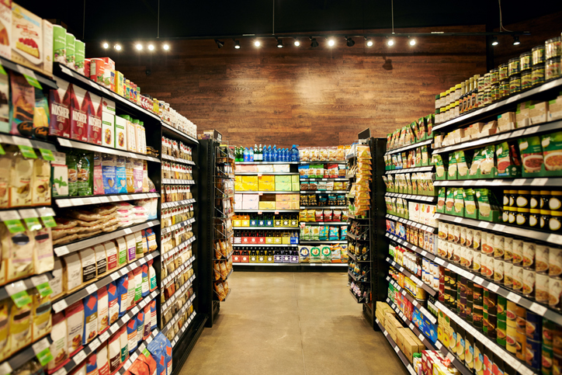
How does the customer see it?

Slide 20
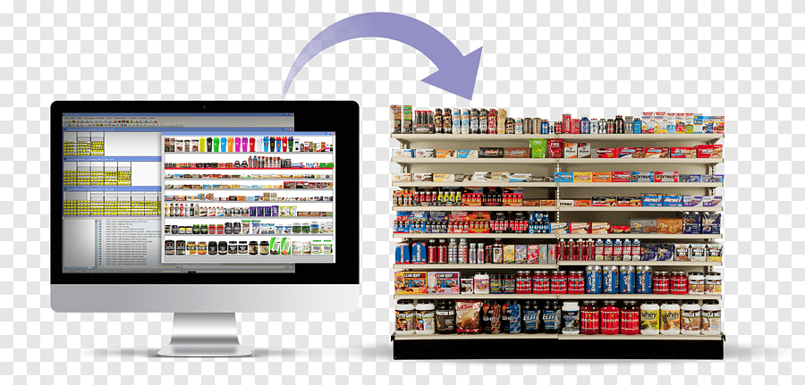
How does the merchandiser see it?

Slide 21
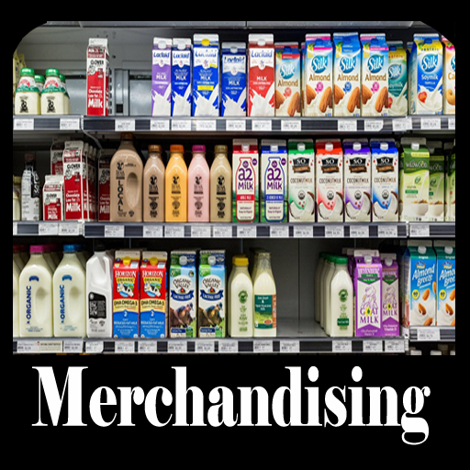

Slide 22
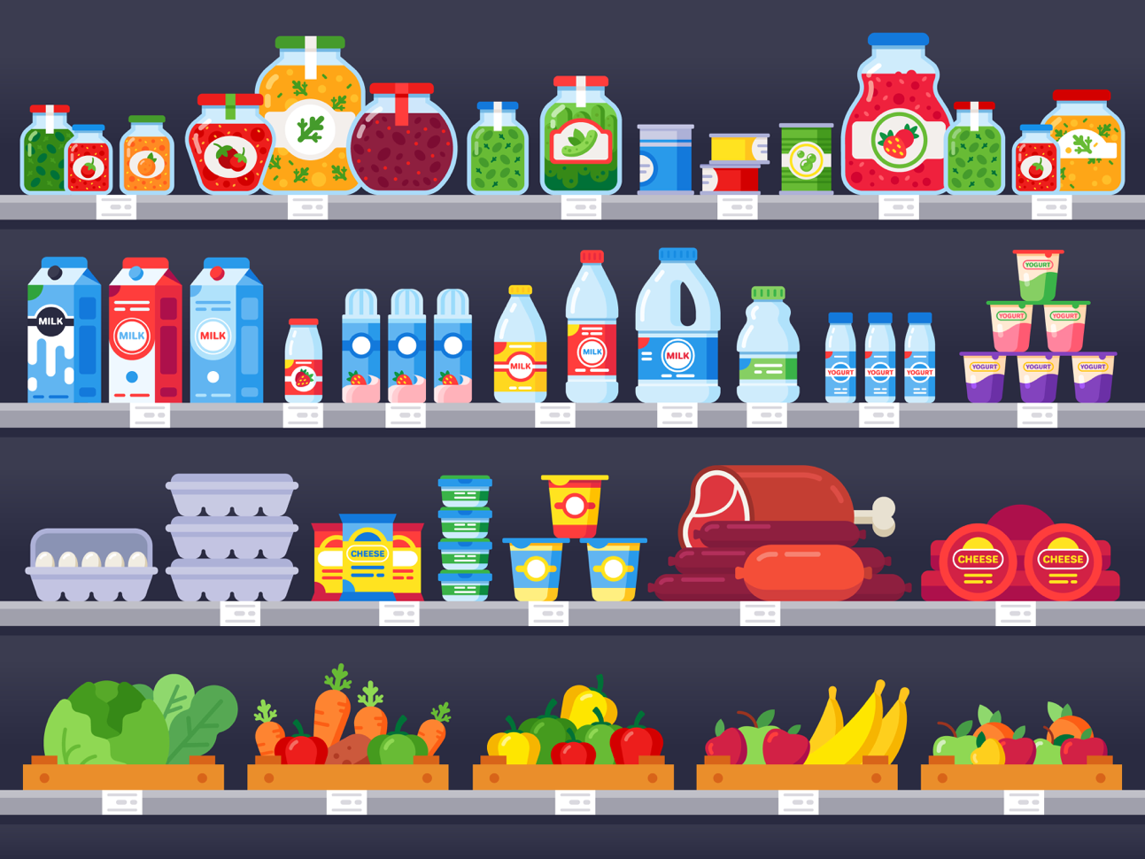
Planograms

Slide 23
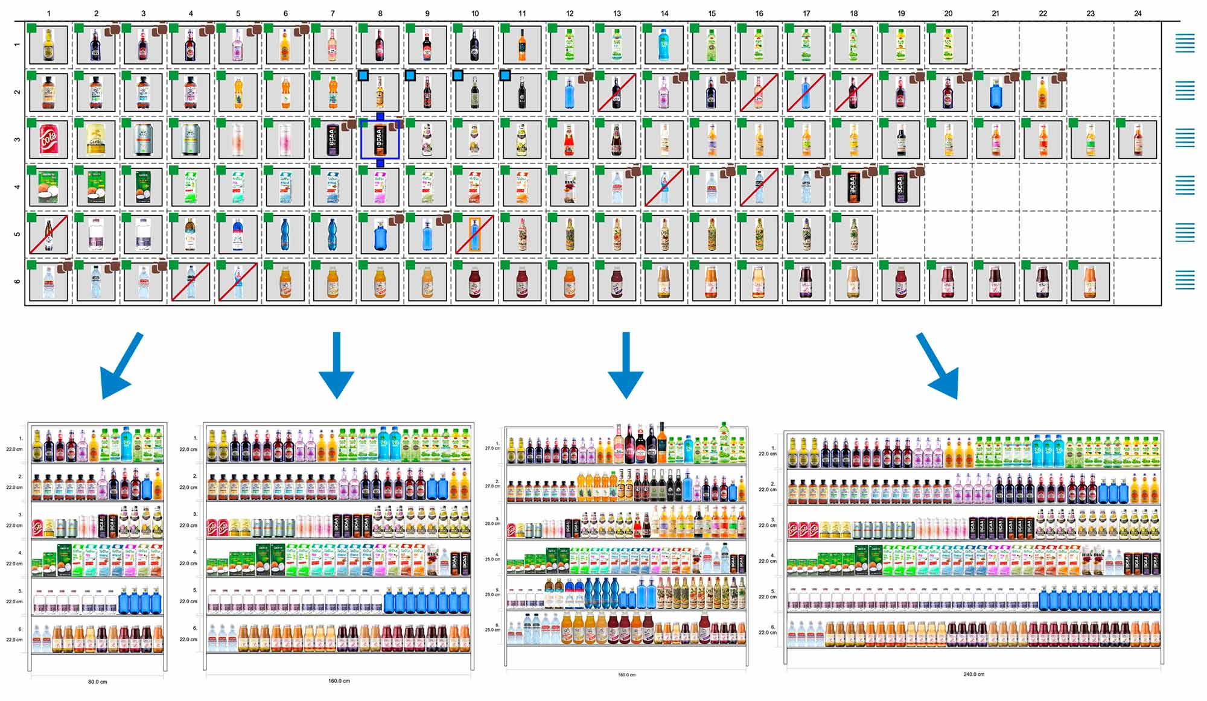
Planograms

Slide 24
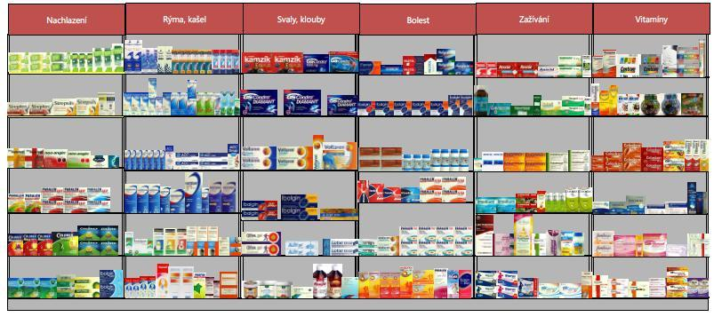
Planograms

Slide 25
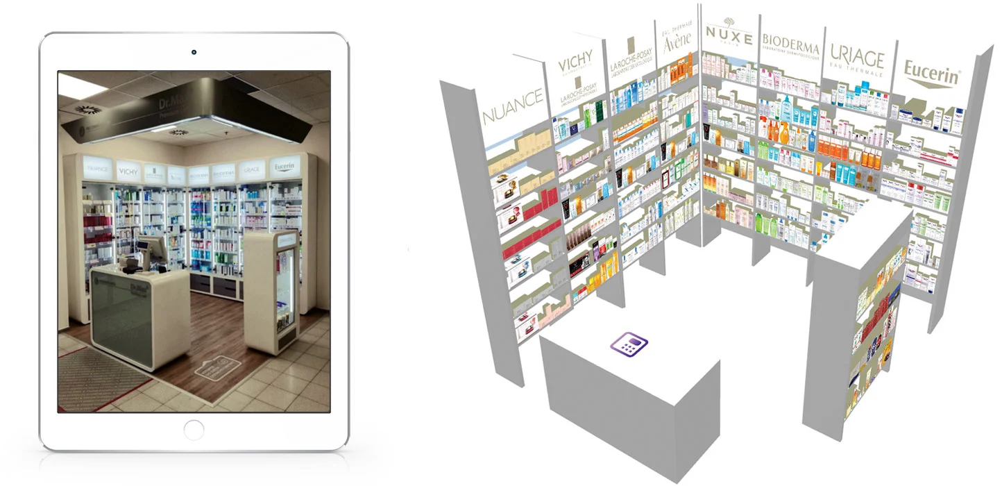
Planograms

Slide 26
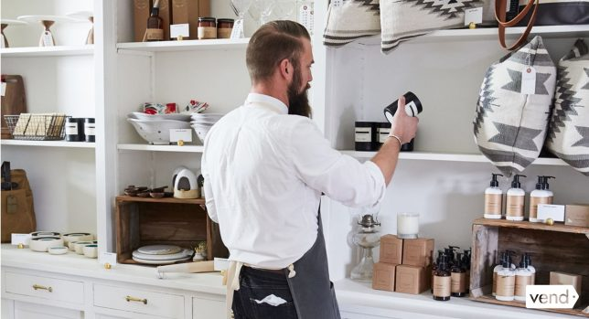
In-store design

Slide 27
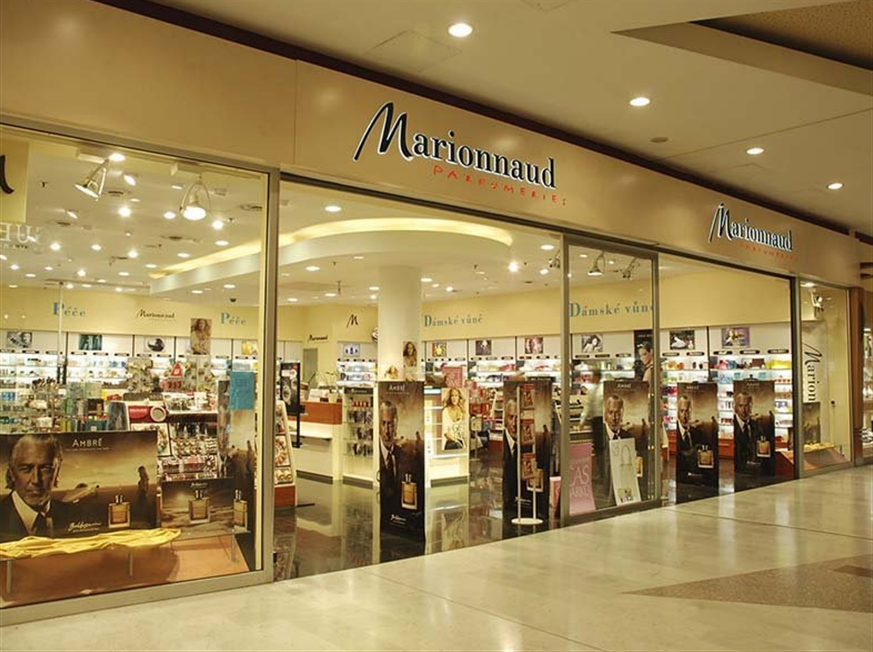

Slide 28
