Slide 1
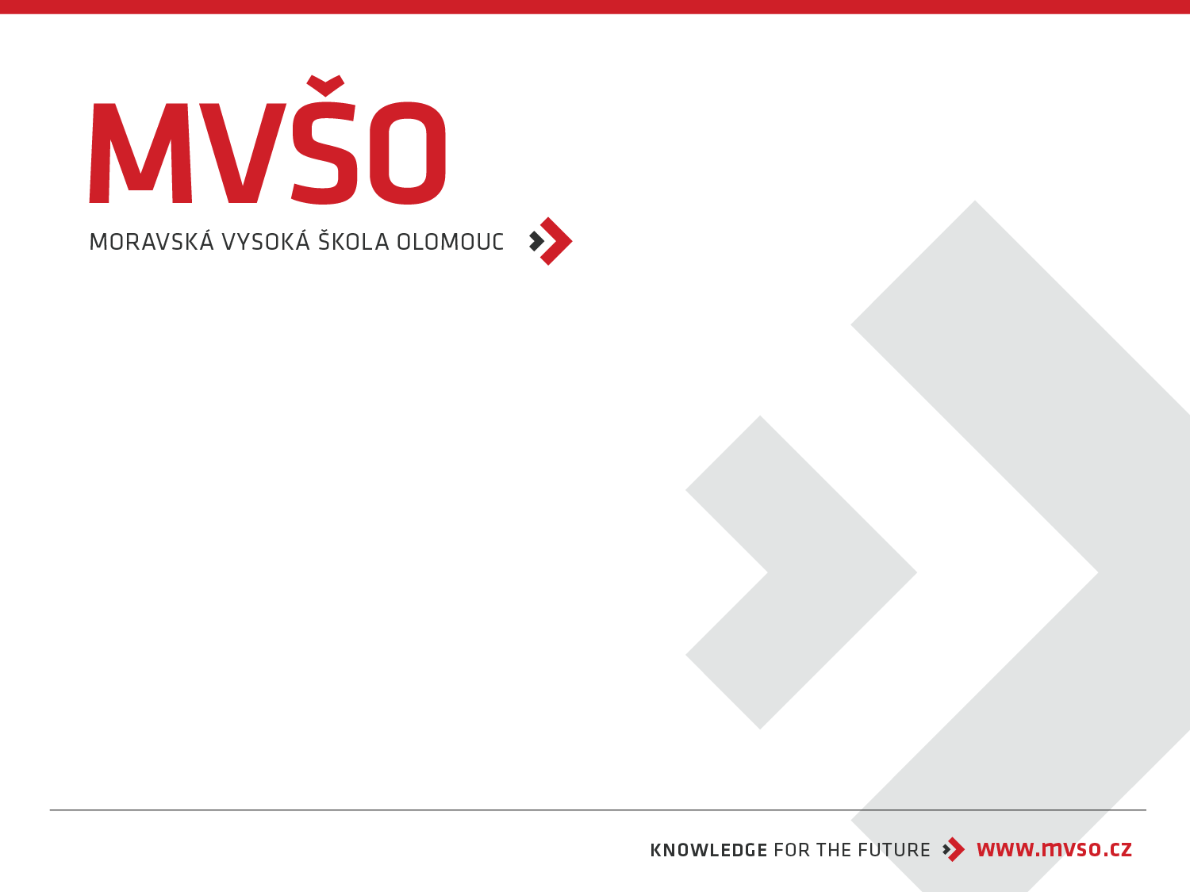
Sales Promotion
Tomáš Jelínek
Olomouc, 2025/2026

Slide 2
Definition of Sales Promotion
Activities or materials that support the purchase or sale of products or services. Typically irregular and focused on achieving immediate, short-term effects.
* Uses direct stimuli or advantages to influence decision-making.
* Appeals to saving money or gaining something valuable.
* Short-term effectiveness: consumer behavior returns to normal after the promotion ends.

Slide 3
Examples of Sales Promotion
* More favorable prices/discounts.
* Free goods.
* Monetary prizes in competitions.
* Coupons.
* Samples.
* Premiums.
* Consumer competitions.
* Product demonstrations.
* Gifts.
* Exhibition equipment.

Slide 4
Disadvantages of Sales Promotion
* Can damage the image of the company if it constantly offers sales.
* Frequent promotions may lead consumers to only buy when there's an incentive.
* Consumers may only be buying because of the discount, not the product itself.

Slide 5
Purpose of Sales Promotion
It's a form of marketing communication that uses additional incentives to stimulate interest in the sale of products.
The goal is to increase sales in the short term by offering a limited-time benefit and encouraging an immediate purchase reaction.

Slide 6
Goals of Sales Promotion
* To induce a purchase (e.g., free samples).
* To stimulate repeat purchases (e.g., loyalty cards).
* To differentiate products from competitors.
* To build and improve company image.
* To increase distribution efficiency (e.g., coupon collection).
* To inform about future sales (e.g., assortment changes).
* To appeal to the integration of other parts of the communication mix.

Slide 7
Types of Sales Promotion Goals
* Horizontal: To increase the customer base and the number of retailers selling the product.
* Vertical: To encourage existing customers to buy more frequently or outside of the typical

Slide 8
Forms of Sales Promotion
Classified according to the target subject:
Trade-oriented,
sales personnel-oriented,
or consumer-oriented.

Slide 9
Sales Promotion Tools Oriented to the Consumer
1. Product samples
2. Loyalty rewards
3. Rebates
4. Premiums
5. Promotional gifts
6. Coupons
7. Competitions and lotteries
8. Trade fairs and exhibitions
9. Merchandise presentation

