Slide 1
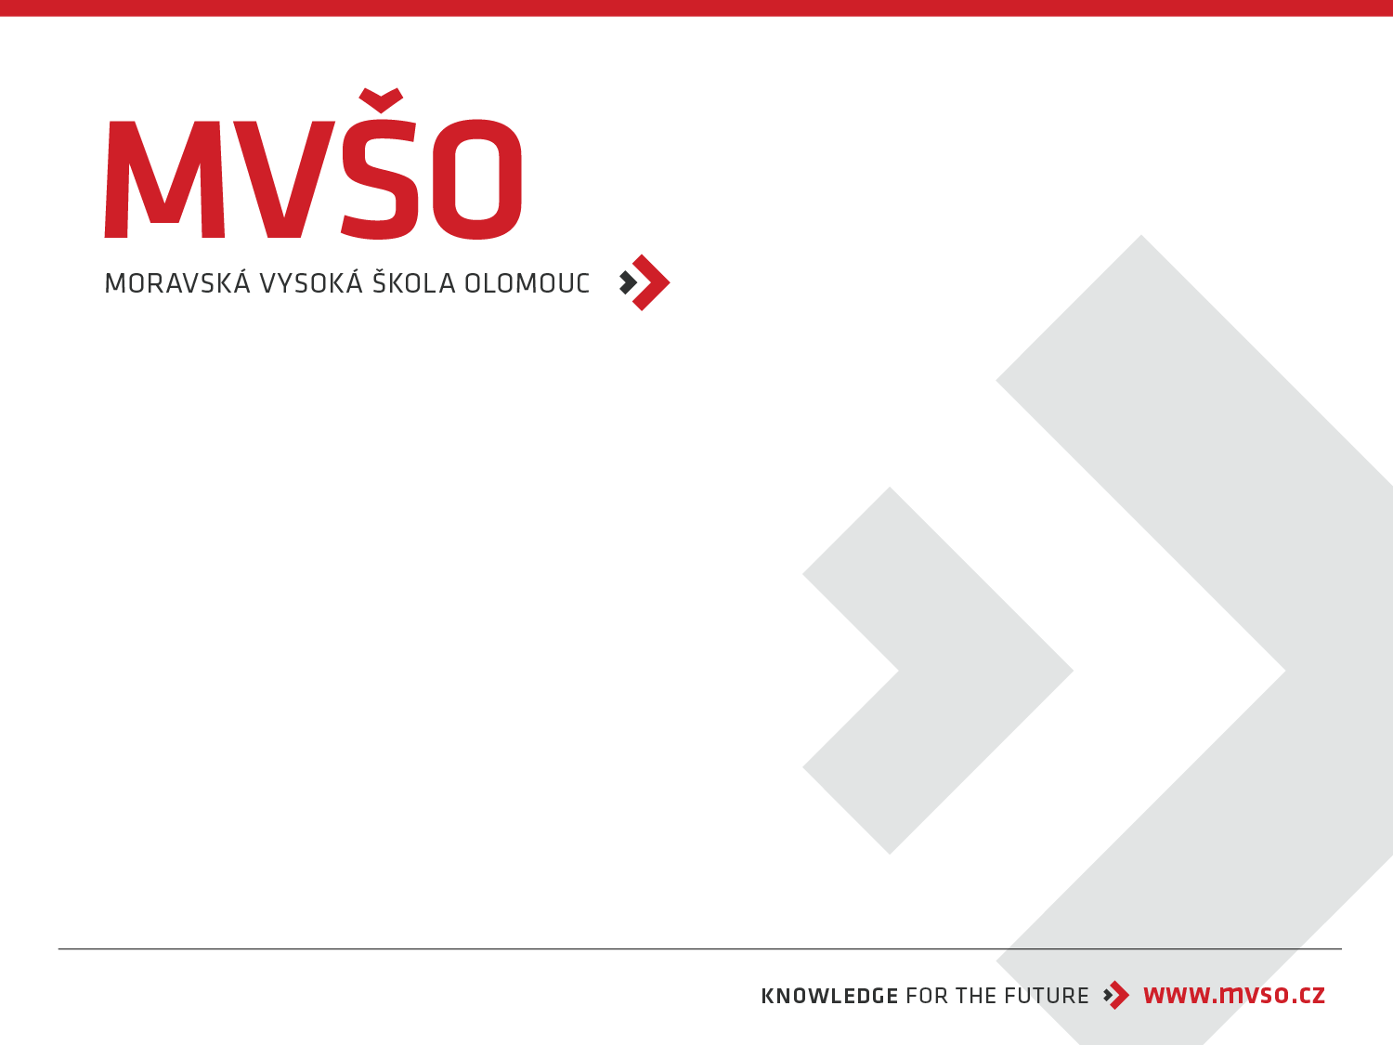
Integrated Marketing Communication
Tomáš Jelínek
Olomouc, 2025/2026

Slide 2
Integrated Marketing Communication (IMC)
Integrated Marketing Communication (IMC) is a strategic approach that coordinates and integrates a brand’s marketing channels and messages to deliver a consistent, unified experience to the target audience. It ensures that advertising, public relations, digital marketing, social media, sales promotion, direct marketing, in‑store/point‑of‑sale activities and any other touchpoints work together around a single core message and objectives.
Key goals: consistent brand positioning, clearer customer journey, higher impact and efficiency, improved measurement and stronger relationships with customers.

Slide 3
Create consistent Integrated Marketing Communication
Define a single clear brand proposition
One core value/benefit and tone that all messages support.
Create a short brand positioning statement for reference.
Develop unified messaging and creative guidelines
Key messages, taglines, value pillars, proof points.
Visual identity rules: logo usage, colors, typography, imagery style.
Tone of voice dos/don’ts and example copy snippets.
Produce a central brand/communications playbook
Combine positioning, messaging, visual and editorial guidelines, campaign templates, approved media and partner lists.
Make it accessible (cloud drive, intranet) and required for all agencies and teams.

Slide 4
Appoint a single IMC owner or steering team
Central coordinator (brand manager/CMO) with authority to approve creative and channels.
Regular cross‑functional meetings (marketing, PR, sales, digital, trade) to align plans.
Use templates and modular creative assets
Preapproved layouts for ads, social, PR releases, POS, email.
Modular assets (copy blocks, image variants) for quick channel adaptation while keeping consistency.
Establish channel playbooks with clear adaptation rules
Explain how core messages map to paid, owned, earned channels; list examples of acceptable edits.
Provide social media scripts, influencer brief templates, and crisis messaging blocks.
Vet and onboard partners/agencies tightly
Share the playbook at kickoff, require sign‑off on concepts, and include brand compliance checkpoints in briefs and contracts.

Slide 5
Implement an approval workflow and brand governance
Defined review stages, approvers, and timelines (creative > legal > brand).
Use a DAM (Digital Asset Management) system to control approved assets and versions.
Train internal teams and partners
Workshops, quick reference cards, monthly check‑ins, and onboarding sessions for new hires/agencies.
Monitor, measure and iterate
Track brand metrics, message recall, channel KPIs and compliance.
Run regular audits of live materials; correct deviations quickly and log learnings.
Maintain a single source of truth for customer data
Unified CRM and audience segments to ensure targeting and personalization remain consistent across channels.
Plan for contingencies and message continuity
Prewritten crisis lines, campaign extensions and evergreen content to preserve consistency during disruptions.

Slide 6
Motivation to use IMC
Four E benefits:
economical
efficient
effective
enhancing
Four C benefits:
coherence
consistency
continuity
complementary communications

Slide 7
The phase of implementing IMC into the organization
Phase: Tactical coordination of all tools in the communication mix within the company
Phase: Redefinition of content, scope, and coordination of marketing communications within the company
Phase: Application of IT, utilization of new media and platforms
Phase: Financial and strategic integration

