Slide 1
Logical Structure of Academic Texts
Mgr. Kamila Cmolová

Slide 2
Why Is It Important to Structure a Text?
In any academic paper or study, not only the content and the achievement of the stated objectives are assessed, but also the clarity and logical organization of the text.
Poor formatting can undermine the author’s credibility.
High-quality formatting is a sign of professionalism and creates a good impression.
Properly formatted text allows for better readability and easier orientation for the reader.
Summary: In academic writing, the saying “Don’t judge a book by its cover” does not apply.

Slide 3
How to Start Writing Your Paper?
Choosing an appropriate topic and research question.
Review of academic literature and other relevant sources.
Drafting an outline (the structure of the document).

Slide 4
Basic Text Structure
INTRODUCTION
TEXT
MAIN TEXT
CONCLUSION
The structure is used for short articles, newspaper articles, essays,…

Slide 5
The Structure of Extensive Texts
    Title page
    Declaration
    Abstract
    Acknowledgement
    Table of contents
    List of abbreviations (or tables/figures)
    Other relevant parts
INTRODUCTORY PART
MAIN TEXTUAL PART
    Introduction
    Main text (e.g. chapters and subsections)
    Conclusion
    Bibliography (List of References)
    Annotation
    Index
    Appendix
CLOSING PART
This structure is used for theses, seminar papers, studies,…

Slide 6
INTRODUCTORY PART

Slide 7
Title Page
The title page contains:
  Title of the paper
  Type of the paper (e.g. seminar paper, bachelor´s thesis, etc.)
  Author´s name
  Name and location of the school
  Year of completion (=submission) of the paper
  The school´s logo
The title page is not numbered!

Slide 8

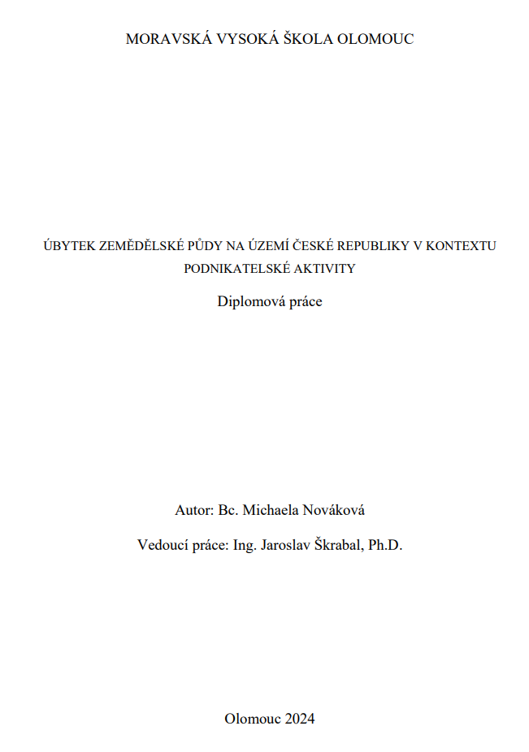

Slide 9
Declaration
Declaration is placed on the second page, after the title page.
The declaration contains a statement by which the author confirms the independent preparation of their work and the inclusion of all sources used.
It is recommended to also include the date, place, and the author’s signature.
For example:
  I hereby declare that I have written this thesis independently and that I have used only the sources and literature listed in the bibliography.
  I further confirm that all sources of information have been properly acknowledged in accordance with academic standards.
  I declare that I have prepared this diploma thesis on the topic Marketing Strategies independently and have listed all the sources and literature used in the prescribed manner.

Slide 10
Abstract
The abstract briefly and concisely characterizes the content of the paper. It describes the problem addressed in the work, its significance, and the stated research objective. It also mentions how the objective is achieved, by which methods, the research results, and the conclusion.
Recommended length: 5–10 lines.
For qualification theses (bachelor’s, master’s, etc.), the abstract is replaced by the annotation, which is usually included at the end of the thesis after the list of references.

Slide 11
Acknowledgement
Acknowledgement is not mandatory, but it is customary to express thanks to the thesis supervisor or other people who somehow contributed to author´s work.
Acknowledgements may also be dedicated to family members, a partner, children, etc.
For example:
  I would like to thank the supervisor of my diploma thesis, Ing. John Doe, Ph.D., for his professional guidance, help, and advice during the preparation of this work.
  I would like to express my gratitude to my thesis supervisor, Prof. Jane Doe, Ph.D., for her valuable advice and the time she devoted to me during the writing of this thesis. I would also like to extend my sincere thanks to my parents for their constant support throughout my studies and to my partner for his motivation and love, which I greatly appreciated while writing this thesis.

Slide 12
Table of Contents
It is placed on a separate page.
It contains the titles of chapters and subchapters together with page numbers indicating their location.
The table must be concise and well-organized.
Page numbers are aligned to the right margin, and their connection to a given chapter title may be visually highlighted (e.g. dots).
It is possible to use hyperlinks in the titles of individual chapters (more reader-friendly).

Slide 13
List of Abbreviations
In some theses, especially those of a technical focus, it is appropriate to compile all abbreviations and symbols used in the text in one place.
In this list, the author explains all abbreviations, which avoids the need to describe each abbreviation at its first occurrence in the text.

Slide 14
List of Tables/Figures
The List of Tables/Figures functions similarly to a Table of Contents, as it lists all tables/figures included in the work along with their corresponding page numbers.
If your paper or thesis contains one or more tables/figures, including a list of them is required.

Slide 15
MAIN TEXTUAL PART

Slide 16
Introduction
Mandatory part
Introduction is the first numbered page of the paper/thesis.
Introduction should consist of:
  The definition of the research problem
  The objectives of the work, outlining its structure
  The placement of the addressed problem within a broader context
  The mention of the current state of research and relevant literature on the topic

Slide 17
Main text
Consists of individual chapters and subchapters.
Main chapters should always begin on a new page.
In academic writing, we present facts, not mere assumptions and all facts must be supported by literature (citations).
Use the terminology of the field (to increase the academic quality of the text).
Maintain the same font throughout the entire text (preferably a serif font, maximum size 12 pt, black color).
Pay attention to spelling.

Slide 18
Conclusion
Mandatory part
Evaluation of the research
Includes summary of the achieved results and whether they correspond to the goals stated in the introduction.

Slide 19
CLOSING PART

Slide 20
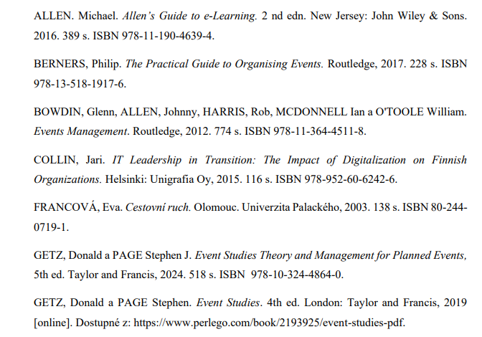
Bibliography
The list must include all sources used during the writing of the paper.
Sources must be arranged alphabetically, or for the same author, by publication date from the most recent.

Slide 21
Index
Index is not a mandatory part of the paper.
It is usually used in more extensive works.
Index is formed of terms and topics included in the document, along with the page numbers where these terms and topics appear.

Slide 22
Annotation
Used in extensive academic works (e.g. thesis) where it replaces the abstract.
The abstract remains a part of the annotation as it briefly characterizes the content of the thesis in a few lines.
Unlike the abstract itself, which appears at the beginning, the annotation is placed on the last page of the thesis.
Annotation also includes:
  Title of the work
  Author´s name and supervisor´s name
  Name of the institution where the thesis was completed
  Keywords

Slide 23
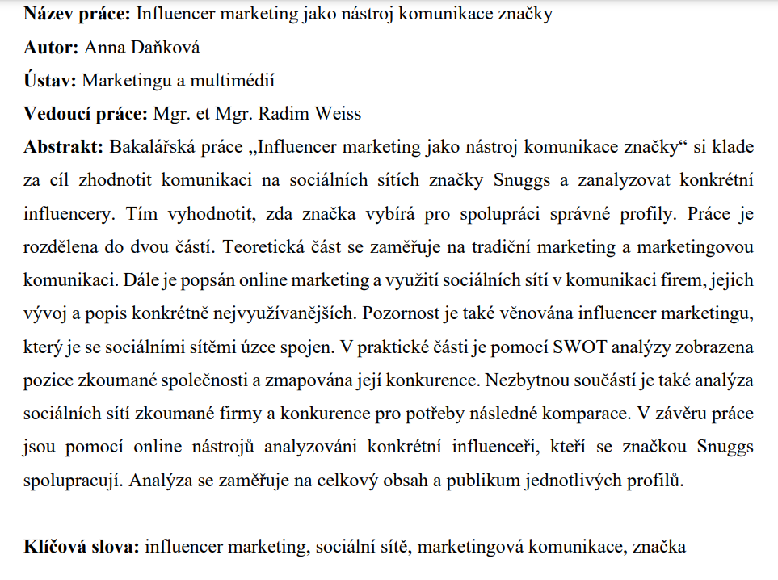

Slide 24
Appendix
Appendix contains all elements that are part of the document but due to their material, length, or other characteristics, are not included in the main text.
It is a very useful tool for providing additional information to the reader (e.g. photographs, tables, diagrams, charts, etc.) that doesn't need or cannot be included in the paper.
If the thesis contains multiple appendices, it is necessary to include a list of appendices indicating the page numbers where each appendix can be found in the document.

Slide 25
Length of the Document
The length is measured in standard pages.
A standard page used to refer to a standardized page of text typed on a typewriter, but today it applies to any text.
  Previously: 30 lines with 60 keystrokes each → 1 800 keystrokes
  Today: 1 800 characters including spaces
The length is measured in standard pages to ensure consistency, as a physical page may contain up to three standard pages with very small font or only one (or only part of one) with larger font.
Be careful: standard page ≠ page!!!

Slide 26
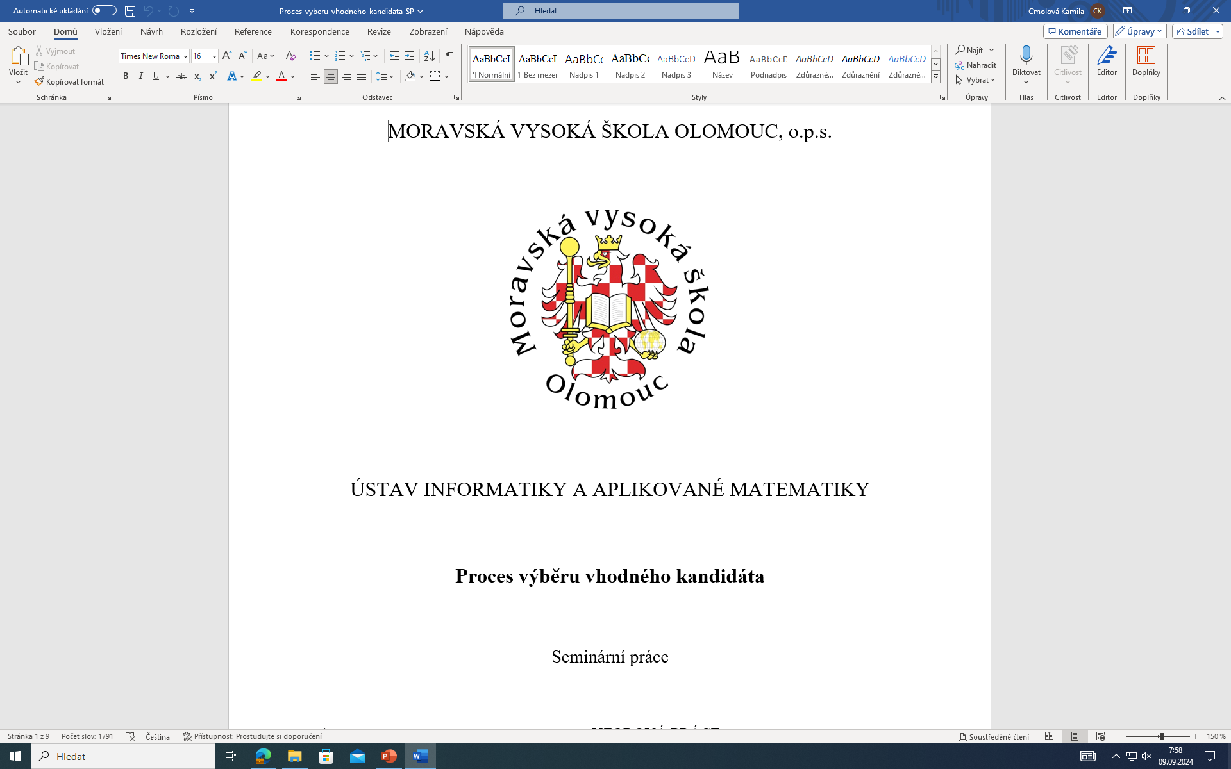
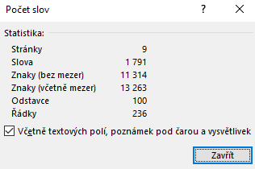
Length of the Document
Calculating standard pages:
13 263 : 1 800 = 7,368 standard pages

Slide 27
Length of the Document
Included in the length of the thesis is only the main textual part:
  Introduction
  Main text (chapters and subchapters)
  Conclusion
Not included in the length of the thesis are:
  Title page
  Declaration and Acknowledgement
  Bibliography
  Abstract/Annotation
  Table of contents and other tables
  Appendices
  Other relevant parts of document

Slide 28
Graphic layout of the paper
The text must be formatted consistently throughout the thesis, with uniform formatting applied across the entire document.
Logical division into numbered chapters and subchapters:
  1 1st level heading
  1.1 (1.2,1.3,…) 1st level subheading
  1.1.1 (1.1.2,…) 2nd level subheading
  2 1st level heading
  2.1 (2.2,2.3,…) 1st level subheading
  2.1.1 (2.1.2,…) 2nd level subheading

Slide 29
Graphic layout of the paper
Too much of anything is bad (avoid dividing the text into too many chapters and subchapters):
  A paragraph never contains only one sentence.
  A chapter never contains only one paragraph.
Page numbering starts from the Introduction
  The introduction is the first numbered page in the document.
  Therefore, if the introduction is for example the sixth page, the page numbering will start with this number.

Slide 30
Graphic layout of the paper
Font size:
  Basic text 10-12 pt.
  Headings of chapters 20-24 pt.
  Subheadings 14-16 pt.
Font:
  Times New Roman, Arial, Calibri, Cambria
Text alignment:
  Usually Justify Text (right and left alignment, 2,5 cm from margins)
Italics, Bold fonts
  Used for chapter headings or to emphasise and highlight a specific term in the text.
  Quotations are also written in italics.

Slide 31
Graphic layout of the paper
All graphic files in the text must be labelled and named.
  E.g. Fig. 1, Fig. 2 or Table 1, Table 2
  A list of tables, figures and graphs with the relevant page numbers should also be included in the introductory section of the paper.
Graphic files should not be surrounded by text.
Avoid garish, bright colours in graphs and tables (less is sometimes more).
Select the appropriate type of graph:
  Bar graphs are suitable for comparing individual variables.
  Line graphs better illustrate the dependence of the variable on time.
  Pie charts best show the ratio of the values, but are not suitable for exact numbers.

Slide 33
Thank you for your attention ☺

