Slide 1
Introduction
Ing. Veronika Volfová
veronika.volfova@mvso.cz

Slide 2
Basic Information about the Czech Republic
The Czech Republic is a landlocked country in the middle of Europe. Rather than as a country in the middle of Europe, we should speak of the Czech Republic as a country in the heart of Europe.

Slide 3
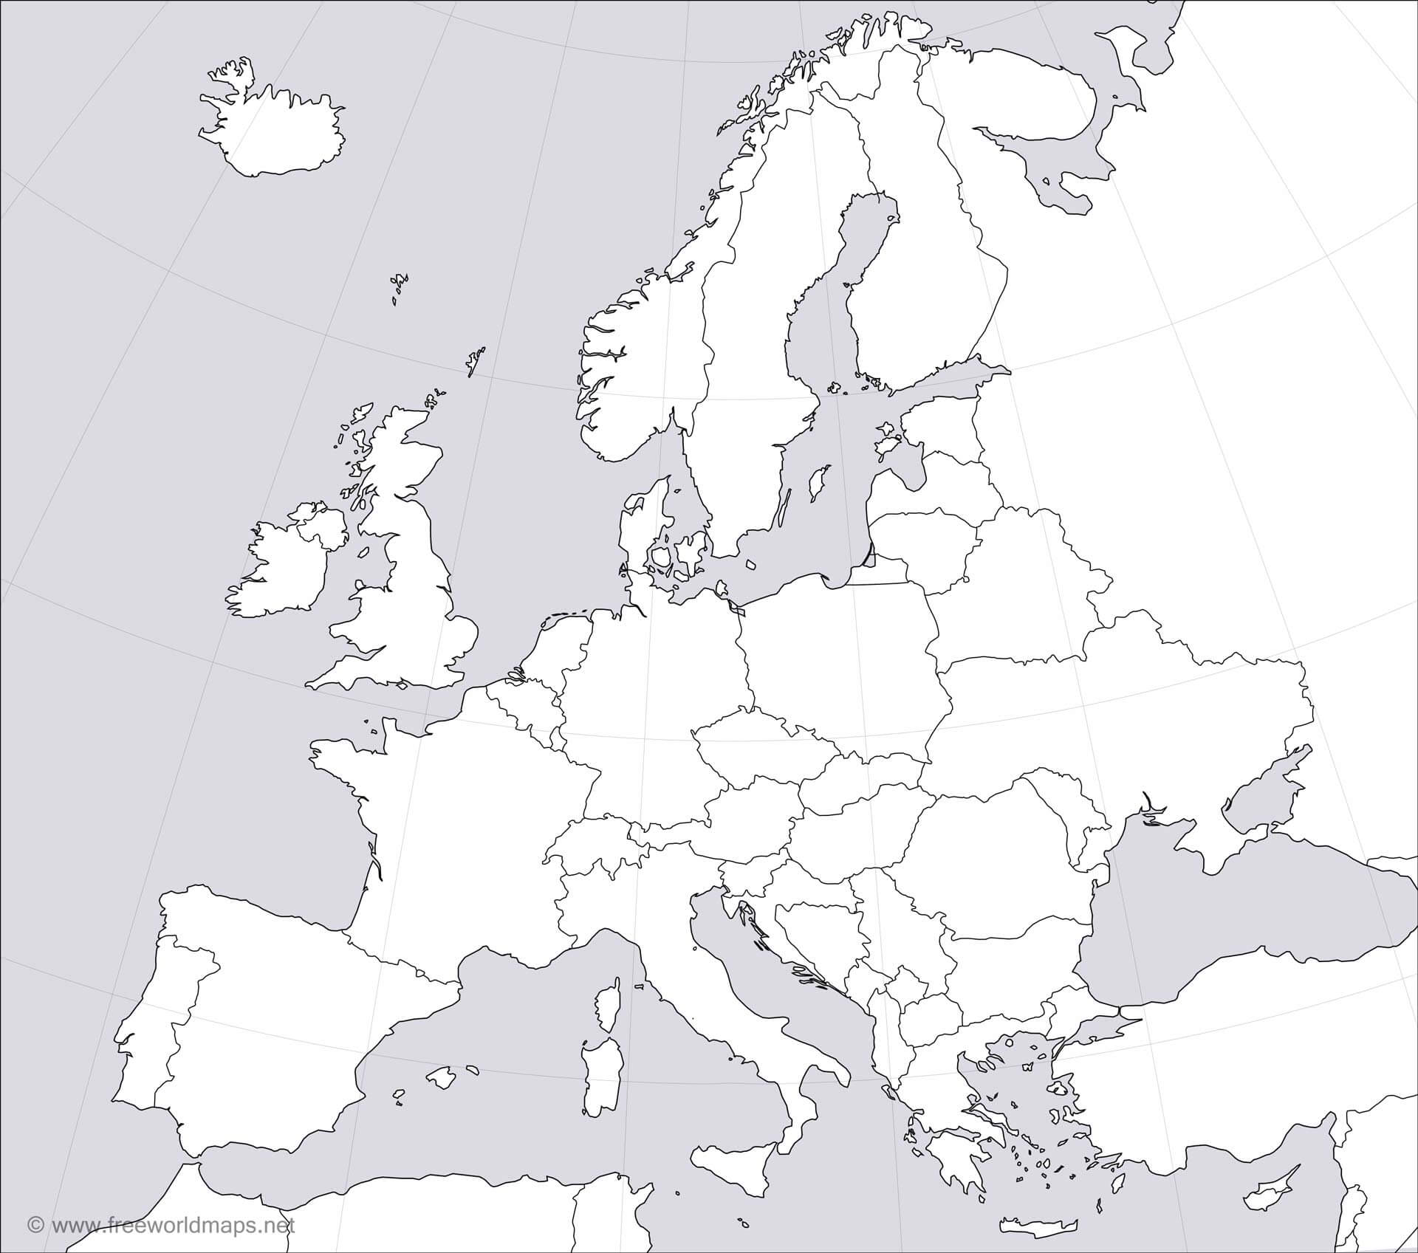
Czech Republic – heart of Europe
Where we are on the map?
Who are direct neighbours of the Czech Republic?
Who are neighbors of your country?

Slide 4
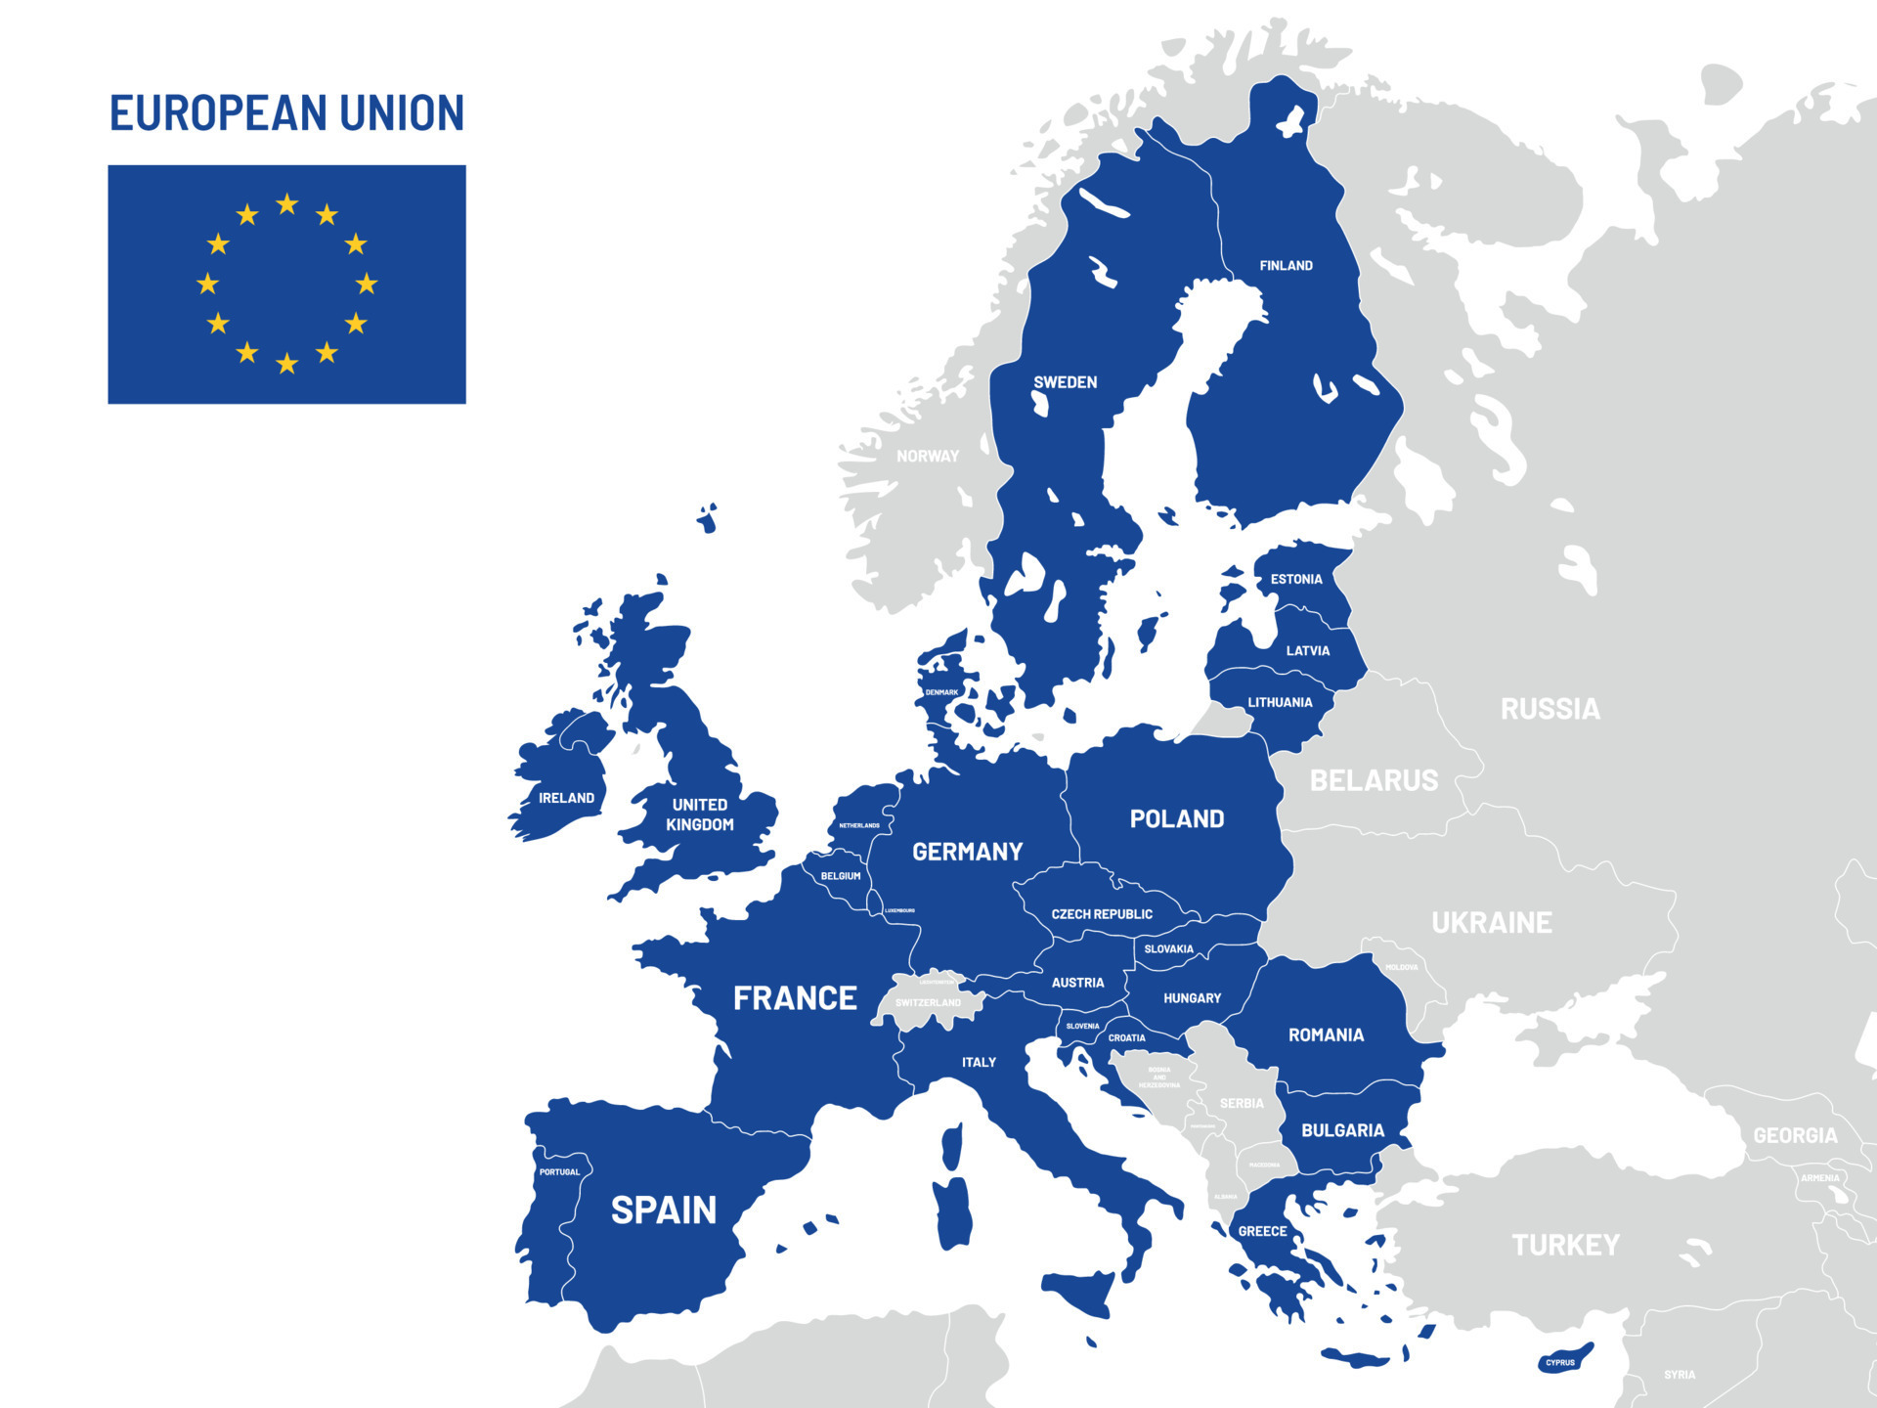
States in Europe
What do „blue states“ on the map mean?

Slide 5
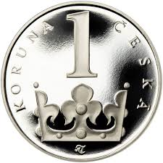
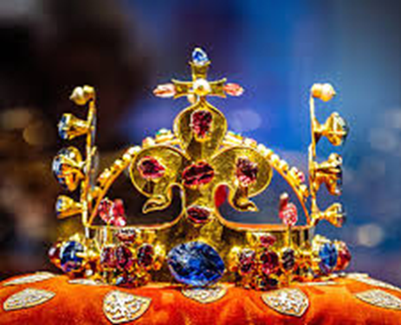
Facts and Figures
Language: czech
Area: 78, 866 sq km
Borders with: Germany, Poland, Slovakia, Austria
Population: 10,51 million
Political system: parlamentary republic
EU member state: since 2004
Currency: czech crown (CZK)
Capital city: Prague

Slide 6
Climate: seasonal variations
Czech Republic lies in the temperate climate zone, which is characterized by mild, humid summers with occasional hot spells, and cold, cloudy and humid winters.
Czech Republic's climate is comparable to that of southern in land Canada.
Czech weather can never be predicted with certainty.

Slide 7
Climate: seasonal variations
Spring
  Spring begins on the 21st of March.
  Many people consider spring and summer the most beautiful seasons of the year and that is why they usually fall in love in spring. Nature begins to awake from its long winter sleep and new life starts. Nights get shorter and days get longer.

Slide 8
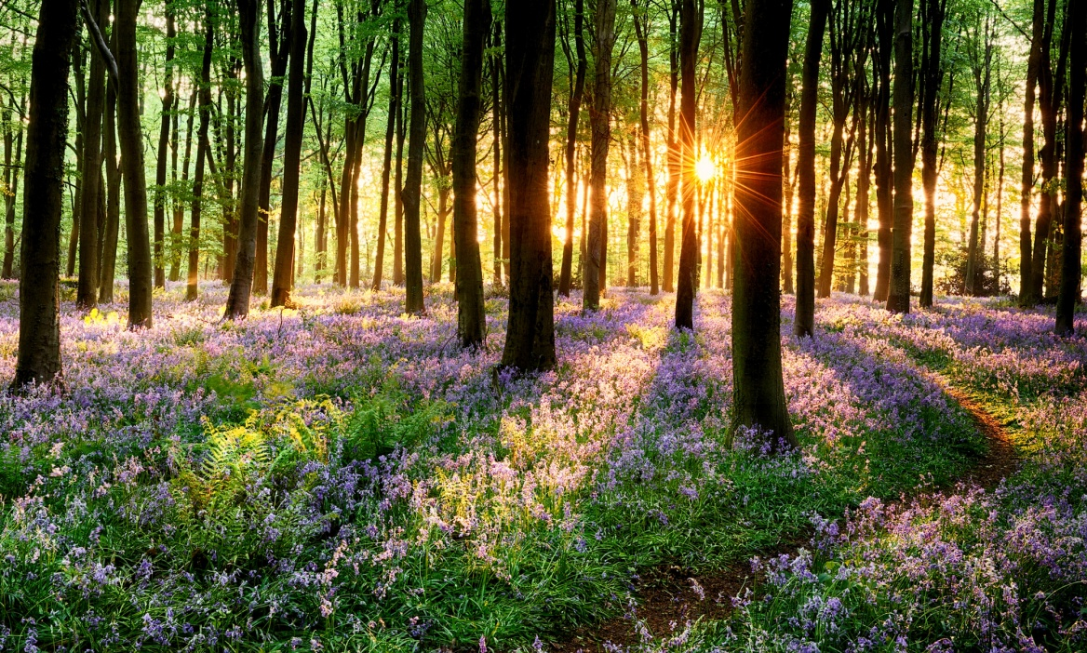
Climate: seasonal variations
Spring
There is more sunshine, and it is warmer and warmer.
The weather in spring, especially in April, is really unpredictable and changeable.

Slide 9
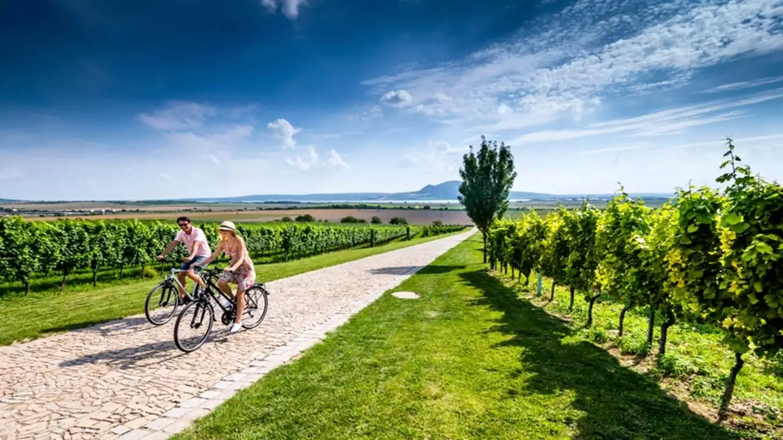
Climate: seasonal variations
Summer
June 21st is the date when summer begins.
School children love this season the most because they have two months of holidays.
Everybody starts to be more interested in the weather because people set off on journeys and take holidays.
In the summer, rain often comes in the form of a storm. It is dangerous to stand under a tree during a storm because the lightning might hit it.

Slide 10
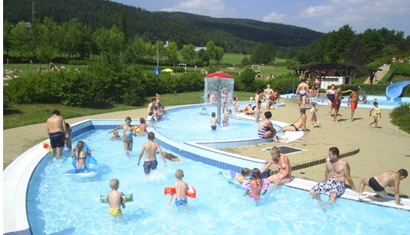
Climate: seasonal variations
Summer
Summer is also the time of strawberries, bilberries, raspberries, blackberries and cranberries, and the harvest of corn.

Slide 11
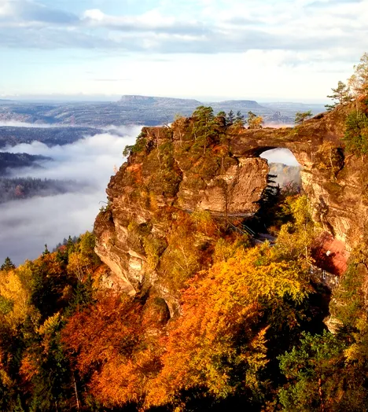
Climate: seasonal variations
Autumn
On the 23rd of September, autumn comes.
At the beginning of autumn we can still enjoy a few fine days of Indian summer. Many people go picking mushrooms.
This colorful period does not last long because soon the trees shed their leaves and by November they are bare.
In autumn, the weather is unsettled, the sky is often cloudy, and the mornings are dull and it looks like rain. People refer to the weather as awful, wretched, or nasty..

Slide 12
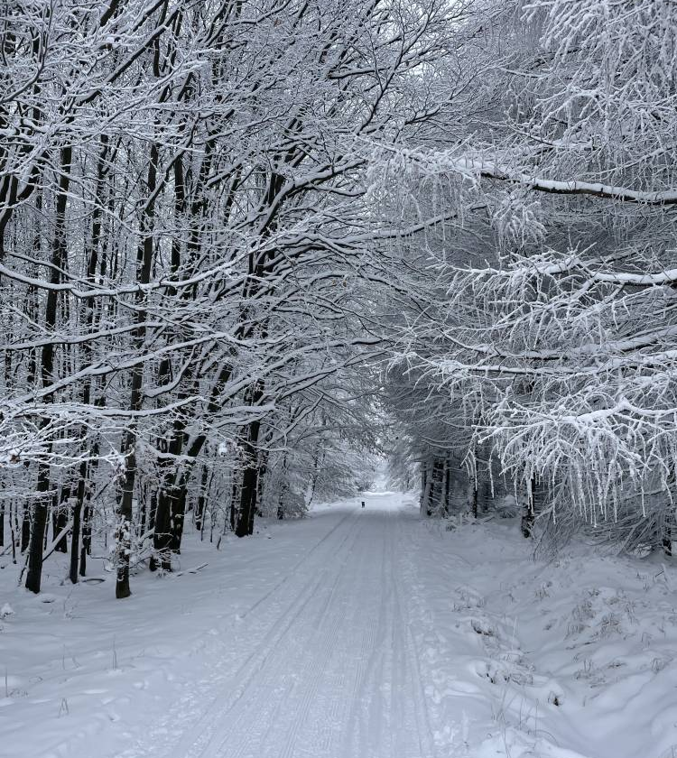
Climate: seasonal variations
Winter
Winter comes on December 21st, but in fact it often begins earlier.
Typical winter weather brings snowfall, icy wind, and hard frosts.
We can enjoy skiing in the mountains and the hills which are covered with a thick layer of fluffy snow and we admire the winter scenery.
The roads become icy and slippery and it makes driving hazardous because you can skid easily.

Slide 13
Climate: seasonal variations
Describe weather in your country?

Slide 14
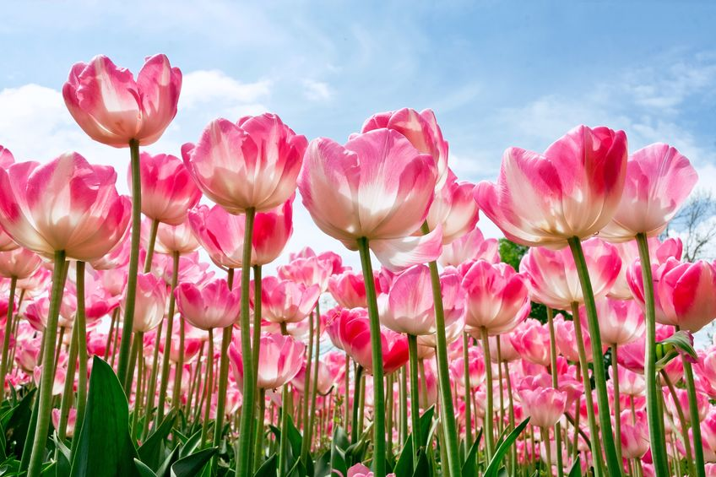
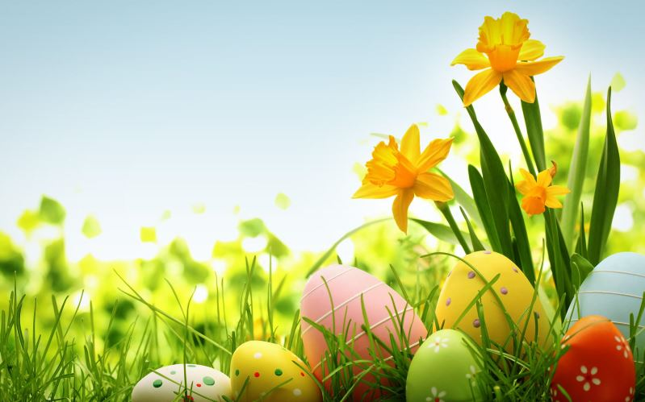
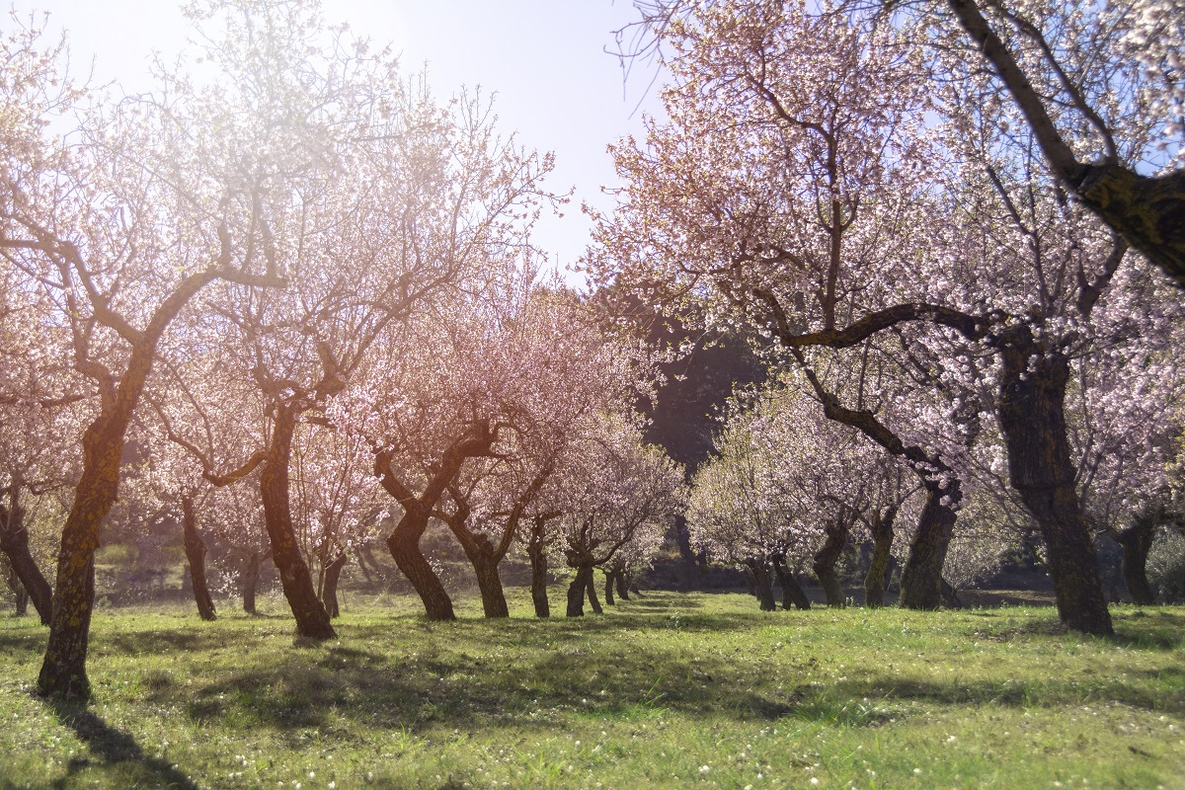
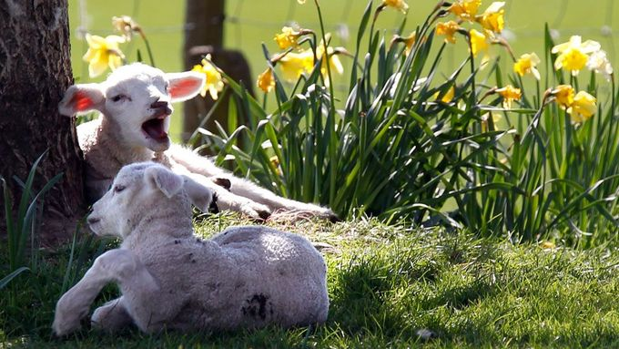
What season is it?

Slide 15
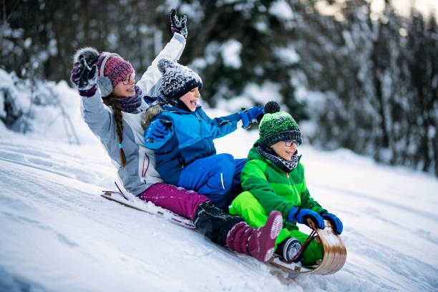
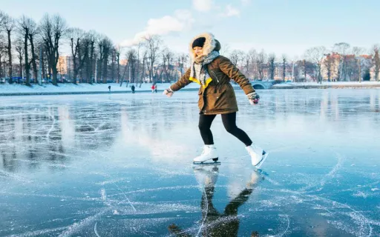
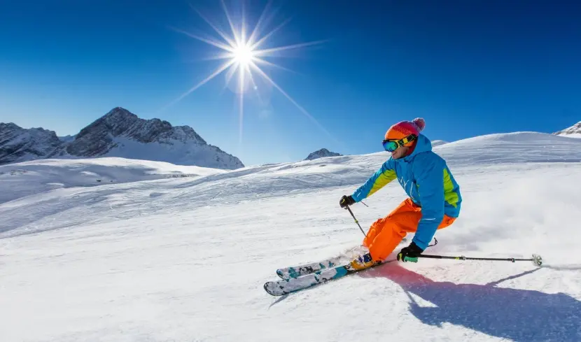

What season is it?

Slide 16
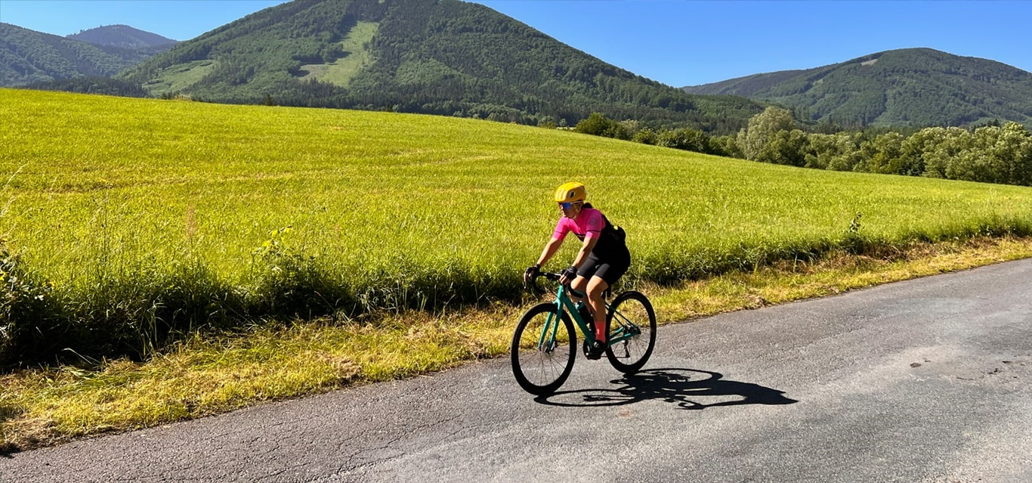
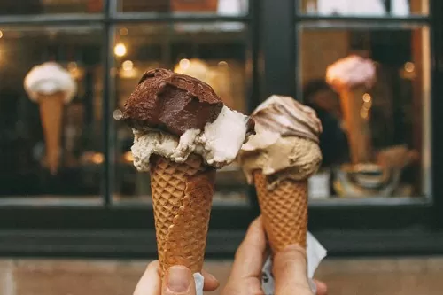
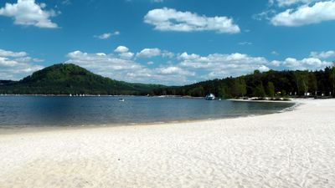
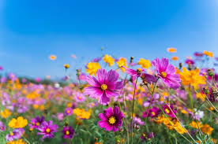
What season is it?

Slide 17
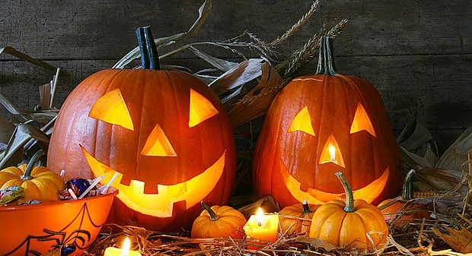
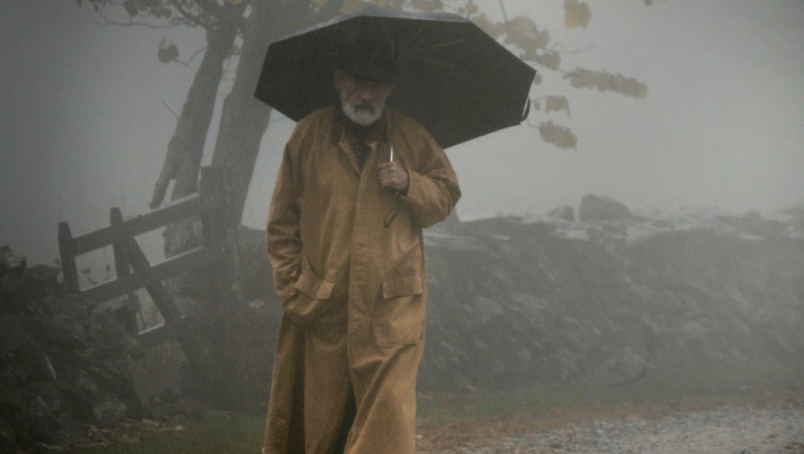
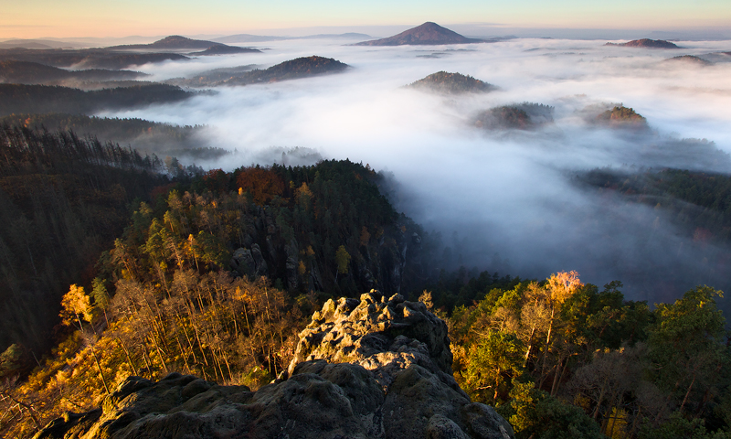
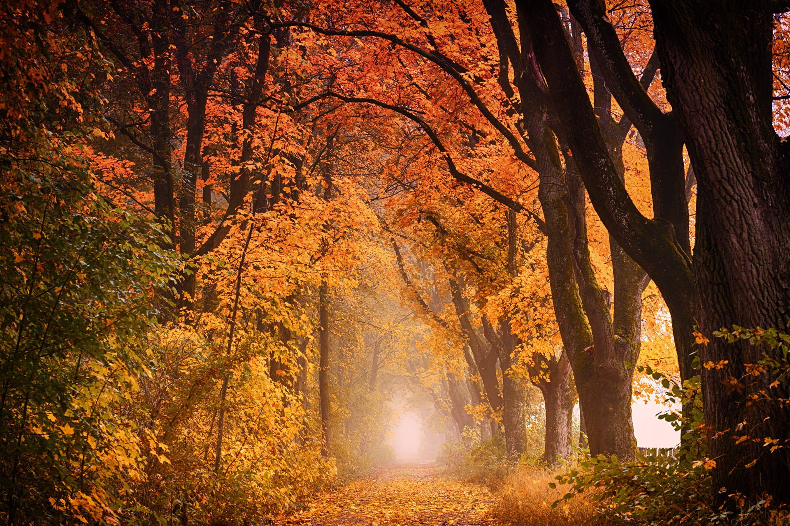
What season is it?

Slide 18
Climate: seasonal variations
Which season do you like and why?

Slide 19
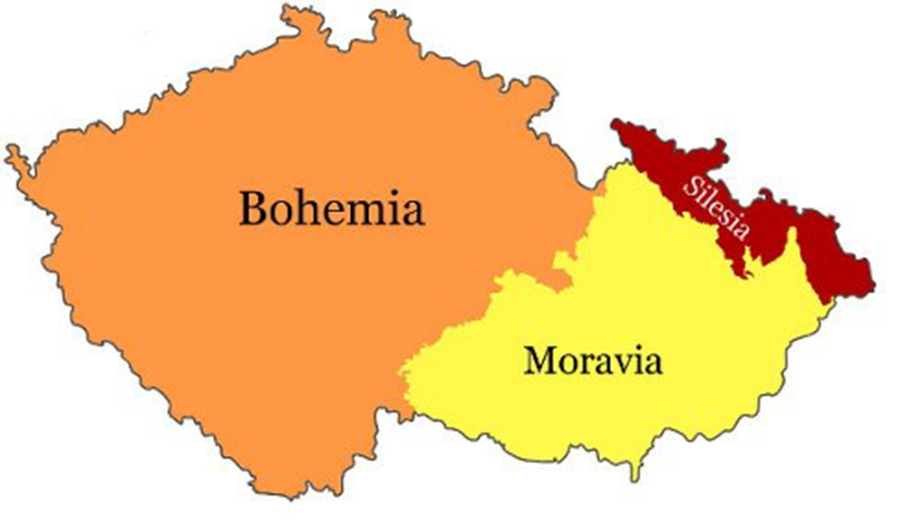
Area
The Czech Republic is historically divided into three regions: Bohemia, Moravia, and a part of Silesia.
The total area is 78,866 square kilometers and the country’s population is around 10, 4 million people.
The capital city is Prague, with 1,2 million inhabitants, and there are 5 other metropolitan cities with a population exceeding 100,000: Brno, Plzeň, Olomouc, Ostrava, and Liberec.

Slide 20
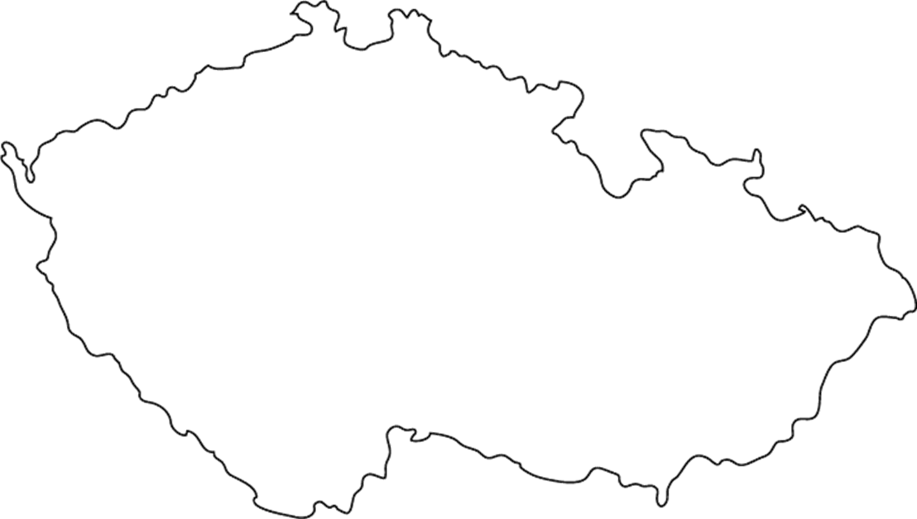
5 other metropolitan cities with a population exceeding 100,000

Slide 21
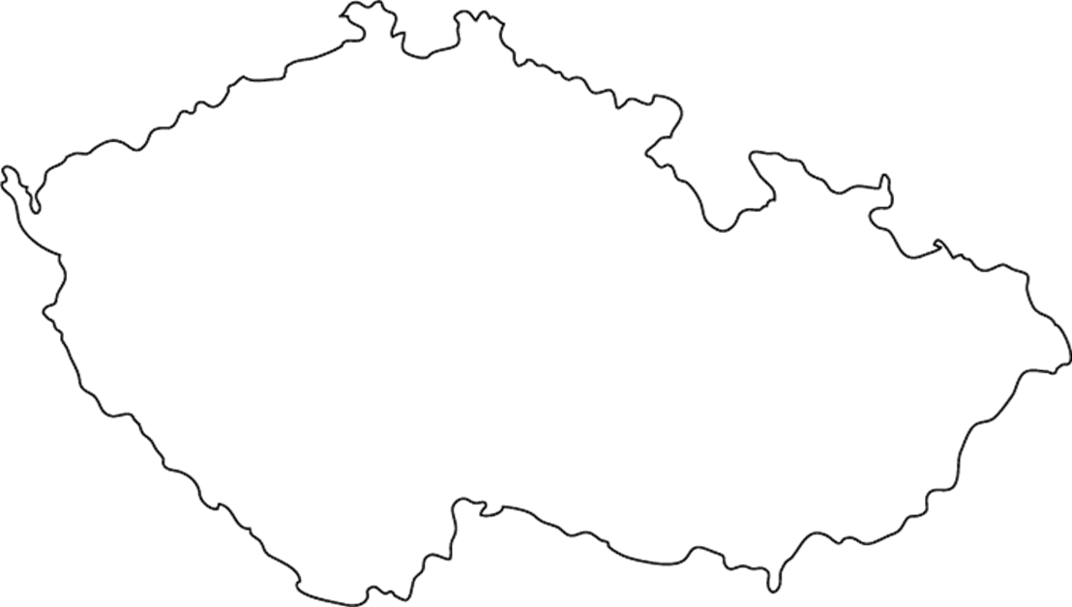
Liberec
Praha
Ostrava
Plzeň
Olomouc
Brno

Slide 22
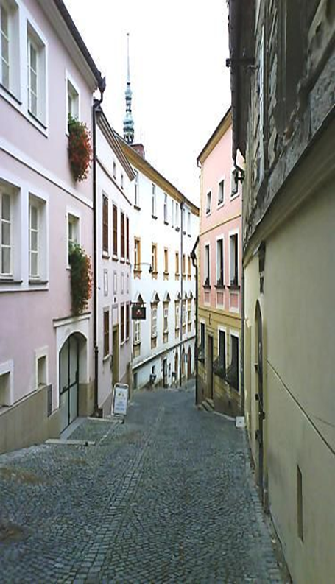
Olomouc
The charming and beautiful city of Olomouc lies beside the Morava River in central Moravia. With around 100,000 inhabitants, it's the fifth largest city in the Czech Republic and certainly one of the most beautiful.
The centre is the largest historic preservation zone outside Prague, and its cobblestoned streets are lined with majestic cathedrals and grand palaces.
Despite its fascinating history and great beauty, you won't find the crowds of tourists that are so common in more famous destinations.

Slide 23
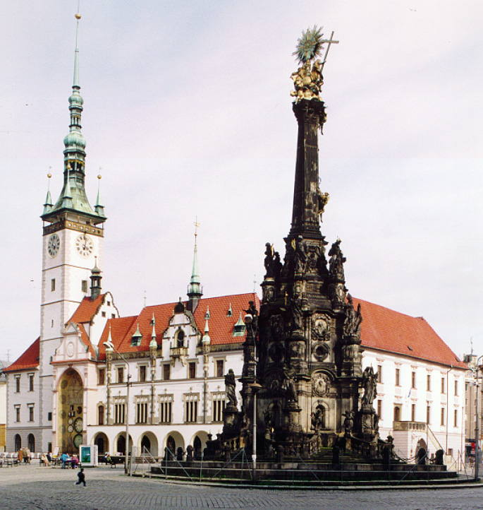
Olomouc
In 2000, the Holy Trinity Column, which was erected in the early 18th century, was added as a UNESCO World Heritage site.

Slide 24
Religion
The Czech Republic is a secular state and every citizen enjoys freedom of religion. The number of people practicing religion is low. More than 50% of the population describe themselves as agnostic or atheist while in northern Bohemia the proportion rises to about three quarters of the population.
The main reasons for this are the suppression of the reformation movement followed by forcible mass re-catholicization (after 1627), and forty years of the official suppression of religion during the communist period (1948 – 1989).

Slide 25
Religion
More than 50% of the population describe themselves as agnostic or atheist while in northern Bohemia the proportion rises to about three quarters of the population.
1. Atheist/ Agnostic
  59 %
2. Roman Catholic
  27 %
3. Protestant
  2 %
4. Other
  12 %

Slide 26
Czech people
Divorce is a popular pastime of Czechs – more than half of the spouses are expected to get divorced, which makes Czech Republic no. 3 in the world rankings.
On a brighter note, Czechs are uncontested world champions in several disciplines such as:
  beer-drinking (annually 159 liters per capita, approx 42 gallons),
  ice hockey (in 1996, hat-trick in 1999-2001, and lastly in 2005) or even such obscure things as
  football on bicycles – cyclo-ball – in which the Pospisil brothers earned 20 gold medals.

Slide 27
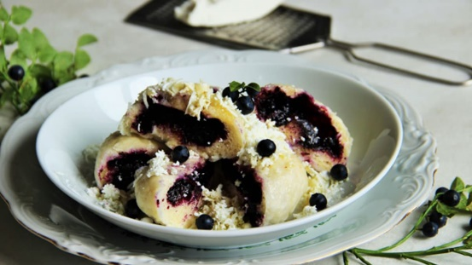
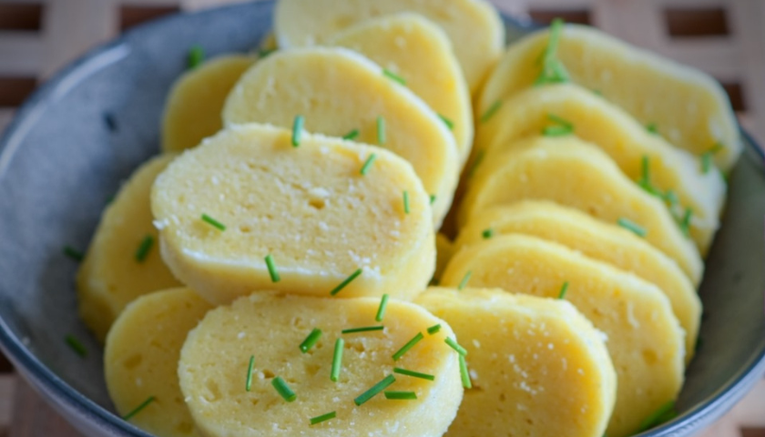
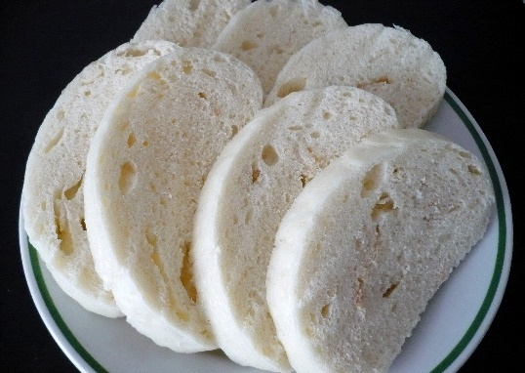
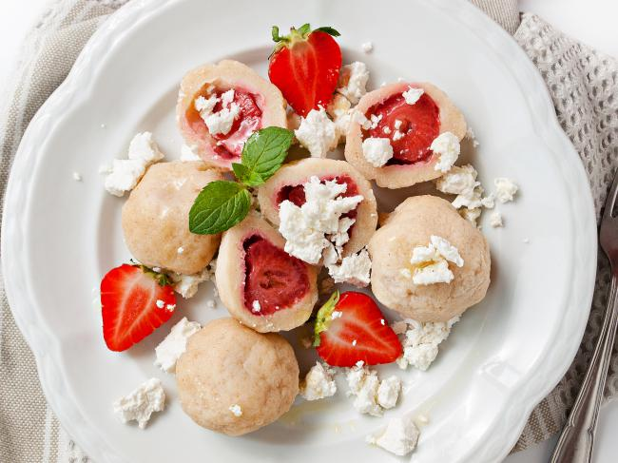
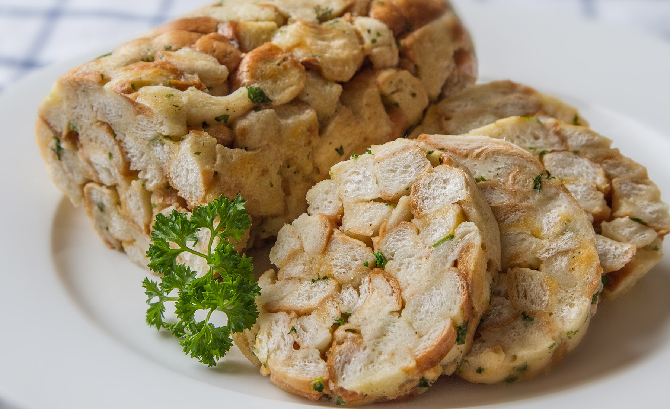
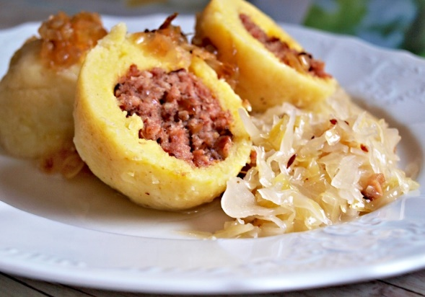
Dumplings
Bread dumplings
Fruit dumplings
Potato dumplings

Slide 28
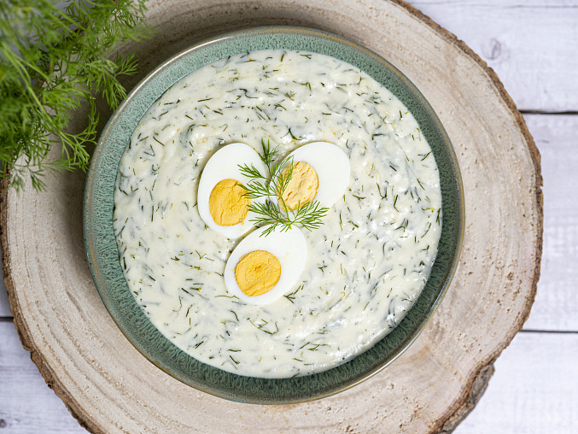
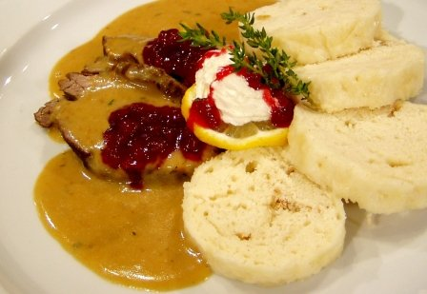
Traditional sauce
Dill sauce
Sirloin sauce

Slide 29
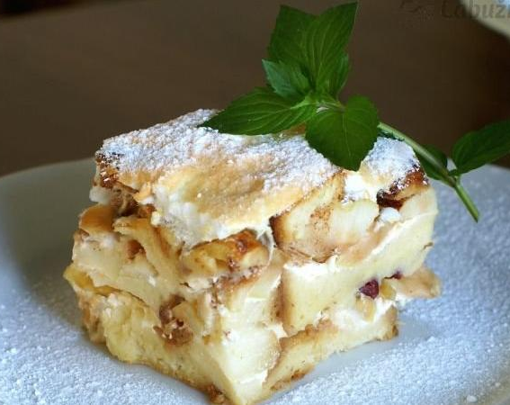
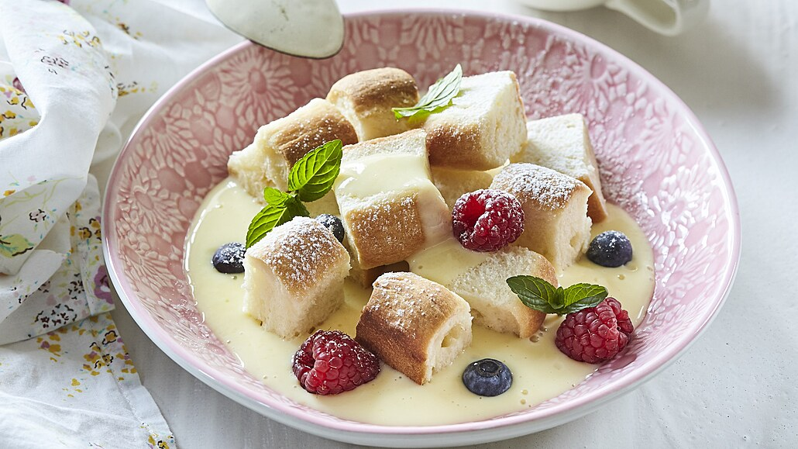
Buns with vanilla cream
Žemlovka

Slide 30
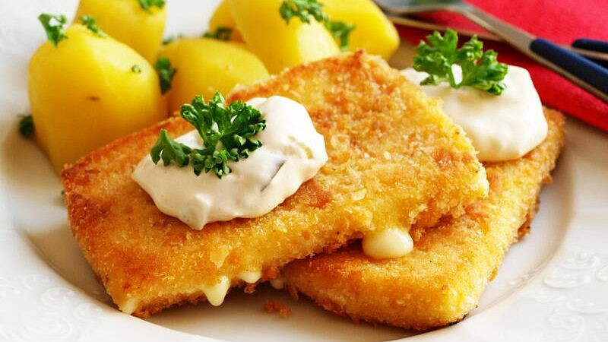
Fried cheese „smažák“

Slide 31
Task for you
Prepare a presentation about your country: (15-20 for preparation)
  Basic information (facts, demografics data, area…)
  Climate, history, food, interesting facts, points of interest, for example: monuments, culture, nature, holidays, foods…
  Introduce your city

Slide 32
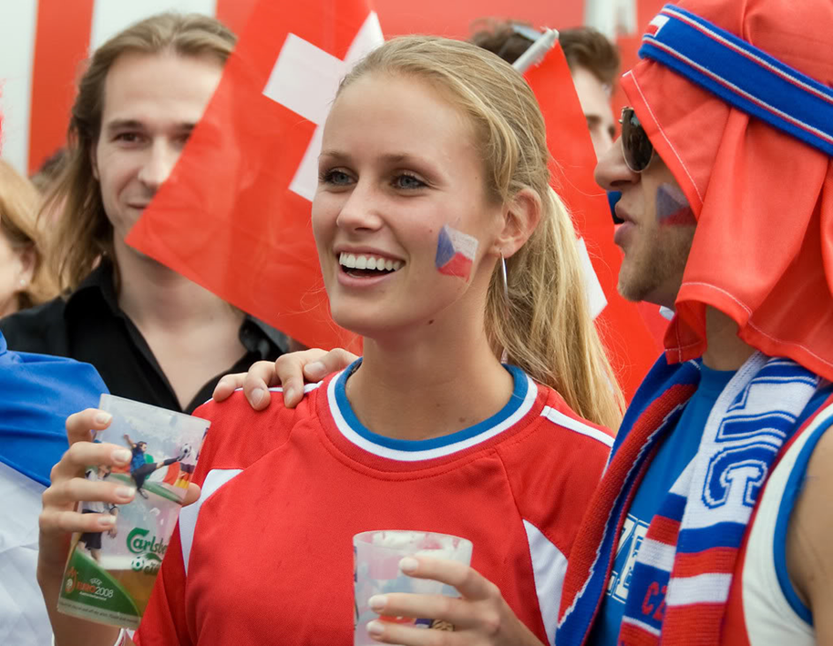
Enjoy staying in the Czech Republic

