Slide 1

Strategy, stakeholders and CSR
Mgr. Martin Fink
Department of Social Sciences and Law
Martin.fink@mvso.cz
+420 587 332 324

Slide 2
STRATEGY
Strategy is one of the most important documents of each enterprise which determines both the specific objectives of the entrepreneurship for a longer period of time (3-5 years) and the ways to achieve these objectives.

Slide 3
STRATEGY
The concept of strategy is comprised of three basic components:
mission - a short text intended for employees and external staff of the enterprise which defines the scope of business activities and relations with stakeholders;
long-term goals (vision) - for selected key performance criteria, it contains numerically and textually defined objectives for the period covered by the strategy;
individual strategy which represents a set of amendments (projects) linked temporally and objectively and whose successful implementation leads to the achievement of the long-term objectives.

Slide 4
MISSION
Mission formulates the purpose and reason of the enterprise existence and gives general answers to three questions:
Why was the enterprise founded?
Who is it created by?
What are the objectives (where are we going, what values do we want to achieve?)?

Slide 5
DEFINING THE MISSION
Customers Who are the customers of the enterprise?
Product or service. What are the principal products/services of the enterprise?
Market. What market does the enterprise compete on?
Technology. Is technology in the centre of interest of the enterprise?
Interest in survival, growth, and profitability. Does the enterprise have the defined economic goals?
Philosophy. What are the basic values, aspirations, and priorities of the enterprise?
Self-concept. How does the enterprise significantly differ from other enterprises? What is its competitive advantage?
Relations with the public. Does the enterprise take into account the interests of the society/community. Does the enterprise take into account environmental protection?
Relations with employees. Are the employees considered a valuable resource of the enterprise?

Slide 6
VISION (LONG-TERM GOALS)
... is the idea of owners and/or top management about the future of the enterprise in the long term.
Direction in which everyone is moving
The idea of something new
The top management’s goal and, at the same time, the commitment to the interest groups
The top management’s personal ambitions
Clarity for everyone
Accepted by all employees

Slide 7
AIMS AND OBJECTIVES OF THE ENTERPRISE
Aims of the enterprise are the next step in defining the vision:
include both financial and non-financial interests of various interest groups;
enable and support reasoned compromises (in particular, e.g. compromises in the case of contradictory objectives – such as cost reduction and, at the same time, maintenance of good relations with employees).
motivating, but achievable,
Integrate in a cross-functional way
Objectives of the enterprise are defined by the aims and express what the enterprise wants to achieve both in the long and short-term period. Objectives must be consistent with the aims of the enterprise and are usually applied to its specific spheres.

Slide 8
STRATEGY AND CSR
Strategy of the enterprise
CSR Strategy
CSR as an integral part of the strategy

Slide 9
STAKEHOLDERS
Interested parties (stakeholders) consist of groups of individuals and institutions that influence the enterprise or are influenced by it. They apply their individual interests following from the relations with the enterprise.
Stakeholders:
Internal
External

Slide 10
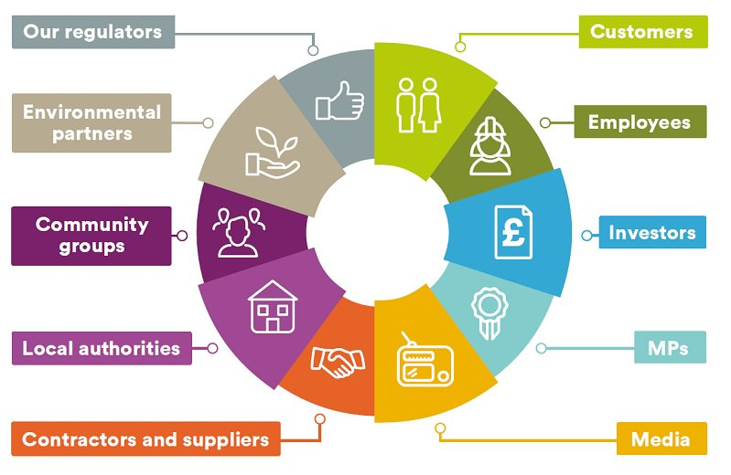
STAKEHOLDERS

Slide 11
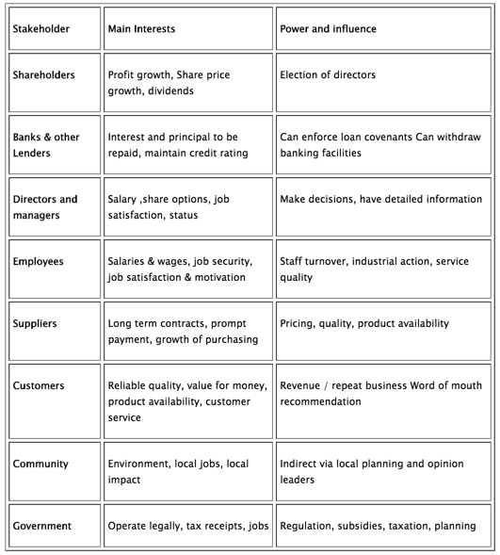
STAKEHOLDERS – EXAMPLES

Slide 12
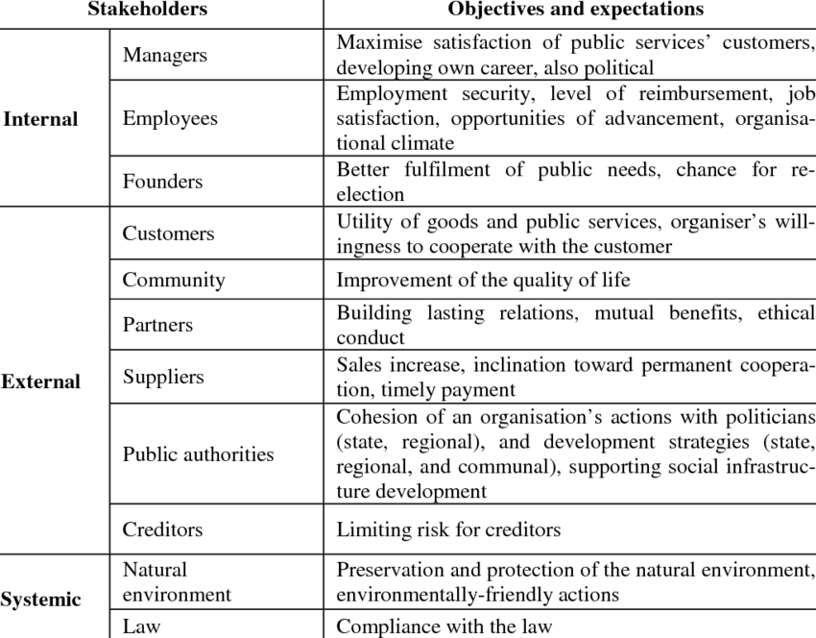
STAKEHOLDERS – EXAMPLES 2

Slide 13
STAKEHOLDERS ANALYSIS
collecting and processing information about the enterprise
creating a list of potential stakeholders
reducing the list according to the factor of importance using the power-interest matrix (power of influence of the group) and the enterprise’s interest in the group

Slide 14
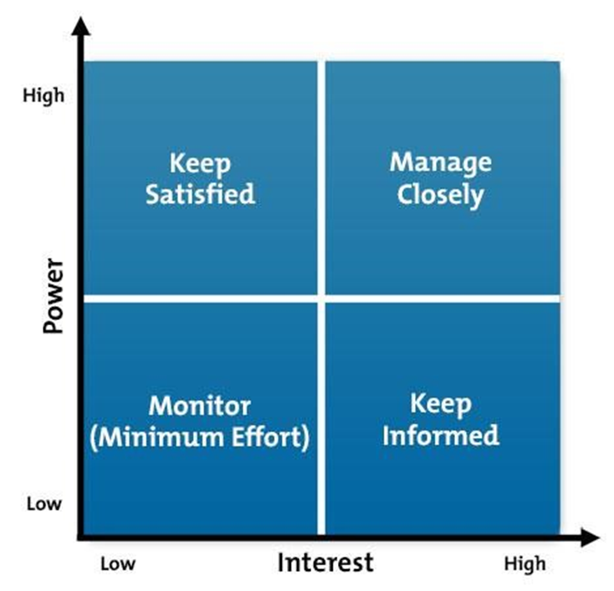
THE POWER-INTEREST GRID

Slide 15
SELECTED STAKEHOLDERS AND THEIR REQUIREMENTS
Stakeholders:
Owners and investors
Customers
Business partners/suppliers
Employees
Environmental non-profit organizations
Expectations of the enterprise:
Increase in the enterprise’s value
High-quality products and services
Reasonable price of products
After- sales service
Quality of contracts and negotiations
Timely fulfilment of commitments
Reasonable salary and non-financial benefits
Good work conditions
Professional development and educational opportunities
Balance between personal and professional life
Eco-friendly production, services
Enterprise’s minimum impact on the environment

Slide 16
Thank you for your attention.

