Slide 1

Corporate Social Responsibility
(CSR)
Martin Fink
Department of Social Sciences
martin.fink@mvso.cz

Slide 2


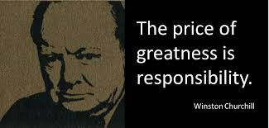
CSRR
Corporate=
Social= People+ Environment
Responsibility= things you have to do

Slide 3
Definition of CSR
World widely accepted definition:
“Social responsibility of business encompasses the economic, legal, ethical, and discretionary expectations that society has of organizations at a given point in time.”
Carroll, 1978
Current definition of CSR in the Czech Republic:
"... a voluntary integration of social and environmental considerations into everyday business operations and interactions with corporate stakeholders."
The European Union Green Paper: Promoting a European Framework for Corporate Social Responsibility Brussels, 2001.

Slide 4
Other Historical Definitions of the Concept
  Friedman – "... another form of profit ..."
  Davis – "...activities beyond the mere profit ..."
  McGuire – "...activities beyond the economic and legal obligations ..."
  Manne – "... voluntary activities of companies ..."
  Wallton – "... demand for the broader social system ..."
  Hay, Gray – "... liability to problem areas of the society."

Slide 5
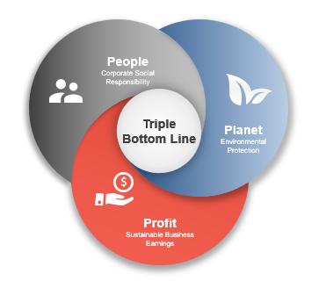
CSR and Sustainability
….from Profit only to 3 Ps
Notes:
The National Action Plan for CSR in the Czech Republic, the European Strategy emphasize the educational dimension of the CSR.

Slide 6
CSR Pillars
Social
      Support of health, safety, underprivileged groups, non-profit spheres, social activities, equal opportunities, healthy lifestyle, etc.
Environmental
      Preserving natural resources, energy and materials management, waste management, ecological production
Economic
      Transparency, rejection of corruption, client loyalty programmes, local suppliers preference, measures for less-favoured customers

Slide 7
CSR Principles
  voluntary basis
  pro-activity, creativity,
  activities beyond one’s own business,
  sense of belonging, social conscience,
  social interaction, transparency,
  flexibility, positive thinking.
  CSR = a stance, not the mere knowledge.

Slide 8
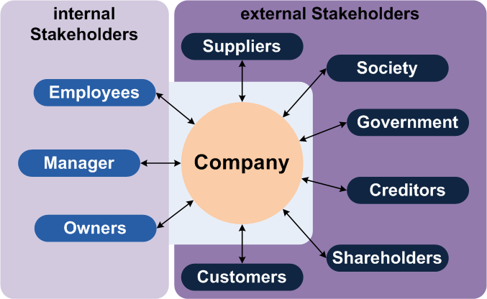
Stakeholders
  „Stakeholder is anyone who can affect or be affected by the success of the firm (organization)“

Slide 9
Benefits for organizations
Innovation
Cost savings
Brand differentiation
Long-term thinking
Customer loyalty
Employee loyalty
  ….

Slide 10
The 10 Companies With The Best CSR Reputations In 2017 (Forbes)
Analysis of 170,000 company ratings from respondents in 15 countries sheds light on which are perceived by consumers as the most socially responsible
The task for you:
Try to guess the winners of the first three places:
?
?
?
BMW Group
Cisco Systems
Colgate-Palmolive
Google
Intel
Lego
Microsoft
Robert Bosch
Rolls-Royce Aerospace
Walt Disney Company

Slide 11
The 10 Companies With … : RESULTS 1
Colgate-Palmolive; Score: 70.4 points
Rolls-Royce Aerospace; Score: 70.7 points
Cisco Systems; Score: 71 points
Robert Bosch; Score: 71 points
Intel; Score: 71.1 points
BMW Group; Score: 71.5 points
Walt Disney Company; Score: 73.5 points

Slide 12

The 10 Companies With … : RESULTS 2
  Google; Score 73.9 points
  Microsoft; Score 74.1 points
  Lego; Score 74.4 points

Slide 13
Thank you for your attention some questions?
Summary

