Slide 1
Health, safety and ergonomics when working with a computer
Lecturer: Lukáš Pavlík, Ph.D.
Winter semester 2021/2022
E-mail: lukas.pavlik@mvso.cz

Slide 2
Ergonomics
The concept of ergonomics is taken from the English "ergonomics", which was created by combining the Greek words ergo - work, nomos - law, rule.
Equivalent terms are: biotechnology, human engineering, human factors.
Definition of ergonomics:
Ergonomics is a scientific field that comprehensively and systematically solves the system man - technology - environment in order to optimize the mental and physical load of man and ensure the development of his personality with maximum efficiency.
Ergonomics is an interdisciplinary field studying the relationship between man and working conditions while applying the latest knowledge of biological, technical and social sciences. Its goal is to optimize a person's position in working conditions, in terms of achieving health, well-being, safety and optimal performance.

Slide 3
Ergonomics
Definition of ergonomics according to the International Ergonomic Association from 2000:
Ergonomics is a scientific discipline based on understanding human interactions and other components of the system. By applying appropriate methods, theory and data, it improves human health, well-being and performance. It contributes to the design and evaluation of work, tasks, products, environments and systems to be compatible with the needs, capabilities and performance constraints of people. Ergonomics is a system-oriented discipline that covers virtually all aspects of human activity. Within a holistic approach, it includes physical, cognitive, social, organizational, environmental and other relevant factors.

Slide 4
Ergonomics
What does the term ergonomics cover?
Ergonomics refers to an interdisciplinary science created by combining applied sciences, the subject of which is work systems.
These are the following fields:
anthropometry including biomechanics,
philosophy of work,
work psychology,
occupational hygiene.

Slide 5
Ergonomics
In the field of research, the subject of ergonomics is:
determinants of performance or working capacity of a person, such as body dimensions, range of motion of the torso and limbs, strength of muscle groups, capacity of sight, hearing, mental capacity,
issues of human adaptation and reaction to working conditions, e.g. shift and night work, monotony, forced work pace, etc., including the body's response to physical, chemical and biological factors of the working environment (noise, vibration, dust, microclimatic conditions, etc.).
the research findings are the basis for the creation of a set of ergonomic criteria and parameters for various work systems and are published in legislation aimed at protecting the health of employees.

Slide 6
Ergonomics when Working with a Computer
We live in modern times, in the age of absolute digitization.
Almost everything we look at is controlled by computers, where a person sits and controls them.
But people were not created to sit at a computer for a long time.
People were not adapted to it and it is not natural for them.

Slide 7
Ergonomics when Working with a Computer
As many people spend more and more time on PCs, the number of health problems is increasing.
These problems are partly caused by the fact that the person sitting at the computer lacks movement, but partly also by the fact that he has a bad habit when working on a PC.
People lack ergonomic thinking.
Recommendations - use the basic principles of ergonomics of working on a PC and how to prevent the so-called RSI syndrome - damage from permanent stress.

Slide 8
Ergonomics when Working with a Computer

Slide 9
Ergonomics when Working with a Computer
Ergonomic principles when working with a computer (PC) include the following points:
1. Office layout and its equipment
2. Height and dimensions of the work table
3. Ergonomic chair and its setting
4. Correct sitting at the PC
5. Breaks and warm-up

Slide 10
Ergonomics when Working with a Computer
Office layout and its equipment
A well-adapted office plays a very crucial role in the entire ergonomics of the computer workplace.
This is the absolute basis for making it a satisfying job.
The whole essence of an ergonomic workplace depends on the chosen device, but also on its arrangement, which is often a stumbling block for most offices.
Ergonomic studies show that one of the main factors for safe ergonomic work with a computer is the stability and adjustability of furniture, especially chairs.
The ability to adjust office furniture will allow its user to freely adapt to his body proportions, but also to his needs.

Slide 11
Ergonomics when Working with a Computer
Height and dimensions of the work table
Another important factor in proper computer ergonomics is the height and dimensions of the desk.
This affects the position and inclination of the shoulders, upper arms, elbows, forearms and hands.
The dimensions of the desk should be designed so that it is possible to change the arrangement of individual computer components (screen, keyboard, document holder, etc.) at any time.
It is always recommended to make the worktop matt to avoid light reflections that can be a problem at work.

Slide 12
Ergonomics when Working with a Computer
If the table is too high, it will force you to lift your shoulders, and your arms at the elbow will be at an acute angle.
The forearm will again be compressed by the edge of the table, which will lead to muscle irritation, reduced blood flow and, consequently, to unpleasant pain that you will only feel in your neck.
By lowering the work table, you achieve a much more natural posture with an angle of more than 90 °.
This will eliminate the discomfort when sitting at the computer.

Slide 13
Ergonomics when Working with a Computer
The ideal solution is a height-adjustable table, which is more expensive…
If the worktop is not height-adjustable, it should generally be about 72 cm above the floor.
For women who are smaller, it is recommended that the table height be a few centimeters lower.
If the table can be adjusted in height, then it is ideal if its height is the same as the height of the elbows.
The forearm and upper arm should be at a 90 ° angle.
The same principle applies when working on a computer while standing.

Slide 14
Ergonomics when Working with a Computer
Ergonomic chair and its setting
A functional ergonomic chair is one of the first office things that should be addressed right at the beginning, not after several years of sitting.
But it's never too late!
If the chair is well adjusted, it relieves the load on the back muscles.
The construction of the chair must be solid and stable, not shaky or swaying.
But there are also chairs whose seat is mounted on a special movable spring, which forces you to engage different types of muscles when sitting.

Slide 15
Ergonomics when Working with a Computer
Such a chair certainly fulfills its essence perfectly, but it does not have to bring comfort to everyone.
The seat of the chair, i.e. what you are sitting on, should always be adjustable.
Ideally, the seat can be adjusted:
height (up and down)
depth (forward and reverse),
inclination (angle of inclination forwards and backwards),
There are also other parameters, such as the shape of the seat, which should be adapted to the human posture as much as possible, or the upholstery, which should be strong and functional.

Slide 16
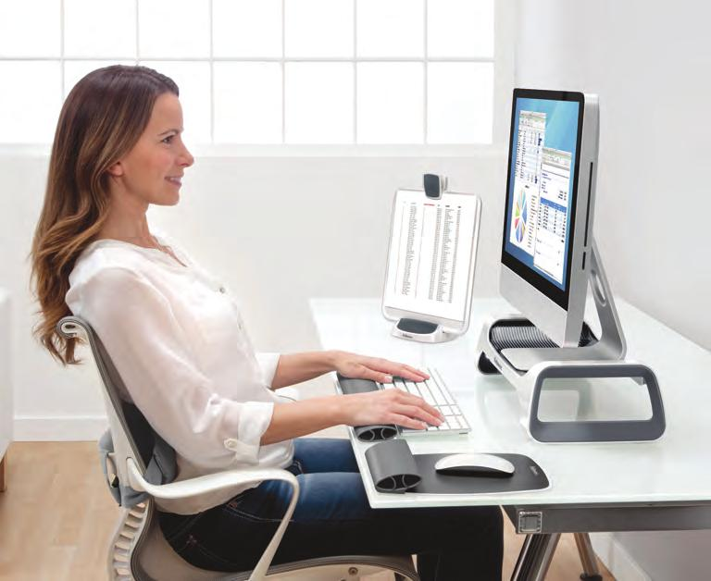
Ergonomics when Working with a Computer
Proper sitting at the PC
One should always sit at a computer so that:
the height of the table when sitting was the same as the height of the elbows,
people held their elbows close to their body,
the upper arm and forearm formed an angle of 90 °,

Slide 17
Ergonomics when Working with a Computer
the calf and thigh were at a 90 ° angle to the knee,
the foot was laid flat on the floor,
ass was as far back as possible,
their back was erect,
ears, shoulders and hips were in a straight line,
the height of the seat and the inclination of the backrest allowed for a comfortable seat.

Slide 18
Ergonomics when Working with a Computer
When sitting, it is good to change the position of the torso, i.e. regularly alternate tilted and straight position or even lean forward.
You will relax muscle tension, perfuse it and reduce the pressure in the intervertebral discs.
You will be relieved.
The legs should have enough space to stretch.
The footrest, which can be positioned and tilted, is ideal and very effective.
The computer screen should be right in front of you at eye level so that the head does not tilt or tilt.
If you wear glasses, they should not slip out of your nose to avoid unnecessary changes in head position.

Slide 19
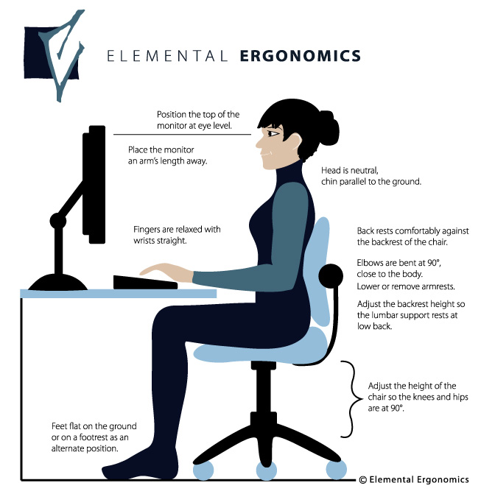
Ergonomics when Working with a Computer

Slide 20
Ergonomics when Working with a Computer
Breaks and warm-up
Movement and rest at the same time is extremely important.
Let your eyes and brain rest, and you stretch your muscles.
Your productivity and desire for further work will be significantly improved.
Get up every 60 minutes, walk around and do some simple stretching exercises.
Just a 5 minute break.
Stretch.
Do the exercises slowly but smoothly.
Also, try to breathe deeply, but do not try to hold your breath.
Rather, try to reach a given exercise position and hold it for 3-5 seconds.

Slide 21
Ergonomics when Working with a Computer
Risks of non-compliance with ergonomic principles of working on a PC
What awaits you if you do not act in time?
The computer has become a part of our lives.
Some sit with him only occasionally, as a source of entertainment, but for more and more people he is a source of livelihood - an everyday work tool.
Human working time is 8 hours, but those who work on a PC rarely work that long.
Rather, they work 12 (or more) hours a day, while health professionals recommend sitting at a PC for a maximum of 4 hours a day.
These are mainly programmers, online marketers, graphic artists, economics and similar professions.

Slide 22
Ergonomics when Working with a Computer
Health problems that arise as a result of working on a computer rarely occur in a short time.
Usually the problems do not manifest themselves until a few years later and are very often serious!
Serious to the point that they can put a person into incapacity for work for a long time, or even cause permanent and irreversible consequences.
And none of us want that, do we?
Therefore, it is not advisable to underestimate the principles of computer workplace ergonomics.

Slide 23
Ergonomics when Working with a Computer
One often does not realize the health risks of working on a computer - one does not perceive them or even admit them.
People usually begin to perceive them only when the long-term pain manifests itself.
Few people start attributing their health status to working on a PC.
But most people who start to feel health problems still do not solve them.

Slide 24
Ergonomics when Working with a Computer
It's because of a kind of laziness and the fact that they don't want to admit it.
But when the first serious problems arise, one becomes more vigilant and finally seeks professional help.
But it can be late sometimes.
At the same time, if he followed the ergonomic principles of working on a computer from the very beginning, it would not have gone that far.

Slide 25
Ergonomics when Working with a Computer
The most common problems when working on a PC:
damage to the back and cervical spine,
pain in the hands, wrists,
elbows and shoulders,
tennis elbow syndrome,
carpal tunnel syndrome,
damage to the movement of the shoulder girdle,
vision problem,
slower limb problems,
tendon and muscle inflammation.

Slide 26
Ergonomics when Working with a Computer
RSI syndrome
All of the above, as well as other health problems, are referred to as Repetitive Strain Injury, or Repetitive Stress Injury, abbreviated as RSI or RSI Syndrome.
What is RSI syndrome?
This is damage to the file, which arises as a result of non-compliance with ergonomics and work environment.
This damage to human health is repeated by repeated exertion, especially by small movements, incorrect position of the body at work, but also by constant muscular tension.

Slide 27
Ergonomics when Working with a Computer
In today's digital world, RSI syndrome is one of the most common causes of occupational diseases, which mainly affect the office professions.
It often leads to surgical procedures.
How to prevent RSI?
RSI syndrome can be prevented by preventive compliance with basic ergonomic rules and ergonomic adaptation of the workplace, but also the work pace.
Think ergonomically, exercise and play sports!

Slide 28
      Thank you for your attention

