Slide 1
Business intelligence
Lecturer: Lukáš Pavlík, Ph.D.
Winter semester 202/2022
E-mail: lukas.pavlik@mvso.cz

Slide 2
Principles of Business Intelligence
The concept of business intelligence (BI) was introduced in 1989 by Howard Dresner, who later served as Vice President of Gartner.
This is a cross-cutting discipline on the range of economy, management and information technology.
Business Intelligence is an overarching term that refers to knowledge, processes, application technologies, and procedures that facilitate business decision making and planning.

Slide 3
Principles of Business Intelligence
BI can be seen as a comprehensive and effective approach to working with corporate data that affects the accuracy of strategic decisions and thus the company's business success.
Business intelligence is based on the transformation of source (usually transaction) data, with the help of which the right decisions are subsequently taken.
BI applications process sales, production, finance, and other data sources for business purposes, especially business performance management.

Slide 4
Principles of Business Intelligence
Business intelligence is also often conceived more as a methodical and technical solution associated with the methods of data aggregation from data sources, their acquisition, transformation into appropriate formats, storage and appropriate presentation to users.
BI technology works with used (historical) data in the desired context and helps make business decisions for the future.
BI systems are sometimes called Decision Support Systems (DSS).
Current BI systems allow enterprise users to directly query data themselves without the help of it staff.
Today, the term is based on the Corporate Performance Management (CPM), Product Lifecycle Management (PLM) systems and, above all, data warehouses.

Slide 5
Principles of Business Intelligence
The Corporate Performance Management (CPM) systems are used to measure the performance of businesses.
For this purpose, the most important metrics are selected, called KPI (Key Performance Indicators).
One of the main applications of CPM is dashboards that allow you to monitor changes in KPIs on one panel depending on your business activities, and scoreboards allow you to track "cause-effect" relationships to analyze how target KPIs are met.

Slide 6
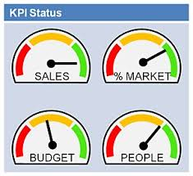
Principles of Business Intelligence
The Product Lifecycle Management (PLM) systems monitor the life curve of the production (usually With a curve).
While PLM and ERP can work independently in the production plant, it is highly desirable that they should be connected together as closely as possible (integrated).

Slide 7
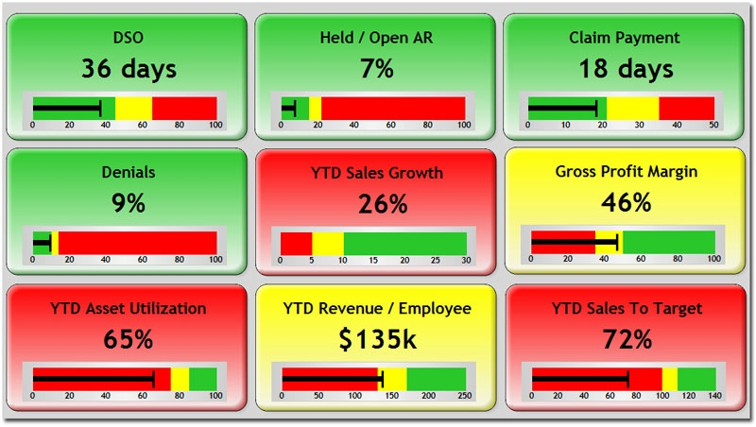
Principles of Business Intelligence

Slide 8
Business Intelligence Technology
The problem of today's manager is often not a lack of data, but an excess of data.
Data from different sources are placed in different information systems.
However, for analysis, data must be kept together and compared with each other.
For a qualified decision, the data should be thoroughly analyzed and subsequently interpreted by appropriate outputs.

Slide 9
Business Intelligence Technology
The main categories of business intelligence assets are:
- reports (tables or reports),
- questions (reporting and querying software; tools that select, sort, summarize and present selected data)
- OLAP - Online Analytical Processing,
- data mining,
- data warehouse,
- local information systems.

Slide 10
Business Intelligence Technology
Business intelligence is built on the transformation of data between several layers from the source database (ERP, CRM, etc.) to the analytical database (data warehouses, data market, OLAP).
The analytical database provides information for general tools such as portals, dashboards, scoreboards, etc. or special tools business intelligence through analytical applications and reports.

Slide 11
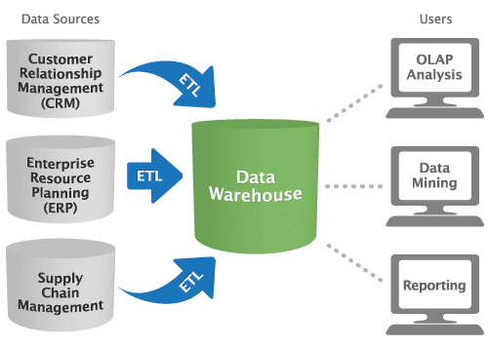
Business Intelligence Technology

Slide 12
Business Intelligence Technology
When transferring from source (primary, production) to analysis databases, data selection, transformation into other data structures and ultimately physical storage should be ensured.
This is provided by ETL programs, otherwise also called as data pumps.
The transformation layer must have "data consolidation", that is, avoiding duplication and multiplicity, but also avoiding errors, lack of clarity, etc.

Slide 13
Business Intelligence Technology
Data Warehouse is a system that allows you to collect, organize, store and share historical data.
Enterprise users use a data warehouse to support decision making.
In this case, decision-making support is synonymous with business intelligence technology, which is based on data usage and how they are collected, stored and presented in a data warehouse.

Slide 14
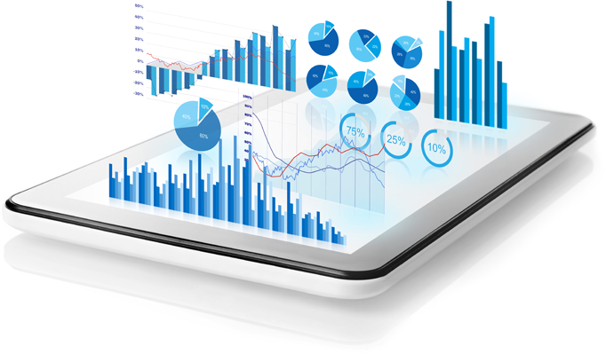
Business Intelligence Technology
There is usually one large database at the core of the data warehouse, but it can also be a set of databases that can be located on different servers in different locations.
Differences between relational database and data stock can be interpreted according to different viewing angles as follows:

Slide 15
Business Intelligence Technology
1. Orientation per subject
For a common relational database, the usual effort is to minimize data storage redundancy.
This fact is achieved by their normalization to 3NF and internal interlinking of individual logical functional units.
In the data warehouse, on the other hand, the solution is always driven by an effort to clear internal separation of individual functional units – the result is a structure that is more readable for users (managers, business analysts) and at the cost of increased memory space requirements.

Slide 16
Business Intelligence Technology
2. Integration
A common operating application (program) above the relational database solves a specific circle of tasks above specific data.
In the data warehouse, on the other hand, information needs to be collected from many different sources and grouped not by origin but by logical meaning; i need to have all the data relating to a specific functional area "in one place", regardless of where they come from).

Slide 17

Business Intelligence Technology
3. Low variability
The data is usually recorded in larger batches (for example, at daily or weekly intervals) to the data warehouse and then they are no longer modified.

Slide 18
Business Intelligence Technology
4. Age of data
Data is usually maintained in historical form in the data warehouse, not only in the current state.
In a common relational database, only the current state of the data objects is usually interesting from the user's perspective.
Regardless of the configuration, the bag should be centrally controlled.
This central area plays a powerful role in transforming and storing data in a structured and organized manner.
Data from the data warehouse can be processed using pre-processed analytical applications or using data mining techniques.

Slide 19
Business Intelligence Technology
When mining data, we look for correlations, regression, trends, diagrams, etc.
They use different classifications according to different criteria to discover new facts, to group data with similar characteristics, etc.
Technology OLAP (Online Analytical Processing)
Usually adds dynamic aspects to static assemblies.
OLAP is a database data storage technology that allows large volumes of data to be organized so that data is accessible and understandable to users engaged in business intelligence analysis.

Slide 20
Business Intelligence Technology
The way data is stored differs from the one used in the Online Transaction Processing (OLTP).
OLTP systems are primarily designed for data acquisition.
Data is acquired in real-time to OLTP systems; tens to hundreds of thousands of transactions per minute take place in normal operation.

Slide 21
Business Intelligence Technology
Basic differences between OLAP and OLTP result from different uses – OLAP is a one-time data recording over which complex queries are performed, OLTP data is continuously and often modified and added, usually by many users at the same time.
The data to be processed should contain valuable information on a specific issue; this data must be integrated, consolidated and transformed into a usable and reliable source.
Data is integrated and cleaned with the consolidation process, because uncleaned data cannot be used as a high-quality, consistent and true source in the information creation process.

Slide 22
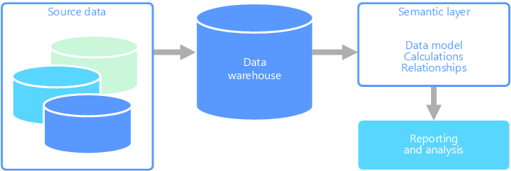
Business Intelligence Technology

Slide 23
Business Intelligence Technology
The process of creating information from a large volume of data requires a flexible storage architecture that is different from traditional operating databases.
There are various ways to store data – each one is prepared for different information needs – but all are created, managed and distributed within a unified architecture.
This includes various storage structures:

Slide 24
Business Intelligence Technology
- relational for current data,
- multidimensional for comparison, analysis, identification of samples and trends,
- tables for forecasting, for comparison with the history of the original saving
- any combination of data storage required for creating information requirements.

Slide 25
Business Intelligence Technology
While a few years ago it was the only task to collect all the data from different systems in order to consolidate them and generate financial statements, in-depth analyzes are currently being carried out using various advanced tools with different approaches.
OLAP tools are complemented by predictive analysis, natural language processing (natural language processing) or artificial intelligence.
Many organizations using analytical tools face a situation where ordinary users cannot fully use these tools because they are too complex for them.

Slide 26
SAP Business Information Warehouse
In Business Intelligence, we focus primarily on implementing SAP solutions.
SAP is the most widely used enterprise system worldwide, the main advantage of which is the complexity and integrity of processes.
Business Information Warehouse is a universal solution whose main goal is to provide fast and reliable cross-cutting information from all areas of business activities and processes in the required detail and thus facilitate managers at all levels of decision-making and corporate governance.

Slide 27
SAP Business Information Warehouse
The basis for a good decision is information that is usable at the moment and in the required structure.
A necessary part of such a solution is a quality reporting tool, which is SAP Business Information Warehouse (SAP BW).
It offers pre-set reports for each area of the entire SAP solution (from logistics, HR, to finance, including specific solutions).
It also allows you to integrate data from any non SAP environment.

Slide 28
SAP Business Information Warehouse
The following areas are addressed within SAP BW:
- data collection – enables integration and storage of data from different sources to support decision-making processes,
- reporting and analysis – provides decision support tools such as query processing, reports, multidimensional online analysis (OLAP), allows data analysis and offers tools for data visualization,
- information support – supports the dissemination of information through multiple channels such as internet, intranet, mobile devices,
- knowledge management – converts unstructured information into a variety of formats, including documents, audio and video,

Slide 29
SAP Business Information Warehouse
- content management of www pages – publication function allows experts and knowledge intermediaries to transfer knowledge to specific users according to roles,
- internet information centers – makes available internet information to particular user groups; provides stand-alone information portals or allows integration with an existing corporate portal
- business efficiency management – provides analysis tools to help companies visually represent goals, monitor progress toward goals and model different scenarios to identify optimal strategies
- analytical applications – analysts forming part of SAB BW integrate business processes, provide predefined business scenarios of the "closed cycle" type and provide ready metrics for measuring business operation efficiency, allowing users to choose immediate correction.

Slide 30
SAP Business Information Warehouse
The following trading areas are among the applications that SAP BW addresses:
- analysis of customer relationships – measure and optimize customer relationships; include applications such as electronic location analysis, market basket analysis and customer retention analysis
- corporate analyzes – evaluate financial efficiency (e.g. payment model analysis), measure the effectiveness of the organization (e.g. workforce optimization), and support business efficiency management,
- analysis of supply chains – measures and optimizes supply chains, contains applications such as procurement, stocks and production; it covers the processing of sales and delivery using the internet interface.

Slide 31
Thank you for your attention

