Slide 1
Computer networks, basic types of networks, network elements
Lecturer: Lukáš Pavlík, Ph.D.
Winter semester 2021/2022
E-mail: lukas.pavlik@mvso.cz

Slide 2
Definition of the Term Computer Network
A computer network is a system that is created by interconnecting computers in order to communicate and share resources connected to individual computers.
The basic reasons for creating the first computer networks were the need for common access to data, data transfer between computers (especially to connect the user to another computer to perform calculations and other operations remotely, usually in the form of a remote terminal session) and last but not least printer connected to another computer.
A group of computers connected together that allows multiple users to access, share, and use a single resource is called a computer network.

Slide 3
Definition of the Term Computer Network

Slide 4
Computer Network Structure
Each computer network consists of individual stations (computers), network hardware (network cards, cables, connectors, active components, etc.) and network software (networking programs).
According to the task that the given computer - the end node - performs in the network, we divide the computers into:
servers,
workstation.

Slide 5
Computer Network Structure
Servers:
provide certain services to other stations (file, application, print, mail, database, terminal),
at the same time it performs the function of a control station in the network, t
here may be one or more servers in the network (there may not be any in small networks - see peer-to-peer network below).

Slide 6
Computer Network Structure
A server is a computer that offers its services to others.
For this reason, it is equipped with different hardware and software than conventional stations.
Server hardware tends to be more powerful and fault-tolerant and must include an uninterruptible power supply (UPS) as well as a backup system.
In terms of software, a different operating system can be used than conventional stations.
A server network operating system consists of two parts: network software installed on clients and installed on servers.
This is the case, for example, with the Windows operating system, which today can be seen, for example, in versions of Windows 2000 server, Windows 2003 server, Windows Server (adapted to cloud services), various versions of Linux servers, etc.

Slide 7
Computer Network Structure
Workstation
The computer on which the user works uses the services provided by the server.
Workstations are usually designed for one user, although they can be accessed remotely by other users.
They usually offer higher performance than conventional computing.
They usually have higher graphics performance, CPU, memory size and multitasking capability.
Workstations are usually adapted for displaying and manipulating complex information (e.g. 3D structures, technical simulation results and mathematical diagrams).

Slide 8
Division of Computer Networks According to their Scope (size)
Networks are divided (according to the scope criterion) according to the ratio of data transmission and reception time.
LAN - Local Area Network
The elements of such a network are distributed in a certain bounded object, which extends over hundreds of meters.
Mostly it is a classroom, school, company, plant, etc.
The entire network is under the control (logical and physical) of one employee, referred to as the network administrator (supervisor, administrator).

Slide 9
Division of Computer Networks According to their Scope (size)
In today's world of considerable scope, there may be several administrators, but they must still form a unified and coordinated team.
The network usually consists of personal computers supplemented with the necessary hardware resources (network adapters, connectors) and connected by network cables.
Transmission media are various - from twisted pair via coaxial cable to high-speed optical cables.
Wireless connections are no longer an exception today.

Slide 10
Division of Computer Networks According to their Scope (size)
The local computer network provides the following services:
sharing expensive peripherals (laser printers, high-capacity disk systems, CD-ROM systems, etc.),
sharing common data and applications (ensuring up-to-date data, saving disk space, easy backup, upgrading products, etc.),
use of intranet and simple communication between users (messaging, computer mail).
Access to local services is more or less constant.
For LAN, the transmission time tv is longer than the propagation time ts on the transmission medium (tv> ts).

Slide 11
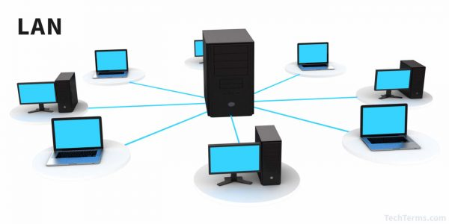
Division of Computer Networks According to their Scope (size)

Slide 12
Division of Computer Networks According to their Scope (size)
MAN - Metropolitan Area Network
Today, due to high transmission speeds, these networks behave like local networks.
They connect local networks in urban areas, used for data, voice and video transmission.
They connect distances of the order of tens of kilometers.
This network is smaller than WAN but larger than LAN.
Approximately the same applies to the classification as in the LAN network.
The MAN network has approximately the same transmission time as the signal propagation (tv = ts).

Slide 13
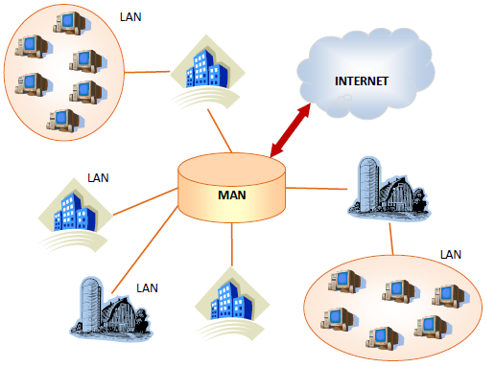
Division of Computer Networks According to their Scope (size)

Slide 14
Division of Computer Networks According to their Scope (size)
WAN - Wide Area Network - large networks
They connect LAN and MAN networks with coverage across the entire country or continent, at any distance.
As the geographic reach of networks grows by connecting users in different cities or states, LAN and MAN grow into Wide Area Networks (WANs).
The number of users in such a network can range from ten to several thousand users.
It is no exaggeration to say that the size of WANs today is limited by the size of the Earth.
WAN networks are made up of control computers (so-called node computers, English host), which are interconnected via a communication subnet.

Slide 15
Division of Computer Networks According to their Scope (size)
The communication subnet usually consists of special data links of organizations providing telecommunications services.
These are most often fixed telephone lines or optical cables, but there are also possibilities of microwave and satellite connection.
WAN nodes are usually powerful computers that are capable of serving multiple users simultaneously and operating continuously.
Recently, individual LANs, which communicate with each other via a large network, are also considered WAN nodes.
With large networks, it is virtually impossible to connect every computer to everyone.
The interconnection therefore takes place indirectly.
The message is transmitted sequentially from one computer to another, up to the destination.

Slide 16
Division of Computer Networks According to their Scope (size)
A large computer network provides the following services:
work on remote computers (remote login),
data transfer (ftp),
electronic mail (e-mail),
access to extensive information databases, conferences, discussion clubs,
WWW (World Wide Web).
An example is the network of Czech universities and scientific institutions CESNET2 and, of course, the world's largest Internet. The transmission time is less than the propagation time (tv <ts).

Slide 17
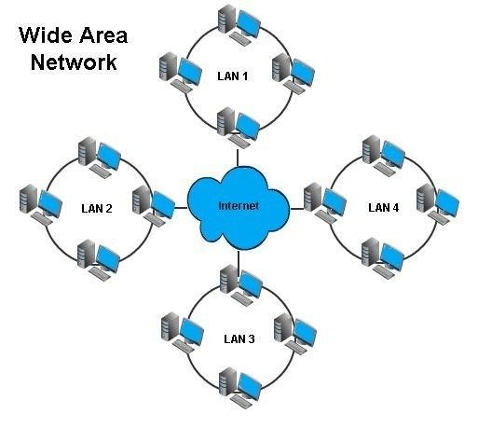
Division of Computer Networks According to their Scope (size)

Slide 18
Division of Computer Networks According to their Scope (size)
PAN - Personal Area Network
IT describes a very small computer network (such as Bluetooth, IrDA or ZigBee) that a person uses to connect his personal electronic devices, such as a mobile phone, PDA, laptop, etc.
Personal computer networks do not aim for the highest possible transmission speed (which typically does not exceed Mbit / s units in PAN), but rather resistance to interference, low power consumption or easy configurability.
Their range is typically only a few meters.

Slide 19
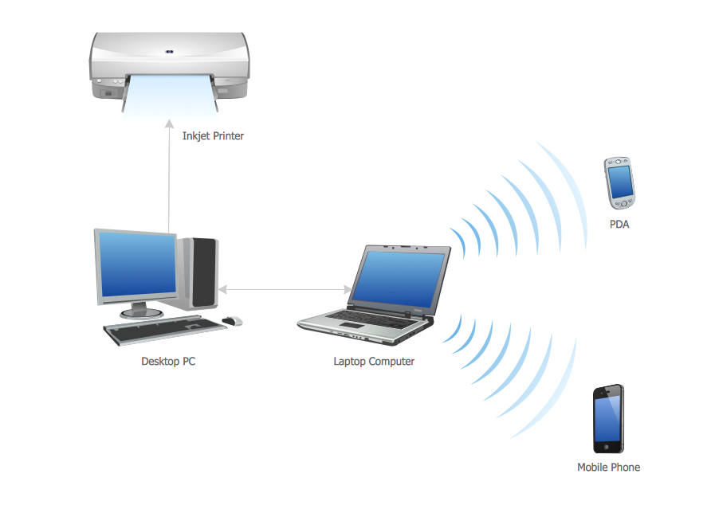
Division of Computer Networks According to their Scope (size)

Slide 20
Division of Networks According to the Relationship between Nodes
Based on how computers on a network are configured and how they access information, we divide networks into two basic types:
Peer-to-Peer and Client-Server
It is a type of computer network in which no computer is superior to others.
It is used with a relatively small number of computers.
Peer-to-Peer networks are also called working groups.
It is a small group of individuals (usually up to ten) working together.

Slide 21
Division of Networks According to the Relationship between Nodes
Such a network has no administrator and is in most cases designed to address the issue of resource sharing, such as the problem of printing in a small organization.
The computers are connected to a network and a printer is connected to one of them, which is then simply "shared" (made available) to other users who can use it from now on.
Most of the operating systems used today already have everything you need to get this type of network up and running.
Examples are Windows 2000, all kinds of Linux and Mac OS operating systems.

Slide 22
Division of Networks According to the Relationship between Nodes
Client – Server
This phrase has already become familiar in the Czech language, even though there were times when language purists wanted the Czech equivalent of "service station" to be used instead of the term server.
In such a network, there are one or more computers that offer their services to others, and that is the servers.
Conversely, those computers that use their services and usually do not offer any services to others are called clients, sometimes workstations or workstations.
Such a network is a typical example of a computer network today and can be found in most organizations or companies.

Slide 23
Division of Networks According to the Relationship between Nodes

Slide 24
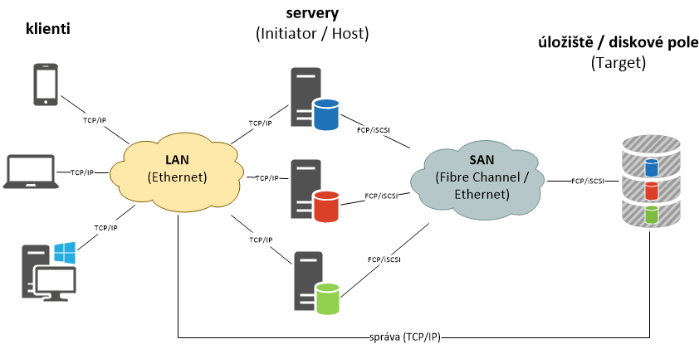
Division of Networks According to the Relationship between Nodes
SAN - Storage Area Network
It is a network specialized in the transmission of large amounts of data.
The data that is transferred between individual repositories and servers does not burden other commonly used lines.
This network is focused on performance and availability.

Slide 25
Network Division according to Topology
Physical and logical topology - network layout design
Network topology means the arrangement or physical location of nodes in a network.
The choice of a certain topology affects the type and capabilities of the equipment, the growth and management of the network.
The topology can also determine how computers on the network will communicate.
The topology describes the physical or logical arrangement of a network.
The topology of local computer networks differs from large computer networks.

Slide 26
Network Division according to Topology
The physical topology defines the cabling of the network, it refers to how the cabling connects the nodes. There are several physical topologies, including bus, ring, star, and star-connected or other hybrid topologies.
The logical topology describes how information is passed between nodes.
There are two basic logical topologies:
Bus
Round
The choice of topology affects many network features such as scalability (possibility and ease of adding stations to the existing network), reconfigurability (possibility to modify the network in case of component failure), reliability (network resilience against component failures), complexity of operation and performance (use of media transmission capacity and message delay).

Slide 27
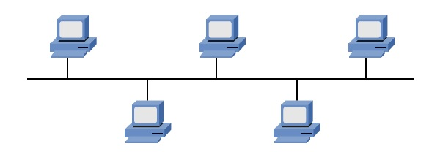
Physical Topology
Bus topology (serial hub)
The bus topology is also known as a linear bus.
This is the simplest and most common way to connect computers to a network.
It consists of a single cable called the main cable (also the backbone or segment) that connects all the computers on the network in one row.

Slide 28
Physical Topology
Star topology
In a star topology, computers are connected by cable segments to a central network element called a hub (HUB).
Signals are transmitted from the transmitting computer through hubs to all computers on the network.
This topology dates back to the beginnings of the use of computer technology, when computers used to be connected to a central mainframe.
There must be only one path between every two stations!

Slide 29
Physical Topology
The star topology offers centralized resources and management.
However, because all computers are connected to a central point, this topology requires a large number of cables when installing a large network.
Failure of the hub in a star topology will cause the network to "fall" at stations connected to it.
It is therefore advisable to protect it from power failure (supply to the UPS).

Slide 30
Physical Topology
Ring topology
An annular topology connects computers using a single-circuit cable.
There are no finished ends.
The signal follows the loop in one direction and passes through all computers.
Unlike a passive bus topology, each computer acts as a repeater, i.e. it amplifies the signal and sends it to another computer.
Because the signal passes through all computers, the failure of one computer can affect the entire network.

Slide 31
Physical Topology
One way to transfer data in a circle is called stamp passing.
A token (special packet) is sent from one computer to another until it reaches the computer that has the data to send.
The sending computer changes the stamp, assigns an e-mail address to the data, and forwards it around the circuit.
Data traverses all computers until they find a computer with an address that matches their assigned address.

Slide 32
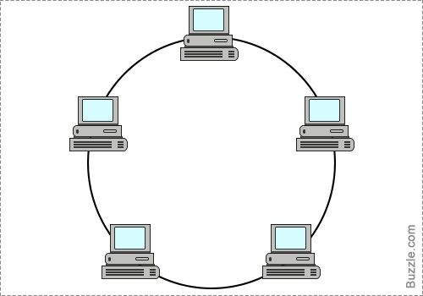
Physical Topology

Slide 33
Physical Topology
Hybrid topology (Tree)
star busstar
shaped annular.
A star bus topology combines several star networks interconnected by a linear bus.
A star-ring topology is sometimes called a star connected in a circle.
Hubs (multiport repeaters) are used to connect computers.

Slide 34
Physical Topology

Slide 35
Physical Topology
Logical topology
The logical topology defines the logical layout of the network.
This layout specifies how the elements in the network communicate with each other and how the information in the network is transmitted.
The two main topologies are bus and ring.
In a bus logic topology, information is sent simultaneously to all nodes.
Nodes, however, read only messages that are intended only for them.
You must wait until the network is temporarily free before you start broadcasting.
In a circular topology, communication takes place from one node to another.
The information is passed sequentially in the order specified by the predefined process.

Slide 36
Basic Network Devices
Network card (adapter)
The network card mediates communication between the computer and the cable according to the rules given by the network standard.
It converts data from a form understood by a computer so that it can be transmitted over a medium, i.e. it translates a parallel signal to a serial one.
Only after installing the network card in the computer will we be able to connect the computer to the network.
During production, the network card is assigned a unique physical address, MAC address.

Slide 37
Basic Network Devices
Sometimes it is possible to change it in the network, but in one local network each end device must have a different MAC address set, otherwise there are problems with addressing and transmission.
A Mac address is a 48-bit address written mostly as six hexadecimal two-digit numbers separated by a hyphen or a colon - for example, 00-B2-63-E2-A6-4E.
Repeater
As we said at the beginning, no signal transmission line treats this signal ideally so that it does not affect it at all during transmission.
Each transmitted signal is affected in some way (attenuated, attenuated, distorted).

Slide 38
Basic Network Devices
This is one of the reasons why the length of each transmission medium is limited.
If we want to transport the signal over a longer distance, we must adjust it appropriately along the way (amplify, correct its course,…).
The device that performs this signal correction is called a repeater.
Typically, this is a two-port device that receives a signal on one port, modifies it, and forwards it from the other side.
The repeater works on the first (physical) layer of the ISO / OSI model.

Slide 39
Basic Network Devices
Transceiver
However, in addition to amplifying and adjusting the signal, the amplifier-like device also allows conversion from one type of transmission medium to another.
Nowadays, the most common is the conversion from optical fiber to twisted pair.
The converter, like the repeater, works on the first physical layer of the ISO / OSI model.
The converter converts the signal from one type to another (for different transmission media it is necessary to adjust the signal to a different shape).
The transmitter is either a stand-alone device or is directly part of another active element.

Slide 40
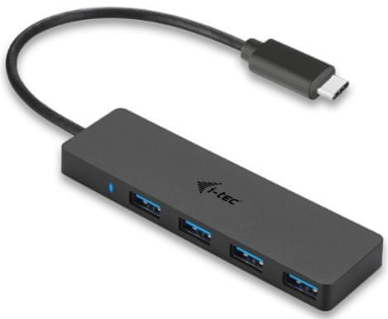
Basic Network Devices
HUB (hub)
Devices used to split (branch) the signal.
It is an essential element in networks with a star topology.
The HUB can also amplify and convert the signal just like the converter.
The HUB also works on the physical layer of the ISO / OSI model, as can be seen from its function.
Today, HUB is already replacing an "intelligent" element called a switch.

Slide 41
Basic Network Devices
Bridge
Bridge is the first "intelligent" element that we encounter, i.e. it not only amplifies the data, but is interested in the transmitted data itself.
It is a device performing two main tasks:
Interconnection of networks of various standards
Packet filtering
Interconnection of networks of various standards using a bridge. The bridge works on the second line layer of the ISO / OSI model and for this reason is no longer interested in the physical differences of the networks.

Slide 42
Basic Network Devices
Switch
It is the most used device in networks with a star topology, where it has almost completely replaced the previously used HUB.
It has the same function as the HUB in conjunction with the bridge.
It therefore serves to branch the signal and filter it.
It performs packet filtering between individual ports (sockets).
Communication via a switch can therefore take place between several ports at the same time.
Packet filtering is the same as for bridge – i.e. using MAC addresses.
Obtaining the MAC address table is the same as for bridge.
The switch also contains a buffer and, thanks to this memory, allows network devices with different baud rates to be connected.

Slide 43
Basic Network Devices
Router
It is a network element working on the third, network layer of the ISO / OSI model.
It is used to interconnect LAN networks, through third layer addressing.
During its operation, the router finds out the addresses of computers and networks connected to individual interfaces and stores a list of them in a table.
The task of the router is therefore to decide in which direction to send individual packets so that they reach their recipients.
This decision is called routing.

Slide 44
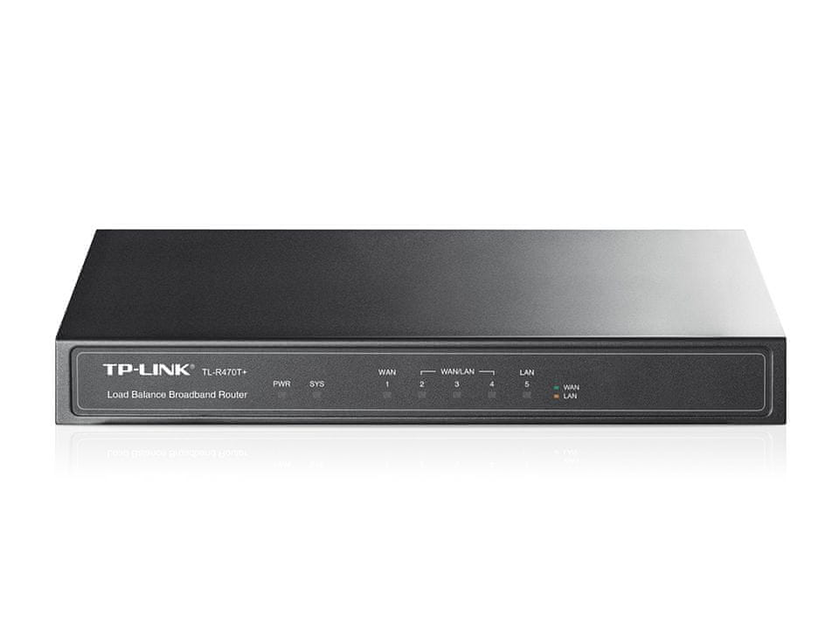
Basic Network Devices
Routing is based on a routing table.
This table contains a set of indicators that are used to decide what to do with a given packet.
The routing table contains the destination address to which the packet is destined.

Slide 45
Basic Network Devices
The router can do two things with the packet:
deliver it directly to the addressee,
pass to one of the neighbors.
Gateway
Bridges, switches and routers are not interested in the data content of frames (packets).
They can only interconnect systems that "pack" the same data into frames / packets, i.e. the same systems, possibly systems that differ in lower layer transmission technologies.
For different systems to work together, it is necessary to understand the transmitted data and perform their conversion.
This is the task of gateways.

Slide 46
Basic Network Devices
Gateways are always application-oriented, they only understand data from a certain application, so they work on the application layer.
Used to connect a computer network to another network, to some foreign environment.
Gateways are implemented in software and are always application-oriented, e.g. gateway for electronic mail transmission, for printing, etc.
Gateways are necessary for the cooperation of different systems.

Slide 47
      Thank you for your attention

