Slide 1
Computer hardware components
Lecturer: Lukáš Pavlík, Ph.D.
Winter semester 2021/2022
E-mail: lukas.pavlik@mvso.cz

Slide 2
Computer Case
We insert the motherboard, power supply and other components into the computer case, which are protected on all sides by a metal or plastic cover.
This cover can usually be removed from one or more sides.
The front section usually has space for a CD / DVD drive (in the past for floppy disks), LEDs that indicate various computer functions (power on, hard drive operation, etc.) and buttons for turning on or resetting the computer.
Most of today's cabinets also have USB ports and connectors for working with sound on the front.
Devices such as a monitor, keyboard, mouse, etc. are usually connected from the back of the case, directly to the connectors integrated on the motherboard.

Slide 3
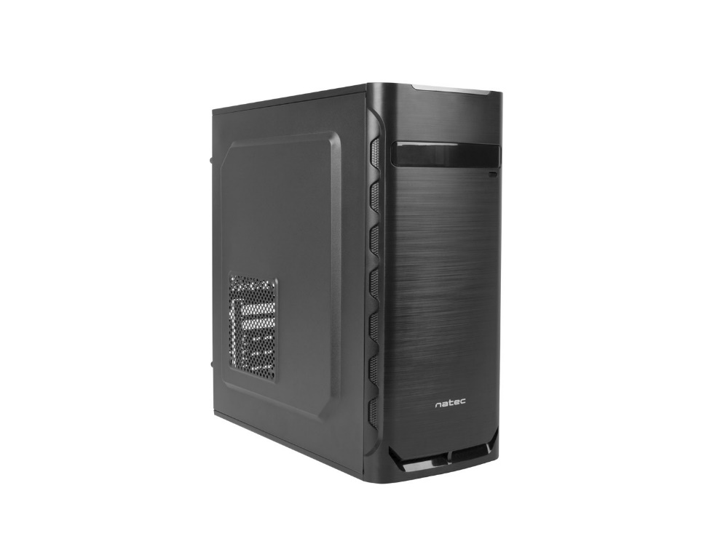
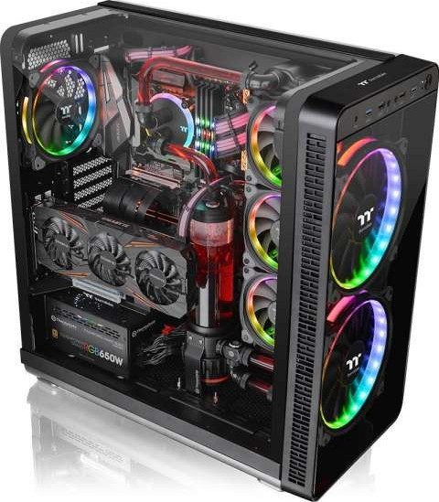
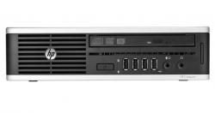
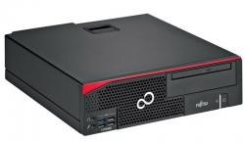
Computer Case

Slide 4
Motherboard
The motherboard ensures trouble-free operation of the computer.
All other computer components are connected to the motherboard.Some components must be connected to the motherboard with cables.
The system board is usually screwed to the computer base.
It includes various slots, sockets, etc., which are then used to connect other components, such as RAM, processor, add-on cards (graphics, sound), hard drives, etc.

Slide 5
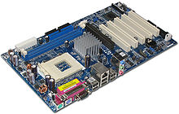
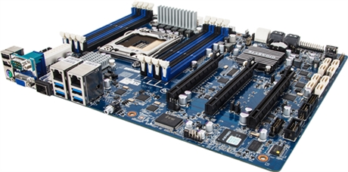
Motherboard

Slide 6
Port
Using ports, we connect peripheral devices to the computer used for data input or output.
In a computer case, they are usually located at the back (most often they are part of the motherboard).

Slide 7
Port
Parallel port - as a parallel port we refer to a port called LPT, or LPT1, LPT2, which is used to connect a printer or scanner.
Parallel ports are characterized by the transmission of multiple bits at once, i.e. the serial ports should be slower.
Nowadays, parallel ports are no longer widely used.
Serial port - A serial port is a port called COM, or COM1, COM2, etc., which is used to connect devices that support serial data transmission, i.e., bit-by-bit transmission.
Due to serial transmission, this transmission is more reliable than parallel transmission.
Serial ports include the USB port in all its versions.

Slide 8
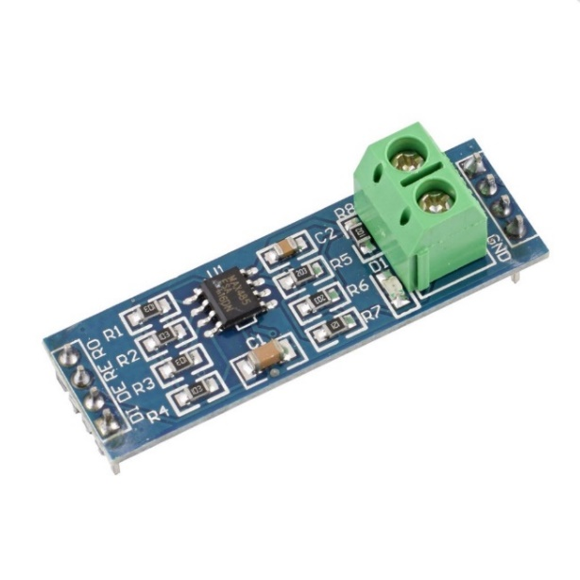
Bus
It is a system of a large number of wires.
We use these wires to send control instructions, addresses, and data between all the components in the computer.
All computer components are connected to the microprocessor via a bus.

Slide 9
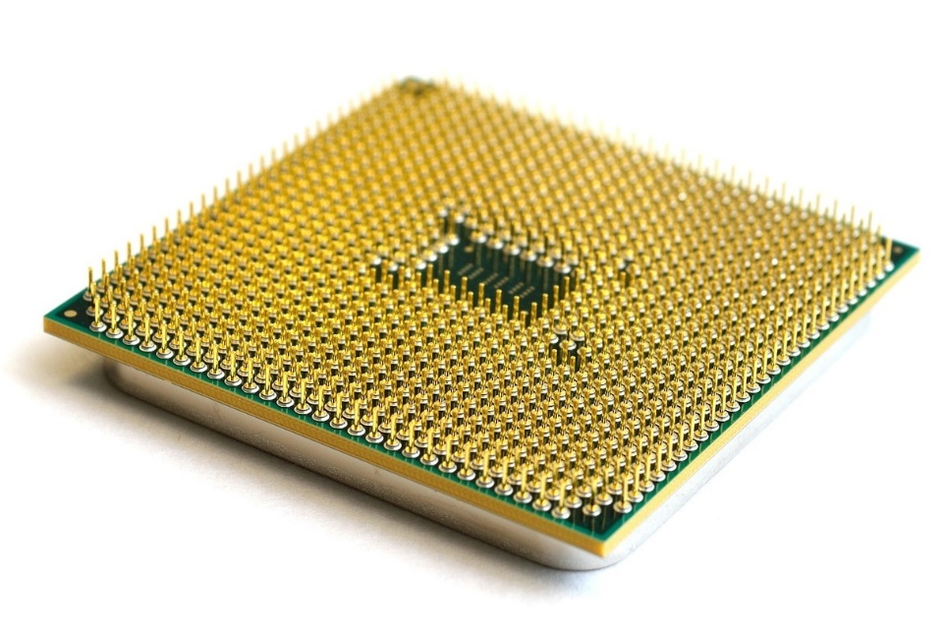
Central Processing Unit (CPU)
The processor is located on the motherboard and controls everything that happens on the computer.
Once launched, the application is converted to machine code.
It is this code that the processor executes using machine instructions that are stored in RAM.

Slide 10
Operation Memory
It is a RAM memory that allows reading and writing.
Applications and data that are being processed by the computer at some point also need to be temporarily stored somewhere.
This temporary storage is mediated by RAM.
Operational memory is used, for example, by the John Von Neumann architecture, which has a single memory for all instructions and data, or the Harvard architecture, which features two separate memories for data and instructions.

Slide 11
HDD - Hard Disk
A hard disk drive, often referred to as a hard disk drive (HDD), is an important storage medium on which data is stored that is retained even after the computer is disconnected from a power source (unlike RAM).
The operating system, programs, and data that we want to store on the computer are usually installed on at least one hard drive in the computer.
When buying a hard drive, we mainly look at its capacity (hundreds of MB or TB drives).
We should also focus on data transfer rate and revolutions per minute and the size of the buffer (cash).
The transfer of data between the hard disk and the bus is accelerated by the cache memory.
Today, there are several types of disks available, the best known of which are mechanical, SSD or hybrid.

Slide 12
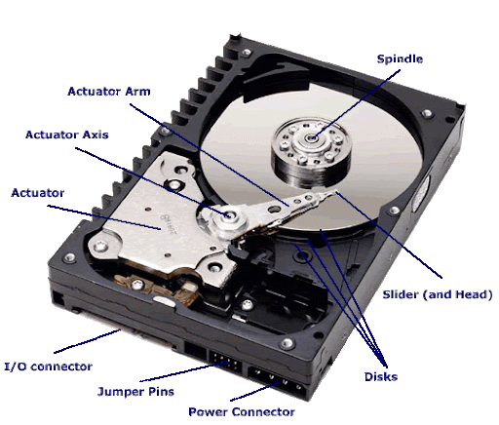
HDD - Hard Disk

Slide 13
Monitor
A device used to display data from a computer.
It connects (usually) from the back of the cabinet using a VGA, DVI or HDMI connector.
In most cases, it is an output device - it is not possible to enter data into the computer via the monitor (except for touch monitors).
This functionality is used more in the case of a tablet or smartphone equipped with a touch screen, with which we can transfer data to a computer (which is also a tablet or smartphone).
In this case, the monitor or display could be referred to as an I / O device.

Slide 14
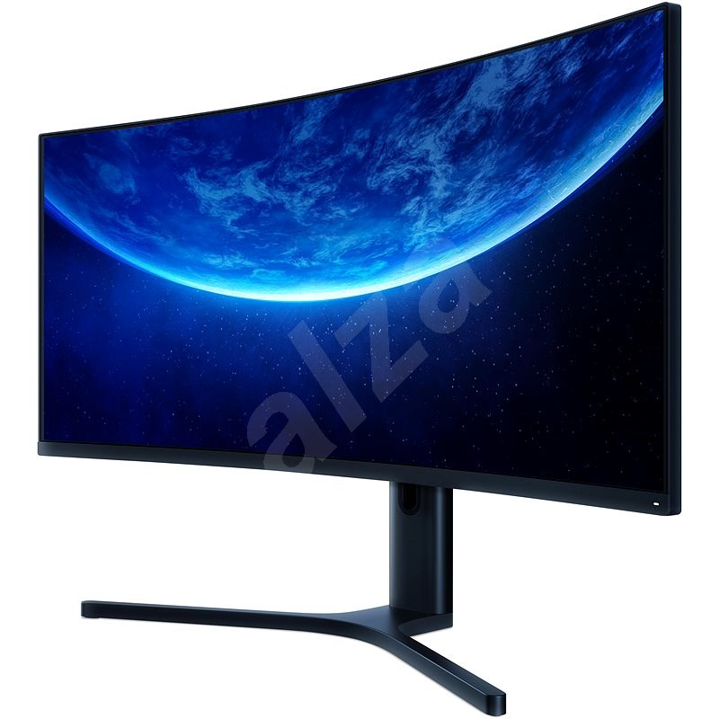
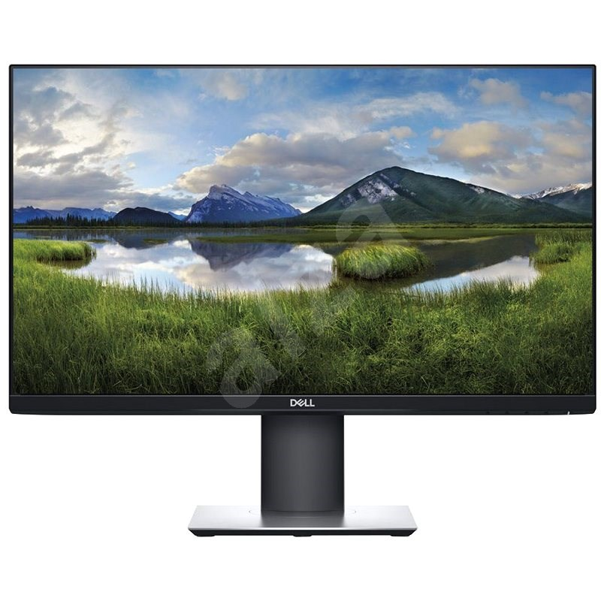
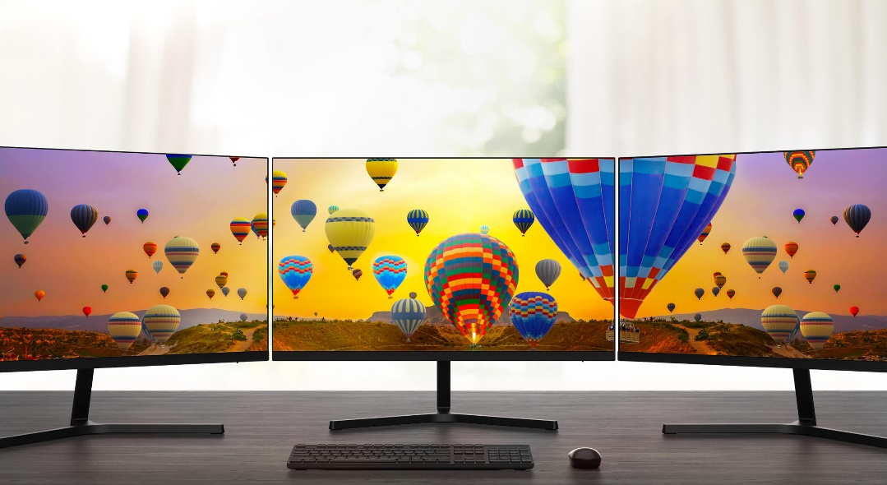
Monitor

Slide 15
Keybord
A keyboard is an input device that we use to enter data into a computer.
It is therefore an input device.
After pressing a certain key, its code is sent to the computer, which is further processed (translated into a command or alphanumeric character).
We usually connect the keyboard to the computer via the USB port or we can use wireless communication via bluetooth.

Slide 16
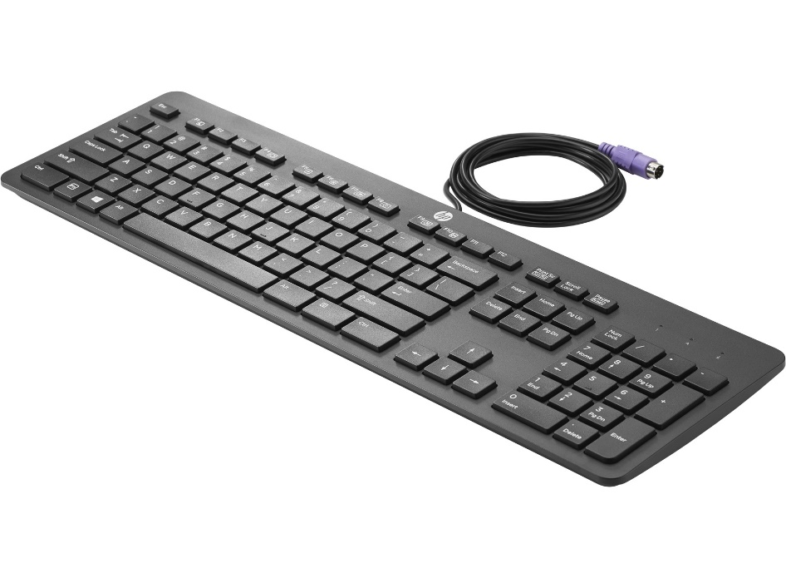
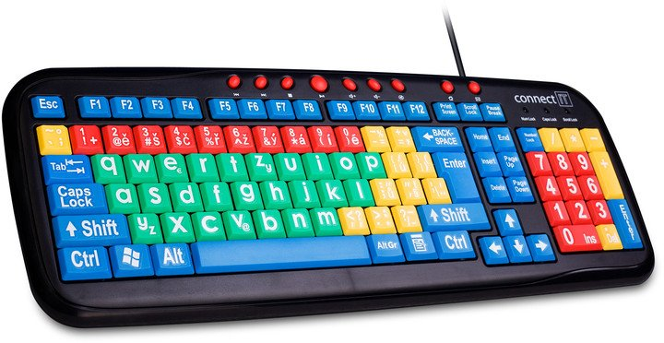
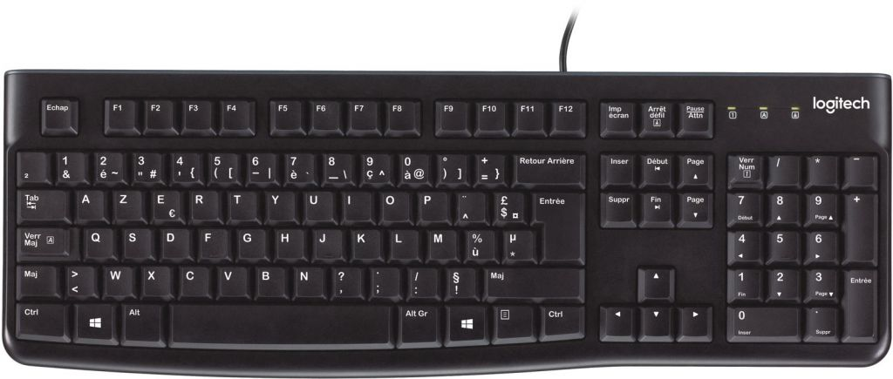
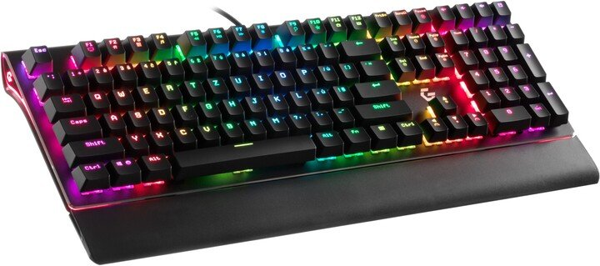
Keybord

Slide 17
Computer Mouse
On the monitor desktop, use the mouse to control the cursor, which can be used to control various computer functions.
The mouse sends data to the computer corresponding to the vertical and horizontal coordinates of the cursor position on the screen and data about pressing one of the buttons.
After evaluating the coordinates and pressing the button, the utility program performs the specified actions.

Slide 18
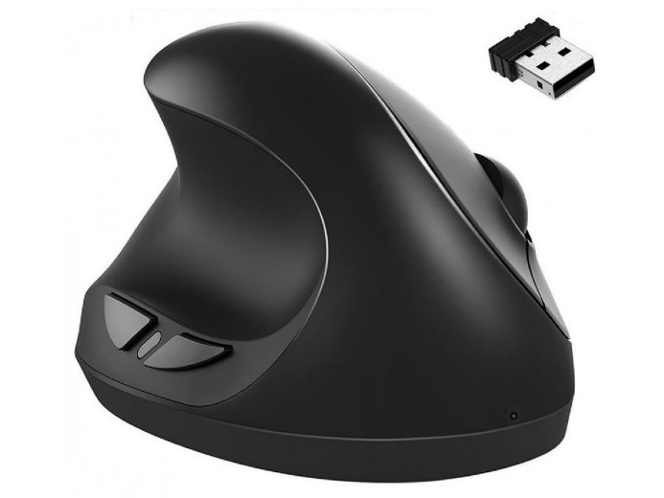
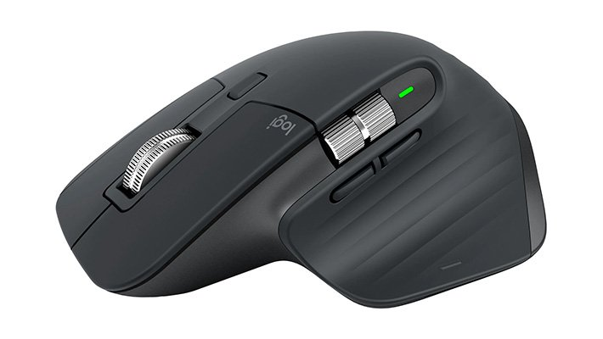
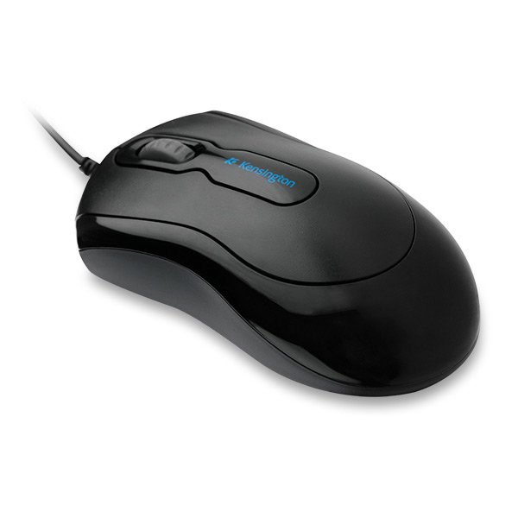
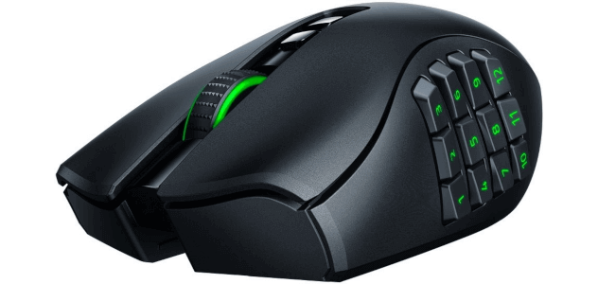
Computer Mouse

Slide 19
      Thank you for your attention

