Slide 1
Basic principles of computer operation
Lecturer: Lukáš Pavlík, Ph.D.
Winter semester 2021/2022
E-mail: lukas.pavlik@mvso.cz

Slide 2
Computer Architecture
To clarify the principles of computer operation, we will use the term computer architecture and introduce its two basic variants.
Computer architecture indicates a specific way in which a computer is implemented, i.e. what components the computer is made of and how these components are interconnected to form a functional unit - the computer.
The most well-known types are considered to be two basic computer architectures:
Von Neumann's architecture
Harvard architecture
In the next parts of the presentation we will look at their basic features and differences.

Slide 3
Von Neumann's architecture
Von Neumann's computer architecture contains several basic components. They are:
Controller,
arithmetic-logic unit (ALU),
(internal) memory,
input and output devices,
external memory,
Our functional requirements.

Slide 4
Von Neumann's architecture
We communicate our requirements for the function of the computer (determining what the computer should perform, including entering input data) to the computer using input devices (keyboard, mouse, previously also punched tape, etc.).
The computer communicates its processed outputs (results of operations, window with image, etc.) by means of output devices, which can be, for example, a monitor, a printer, a sound card, etc.).
Simply put, an ALU (Arithmetic Logic Unit), which is often integrated directly with the controller directly in the processor, evaluates, processes, performs arithmetic operations (addition, multiplication, subtraction and division) and sends the output to the output device.

Slide 5
Von Neumann's architecture
The term controller describes its function: the controller sorts the instructions processed by the processor sequentially as they are executed (using priorities and other dependencies).
The function of the computer is therefore only sequential - the instructions are executed one after the other.
All parts of the computer are connected (for mutual communication) via a bus.
For this (not only) architecture, we distinguish three parts of the bus:
address - the width of this bus is the maximum range of memory that can be addressed. It is used for addressing (address forwarding) when communicating with the internal memory and other devices.

Slide 6
Von Neumann's architecture
data - this bus is used to transfer data between individual components and devices.
control - transmits control signals, such as interrupt signal, interrupt acceptance, read / write mode determination, etc.
The term bus width refers to the number of wires over which signals can be transmitted (simultaneously).
The operating memory of this architecture is used both for storing the program and for storing data.
This results in the same way of reading / writing and addressing program instructions and data.

Slide 7
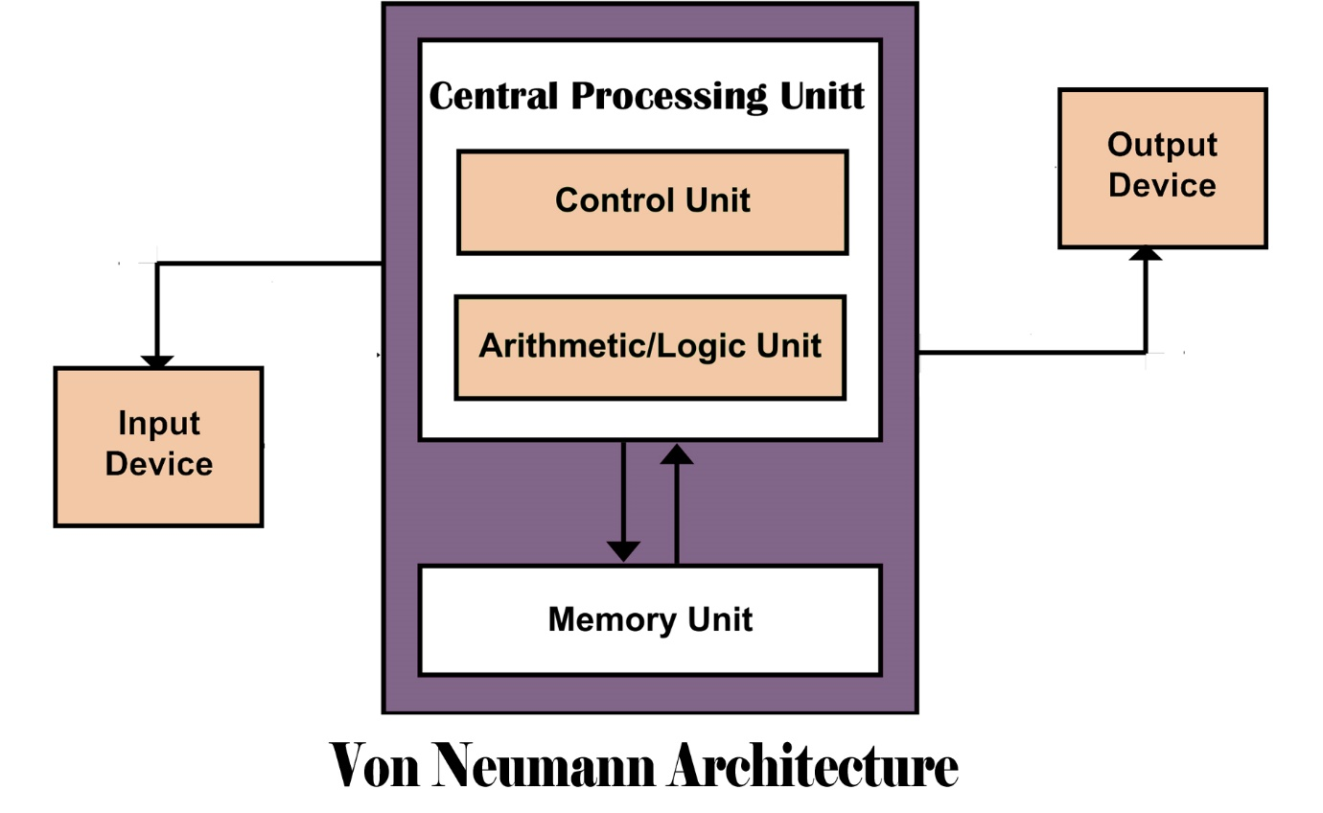
Von Neumann's architecture

Slide 8
Von Neumann's architecture
Von Neumann's architecture is used in most common devices - desktops, laptops, mobile phones, tablets, etc., regardless of the software (operating system).
The main difference with the Harvard architecture described below is access to memory - memory is one type and common to both data and instructions, which means that both data and instructions are treated in the same way and sequentially.
You cannot read both data and instructions.
If we use more physical memories (forming one unit of operational memory) in a computer based on Von Neumann architecture, then these memories must be of the same type in terms of bus width and other properties (does not apply to memory capacity, it may differ).

Slide 9
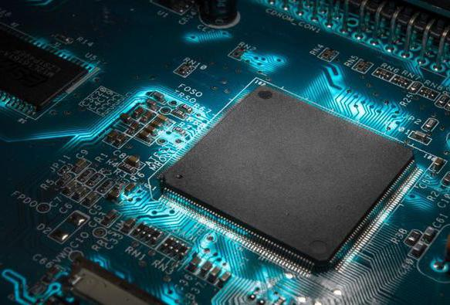
Harvard architecture
The Harvard architecture is made up of the same components as the Von Neumann architecture, except for RAM.
This architecture is divided into:
data memory
memory for instructions (program)

Slide 10
Harvard architecture
This arrangement has advantages and disadvantages.
The advantage is, for example, the possibility of parallel (simultaneous) reading and processing of program instructions and data, which is in some cases an accelerating factor.
On the other hand, it is necessary to ensure the management of two memories, which is more demanding in terms of overall process control (processor performance is then drawn by this control).
Also in terms of application programming, their development is more demanding than with Von Neumann architecture (the programmer must take into account the different ways of addressing both memories, secure synchronization of instructions and data, etc.).
With this architecture, both memories can be completely different - they can work with a different type of addressing, with different bus widths, etc.

Slide 11
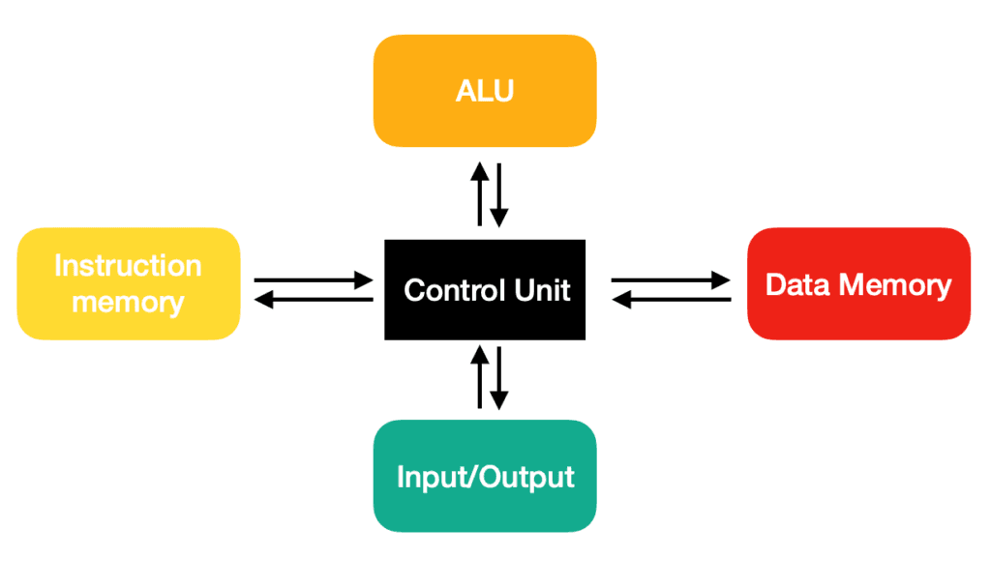
Harvard architecture

Slide 12
Hardware and Software
From the above it is clear that the computer requires for its function both physical devices (according to the architecture), i.e. hardware (HW), and software (program - sequence of executed instructions, or data) - SW.
The software includes, for example, operating systems (Windows, Linux, Android, iOS, Mac OS), application programs (e.g. Microsoft Word, Internet browser, databases, data management tools, etc.).
Software is nothing more than a series of instructions through which we are able to connect to a computer and control, for example, computer hardware and perform various tasks.

Slide 13
Hardware and Software
The hardware category includes all physical (technical) devices of the computer - motherboard, sound / graphics card, RAM memory, printer, monitor, mouse, display, etc.
The computer would not be functional and usable without the appropriate software, and vice versa, the software would have nothing to run on without the hardware.

Slide 14
Peopleware
Peopleware indicates the importance and role of the human factor in the company's information system and technical equipment.
This issue is included in the structure of IS because information technology is operated by people (programmers, but also administrators and users), and therefore this component is considered the third part, related to IS.
Anyone involved in the design and use of computer systems is referred to as peopleware.

Slide 15
Orgware
In the case of the term orgware, these are rules and regulations that are defined for the use, operation and operation of the IS.
This also includes recommended working procedures, regulations and obligations.
Specific rules for the use, operation and operation of IS are contained in the information strategy of the organization.

Slide 16
      Thank you for your attention

