Slide 1
The importance of abstraction, representation and interpretation of information
Lecturer: Lukáš Pavlík, Ph.D.
Winter semester 2021/2022
E-mail: lukas.pavlik@mvso.cz

Slide 2
The Goal of Course and Conditions of Exam
Credit:
at least 80 % participation in exercises
submission of seminar work (until December 20, 2021)
presentation of seminar work (20. 12 - 23 .12.)
Passing the exam:
passing at least 65 % of the written test (January - February 2021)

Slide 3
Abstraction
It is a deliberate hiding of information that is not important at the time and for the recipient.
For example, a normal car user can drive a car well without knowing how the engine works inside, how many cylinders the engine has, or what type of microprocessor the injection pump control unit is equipped with.
This information is not important to the driving itself and can remain hidden from the driver without compromising his ability to drive.

Slide 4
Abstraction
Another example could be a description of the route.
It is possible to explain to a friend who does not know your street that you live in the last house on the left - but to understand him, you do not have to describe every house that stands on your street.
Abstractions have their levels, which we call the level of abstraction.
This is actually the depth of information that we present or hide - depending on the specific situation.

Slide 5
Abstraction
If we stick to computer science, then the user can control the computer without knowing what is inside the computer.
Another level of abstraction is necessary for the person who assembles the computer – he or she must already know that inside the computer there is a motherboard, microprocessor, memory, power supply, graphics card, etc.
However, he does not have to understand how the individual components on the graphics card or the motherboard work together.

Slide 6
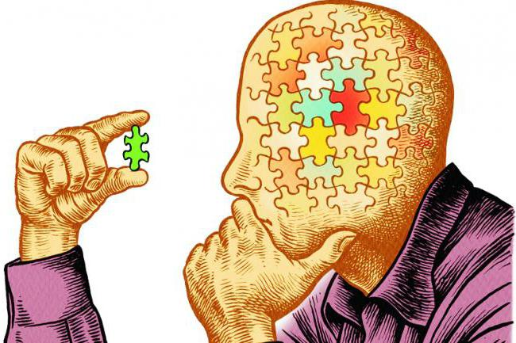
Abstraction
An even deeper level of abstraction would be used by a person who, for example, designs graphics cards.
He or she must already understand how the individual components of the graphics card work down to the signal level.
They do not have to, but understand how the components actually work together at the deepest level (in the case of a microprocessor, for example, the individual transistors that make it up).
However, the designer of these components must understand them.

Slide 7
Abstraction in Computer Science
Informatics consists of four cornerstones, one of which is abstraction.
Abstraction is a technique in this field for managing the complexity of computer systems.
At the level of complexity created by abstraction, man eliminates details below the current level that are complicated, while interacting with the system.
Abstraction is related to control or data
Control abstraction is the abstraction of actions, involving the use of subprograms and related control flow concepts.
Data abstraction is a data structure, allowing data bits to be manipulated in a meaningful way.

Slide 8
Information
This is a term that is currently used more than often.
But could we define it?
What does the term information actually mean?
Let's try to give an example.
For example, if we accidentally hear the word "fenêtre" in a conversation and we do not speak French, is this information?

Slide 9
Information
Intuitively, we can answer that most likely not.
The word has no meaning for us, it does not inform us of anything, it does not bring us any knowledge.
However, if this word is communicated to us in a French lesson with an explanation of its meaning (in our case, translation into Czech), then it will be information.
Why?
Because in this context, the term has some meaning for us.

Slide 10

Information
From the above we can try to define the term information:
Information is a stimulus, a stimulus that has some significance for its recipient in a certain context or context.

Slide 11
Representation of Information
The term information representation refers to the way in which data is stored, processed and transmitted on a computer.
All data that the computer handles must be represented in binary form, in layman's terms "using zeros and ones".
Data can take various forms:
letters,
numbers, etc. (1, 2, a, b, A…),
fixed or dynamic images,
sound, etc.

Slide 12
Representation of Information
The most used number systems used in computer science are:
binary system,
octal system,
hexadecimal system,
Examples of these systems are given in the following table:

Slide 13
Representation of Information
Number in Decimal | Binary Equivalent | Octal Equivalent | Hexadecimal Equivalent
0 | 0 | 0 | 0
1 | 1 | 1 | 1
2 | 10 | 2 | 2
3 | 11 | 3 | 3
4 | 100 | 4 | 4
5 | 101 | 5 | 5
6 | 110 | 6 | 6
7 | 11 | 7 | 7
8 | 1000 | 10 | 8
9 | 1001 | 11 | 9
10 | 1010 | 12 | A
11 | 1011 | 13 | B
12 | 1100 | 14 | C
13 | 1101 | 15 | D
14 | 1110 | 16 | E
15 | 1111 | 17 | F

Slide 14
Representation of Information
Interpretation can be understood as the opposite of representation.
How to understand it?
Data, as a sequence of some characters, has no value.
The recipient of the information assigns them their interpretation.
At the deepest level of abstraction, i.e. within the hardware, the data is represented in the form of signals.
The signals can be interpreted, for example, in the form of graphs, displaying the course of signals on an oscilloscope or in the form of activities or meaningful outputs from a computer.
Signals can be represented by 0 or 1.

Slide 15
Representation of Information
The basic and at the same time the smallest unit of information is the bit.
A digit in binary form can have only one value, 1 or 0.
Values 1 and 0 can also be represented as True or False, on / off, etc.
In the international system of units, the bit is not formulated.
The IEC 60027 specifies that a bit is to be referred to as a character for digits in binary format.
Bits are used to encode information.
If we could use only 1 bit, we would encode only 2 characters.

Slide 16
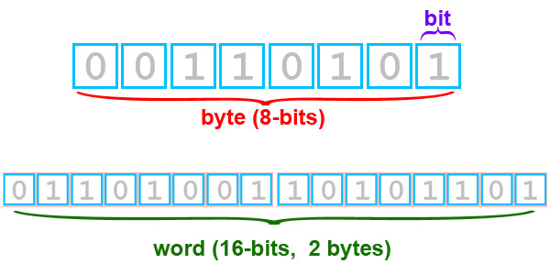
Representation of Information
Example: A = 1, B = 0, then 0011 = BBAA.
If we used bits 2, then we would encode 4 characters.
In order to encode the alphabet as a whole + digits + a certain space, 256 combinations are needed, i.e. 28.
The grouping of eight "zeros and ones" is called 1 Byte or octet.

Slide 17
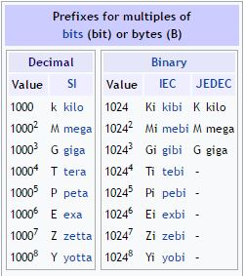
Representation of Information
Due to the ever-improving technologies and the associated higher volumes of processed data, the data takes up more and more space on the computer.
Due to this fact, so-called multiple units are used, as shown in the following table:

Slide 18
Representation of Information
At the time when the computer processes the data, it works with the least number of bits, the so-called word.
In the concept of computer architecture, word size is a significant value.
We divide the word into two half-words.
The word size is usually determined by 16, 32 or 64 bits on current computers.
The last term in this area is the so-called nibble. 1 nibble is 4 bits.
We can formulate it as half a byte.
It follows from the above that 1 Byte is thus formed by 2 nibbly.

Slide 19
Data
Quite simply, the data describe some part of the real world around us in a form suitable for computer processing.
It can be text, image, sound, etc.
We can determine two basic types of data:
1) Unstructured
Today, a virtually endless flow of data without a fixed sorting or schema.
If you look at this character set 78555146darr62dasss2gtg2ggg222, you can define that you are viewing unstructured data.
You need some specific tool, software, that will convert it into some meaningful form.

Slide 20
Data
2) Structured
These data already have some order.
An example is Mr. Novak, who wants to become a beekeeper.
He decides to look for contacts with some beekeeper-experts.
Enter a query within one of the company catalogs.
What he does not know yet is that a catalog as a type of information system has a database in it, i.e. a set of some data in a certain structure.

Slide 21
Data
The big phenomenon is the so-called big data or big data.
This is the amount of data that cannot be processed by traditional methods and it is necessary to use specialized tools.
An example is Hadoop.
Their usability extends to many fields.
For example, transport systems are a source of data on traffic and traffic convoys and can help operators optimize the use of individual roads.
In addition to this trend, in cities, for example, a centralized organization for the collection of sorted waste is being addressed.

Slide 22
Knowledge
If we can use the information in practice, it is already knowledge.
These are, of course, gained through experience.
The example of Mr. Novak shows two different approaches to knowledge.
The moment the system returns a list of beekeepers and sees their phone numbers, he knows how to use those phone numbers (he simply takes the phone and dials it).
He doesn't even think about how the number is used, he does it automatically.
This can be called knowledge.

Slide 23
      Thank you for your attention

