Slide 1
Welcome to the Czech Republic
Ing. Zuzana Repaská, Ph.D.

Slide 2
Basic Information about the Czech Republic
The Czech Republic is a landlocked country in the middle of Europe. Rather than as a country in the middle of Europe, we should speak of the Czech Republic as a country in the heart of Europe

Slide 3
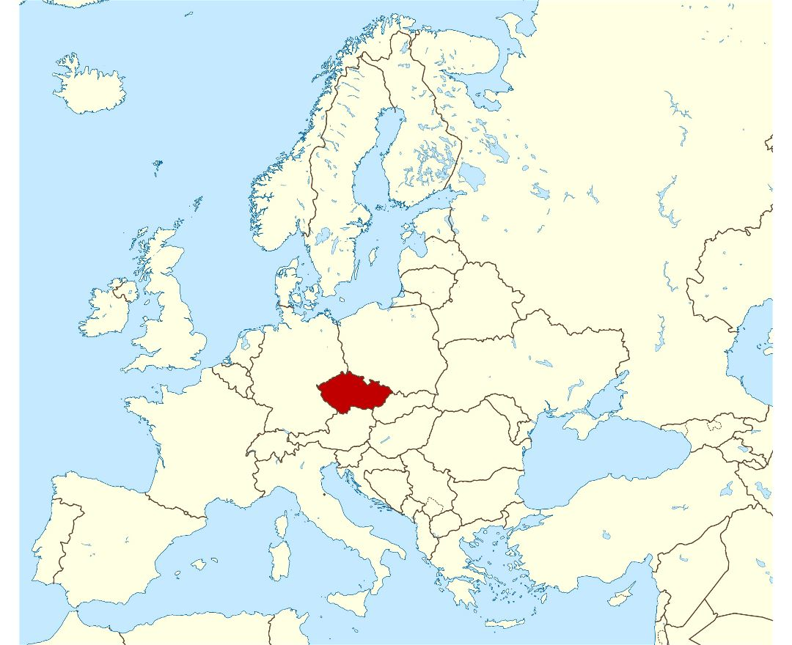
Czech Republic – heart of Europe
Who are direct neighbours of the Czech Republic?

Slide 4
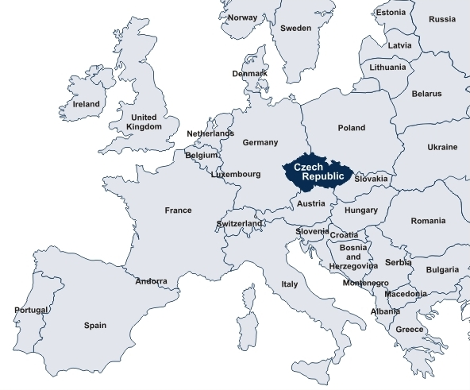
States in Europe

Slide 5
Facts and figures
Language:
Czech
Area:
78,866 sq km
Borders with:
Germany, Poland, Slovakia, Austria
Population:
10,4 million
Political system:
parliamentary republic
EU member state:
since 2004
Currency:
Czech crown / CZK
Capital:
Praha (Prague)

Slide 6
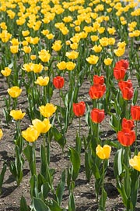
Climate: seasonal variations
Czech Republic lies in the temperate climate zone, which is characterized by mild, humid summers with occasional hot spells, and cold, cloudy and humid winters.
Czech Republic's climate is comparable to that of southern inland Canada.
Czech weather can never be predicted with certainty

Slide 7
Climate: seasonal variations
Spring
Spring begins on the 21st of March. Many people consider spring and summer the most beautiful seasons of the year and that is why they usually fall in love in spring. Nature begins to awake from its long winter sleep and new life starts. Nights get shorter and days get longer.

Slide 8
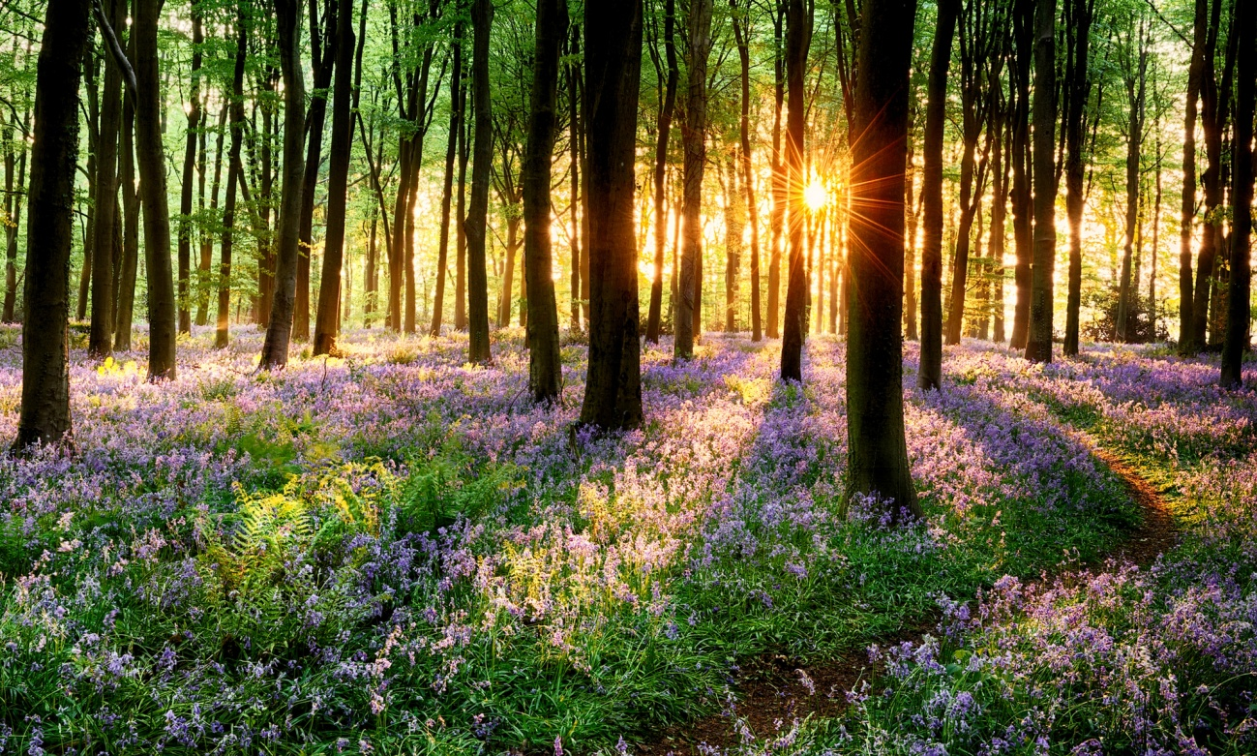
Climate: seasonal variations
Spring
There is more sunshine, and it is warmer and warmer. The weather in spring, especially in April, is really unpredictable and changeable.

Slide 9
Climate: seasonal variations
Summer
June 21st is the date when summer begins. School children love this season the most because they have two months of holidays. Everybody starts to be more interested in the weather because people set off on journeys and take holidays. In the summer, rain often comes in the form of a storm. It is dangerous to stand under a tree during a storm because the lightning might hit it.

Slide 10
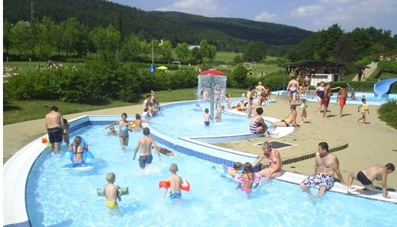
Climate: seasonal variations
Summer
Summer is also the time of strawberries, bilberries, raspberries, blackberries and cranberries, and the harvest of corn.

Slide 11
Climate: seasonal variations
Autumn
on the 23rd of September, autumn comes. The nice weather stops although we can still enjoy a few fine days of Indian summer. Many people go picking mushrooms. This colorful period does not last long because soon the trees shed their leaves and by November they are bare. In autumn, the weather is unsettled, the sky is often cloudy, and the mornings are dull and it looks like rain. People refer to the weather as awful, wretched, or nasty..

Slide 12
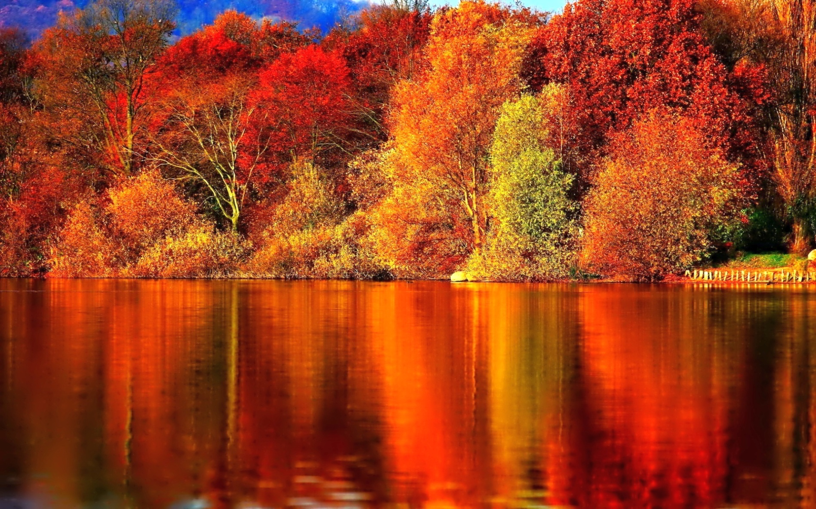
Autumn

Slide 13
Climate: seasonal variations
Winter
winter comes on December 21st, but in fact it often begins earlier. Typical winter weather brings snowfall, icy wind, and hard frosts. We can enjoy skiing in the mountains and the hills which are covered with a thick layer of fluffy snow and we admire the winter scenery.
The roads become icy and slippery and it makes driving hazardous because you can skid easily.

Slide 14
Area
The Czech Republic is historically divided into three regions: Bohemia, Moravia, and a part of Silesia. The total area is 78,866 square kilometers and the country’s population is around 10, 4 million people.
The capital city is Prague, with 1,2 million inhabitants, and there are 5 other metropolitan cities with a population exceeding 100,000: Brno, Plzeň, Olomouc, Ostrava, and Liberec.

Slide 15
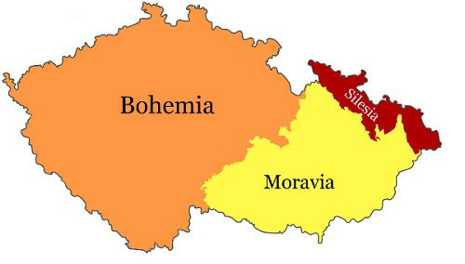

Slide 16
5 other metropolitan cities with a population exceeding 100,000

Slide 17
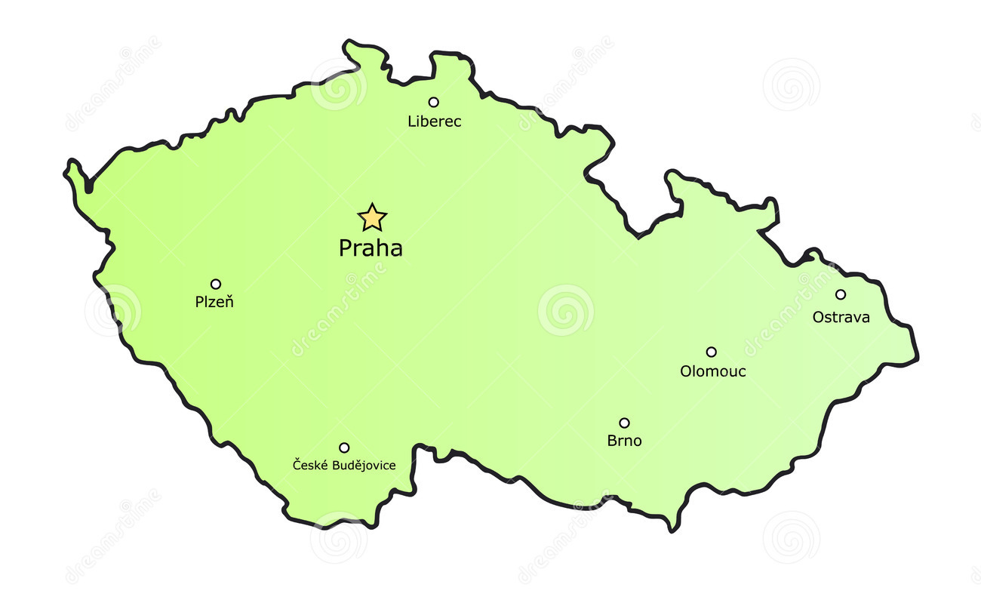

Slide 18
Pilsner beer
Pilsner (also pilsener or simply pils) is a type of pale lager which accounts for more than two-thirds of the beer produced in the world. It takes its name from Plzeň, a city in Bohemia, then in the Austrian Empire, now in the Czech Republic, where it was first produced in 1842. The world’s first blond lager, the original Pilsner Urquell, is still produced there today.

Slide 19
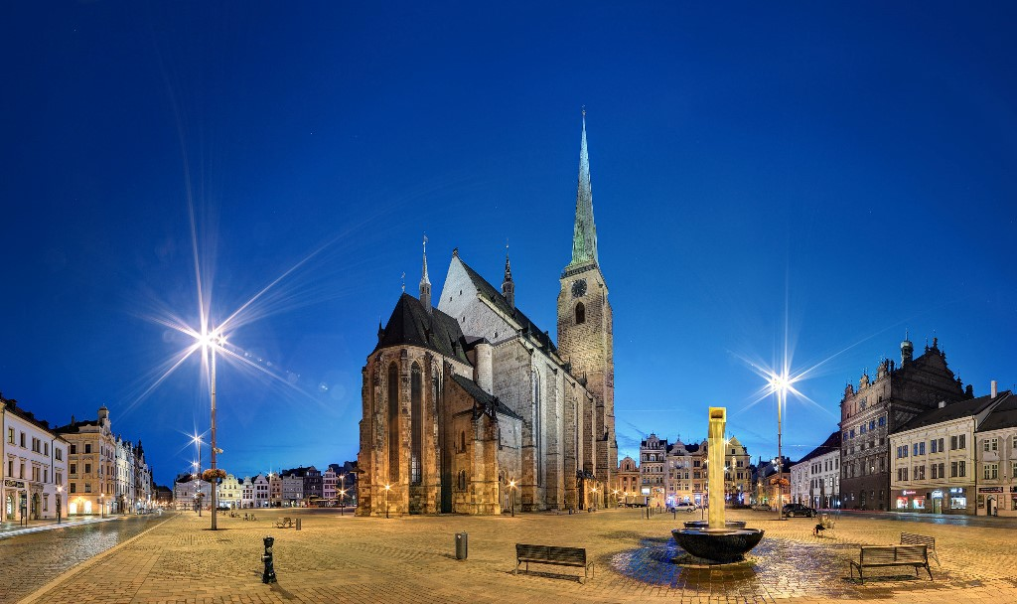
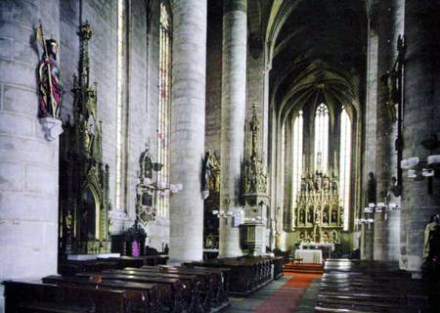
St. Bartholomew's Cathedral
With a height of 102.6 metres, it is the tallest church tower in the Czech Republic.

Slide 20
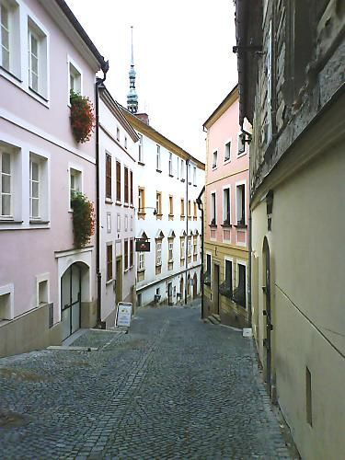
Olomouc
The charming and beautiful city of Olomouc lies beside the Morava River in central Moravia. With around 100,000 inhabitants, it's the fifth largest city in the Czech Republic and certainly one of the most beautiful.
The centre is the largest historic preservation zone outside Prague, and its cobblestoned streets are lined with majestic cathedrals and grand palaces.
Despite its fascinating history and great beauty, you won't find the crowds of tourists that are so common in more famous destinations.

Slide 21
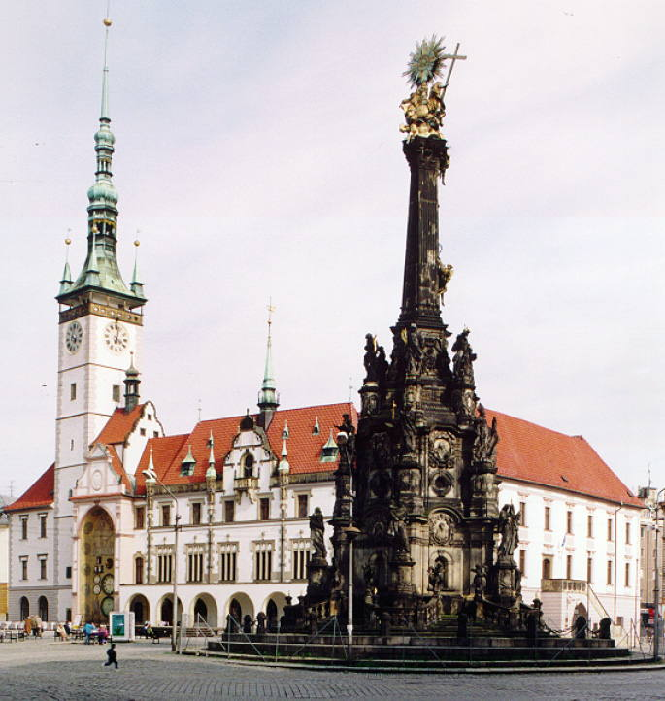
Olomouc
In 2000, the Holy Trinity Column, which was erected in the early 18th century, was added as a UNESCO World Heritage site.

Slide 22
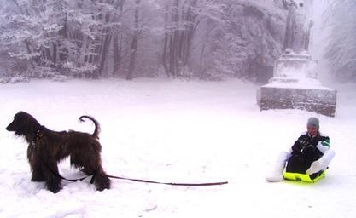
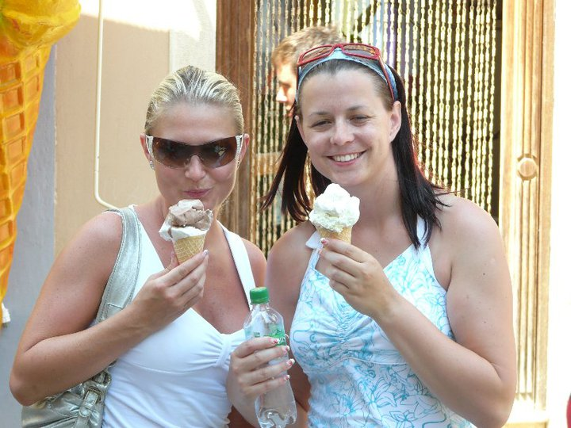
What season is it?

Slide 23
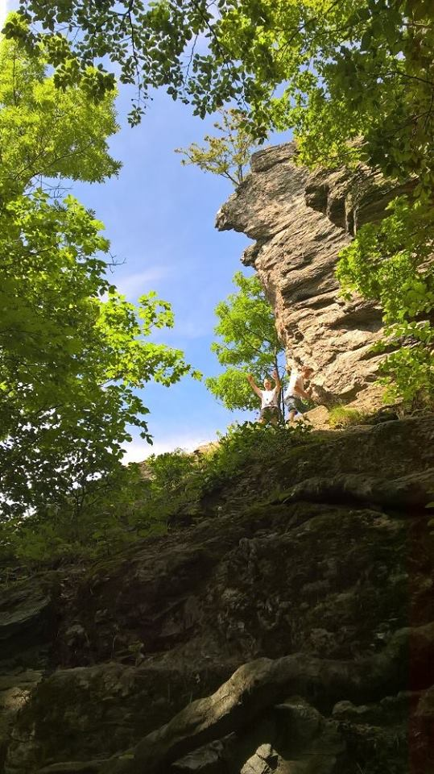
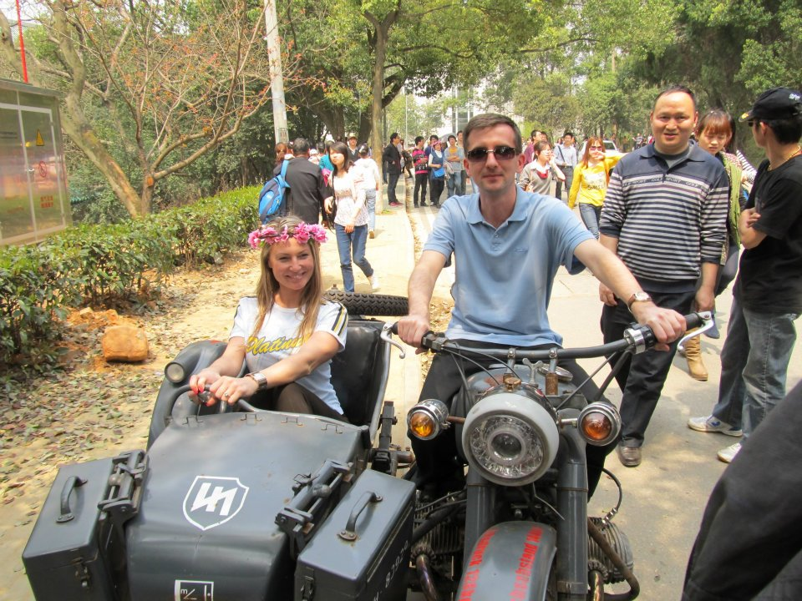

Slide 24
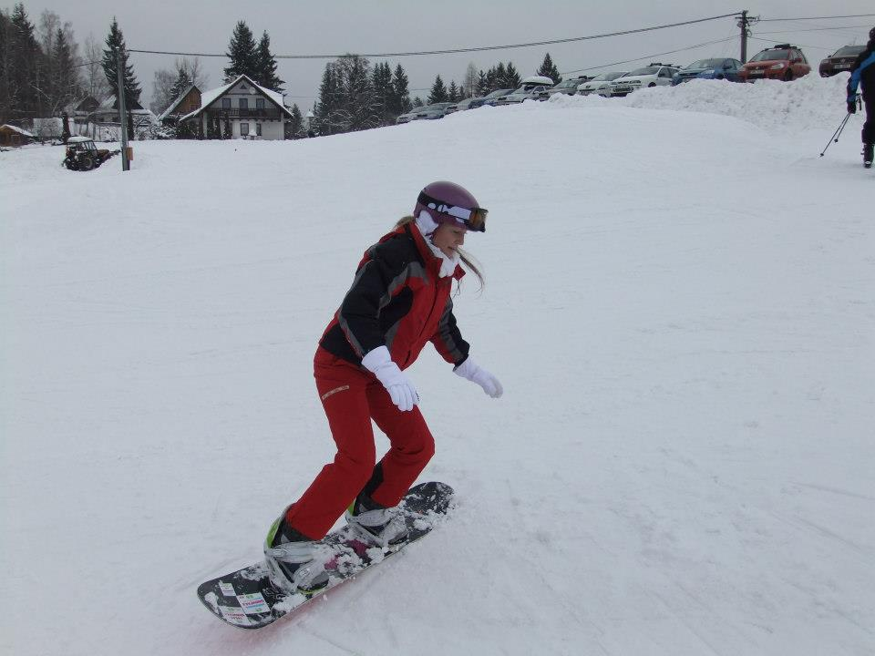
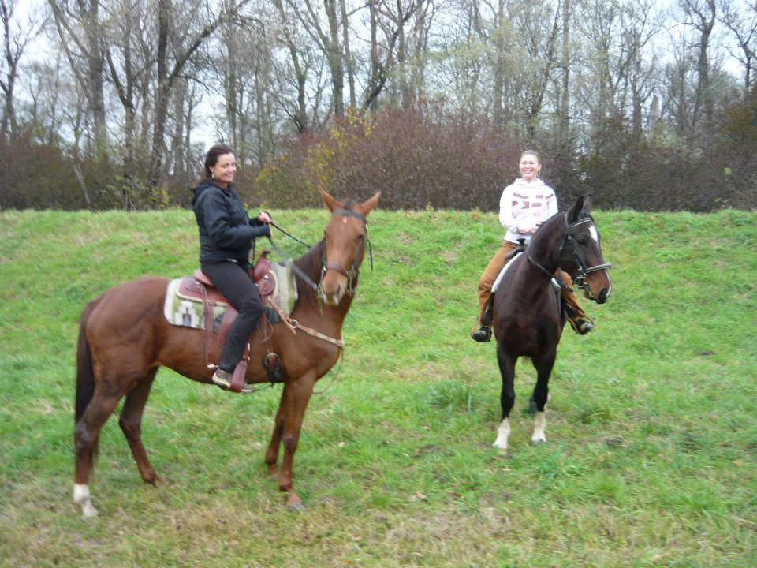

Slide 25
System of Government
The Czech Republic is a parliamentary democracy. Every citizen over the age of 18 has the right to vote. The supreme legislative body is the Parliament, which consists of the
House of Deputies,
the lower house of the legislature, and
the Senate, which is the upper house. The supreme executive body is the government.
The prime minister heads the government and is appointed by the president of the republic. The president also appoints other cabinet members based on the prime minister's recommendations.

Slide 26
President
The highest executive authority is the president, who is the formal head of state and was elected jointly by both houses of parliament for a term of five years.
In 2013 president was for the first time elected directly by people.
The first direct presidential election in the Czech Republic was held on 11–12 January 2013.
Nine individuals secured enough popular signatures or support of parliamentarians to become official candidates for the office. Miloš Zeman and Karel Schwarzenberg qualified for the second round of the election.

Slide 27
List of Presidents of the Czech Republic
This is a list of Presidents of the Czech Republic, a political office that was created in 1993 following the dissolution of Czechoslovakia.
The first President of the Czech Republic was Václav Havel.
The only living former President of the Czech Republic is Václav Klaus.
The current President is Miloš Zeman, in office since 8 March 2013.

Slide 28
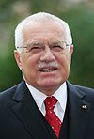
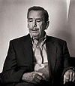
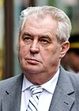
Who are they?

Slide 29
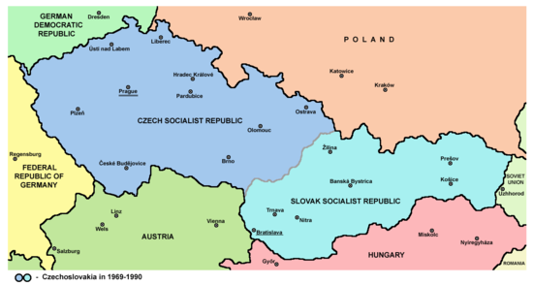
Czechoslovakia
In 1917, a meeting took place in Pittsburgh, Pennsylvania, USA, where the future Czechoslovak president Tomáš Garrigue Masaryk and other Czech and Slovak representatives signed the Pittsburgh Agreement which promised a common state consisting of two equal nations, Slovaks and Czechs.

Slide 30
Velvet revolution
The Velvet Revolution or Gentle Revolution was a non-violent transition of power in what was then Czechoslovakia. Popular demonstrations against the one-party government of the Communist Party of Czechoslovakia combined students and older dissidents.
The result was the end of 41 years of one-party rule in Czechoslovakia, and the subsequent dismantling of the planned economy and conversion to a parliamentary republic.

Slide 31
Dissolution of Czechoslovakia
The Dissolution of Czechoslovakia which took effect on 1 January 1993, was an event that saw the self-determined split of the federal state of Czechoslovakia into
the Czech Republic and Slovakia,
In a September 1992 poll, only 37% of Slovaks and 36% of Czechs favoured dissolution.
The separation occurred without violence.
It is sometimes known as the Velvet Divorce, a reference to the bloodless Velvet Revolution of 1989 that led to the end of the rule of the Communist Party of Czechoslovakia and the formation of a democratic government.

Slide 32
Human Rights
The Czech Republic respects equal rights for all its citizens. Human and civil rights including freedom of speech and the freedom of the press are guaranteed by the Constitution.
Many organizations have been established to promote, protect and monitor abuse of human rights within the Czech Republic, including the Czech Helsinki Committee and the Czech office of Amnesty International.

Slide 33
Religion
The Czech Republic is a secular state and every citizen enjoys freedom of religion. The number of people practicing religion is low. More than 50% of the population describe themselves as agnostic or atheist while in northern Bohemia the proportion rises to about three quarters of the population.
The main reasons for this are the suppression of the reformation movement followed by forcible mass re-catholicization (after 1627), and forty years of the official suppression of religion during the communist period (1948 – 1989).

Slide 34
Religion
Atheist/Agnostic
59%,
Roman Catholic
27%,
Protestant
2%,
Other
12%

Slide 35
Czech people
Divorce is a popular pastime of Czechs – more than half of the spouses are expected to get divorced, which makes Czech Republic no. 3 in the world rankings.
On a brighter note, Czechs are uncontested world champions in several disciplines such as:
beer-drinking (annually 159 liters per capita, approx 42 gallons),
ice hockey (in 1996, hat-trick in 1999-2001, and lastly in 2005) or even such obscure things as
football on bicycles – cyclo-ball – in which the Pospisil brothers earned 20 gold medals.

Slide 36
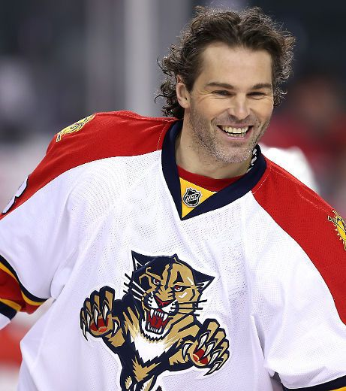
WHO IS HE?

Slide 37
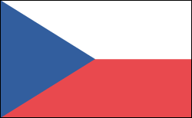
The Czech flag
What colours are on the Czech flag?
White
Blue
Red

Slide 38
Czech Etiquette and Customs
Meeting and Greeting
Most greetings include a handshake, direct eye contact, and the appropriate greeting for the time of day.
Wait to be invited before using someone's first name or an informal greeting, as these are all signs of friendship.
The offer to move to the informal is generally offered by the woman, the older person, or the person of higher status.

Slide 39
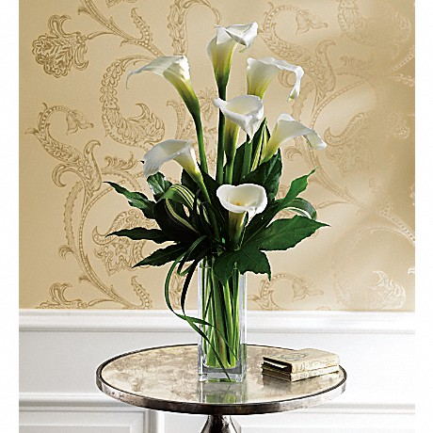
Czech Etiquette and Customs
Giving and Accepting Gifts
If you are invited to dinner, bring a box of good quality chocolates, or flowers to the hostess or a bottle of wine or good brandy to the host.
If you give flowers, give an odd number, but not 13, which is considered unlucky.
Do not give calla lilies as they are used at funerals.
Gifts are usually opened when received.

Slide 40
Czech Etiquette and Customs
Dining Etiquette
If you are visiting a Czech's house:
Arrive on time.
Remove your shoes..
Expect to be treated with great honour and respect.
Dress modestly and well.
Do not discuss business. Czechs separate their business and personal lives.
Table manners are rather formal in Czech Republic.
Remain standing until invited to sit down. You may be shown to a particular seat.
Do not begin eating until the hostess starts.
The oldest woman or honoured guest is generally served first.
Compliment the meal while you are eating. This allows the hostess to discuss the food and the preparation.
Indicate you have finished eating by laying your knife and fork parallel across the right side of your plate.

Slide 41
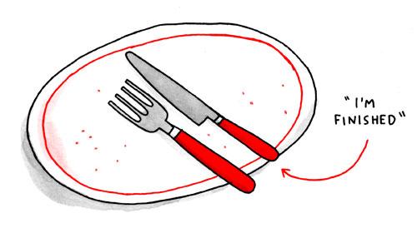
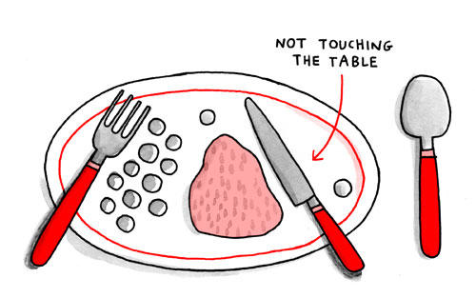
Czech Etiquette and Customs

Slide 42
Till 1989 it was a communist country
Its economy is the second most stabile from the group of post-communist countries
The most important branch is industry and services (60 %).
Agriculture share is less than 5 %, while in Poland it is 14 percent

Slide 43
Structure of economy according to contribution to creation of GDP
Agriculture – 1,8 %
Industry – 39,6 %
Services – 58,6 %

Slide 44
Export and import
What do we export?
Machinery
Cars

Slide 45
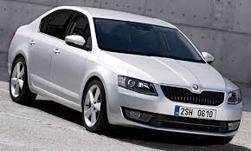
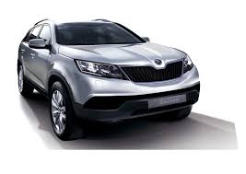
What cars do we export?
Škoda

Slide 46
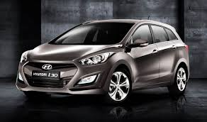
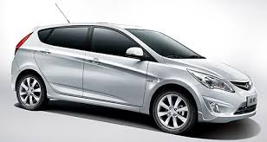
What cars do we export?
Hyundai

Slide 47
What cars do we export?
Factory TPCA
Citroen
Peugeot
Toyota

Slide 48
The biggest business partners according to total turnover
Germany
Slovak Republic
China
Poland
France
Italy
Austria
Russia
Great Britain
Nederland

Slide 49
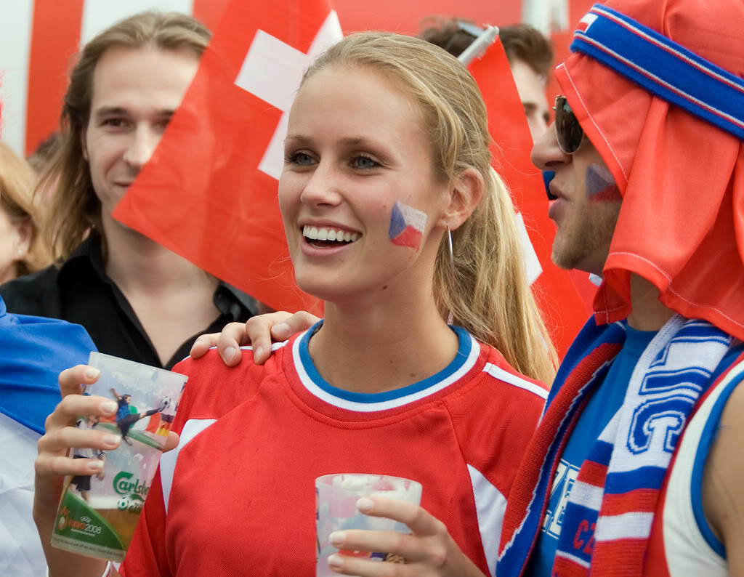
Enjoy staying in the Czech Republic

