Slide 1


Economic Integration

Slide 2

OVERVIEW
The Hierarchy of Economic Integration
A Progressive Architecture
Economic integration is the systematic joining of commercial and financial activities among nations through the abolition of nation-based economic institutions and the reduction of barriers to trade.
Nations progressively surrender elements of SOVEREIGN AUTONOMY in exchange for heightened ECONOMIC EFFICIENCY, increased market scale, and enhanced geopolitical leverage.
The hierarchy of integration is classified into additive levels, each building upon the previous stage and requiring increasingly complex shared institutions and higher levels of political will — from
Preferential Trade Agreements at the foundation
to Economic & Monetary Union at the apex.
Notes:
The contemporary global economy is defined by a sophisticated architecture of regional trade agreements that represent varying degrees of institutional and economic convergence. Economic integration refers to the systematic joining of commercial and financial activities among nations through the abolition of nation-based economic institutions and the reduction of barriers to trade. This phenomenon is not merely an exercise in lowering tariffs; it is a profound transformative process wherein nation-states progressively surrender elements of their sovereign autonomy in exchange for the promise of heightened economic efficiency, increased market scale, and enhanced geopolitical leverage.
The hierarchy of economic integration is typically classified into additive levels, each building upon the previous stage and requiring increasingly complex shared institutions and higher levels of political will.

Slide 3




Levels of Integration at a Glance
STAGES
Preferential Trade Agreement
Free Trade Area
Selective tariff reductions on specific goods. A diplomatic entry point to test broader liberalization. Minimal policy harmonization.
Internal tariffs and quotas removed for nearly all goods. Members maintain independent external trade policies. Requires "rules of origin."
Common / Single Market
Free movement of goods, services, capital, and labor. Technical, legal, and fiscal barriers are dismantled through harmonization and mutual recognition.
Customs Union
Adds a Common External Tariff (CET). Members surrender individual trade-negotiating powers and adopt a unified stance toward non-members.
Notes:
At the foundation of this hierarchy resides the Preferential Trade Agreement (PTA), characterized by selective tariff reductions on specific goods, often serving as a diplomatic entry point for nations to test the feasibility of broader liberalization.
As commitments deepen, nations advance to Free Trade Areas (FTAs), where internal tariffs and quotas are removed for nearly all goods while member states maintain independent external trade policies toward non-members. This independence necessitates the implementation of "rules of origin" to prevent trade deflection, wherein goods enter the bloc through the country with the lowest tariff.
The transition to a Customs Union (CU) signifies a qualitative shift, as members adopt a Common External Tariff (CET), necessitating a unified trade stance and the surrendering of individual trade-negotiating powers.
Deeper integration manifests in the Common Market, which adds the free movement of factors of production—labor and capital—to the features of a customs union. The Single Market, often synonymous with the internal market, represents the pinnacle of this journey, seeking the total removal of technical, legal, and fiscal barriers to ensure that the movement of resources across borders is as seamless as movement within a single nation. Beyond this lies the Economic Union, involving the harmonization of monetary and fiscal policies, often culminating in a shared currency and a central bank.

Slide 4

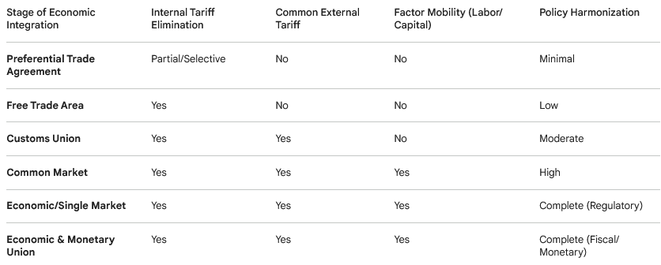
The Comprehensive Framework of Economic Integration: Levels of Integration Comparison
Notes:
At the foundation of this hierarchy resides the Preferential Trade Agreement (PTA), characterized by selective tariff reductions on specific goods, often serving as a diplomatic entry point for nations to test the feasibility of broader liberalization. As commitments deepen, nations advance to Free Trade Areas (FTAs), where internal tariffs and quotas are removed for nearly all goods while member states maintain independent external trade policies toward non-members. This independence necessitates the implementation of "rules of origin" to prevent trade deflection, wherein goods enter the bloc through the country with the lowest tariff. The transition to a Customs Union (CU) signifies a qualitative shift, as members adopt a Common External Tariff (CET), necessitating a unified trade stance and the surrendering of individual trade-negotiating powers.
Deeper integration manifests in the Common Market, which adds the free movement of factors of production—labor and capital—to the features of a customs union. The Single Market, often synonymous with the internal market, represents the pinnacle of this journey, seeking the total removal of technical, legal, and fiscal barriers to ensure that the movement of resources across borders is as seamless as movement within a single nation. Beyond this lies the Economic Union, involving the harmonization of monetary and fiscal policies, often culminating in a shared currency and a central bank.

Slide 5
THEORY
The Theoretical Underpinnings of Trade Integration: The Vinerian Paradigm
The economic rationale for regional integration – fundamentally rooted in the concepts of comparative advantage and economies of scale.
But: the welfare effects of forming a trade bloc – not universally positive, a nuance first articulated by Jacob Viner (1950): "The Customs Union Issue".
Feature | Trade Creation | Trade Diversion
Shift in Production | From high-cost domestic to low-cost partner | From low-cost non-member to high-cost partner
Efficiency Impact | Improves global resource allocation | Distorts global trade patterns
Welfare Outcome | Generally positive for consumers and nation | Potentially negative; dampens overall welfare
Price Effect | Decreases prices through efficiency | Prices may rise compared to world-market levels
Example | Germany car parts to France (EU) | Brazil shifting wheat from Canada to Argentina (MERCOSUR)
Viner’s analysis moved beyond the simplified view that any move toward free trade is beneficial,
introducing a microeconomic model to illustrate the potential distortions inflicted on global trade dynamics by bilateral rather than unilateral tariff reductions.
Notes:
The Theoretical Underpinnings of Trade Integration: The Vinerian Paradigm
The economic rationale for regional integration is fundamentally rooted in the concepts of comparative advantage and economies of scale. However, the welfare effects of forming a trade bloc are not universally positive, a nuance first articulated by Jacob Viner in his seminal 1950 work, "The Customs Union Issue". Viner’s analysis moved beyond the simplified view that any move toward free trade is beneficial, introducing a microeconomic model to illustrate the potential distortions inflicted on global trade dynamics by bilateral rather than unilateral tariff reductions.
Trade Creation and Economic Efficiency
Trade creation occurs when the removal of trade barriers within a regional bloc leads a member country to replace its higher-cost domestic production with lower-cost imports from a more efficient partner within the union. This shift represents a genuine improvement in global resource allocation, as production gravitates toward firms with a legitimate comparative advantage. The resulting increase in bilateral trade generally produces a net economic gain characterized by lower consumer prices, increased product diversity, and higher overall welfare for the participating nations.
In the context of the European Union, a textbook example of trade creation involves the German automotive sector. If Germany, as an efficient producer, can export car components to France at a lower price than France could produce them domestically, the elimination of tariffs allows France to shift its resources to other sectors while consumers benefit from more affordable vehicles. This efficiency gain is characterized by a shift in consumption of an importable good from a high-cost domestic producer to a lower-cost external producer within the bloc.
Trade Diversion and Market Distortions
Conversely, trade diversion occurs when a member country shifts its source of imports from a lower-cost, more efficient producer outside the trade bloc to a higher-cost, less efficient producer within the bloc, simply because the latter now enjoys preferential tariff treatment. This phenomenon can lead to a net economic loss for the importing country and the global economy, as it distorts trade patterns away from globally efficient producers toward regional partners solely on the basis of price discrimination.
A prominent example of trade diversion is the historical case of the United Kingdom’s lamb imports. Before joining the European Economic Community (EEC), the UK imported lower-cost lamb from New Zealand. Following its entry into the EEC, the implementation of common tariffs on non-members made New Zealand lamb more expensive than higher-cost lamb produced within Europe, causing the UK to shift its source of supply and creating an efficiency loss. Viner’s theory posits that the desirability of a customs union decreases as the degree of complementarity between members increases, as complementarity often encourages the replacement of imports from third countries rather than the replacement of high-cost domestic production.

Slide 6

THEORY
The Vinerian Paradigm: Trade Creation vs. Trade Diversion
Jacob Viner's seminal 1950 work, The Customs Union Issue, established that regional trade blocs do not universally improve welfare — the net effect depends on the balance of CREATION and DIVERSION.
Trade Creation
Customs Union Formation
Trade Creation
Trade Diversion
A member replaces high-cost domestic production with lower-cost imports from an efficient partner. Example: France importing German car components after EU tariff removal — lower prices, better resource allocation.
Trade Diversion
Policy Implication
A member shifts from a low-cost non-member supplier to a higher-cost bloc partner due to preferential tariffs. Example: UK shifting lamb imports from New Zealand to Europe after joining the EEC — a net efficiency loss.
A customs union is more desirable when members are competitive rather than complementary, and when the CET is not raised so high as to divert large volumes of trade from efficient non-members.
Notes:
The Theoretical Underpinnings of Trade Integration: The Vinerian Paradigm
The economic rationale for regional integration is fundamentally rooted in the concepts of comparative advantage and economies of scale. However, the welfare effects of forming a trade bloc are not universally positive, a nuance first articulated by Jacob Viner in his seminal 1950 work, "The Customs Union Issue". Viner’s analysis moved beyond the simplified view that any move toward free trade is beneficial, introducing a microeconomic model to illustrate the potential distortions inflicted on global trade dynamics by bilateral rather than unilateral tariff reductions.
Trade Creation and Economic Efficiency
Trade creation occurs when the removal of trade barriers within a regional bloc leads a member country to replace its higher-cost domestic production with lower-cost imports from a more efficient partner within the union. This shift represents a genuine improvement in global resource allocation, as production gravitates toward firms with a legitimate comparative advantage. The resulting increase in bilateral trade generally produces a net economic gain characterized by lower consumer prices, increased product diversity, and higher overall welfare for the participating nations.
In the context of the European Union, a textbook example of trade creation involves the German automotive sector. If Germany, as an efficient producer, can export car components to France at a lower price than France could produce them domestically, the elimination of tariffs allows France to shift its resources to other sectors while consumers benefit from more affordable vehicles. This efficiency gain is characterized by a shift in consumption of an importable good from a high-cost domestic producer to a lower-cost external producer within the bloc.
Trade Diversion and Market Distortions
Conversely, trade diversion occurs when a member country shifts its source of imports from a lower-cost, more efficient producer outside the trade bloc to a higher-cost, less efficient producer within the bloc, simply because the latter now enjoys preferential tariff treatment. This phenomenon can lead to a net economic loss for the importing country and the global economy, as it distorts trade patterns away from globally efficient producers toward regional partners solely on the basis of price discrimination.
A prominent example of trade diversion is the historical case of the United Kingdom’s lamb imports. Before joining the European Economic Community (EEC), the UK imported lower-cost lamb from New Zealand. Following its entry into the EEC, the implementation of common tariffs on non-members made New Zealand lamb more expensive than higher-cost lamb produced within Europe, causing the UK to shift its source of supply and creating an efficiency loss. Viner’s theory posits that the desirability of a customs union decreases as the degree of complementarity between members increases, as complementarity often encourages the replacement of imports from third countries rather than the replacement of high-cost domestic production.

Slide 7
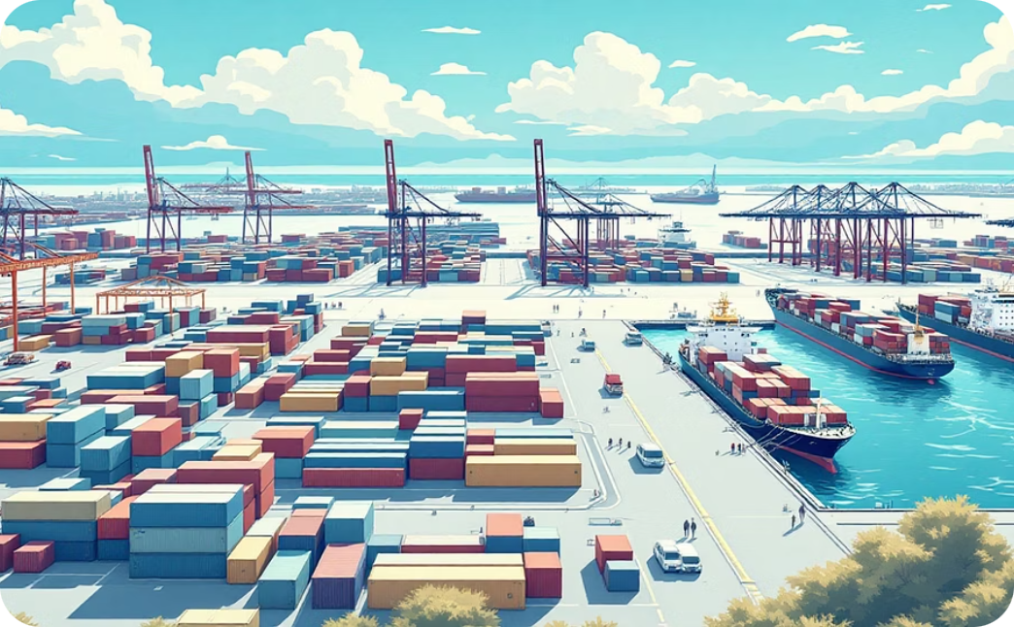
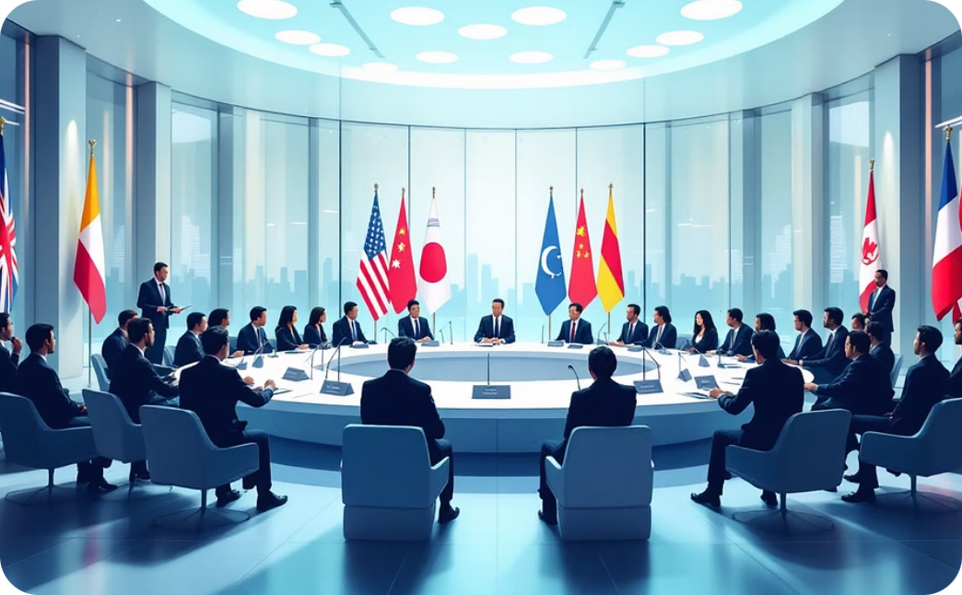

CUSTOMS UNION
Mechanics of the Customs Union
Common External Tariff
WTO & Sovereignty
Revenue Distribution
The CET ensures goods from outside the union attract the same duty at any point of entry. Once paid, goods enter "free circulation" and move throughout member states without further customs checks or rules-of-origin documentation.
Under GATT Article XXIV, customs unions are permitted if they cover "substantially all trade" and do not raise average tariffs for non-members. Members must negotiate as a unified bloc in global forums, surrendering individual trade-negotiating power.
In the EU, customs duties are treated as "own resources" for the EU budget. In SACU — the world's oldest customs union, founded in 1910 — complex revenue-sharing formulas distribute funds among Botswana, Lesotho, Namibia, and South Africa.
Notes:
The Mechanics and Challenges of the Customs Union
The transition from a Free Trade Area to a Customs Union represents a critical milestone in economic integration, moving from a system based on national autonomy to one requiring collective regional action. While an FTA eliminates internal tariffs, it allows each member to maintain its own external trade policy toward the rest of the world. This independence creates the risk of "trade deflection," where third-party exporters seek to enter the bloc through the country with the lowest external tariff to avoid higher duties elsewhere. To counter this, FTAs must implement complex "rules of origin," which require exporters to provide extensive documentation proving that a product was sufficiently manufactured within the bloc.
The Common External Tariff and Free Circulation
A Customs Union resolves the problem of trade deflection by implementing a Common External Tariff (CET), ensuring that goods imported from outside the union attract the same duty regardless of their point of entry. Once this common duty is paid at the external border, the goods enter into "free circulation" and can move throughout the member states without further customs checks, internal tariffs, or rules-of-origin documentation. This simplification significantly reduces the administrative burden on businesses and facilitates the fluidity of regional trade.
However, agreeing on a CET is a politically and economically complex endeavor. Member countries must harmonize their trade policies across thousands of import industries, a process that requires significant compromise and often forces a nation to abandon strategic trade relationships with third countries. The surrendering of trade policy autonomy means that members must negotiate as a unified bloc in global forums such as the World Trade Organization (WTO). Members of the WTO are permitted to establish customs unions under Article XXIV of the General Agreement on Tariffs and Trade (GATT), provided that the union covers "substantially all trade" and does not result in higher average tariffs for non-members than existed previously.
Revenue Distribution and Customs Cooperation
Beyond the tariff itself, a functioning customs union requires deep cooperation in customs administration and the apportionment of collected revenues. In the European Union, customs duties collected at external ports like Rotterdam or Antwerp are treated as "own resources" for the EU budget, rather than belonging to the specific country where the goods first landed. In other unions, such as the Southern African Customs Union (SACU)—the world’s oldest, founded in 1910—complex revenue-sharing formulas are used to distribute funds among members like Botswana, Lesotho, Namibia, and South Africa. The failure to implement a common customs code or a centralized revenue-sharing mechanism remains a significant barrier to the maturation of other blocs, such as MERCOSUR, where members still maintain individual customs borders and have struggled to ratify a unified code.
SACU (Southern African Customs Union)
Founded: 1910 (The world's oldest existing customs union).
Member States: South Africa, Botswana, Lesotho, Namibia, and Eswatini.
Key Features:
Free Trade: No customs duties on goods moving between member countries.
Common External Tariff: All members apply the same duties on imports from outside the union.
Revenue Sharing: All customs and excise duties are collected into a Common Revenue Pool and shared among members.
Economic Context: For smaller members (like Lesotho and Eswatini), SACU revenue often makes up a massive portion of their national budget.

Slide 8
COMMON MARKET
The Four Freedoms of the Common Market
Beyond the Customs Union
A Common Market extends integration to the free movement of factors of production — labor and capital — creating a regional economic space where firms and individuals operate with the same ease as within a single national territory.
01
02
Free Movement of Goods
Free Movement of Services
Elimination of internal tariffs, quotas, and border controls through harmonization and the mutual recognition principle established in the landmark 1979 Cassis de Dijon ECJ ruling.
Professionals and firms may provide services across borders or establish a permanent presence in another member state. Often the hardest freedom to implement due to deep-seated national regulations in finance, legal services, and energy.
03
04
Free Movement of Capital
Free Movement of Persons
Prohibits restrictions on capital movements between member states and with third countries. A vital prerequisite for the Economic and Monetary Union (EMU) and the introduction of the Euro.
Citizens may move and reside freely for employment. Includes mutual recognition of professional qualifications — though the most politically contentious freedom, raising concerns over "social dumping" and migration.
Notes:
The Common Market and the Four Freedoms of Movement
A Common Market represents a deeper tier of integration that encompasses all features of a customs union while extending the principle of free movement to the factors of production: labor and capital. The objective is to create a regional economic space where firms and individuals can operate with the same ease as they would within a single national territory. This is traditionally achieved through the guarantee of the "four fundamental freedoms": the free movement of goods, services, capital, and persons.
Free Movement of Persons and Labor
Perhaps the most socially and politically significant aspect of a common market is the free movement of labor. This freedom grants citizens of member states the right to move and reside freely within the union for the purpose of employment. This entails the abolition of discrimination based on nationality regarding employment, remuneration, and other conditions of work. It also includes the recognition of professional qualifications across the union, allowing a Danish architect to practice in Portugal or a French engineer to work in Italy without facing undue bureaucratic obstacles.
The implications of factor mobility are profound. From an economic perspective, allowing labor to move from regions of high unemployment to regions of high demand optimizes resource allocation and increases overall productivity. However, this freedom is often the most contentious to maintain, as it can lead to concerns about "social dumping"—where differences in wages and social security standards between member states are exploited to gain a competitive advantage—and can spark domestic political resistance to migration.
Free Movement of Services and Capital
The free movement of services allows professionals and firms to provide services across borders either through temporary cross-border activity or by establishing a permanent presence in another member state (freedom of establishment). This is often the most difficult freedom to implement due to the intangible nature of services and the deep-seated national regulations governing sectors like finance, legal services, and energy.
Complementing this is the free movement of capital, which prohibits restrictions on capital movements and payments between member states and between members and third countries. This liberalization reduces transaction costs for cross-border investments and allows investors to deploy capital where it can be most efficiently utilized. In the European context, the free movement of capital was a vital prerequisite for the development of the Economic and Monetary Union (EMU) and the eventual introduction of the Euro.

Slide 9
The Evolution of the Single Market: Overcoming Invisible Barriers
COMMON MARKET vs. SINGLE MARKET
🔹 Key distinction
The terms often used interchangeably, BUT:
➡️ Single Market (Internal Market) = more advanced stage of integration;
Common Market: removes tariffs + allows labour mobility
→ technical, legal, and fiscal barriers may still exist;
Single Market: aims to eliminate these barriers
→ through regulation, harmonization, and enforcement.
🔹 Types of barriers
Technical barriers
Different product standards, safety rules, packaging:
→ firms must adapt products (multiple versions)
Fiscal barriers
Differences in taxes (VAT, excise duties)
→ need for alignment to avoid distortions
Legal / Physical barriers
Border controls (Schengen)
National laws (e.g. recognition of qualifications, procurement rules)
➡️ Goal of the Single Market:
A fully integrated economy without hidden barriers
Notes:
The Evolution of the Single Market: Overcoming Invisible Barriers
While the terms "Common Market" and "Single Market" are often used interchangeably, the Single Market (or Internal Market) represents a more advanced and refined stage of integration. A common market may eliminate tariffs and allow labor mobility, but it can still be plagued by technical, legal, and fiscal barriers that prevent a truly integrated economy. A Single Market aims to eliminate these technical obstacles through a comprehensive set of regulations, enforcement mechanisms, and arbitration processes.
Technical, Legal, and Fiscal Barrier Removal
The creation of a single market requires the removal of three primary types of barriers:
Technical Barriers: These involve differences in national product regulations, safety standards, and packaging requirements. Without harmonization, a manufacturer might have to produce twenty-seven different versions of a lawnmower to meet the specific noise or safety rules of each member state.
Fiscal Barriers: These concern differences in national tax systems, particularly indirect taxes like VAT and excise duties. While total tax harmonization is rare, the single market seeks to align these systems sufficiently to prevent competitive distortions and the need for border tax adjustments.
Physical/Legal Barriers: Physical barriers refer to border controls, which were largely abolished in the EU through the Schengen Agreement. Legal barriers include national laws that obstruct enterprise, such as discriminatory procurement policies or the lack of mutual recognition for professional licenses.

Slide 10
Single Market: Removing Barriers – Harmonization vs. Mutual Recognition
🔹 Two main strategies
1. Harmonization (positive integration)
Creation of common EU rules replacing national standards;
Important in sensitive sectors (health, safety, environment):
→ e.g. pharmaceuticals, chemicals.
2. Mutual Recognition (Cassis de Dijon, 1979)
Product legal in one Member State → must be accepted in others:
Exception: mandatory requirements (e.g. public health, consumer protection)
➡️ allows integration without full harmonization
→ faster, more flexible.
🔹 Result of Mutual Recognition:
Market integration without the need for exhaustive, time-consuming: legislation for every single product
uniform market access;
diversity of products.
Governance Models
Intergovernmentalism → cooperation between states;
Supranationalism → powers transferred to EU institutions;
➡️ Level of integration depends on this choice.
Notes:
The Single Market utilizes two primary legislative strategies to overcome technical barriers. The first is Harmonization, the process of creating a single set of regional rules that replace divergent national standards. This "positive integration" is essential in sectors where health, safety, or environmental standards are paramount, such as pharmaceuticals or chemical regulation.
The second strategy is the Principle of Mutual Recognition, established by the European Court of Justice (ECJ) in the landmark 1979 Cassis de Dijon case. The court ruled that if a product is legally produced and marketed in one member state, it must be accepted in all others unless the importing state can justify a restriction based on "mandatory requirements" such as public health or consumer protection. Mutual recognition allows for market integration without the need for exhaustive, time-consuming legislation for every single product, fostering both uniformity in market access and diversity in consumer choice.
----------
Governance Models: Supranationalism versus Intergovernmentalism
The depth and success of economic integration are inextricably linked to the institutional framework governing the trade bloc. National governments must decide whether to cooperate through intergovernmental arrangements or to delegate authority to supranational institutions.

Slide 11
Governance Models: Supranationalism vs. Intergovernmentalism
Governance Models of Integration
Intergovernmentalism (sovereignty)
Decisions made by member states;
Usually CONSENSUS → veto possible.
➡️ Advantages:
States keep full control;
➡️ Disadvantages:
Slow decision-making / paralysis;
National interests dominate;
No strong supranational institutions:
disputes solved politically: “presidential diplomacy” (not binding arbitration):
→ inconsistent application of rules.
Example: MERCOSUR, ASEAN
Supranationalism (pooling sovereignty)
States delegate powers to common institutions:
→ European Commission, Court of Justice;
➡️ Key features:
Direct effect → EU law creates rights for individuals;
Qualified Majority Voting (QMV) → no single-state veto.
➡️ Result:
More efficient decision-making;
Stable and predictable system.
🔹 Key difference
Intergovernmentalism = control by states;
Supranationalism = shared authority → deeper integration.
Notes:
Intergovernmentalism: Sovereignty and Consensus
In an intergovernmental model, such as that employed by MERCOSUR or ASEAN, decision-making power remains entirely with the member states. Decisions are typically made by consensus during summits of national leaders, and any state can exercise a veto to block proposals. While this model allows nations to retain their sovereignty, it frequently leads to institutional paralysis, as regional goals are often sacrificed to domestic political interests. In MERCOSUR, the lack of a supranational court or commission means that disputes are often resolved through "presidential diplomacy" rather than binding arbitration, leading to inconsistent application of trade rules.
Supranationalism: Pooling Sovereignty
The European Union represents the world's most advanced supranational model. Member states have agreed to "pool" their sovereignty by delegating decision-making powers to independent bodies like the European Commission and the European Court of Justice. Supranational law has "direct effect," meaning it creates rights for individuals that national courts must uphold, even against their own governments. This institutional structure allows the EU to make decisions through "Qualified Majority Voting" (QMV) in many areas, preventing a single country from blocking progress on the single market. The autonomy of this legal order is the "Archimedean point" of European integration, providing the stability and predictability necessary for a unified market of 450 million consumers.

Slide 12

Regional Integration in Practice: MERCOSUR
CASE STUDIES
🔹 Goal
Founded in 1991;
Aim: common market in South America;
➡️ In reality: incomplete customs union.
🔹 Internal challenges
Economic asymmetries;
Weak supranational institutions;
Reliance on consensus (veto risk);
➡️ Slow progress / paralysis.
🔹 Trade limitations
Exceptions to Common External Tariff
Key sectors excluded (automotive, sugar)
→ strong national interests.
🔹 Political instability
Dependent on Brazil & Argentina
Shifts: integrationist vs protectionist governments
🔹 External pressures (2025)
China = main trade partner
→ trade: $180.9 bn (4× intra-MERCOSUR trade)
tensions inside bloc
→ e.g. Uruguay–China FTA attempt (breaks common policy)
EU–MERCOSUR agreement
→ opportunity for deeper integration
→ but faces environmental + industrial policy conflicts
🔹 Overall
➡️ Lack of supranational power + external pressures → limits deeper integration.
Notes:
Regional Integration in Practice: The MERCOSUR Experience
Founded in 1991 with the goal of creating a common market in South America, MERCOSUR (Southern Common Market) illustrates the challenges of integration among developing economies with significant structural asymmetries. While its founding documents envisioned an EU-style union, the bloc has struggled to move beyond a "fractious" and incomplete customs union.
Institutional Limitations and External Pressures
MERCOSUR’s progress has been hampered by a lack of supranational capacity and the persistence of national exceptions to its Common External Tariff. Major sectors like the automotive and sugar industries remain excluded from the union's trade rules, shielded by national interests. Furthermore, the bloc's reliance on intergovernmental consensus makes it highly susceptible to domestic political shifts in Brazil and Argentina. The recent alternation between integrationist and protectionist governments in these larger states has often resulted in regional paralysis.
Entering 2025, MERCOSUR faces additional pressure from the shifting landscape of global trade. China has become the bloc's largest export and import partner, with trade flows totaling $180.9 billion in 2025—four times the level of intra-bloc trade. This has led to internal tensions, such as Uruguay’s attempts to negotiate a bilateral free trade deal with Beijing, which would violate MERCOSUR’s requirement for a unified external trade policy. The ongoing attempt to finalize a trade agreement with the European Union is seen as a vital opportunity to revitalize the bloc's internal convergence, though it faces "headwinds" due to European concerns over environmental standards and MERCOSUR's demands for greater industrial policy space.

Slide 13
Regional Integration in Practice: MERCOSUR
CASE STUDIES
Challenge for MERCOSUR | Economic/Political Impact | Future Outlook (2025-2026)
Institutional Rigidity | Decisions require consensus; frequent paralysis | Ongoing pressure for governance reform
CET Exceptions | Cars and sugar sectors are not integrated | Efforts to reduce tariff barriers are slow
Trade Asymmetry | Intra-bloc trade is only 11.7% of total exports | Increasing dependence on Chinese markets
Legal Implementation | Directives must be ratified by national parliaments | Massive backlog of non-ratified legislation
Environmental Issues | Friction with EU over Amazon deforestation | Brazil pushing animal traceability for COP30
Notes:
The core members of MERCOSUR (Southern Common Market) are:
4 full members: Argentina, Brazil, Paraguay, Uruguay
1 suspended (Venezuela)
Several associates across South America:
Chile
Bolivia (in process of becoming a full member)
Peru
Colombia
Ecuador
Guyana
Suriname

Slide 14
CASE STUDIES
EU vs MERCOSUR: Comparative Framework of Economic Integration
🔹 Depth of Integration
EU: Advanced Single Market → removal of tariff and non-tariff barriers;
MERCOSUR: Fragmented Customs Union → persistent exemptions and asymmetries.
🔹 Institutional Structure
EU: Supranational governance
→ European Commission, Court of Justice, Qualified Majority Voting;
MERCOSUR: Intergovernmental model
→ consensus-based decision-making, absence of binding supranational authority.
🔹 Legal Order
EU: Autonomous legal system
→ direct effect, supremacy, uniform enforcement;
MERCOSUR: Weak legal integration
→ limited enforcement, reliance on diplomatic dispute resolution.
🔹 Market Functioning
EU:
→ harmonization + mutual recognition (Cassis framework);
→ high level of regulatory convergence.
MERCOSUR:
→ incomplete CET, sectoral exclusions
→ low regulatory coordination.

Slide 15
CASE STUDIES
EU vs MERCOSUR: Comparative Framework of Economic Integration
🔹 Political Economy Dimension
EU: Institutional insulation from short-term domestic politics;
MERCOSUR: High sensitivity to domestic political cycles (Brazil, Argentina).
🔹 External Pressures
EU: Coherent external trade policy;
MERCOSUR:
→ growing dependence on China:
→ internal tensions (e.g. bilateral FTA initiatives);
→ stalled EU agreement (environmental vs industrial policy conflicts).
🔹 Analytical Conclusion
➡️ EU = rule-based, supranational integration model;
➡️ MERCOSUR = state-driven, politically constrained integration with limited depth.

Slide 16
Regional Integration in Practice: GCC Model of Integration:
Structure and Challenges
CASE STUDIES
🔹 Specific model
6 high-income, oil-dependent economies: Bahrain, Kuwait, Oman, Qatar, Saudi Arabia, UAE;
Focus: diversification + digital transformation + infrastructure connectivity.
🔹 Resilience & diversification
Strong growth (2025): UAE ~4.8%, Saudi Arabia ~3.8%;
High factor mobility (national treatment across states).
➡️ “Vision” strategies:
Shift to non-oil sectors (logistics, tourism, finance);
Strong adoption of AI.
🔹 Trade strategy
Shift to "commercially-focused" diplomacy:
→ bilateral CEPAs (Asia, Africa, Europe):
flexible alignment with domestic priorities
→ support digital trade & green standards.
Notes:
The Gulf Cooperation Council offers a different model of integration, characterized by six high-income, oil-dependent economies—Bahrain, Kuwait, Oman, Qatar, Saudi Arabia, and the United Arab Emirates—seeking diversification through digital transformation and infrastructure connectivity.
Resilience and Strategic Diversification
As of late 2025, the GCC has demonstrated significant economic resilience, with growth projected to reach 4.8% in the UAE and 3.8% in Saudi Arabia. The bloc has achieved a high degree of factor mobility, granting citizens national treatment across member states in employment and investment. The current focus of the region is on "Vision" strategies that prioritize non-oil sectors, such as logistics, tourism, and financial services, supported by a rapid adoption of Artificial Intelligence (AI).
Trade dynamics in the GCC are evolving toward a "commercially-focused" diplomacy, with a rapid expansion of bilateral Comprehensive Economic Partnership Agreements (CEPAs) with partners in Asia, Africa, and Europe. These agreements allow members to align trade policy with domestic economic priorities while supporting deeper cooperation in fields like digital trade and green standards.

Slide 17
Regional Integration in Practice: GCC
CASE STUDIES
🔹 Monetary union limits
Project (single currency ) stalled (UAE, Oman withdrawal)
Structural issue: similar oil-based economies →
→ Synchronized cycles – with oil prices, not internal trade;
All GCC states: USD peg/ Kuwait: basket
→ stability BUT limited MONETARY AUTONOMY
➡️ Uneven fiscal capacity → potential currency risks (“peso problems”) →the risks of a currency crisis in countries with lower reserves.
🔹 Current direction
Shift from monetary union → pragmatic integration:
→ physical connectivity: GCC Railway;
→ regulatory alignment: unified tourist visa; → → →
Tangible economic gains without the sovereignty costs of a monetary union.
Notes:
The Monetary Union and Currency Pegs
The ambition for a full GCC Monetary Union has faced substantial hurdles. While the institutional architecture is in place, progress toward a single currency has stalled following the withdrawal of the UAE and Oman from the process. The primary challenge remains the structural similarity of the economies; because they are all major oil exporters, their business cycles are highly synchronized with global oil prices rather than internal trade.
Furthermore, all GCC states maintain a hard peg to the U.S. Dollar (with Kuwait using a basket peg), which has provided long-term macroeconomic stability but limits their ability to conduct independent monetary policy. The differing levels of financial buffers and the ability to tighten fiscal policy across the region have created "peso problems" and increased the risks of a currency crisis in countries with lower reserves.
In 2026, the focus of GCC integration has shifted toward physical connectivity, such as the GCC Railway project, and regulatory alignment, such as the proposed unified tourist visa, which offer tangible economic gains without the sovereignty costs of a monetary union.
The “peso problem” is a concept from economics/finance describing a situation where:
➡️ Market prices reflect a risk that hasn’t actually happened yet—but could happen.
🔹 Origin
Comes from the Mexican peso in the 1970s
Investors expected a possible devaluation of the peso
Even though it didn’t happen for a long time,
➡️ interest rates and exchange rates already reflected that risk
🔹 Core idea
➡️ People price in rare but possible events
So:
outcomes we observe ≠ all outcomes people expect
expectations include low-probability, high-impact events
🔹 Simple example
Country has stable currency today BUT markets fear possible crisis/devaluation
➡️ interest rates are higher than “normal”
Even if:
crisis never happens during observed period
🔹 In the GCC context
➡️ “peso problems” = markets fear currency instability in weaker GCC states
due to:
lower reserves
fiscal differences
fixed exchange rate (USD peg)
➡️ Result:
risk is priced in advance
even without an actual crisis
🔹 Key takeaway
➡️ Expectations include risks we may never actually observe
→ but they still influence prices and decisions
🔹 Relation: Peso Problem × Lucas (Rational Expectations)
The connection is through Robert Lucas and his theory of Rational Expectations.
🔹 1. Lucas: Rational Expectations
Lucas argues:
➡️ Economic agents use all available information
➡️ They form expectations about the future correctly on average
So:
people anticipate policy changes, risks, crises
markets are forward-looking, not naive
🔹 2. Peso Problem = empirical implication
The peso problem shows:
➡️ Markets include low-probability future events (e.g. devaluation, crisis)
Even if:
these events don’t happen in observed data
🔹 3. The link
👉 Peso problem actually supports Lucas
Because:
data may show “strange” outcomes (e.g. high interest rates) BUT under rational expectations:
➡️ agents are reacting to real perceived risks
➡️ not making systematic errors
🔹 Example connection
Econometrician sees: “Why are rates so high? No crisis happened.”
Lucas-style answer:
➡️ “Because agents expected a possible crisis.”
➡️ “You just didn’t observe it in your sample.”
🔹 Key insight
➡️ Observed data ≠ full expectation set
Rational expectations include:
rare events
unobserved risks
👉 Peso problem explains why data may look inconsistent
👉 Lucas explains why it is actually consistent with rational behavior
🔹 In one sentence
👉 The peso problem is an empirical manifestation of rational expectations, where agents price in low-probability events that may not be observed in the sample, consistent with Lucas’s framework.

Slide 18
Regional Integration in Practice
CASE STUDIES SUMMARY
MERCOSUR: An Incomplete Union
GCC: High-Income Diversification
EU: The Supranational Benchmark
Founded in 1991,
MERCOSUR illustrates the challenges of integration among developing economies.
Key sectors like automotive and sugar remain excluded from the CET.
China has become the bloc's largest partner at $180.9 billion in trade — four times the level of intra-bloc trade.
Intergovernmental consensus leads to frequent paralysis, and a massive backlog of non-ratified legislation persists.
The six GCC states — Bahrain, Kuwait, Oman, Qatar, Saudi Arabia, and the UAE — pursue integration through "Vision" strategies, targeting logistics, tourism, and AI-driven financial services.
Growth is projected at 4.8% in the UAE and 3.8% in Saudi Arabia.
A full monetary union has stalled after UAE and Oman withdrawal; all states maintain a hard peg to the U.S. Dollar.
Focus has shifted to the GCC Railway and a unified tourist visa.
The EU's 450-million-consumer single market demonstrates the power of supranational institutions.
Through the European Commission, the ECJ, and Qualified Majority Voting, EU law has "direct effect“,
it creates rights for individuals that national courts must uphold — the "Archimedean point" of European integration.
Notes:
The Gulf Cooperation Council = GCC

Slide 19
Future Frontiers: The Digital Single Market and Sustainability
:
CASE STUDIES
New Frontiers of Integration
🔹 Digital integration – EU:
Shift beyond goods → data, services, knowledge: Digital Single Market:
→ harmonized rules: e-commerce, data, services:
→ “Fifth freedom”: knowledge, innovation – Letta Report 2024;
GCC:
→ rapid AI integration, digital state + startups.
🔹 Green trade dimension
Sustainability = core condition of trade agreements
→ e.g. EU–MERCOSUR tensions → → →
➡️ Requirements:
Paris Agreement compliance;
deforestation-free supply chains.
→ risk: added complexity + regulatory alignment pressure.
🔹 Sovereignty vs integration
Integration = progressive delegation of sovereignty
FTA → Single Market:
from national control → supranational rules
➡️ Trade-off:
De jure sovereignty ↓
De facto influence ↑ (larger market power) in globalized world
🔹 Core tension
EFFICIENCY vs SOVEREIGNTY:
→ key political constraint (e.g. Brexit, EU debates).
Notes:
Future Frontiers: The Digital Single Market and Sustainability
As the global economy faces increasing geo-economic fragmentation, the nature of economic integration is evolving beyond the traditional focus on physical goods and tariffs. The next generation of trade agreements is increasingly centered on digital integration and environmental sustainability.
The Digital Single Market Initiative
The European Union has pioneered the "Digital Single Market," which aims to ensure that the four freedoms apply as effectively online as they do offline. This involves harmonizing rules for e-commerce, digital services, and data protection to allow businesses to scale across the union without navigating 27 different regulatory frameworks. Recent high-level reports, such as the 2024 Letta Report, have called for a "fifth freedom" focused on the free movement of knowledge and innovation to support the digital transition. Similarly, the GCC is aggressively pursuing digital transformation, integrating generative AI applications into government services and startup ecosystems.
The "Green" Trade Pillar
Environmental sustainability has become a "cornerstone" of modern trade negotiations. The controversy surrounding the EU-MERCOSUR agreement highlights how trade liberalization is now conditioned on commitments to the Paris Agreement and deforestation-free supply chains. While these provisions are intended to prevent a "race to the bottom" in environmental standards, they also introduce new complexities into the integration process, as members must align their domestic environmental and labor laws to maintain market access.
The Socio-Political Economy of Sovereignty and Integration
The defining characteristic of the journey from a free trade area to a single market is the progressive surrendering of national sovereignty. In a simple FTA, a nation retains the power to set its own taxes, labor laws, and external tariffs. By the time it reaches a single market, it has delegated the power to set product standards to a regional body, allowed foreign citizens to work in its public services, and accepted the jurisdiction of a supranational court.
This loss of "de jure" sovereignty—the legal right to be the ultimate authority in a territory—is often traded for "de facto" sovereignty—the actual ability to control economic outcomes in a globalized world. By pooling their resources, smaller nations can exert greater influence in international trade negotiations and create a larger, more attractive market for foreign investment. However, the tension between these two forms of sovereignty remains the primary source of political resistance to integration, as seen in the debates over Brexit or the "ever closer union" in Europe.

Slide 20

FUTURE FRONTIERS
The Digital, Green & Sovereignty Frontiers Summary
Digital Single Market
The Green Trade Pillar
Sovereignty vs. Prosperity
Environmental sustainability has become a cornerstone of modern trade negotiations. The EU-MERCOSUR agreement is conditioned on commitments to the Paris Agreement and deforestation-free supply chains, introducing new complexities as members must align domestic environmental and labor laws to maintain market access.
The journey from FTA to single market involves trading "de jure" sovereignty — the legal right to be the ultimate authority — for "de facto" sovereignty — the actual ability to control economic outcomes in a globalized world.
Brexit and EU debates over "ever closer union" embody this defining tension.
The EU's Digital Single Market harmonizes e-commerce, digital services, and data protection rules. The 2024 Letta Report called for a "fifth freedom" — the free movement of knowledge and innovation. The GCC is integrating generative AI into government services and startup ecosystems.

