Slide 1
Key entrepreneurship concepts. Entreprenurial ethics.
Ing. Veronika Volfová

Slide 2
Key entrepreneurship concepts
We generally distinguish three key concepts:
entrepreneurship,
entrepreneur,
and entrepreneurial management.

Slide 3
1. Entrepreneurship
Entrepreneurship is a dynamic process of:
vision,
change,
and creation
that requires an application of energy and passion toward the creation and implementation of new ideas and creative solutions.

Slide 4
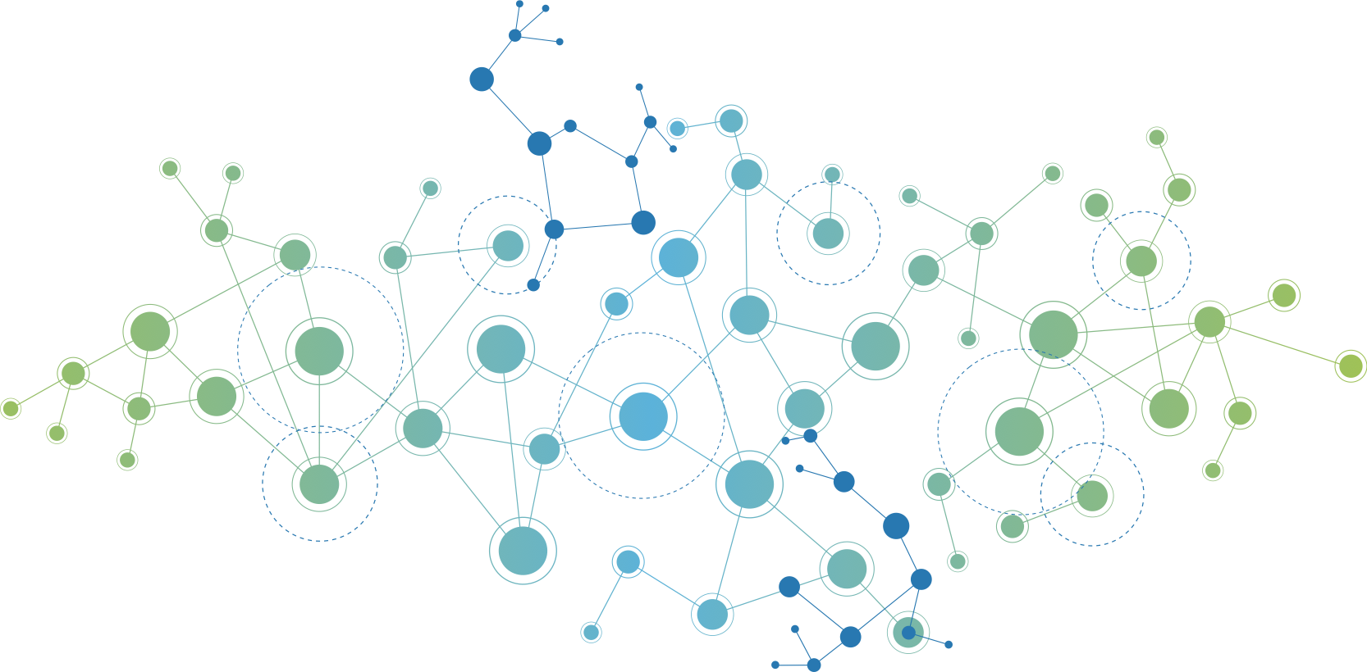
1. Entrepreneurship
This process of innovation and new-venture creation is accomplished through four major dimensions:
individual,
organizational,
environmental,
and process,
and is aided by collaborative networks in government, education, and institutions.

Slide 5
1. Entrepreneurship
All of the macro and micro positions of entrepreneurial thought must be considered while recognizing and seizing opportunities that can be converted into marketable ideas capable of competing for implementation in today´s economy.

Slide 6
1. Entrepreneurship
Entrepreneurship follows the same rules, whether:
You are starting a venture within a large corporation or starting on your own.
You are running a for-profit business, a non-profit organization, or a public service.
You are working for a governmental or non-governmental institution.

Slide 7
2. Entrepreneur
The entrepreneur is an innovator or developer who:
recognizes and seizes ………………,
converts those opportunities into workable/ marketable …….;
adds value through time, effort, money, or ………;
and assumes the risks of the competitive marketplace to implement these ideas.
Notes:
Opportunities
Ideas
Skills

Slide 8
2. Entrepreneur
The entrepreneur is a catalyst for economic change who uses:
purposeful searching,
careful planning,
and sound judgement,
when carrying out the entrepreneurial process.

Slide 9
2. Entrepreneur
The entrepreneur is uniquely optimistic and committed person who works creatively to establish new resources or endow old ones with a new capacity, all for the purpose of creating …….
Notes:
1. wealth

Slide 10
3. Entrepreneurial Leadership
Entrepreneurship is the main driver of the economy, it empowers people, and it changes society, companies, and individuals.
Researchers use the metaphor of „fire in a bottle“ - it's full of energy and potential.

Slide 11
3. Entrepreneurial Leadership
From a leadership perspective, entrepreneurship has become the symbol of business tenacity and achievement.
Entrepreneurs can see opportunities, they want to create new things, and they can achieve their goals. These qualities have become the benchmark for how good a true leader is.

Slide 12
3. Entrepreneurial Leadership
Entrepreneurial leadership is when you combine leading people with taking ….. to create new …..
It is leadership in:
discovering new possibilities,
opening up new horizons,
promoting a new vision,
combining resources in new ways,
and inspirinng others while implementing new-venture concepts.
Notes:
Risks
Things

Slide 13
3. Entrepreneurial Leadership
Leadership also means dealing with the problems and ethical choices that surround entrepreneurial action.

Slide 14
Entrepreneurial ethics
Ethics is not a new topic. It has figured in philosophical thought since the time of Socrates, Plato, and Aristotle.
Derived from the Greek word „ethos“, meaning „custom or mode of conduct“.

Slide 15
Entrepreneurial ethics
Entrepreneurs are faced with many ethical decisions, specially during the early stages of their new ventures they face many ethical dilemmas.

Slide 16
Entrepreneurial ethics
Ethics gives us the basic rules for doing things in a good way.
Ethics represents a set of principles prescribing a behavioral code that explains what is good and ….. or ….. and wrong.

Slide 17
Entrepreneurial ethics
Conflict arises for a number of reasons:
1. Business enterprises are confronted by many interests both inside and outside the organization.
For example: customers, managers, community, government, employees…
2. Society is undergoing dramatic change when values, mores, and societal norms have gone.

Slide 18
Ethical dilemmas
A "dilemma" is a difficult situation where you have to make a choice between two or more options, and none of those options are entirely satisfactory.
For entrepreneur is a vital one the legal versus ethical dilemma.

Slide 19
Ethical dilemmas
The most important thing for an entrepreneur is the survival and growth of their business but the law tells them what not to do, but it doesn't provide answers for ethical questions.
We divide ethical considerations into 4 main areas:
ethical rationalizations,
the matter of morality,
complexity of decisions,
online ethical dilemmas in e-commerce.

Slide 20
1. area: Ethical Rationalizations
Ethical rationalizations are ways entrepreneurs explain why they do something that might not be right.
Managers often try to justify bad behavior by saying:
that the activity is not „really“ illegal or immortal,
that it is in the individual´s or the corporation´s best interest,
that it will never be found out,
that it helps the company and the company will condone it.

Slide 21
1. area: Ethical Rationalizations
In business, we use laws to know what's right. But laws don't cover everything. Ethics and morals are personal, and that's why we have ethical problems.

Slide 22
2. area: The Matter of Morality
The law tells you what you must do. Ethics is about what you should do.
Think of the law and ethics like two circles that touch a little. Where they touch is where the law and ethics agree.
But most of the circles are separate you can follow the law and still not be doing the right thing.
Moral Standards
Legal Standards

Slide 23
2. area: The Matter of Morality
There are generally three things about the relationship between law and morality:
While laws and moral standards can sometimes agree, they are not identical.
Some laws are purely practical and have no moral basis (like driving on a specific side of the road).
Historically, some laws have been considered morally wrong (like racial segregation).
Conversely, some moral principles are not enforced by law (like telling the truth).

Slide 24
2. area: The Matter of Morality
There are generally three things about the relationship between law and morality:
Laws often say what you can't do, but morals say what you should do.
Legal systems tend to envolve more slowly than societal moral values.

Slide 25
2. area: The Matter of Morality
People often think that laws are supposed to be the collective moral judgment of society, but it is a problem when people think laws are always right.
Why do people often think this?

Slide 26
2. area: The Matter of Morality
This is due to:
a lack of information on issues,
a misrepresentation of values or laws,
laws and courts aren't perfect, they can't always deal with all ethical problems.

Slide 27
2. area: The Matter of Morality
Why do you think entrepreneurs behave unethically? What drives them to do so?

Slide 28
2. area: The Matter of Morality
A few possible explanations include:
Greed - wanting more and more, even if it hurts others.
Work vs. home - thinking it's okay to act differently at work than at home.
No ethics basics - not learning about what's right and wrong.
Survival - thinking only about making money, no matter what.
Relying on Others - they don't take responsibility for themselves, but rely on others.

Slide 29
2. area: The Matter of Morality
Whatever the reason, ethical decision making is a challange that confronts every entrepreneur.

Slide 30
3. area: Complexity of Decisions
Entrepreneurs make lots of decisions every day. Some are really hard and make you think about what is right and wrong.
The business decisions of entrepreneurs are highly complex for five reasons:

Slide 31
3. Complexity of Decisions
reason: Ethical decisions have big effect
When an entrepreneur decides something, it affects many people, not just the company.
For example, the decision to use inexpensive but unsafe products in operations will affect both workers and consumers of the final good.

Slide 32
3. Complexity of Decisions
reason: Many choices
Business decisions have multiple alternatives. The choices are not always „yes“ or „no“.
For example, the entrepreneur may have the alternative of using still less expensive but nevertheless safe products.

Slide 33
3. Complexity of Decisions
reason: Ethical business decisions often have mixed outcomes.
Every choice has good and bad parts. It can make money but also cause problems.

Slide 34
3. Complexity of Decisions
reason: Uncertain what actual consequence(s) a decision will have
We never know exactly what will happen when we decide. There is always some ethical risk.

Slide 35
3. Complexity of Decisions
reason: Personal implications
Entrepreneurs can't just ignore their decisions. It affects them and their company.
For example, venture success, financial opportunity, and new-product development are all areas that may be affected by decisions with ethical consequences.

Slide 36
3. Complexity of Decisions
One ethics expert says that entrepreneurs need to understand how their business works. They need to know "what usually happens" in their business so they can see problems coming. This helps them make better ethical choices.

Slide 37
3. Complexity of Decisions
When starting a new business, entrepreneurs need to think about those 5 things about decisions. It means they should learn as much as they can about every big choice.

Slide 38
4. area: Online Ethical Dilemmas in E-commerce
Online shopping is currently very popular.
For entrepreneurs is very important question of how to build trust with customers, because unethical behaviour is more likely to take place through online transactions than through offline ones.

Slide 39
4. area: Online Ethical Dilemmas in E-commerce
It's easier to deceive customers in the online environment, which is why customers turn to online reviews.
However, a new ethical concern has arisen in regard to the use and sometimes abuse of these new systems.

Slide 40
4. Online Ethical Dilemmas in E-commerce
Some businesses violate the trust of their customers to protect their online reputation, and they have started to influence their online reputation for the purpose of strategic manipulation.

Slide 41
Business ethical dilemmas and stakeholders
https://www.youtube.com/watch?v=ahH_P_5yVSo

