Slide 1
Introduction
Ing. Veronika Volfová
veronika.volfova@mvso.cz

Slide 2
About subject
The aim of this course is to provide a complete overview of Entrepreneurship (historical development, trends and challenges, approaches to entrepreneurship, legal forms, organizational structures, etc.).
You will be introduced to concepts such as the entrepreneurial ecosystem, incubators, accelerators, and will explore the ethical aspects of entrepreneurship.
The course also provides an overview of support for entrepreneurship from European Union funds and a comparison of the entrepreneurial in Europe and beyond.

Slide 3
Requirements
Attendance at seminars (min. 80 %)
Credit: semestral project (will be processed as part of the seminars, close information you will receive at the second seminar.)
Examination: oral examination

Slide 4
Basic Information about the Czech Republic
The Czech Republic is a landlocked country in the middle of Europe. Rather than as a country in the middle of Europe, we should speak of the Czech Republic as a country in the heart of Europe.

Slide 5
Czech Republic – heart of Europe
Where we are on the map?
Who are direct neighbours of the Czech Republic?
Who are neighbors of your country?

Slide 6
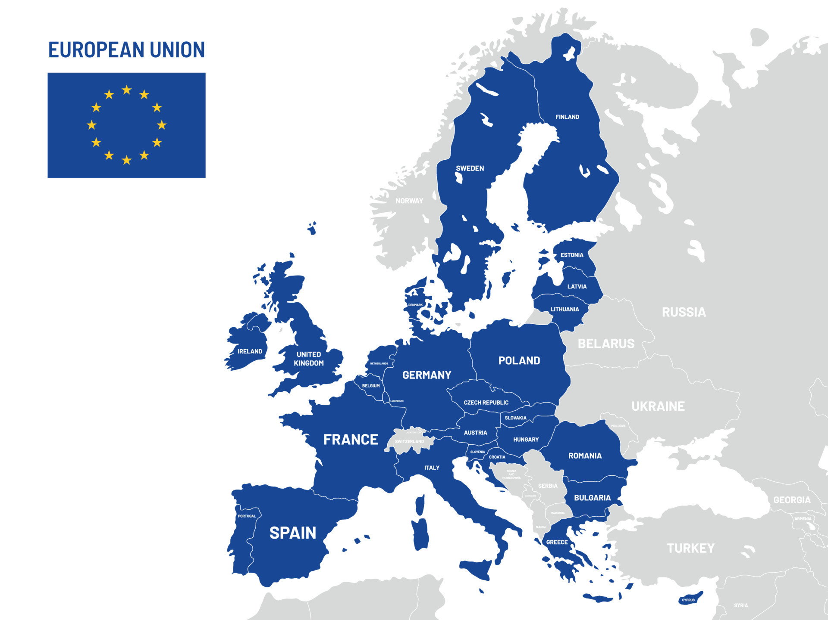
States in Europe
What do „blue states“ on the map mean?

Slide 7
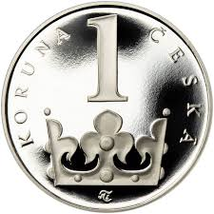
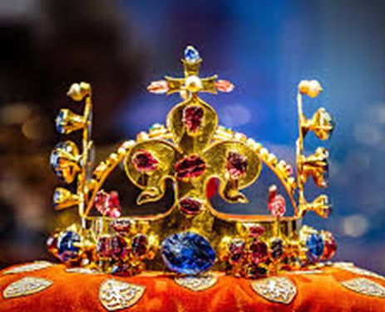
Facts and Figures
Language: czech
Area: 78, 866 sq km
Borders with: Germany, Poland, Slovakia, Austria
Population: 10,51 million
Political system: parlamentary republic
EU member state: since 2004
Currency: czech crown (CZK)
Capital city: Prague

Slide 8
Climate: seasonal variations
Czech Republic lies in the temperate climate zone, which is characterized by mild, humid summers with occasional hot spells, and cold, cloudy and humid winters.
Czech Republic's climate is comparable to that of southern in land Canada.
Czech weather can never be predicted with certainty.

Slide 9
Climate: seasonal variations
Spring
Spring begins on the 21st of March.
Many people consider spring and summer the most beautiful seasons of the year and that is why they usually fall in love in spring. Nature begins to awake from its long winter sleep and new life starts. Nights get shorter and days get longer.

Slide 10
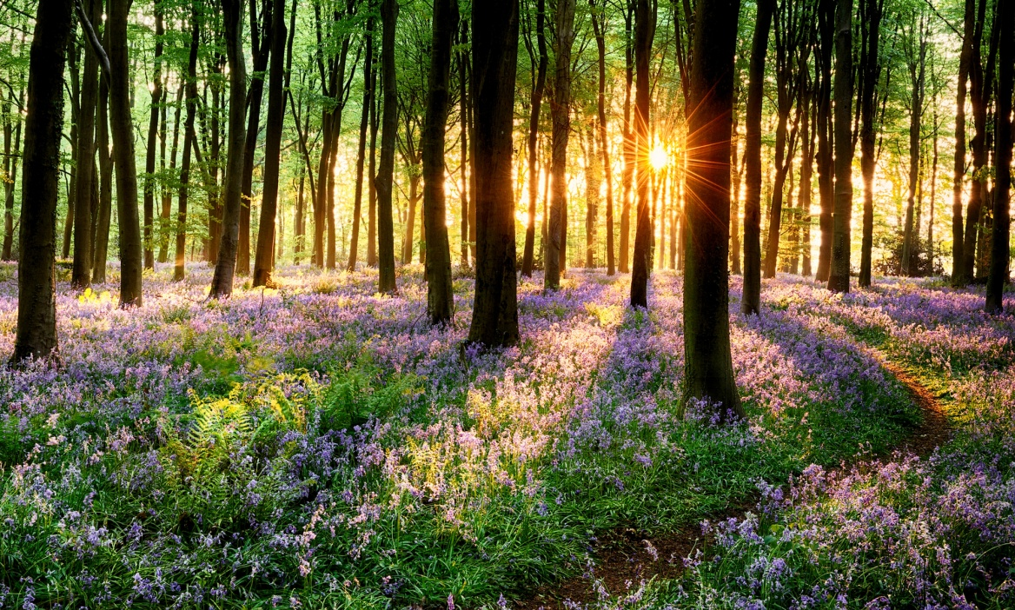
Climate: seasonal variations
Spring
There is more sunshine, and it is warmer and warmer.
The weather in spring, especially in April, is really unpredictable and changeable.

Slide 11
Climate: seasonal variations
Summer
June 21st is the date when summer begins.
School children love this season the most because they have two months of holidays.
Everybody starts to be more interested in the weather because people set off on journeys and take holidays.
In the summer, rain often comes in the form of a storm. It is dangerous to stand under a tree during a storm because the lightning might hit it.

Slide 12
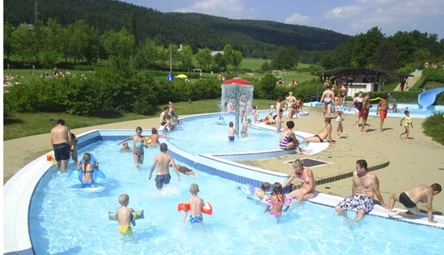
Climate: seasonal variations
Summer
Summer is also the time of strawberries, bilberries, raspberries, blackberries and cranberries, and the harvest of corn.

Slide 13
Climate: seasonal variations
Autumn
On the 23rd of September, autumn comes.
At the beginning of autumn we can still enjoy a few fine days of Indian summer. Many people go picking mushrooms.
This colorful period does not last long because soon the trees shed their leaves and by November they are bare.
In autumn, the weather is unsettled, the sky is often cloudy, and the mornings are dull and it looks like rain. People refer to the weather as awful, wretched, or nasty..

Slide 14
Climate: seasonal variations
Winter
Winter comes on December 21st, but in fact it often begins earlier.
Typical winter weather brings snowfall, icy wind, and hard frosts.
We can enjoy skiing in the mountains and the hills which are covered with a thick layer of fluffy snow and we admire the winter scenery.
The roads become icy and slippery and it makes driving hazardous because you can skid easily.

Slide 15
Climate: seasonal variations
Describe weather in your country?

Slide 16
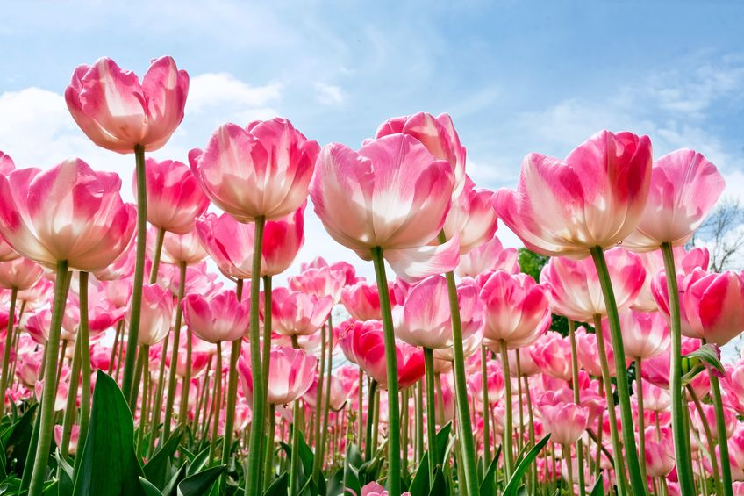
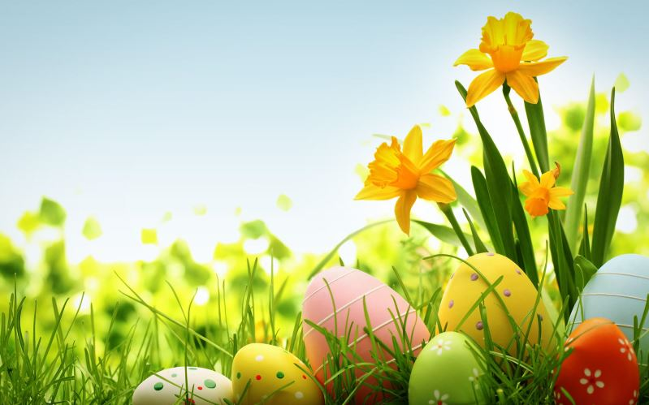
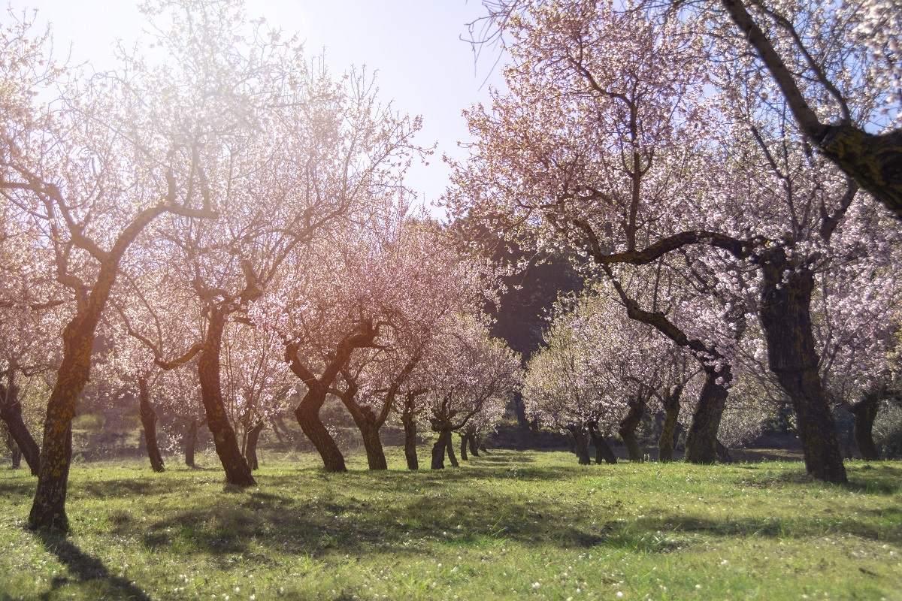
What season is it?

Slide 17
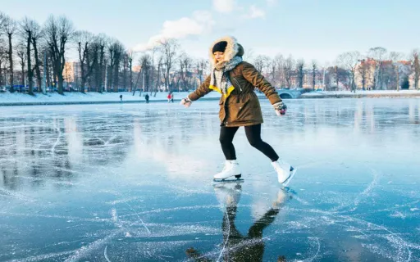
What season is it?

Slide 18
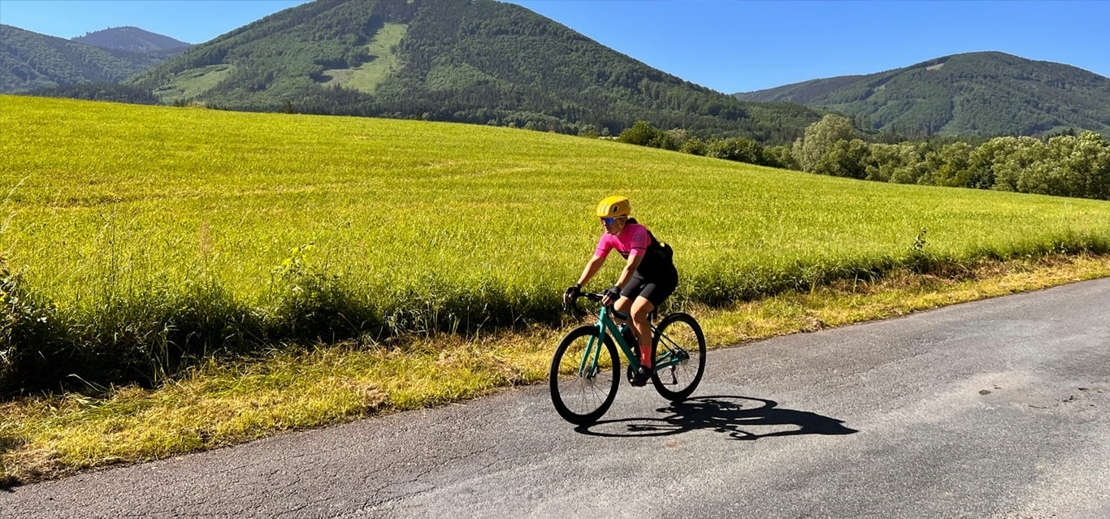
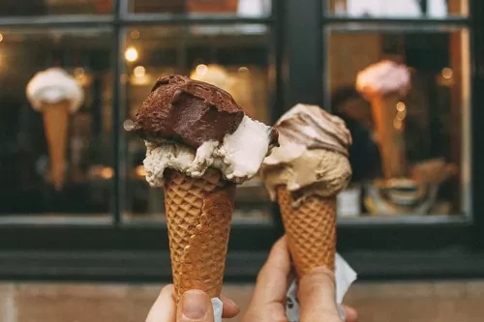
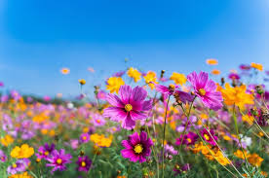
What season is it?

Slide 19
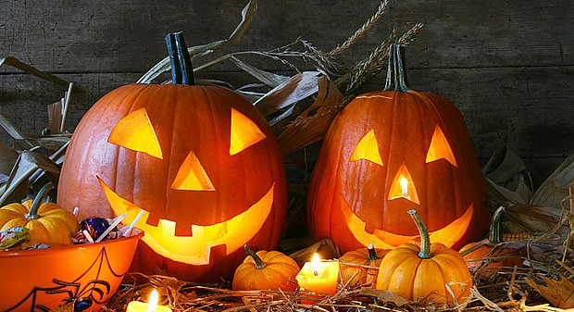
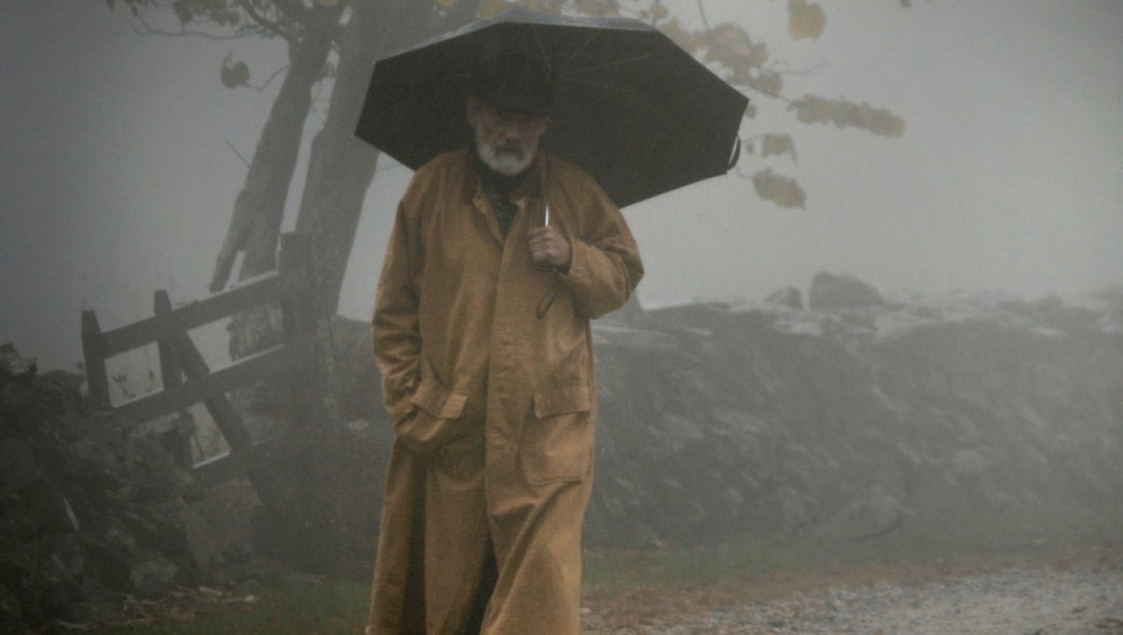
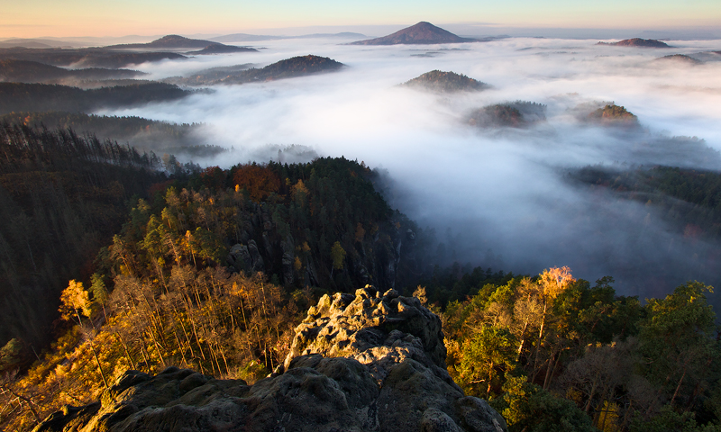
What season is it?

Slide 20
Climate: seasonal variations
Which season do you like and why?

Slide 21
Area
The Czech Republic is historically divided into three regions: Bohemia, Moravia, and a part of Silesia.
The total area is 78,866 square kilometers and the country’s population is around 10, 4 million people.
The capital city is Prague, with 1,2 million inhabitants, and there are 5 other metropolitan cities with a population exceeding 100,000: Brno, Plzeň, Olomouc, Ostrava, and Liberec.

Slide 22
5 other metropolitan cities with a population exceeding 100,000

Slide 23
Liberec
Praha
Ostrava
Plzeň
Olomouc
Brno

Slide 24
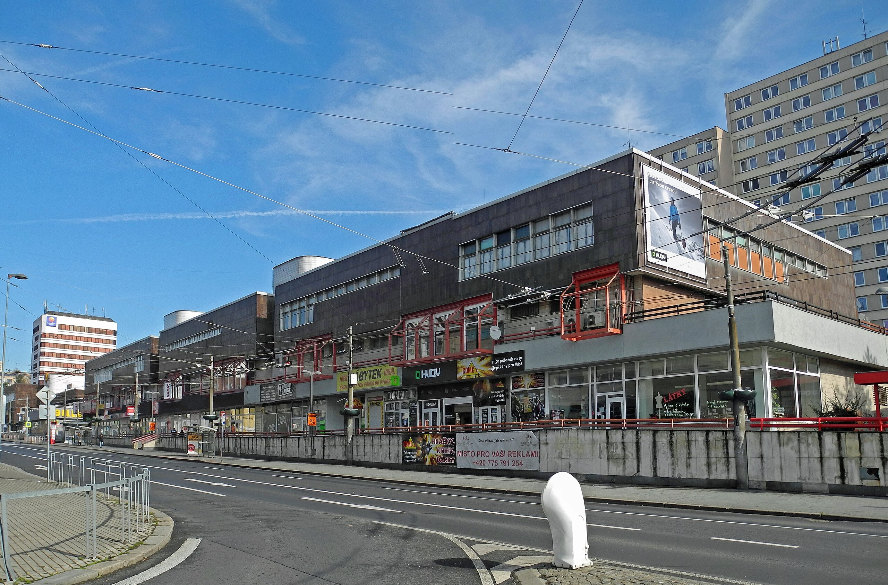
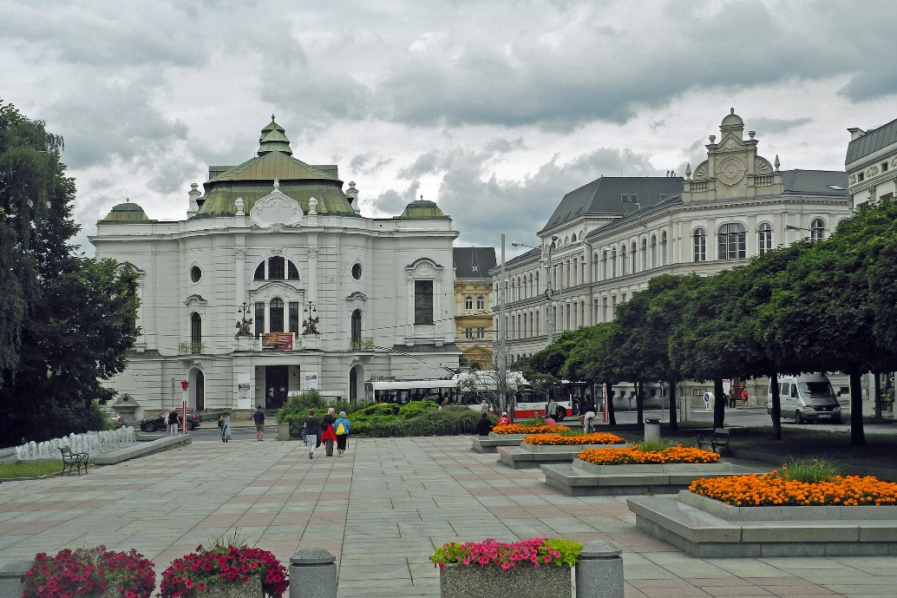
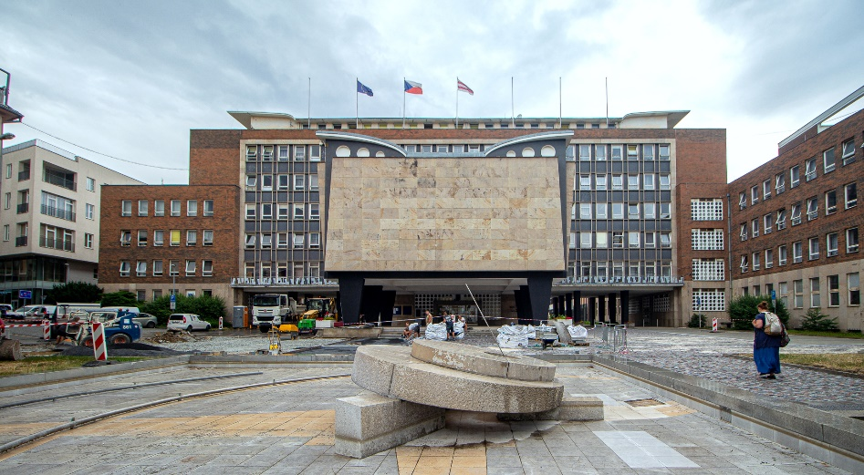

Slide 25
Olomouc
The charming and beautiful city of Olomouc lies beside the Morava River in central Moravia. With around 100,000 inhabitants, it's the fifth largest city in the Czech Republic and certainly one of the most beautiful.
The centre is the largest historic preservation zone outside Prague, and its cobblestoned streets are lined with majestic cathedrals and grand palaces.
Despite its fascinating history and great beauty, you won't find the crowds of tourists that are so common in more famous destinations.

Slide 26
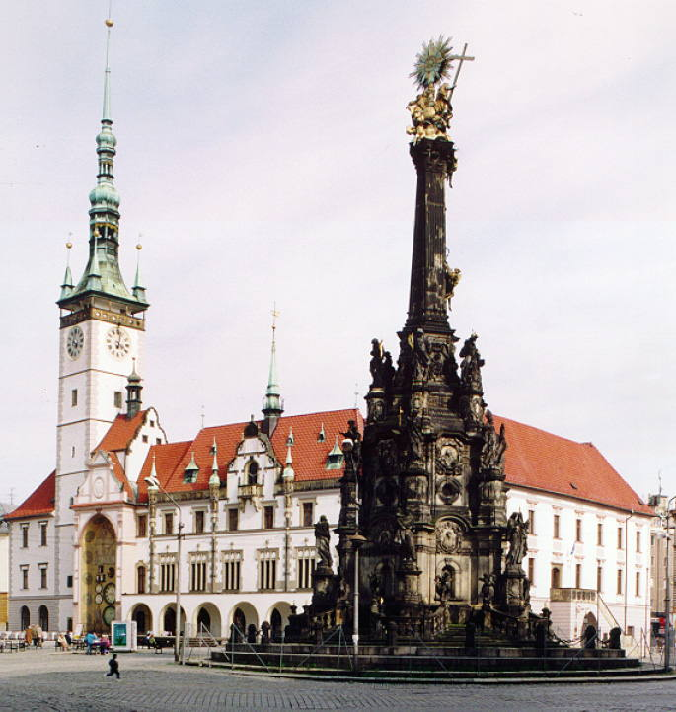
Olomouc
In 2000, the Holy Trinity Column, which was erected in the early 18th century, was added as a UNESCO World Heritage site.

Slide 27
Religion
The Czech Republic is a secular state and every citizen enjoys freedom of religion. The number of people practicing religion is low. More than 50% of the population describe themselves as agnostic or atheist while in northern Bohemia the proportion rises to about three quarters of the population.
The main reasons for this are the suppression of the reformation movement followed by forcible mass re-catholicization (after 1627), and forty years of the official suppression of religion during the communist period (1948 – 1989).

Slide 28
Religion
More than 50% of the population describe themselves as agnostic or atheist while in northern Bohemia the proportion rises to about three quarters of the population.
1. Atheist/ Agnostic
59 %
2. Roman Catholic
27 %
3. Protestant
2 %
4. Other
12 %

Slide 29
Czech people
Divorce is a popular pastime of Czechs – more than half of the spouses are expected to get divorced, which makes Czech Republic no. 3 in the world rankings.
On a brighter note, Czechs are uncontested world champions in several disciplines such as:
beer-drinking (annually 159 liters per capita, approx 42 gallons),
ice hockey (in 1996, hat-trick in 1999-2001, and lastly in 2005) or even such obscure things as
football on bicycles – cyclo-ball – in which the Pospisil brothers earned 20 gold medals.

Slide 30
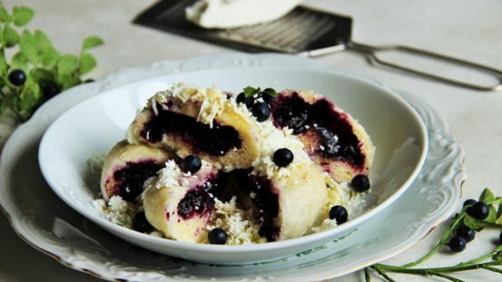
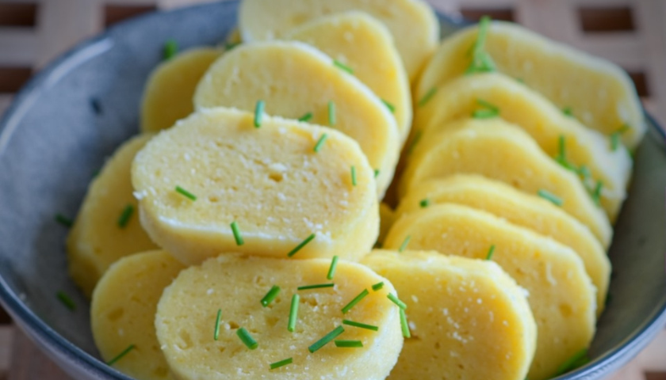
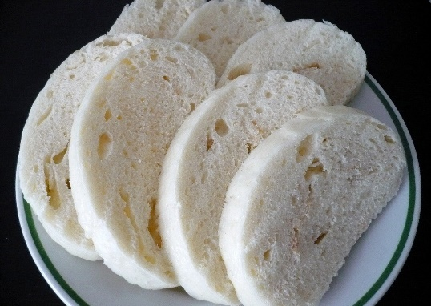
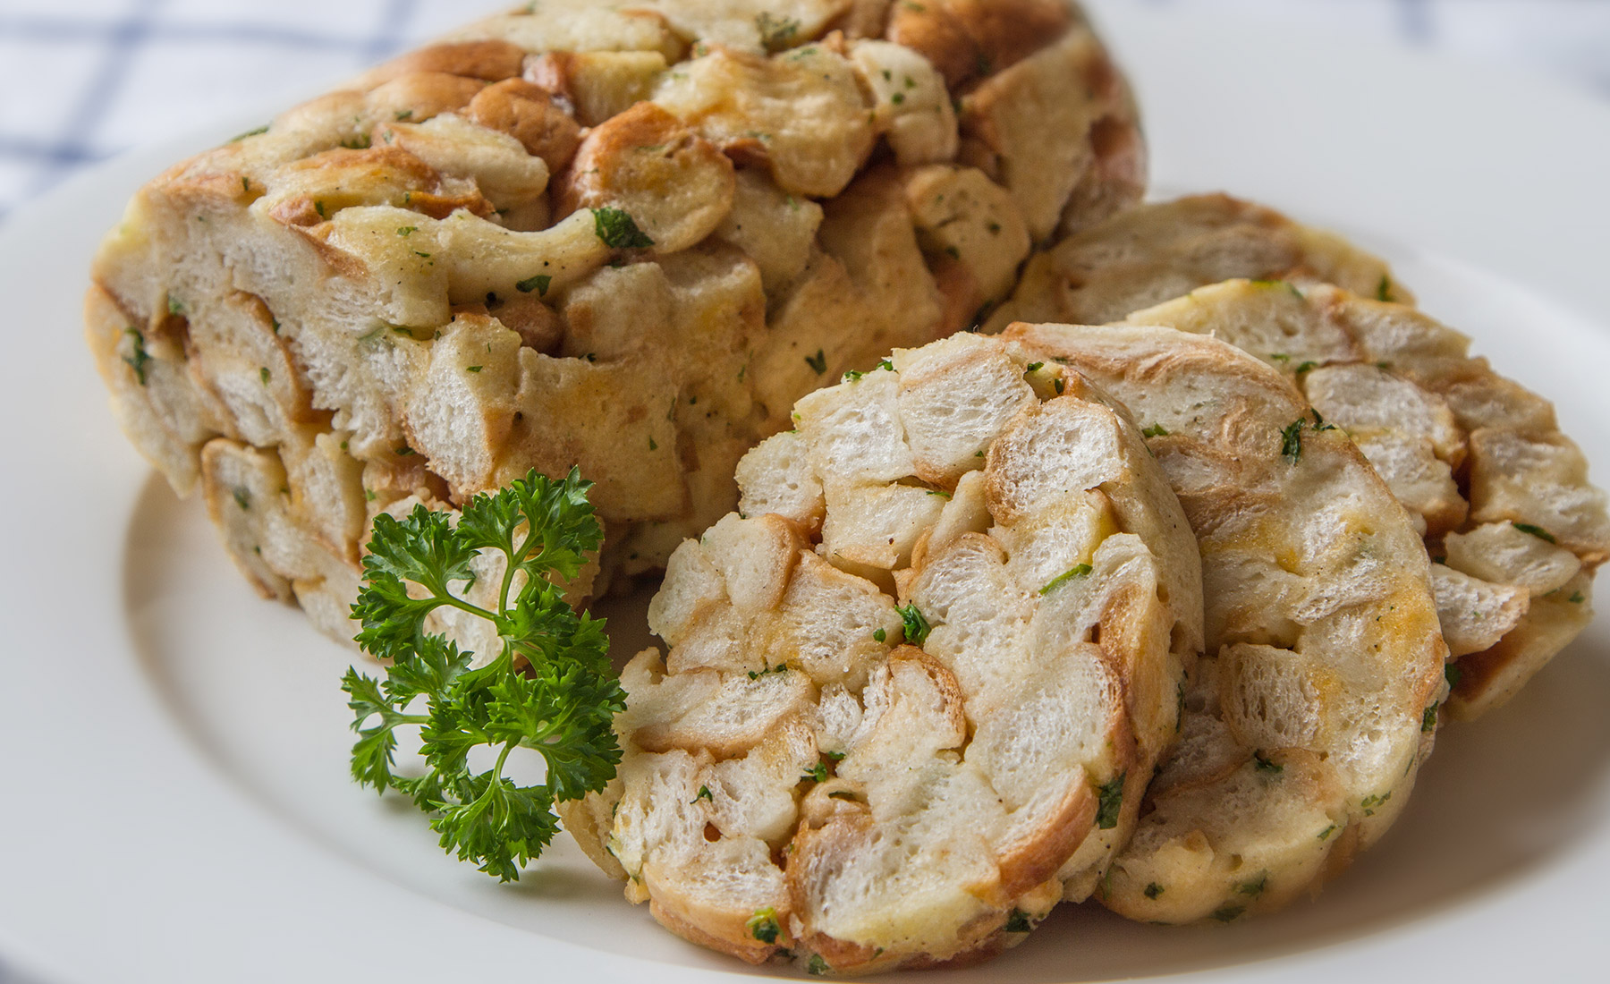
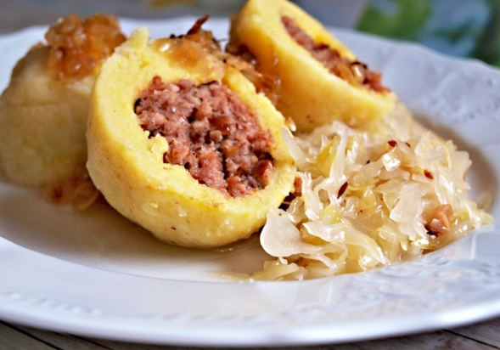
Dumplings
Bread dumplings
Fruit dumplings
Potato dumplings

Slide 31
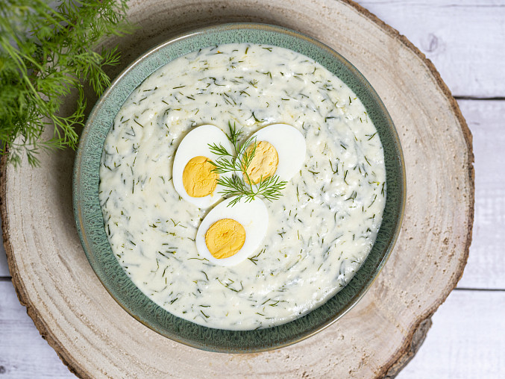
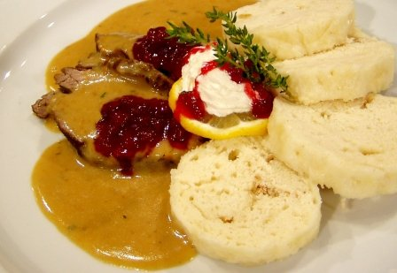
Traditional sauce
Dill sauce
Sirloin sauce

Slide 32
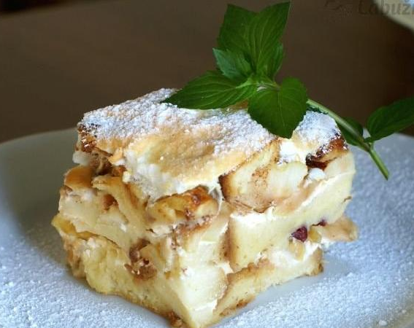
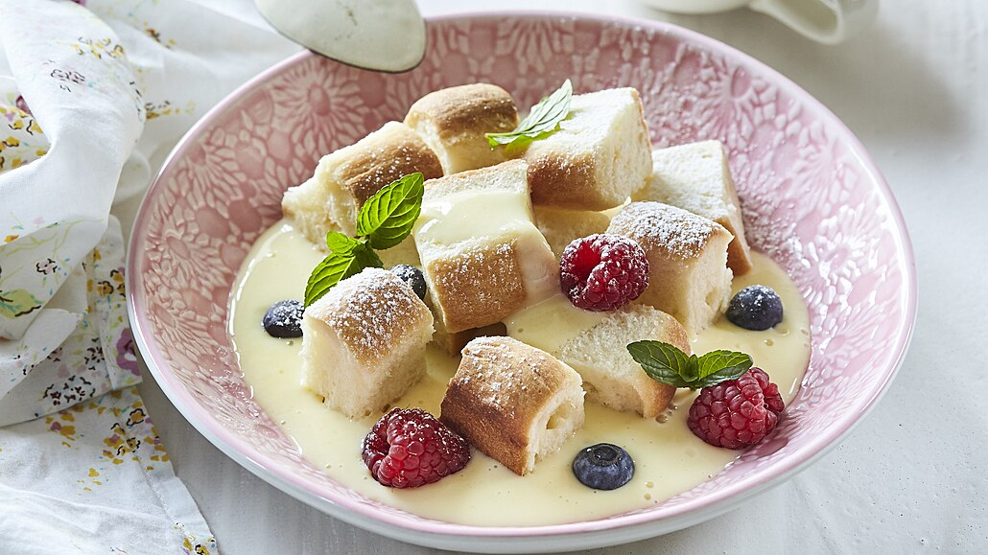
Buns with vanilla cream
Žemlovka

Slide 33
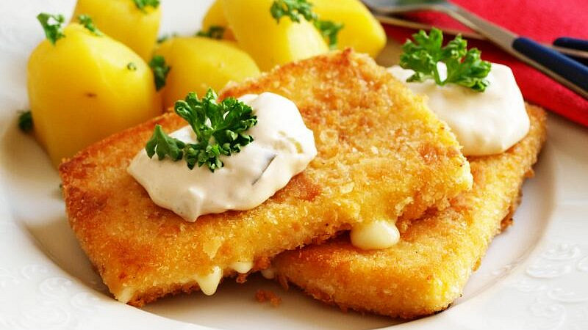
Fried cheese „smažák“

Slide 34
History
In 1917, a meeting took place in Pittsburgh, Pennsylvania, USA, where the future Czechoslovak president Tomáš Garrigue Masaryk and other Czech and Slovak representatives signed the Pittsburgh Agreement which promised a common state consisting of two equal nations, Slovaks and Czechs.

Slide 35
History
First Republic (1918-1938)
A period of:
democracy and economic development.
building state institutions and developing culture.
National problems with Sudeten Germans and Slovaks.

Slide 36
History
Communist regime (1948-1989)
There were:
Economic problems and lagging behind Western countries.
Political trials of opponents of the regime and persecution of inconvenient persons.
Restrictions on human rights and freedoms, travel and speech.
Many people were dissatisfied and opposed to the regime.

Slide 37
History
Velvet revolution (1989)
The Velvet Revolution or Gentle Revolution was a non-violent transition of power in what was then Czechoslovakia.
In the streets was mass demonstrations and protests against the communist regime.
The result was the end of one-party rule and the beginning of democratic reforms.

Slide 38
The breakup of Czechoslovakia and the creation of the independent Czech Republic (1992-1993)
The Slovak National Council and the Czech National Council declared independence.
On January 1, 1993, two independent states were established - the Czech Republic and the Slovak Republic.

Slide 39
Enjoy staying in the Czech Republic

