Slide 1
EUROPEAN UNION
Mgr. Eliška Mikuláštíková
XMENT – Modern Entrepreneurship

Slide 2
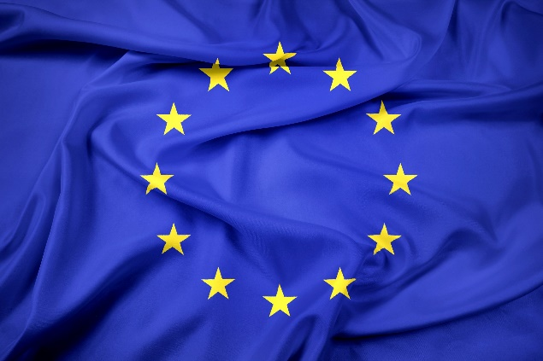
What is the European Union?
The EU is a community of liberal democratic states
Close cooperation between member states > through a system of institutions
Sharing common values > democracy, human rights, principles of social justice
Cultural and linguistic diversity
27 EU Member States; more than 500 million inhabitants
Main institutions are located in Brussels, but also Luxembourg, Strassbourg, …

Slide 3
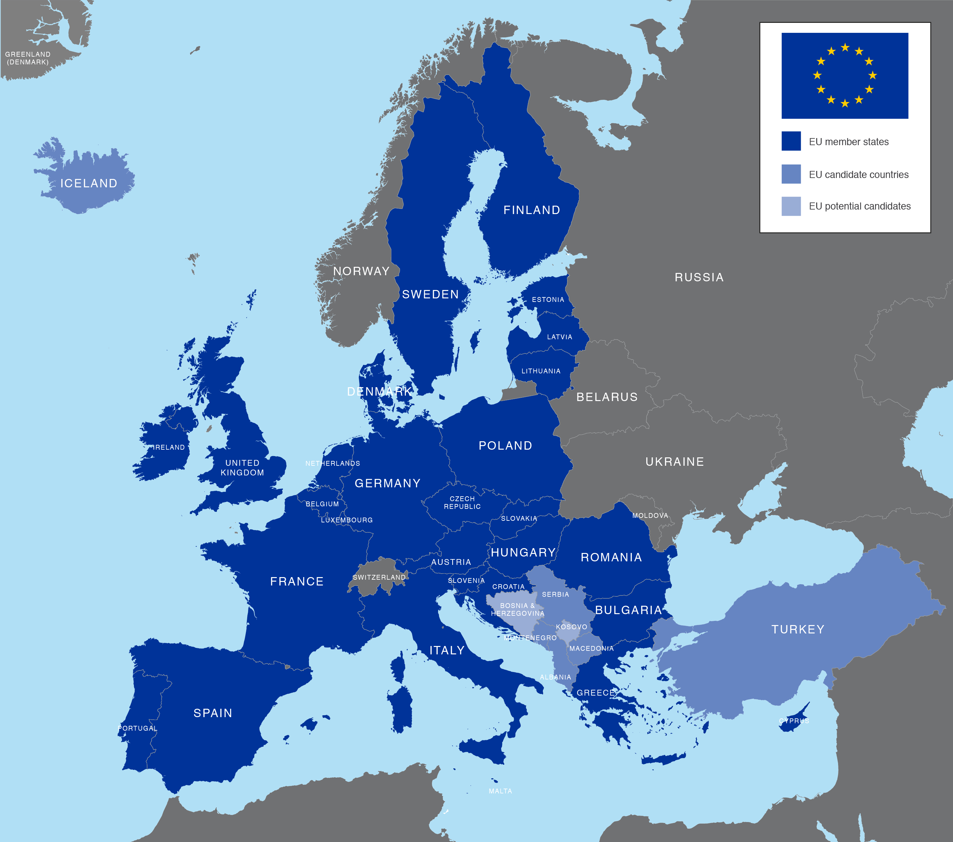

Slide 4
History - The forerunners of European integration
The idea of uniting Europe is not new
  Already rulers and philosophers (George of Poděbrady, Kant)
After WW 1, the first federalist movements appeared
  Richard Coudenhove - Kalergi: Pan-European Movement
  Subdued by the rise of nationalism and WW 2
Federalist ideas in resistance movements
  E.g. IT
  Altiero Spinelli: Manifesto of Ventotene
  Schuman Plan
Major developments after WW 2

Slide 5
Post-war cooperation
The end of WW2 gives new urgency to the idea of cooperation
The clear need for cooperation between WE countries
Post-war cooperation - specific context = main idea to keep peace
  Concerns about Germany
  The onset of the Cold War
  Fear of the spread of communism
  Need for post-war reconstruction
Often in cooperation with the US
  Marshall Plan, NATO
Intergovernmental nature

Slide 6
Post-war cooperation
1946 Treaty of Dunkirk
  UK + FR
1947 Marshall Plan
  Provision of financial and material aid to European countries
  Countries forced to cooperate in the distribution of aid
  1948 Organization for European Economic Cooperation (OEEC) → 1960 OECD
1948 Brussels Treaty
  UK + FR + Benelux
1949 formation of NATO
  Germany ceases to be the main threat → USSR
  "To keep the Americans in, the Russians out, and the Germans down." (Lord Ismay)
1949 founding of the Council of Europe

Slide 7
European Coal and Steel Community (ECSC)
The direct predecessor of the EU
Surrender of some sovereignty to the supranational level
1950 Schuman Plan Created by
  Jean Monnet
  Plan to create a common market for coal and steel
  Economic integration leading to political unity
    Gradual integration of economic sectors = sectoral approach
Economic reconstruction, seeking rapprochement with Germany BUT at the same time controlling it
  Germany accepted the plan (Adenauer)
Offered to other countries
  Many refused, e.g. UK → supranational dimension of cooperation
  IT, Benelux finally joined → the so-called Six

Slide 8
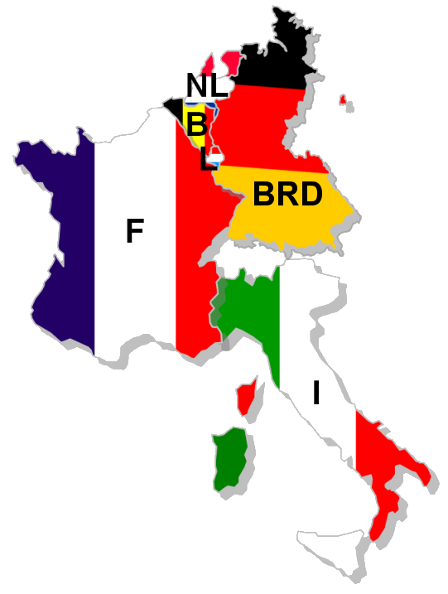
European Coal and Steel Community (ECSC)
Treaty of Paris 1951
  Treaty establishing the European Coal and Steel Community
  For a period of 50 years
  In force since 1952

Slide 9
European Coal and Steel Community (ECSC)
ECSC institutions:
  The High Authority
    President: J. Monnet
    Multinational institution
    9 members, independent of national governments, 6 years
    Chief executive body
  Council of Ministers
    Representatives of governments → counterweight to the High Authority
    Main decision-making body
  ECSC Assembly
    78 representatives of national parliaments
    Control functions only (could dismiss the HQ as a whole)
    1962 European Parliament
  Court of Justice
    Independent of other institutions

Slide 10
European Economic Community and EURATOM
ECSC = success of sectoral integration
BUT Declining importance of coal and steel
  Which sectors to pursue?
1957 Treaty of Rome
European Atomic Energy Community (EURATOM)
  Common market in nuclear material and promotion of peaceful uses
  Gradually losing importance
European Economic Community (EEC)
  Creation of the common market in three phases
    Four freedoms: free movement of goods, services, persons and capital
  Development of common policies
    Common trade policy
    Common agricultural policy
    Common transport policy

Slide 11
European Economic Community and EURATOM
Institutions similar to the ECSC
  Commission - 3x
  Council of Ministers- 3x
  Assembly - common to all 3 Communities
  Court of Justice - common to all 3 Communities
1965 Merger Treaty
  Merger of ECSC, EEC and EURATOM → European Communities
  Simplification of institutions (1x Commission, 1x Council)

Slide 12

European Free Trade Area (EFTA)
The reserved attitude of the UK and other countries towards European integration
Response to the creation of the EEC
Initiated by the UK
1960 Stockholm Treaty
  Free trade zone for industrial goods
  Did not apply to agriculture and fisheries (strategic sectors)
  UK, Denmark, Norway, Sweden, Austria, Switzerland, Portugal
  Later Finland, Iceland, Liechtenstein
  Most countries now EU members
  Today: Norway, Iceland, Switzerland, Liechtenstein

Slide 13
The crisis of the Community and the de Gaulle vetoes of UK entry
Since the mid-1960s - Charles de Gaulle
  Own approach to integration, Intergovernmental principle, Strengthening the role of the FR
Rejection of UK applications for entry - 1963 and 1967 de Gaulle's veto
1966 Transition to the third phase of the common market
1969 New areas added: monetary union, foreign policy cooperation
Focus on enlargement to UK, Ireland, Denmark, Norway

Slide 14
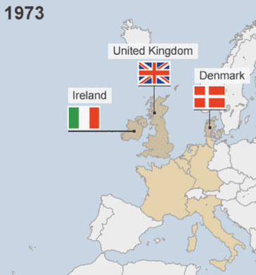
First extension (north)
1972 negative referendum
in Norway
1 January 1973 UK, Ireland,
Denmark

Slide 15
Closer cooperation and Communities' own revenue
Oil shocks, changes in the dollar exchange rate
Resolved by the adoption of "budget contracts„
1970 Luxembourg Treaty
  Introduction of own revenue (customs duties, agricultural levies, VAT of the CS)
    Budget no longer dependent on contributions from the CS
  Involvement of the EP in the adoption of the budget
1975 Brussels Treaty
  Strengthening of EP powers
  Establishment of the Court of Auditors
    Audit of EC accounts

Slide 16
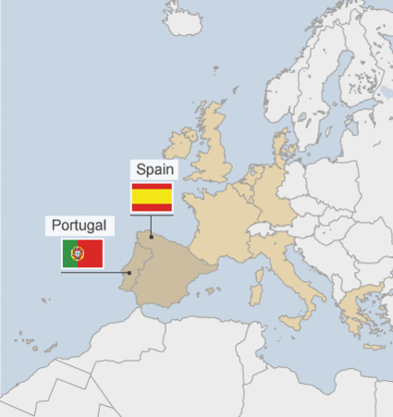
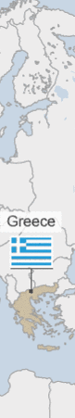
Second Extension (South)
1974-1975 The fall of the undemocratic regimes in Greece, Spain and Portugal
Acceptance of applications for entry, but need to integrate previous wave first
1981 entry of Greece
1986 entry of Spain and Portugal (third)

Slide 17
The road to the Single European Act (SEA)
1985 Jacques Delors takes over as President of the Commission
  The main objective of completing the internal market
  White Paper on the Internal Market
  Lord Cockfield
Constraints and obstacles to completion Cooperation in areas linked to the internal market
  1985 Schengen area (Germany, Benelux, France)
  Elimination of border controls, facilitated movement of people
Signing of a new treaty to complete the internal market

Slide 18
Single European Act (SEA)
Signed in February 1986, effective 1987
Enabled the completion of the single market
  Timetable for completion: 1992 at the latest
  QMV vote in the Council of Ministers on SM issues
Bigger involvement of the European Parliament in decision-making
Definition of new areas of cooperation
Efforts to deepen cooperation
Reform proposals of the Delors Commission
  Completing the internal market
  Monetary union:
    The Delors Report
    The introduction of the single currency in three stages

Slide 19
Treaty on European Union (Maastricht Treaty)
Signed: Maastricht, 7 February 1992
Validity: 1993
Mix of supranational integration and intergovernmental cooperation
The Maastricht Temple
  Policies divided into pillars

Slide 20
European Union
European communities
National level
Common policies
Economic and Monetary union
Common foreign and security policy
Intergovernmental cooperation
Police and judical cooperation in criminal matters
Intergovernmental cooperation
I. Pillar
II. Pillar
III. Pillar

Slide 21
Treaty on European Union (Maastricht Treaty)
I. Pillar
  Economic and Monetary Union
  Citizenship of the European Union
  Principle of subsidiarity = Bringing decision-making closer to citizens
    Decision-making devolved to national or local level whenever possible
II. Pillar
  Common foreign policy, including security issues
  May eventually lead to common defence
III. Pillar
  Free movement of goods, services, people and capital = increase in cross-border activities

Slide 22
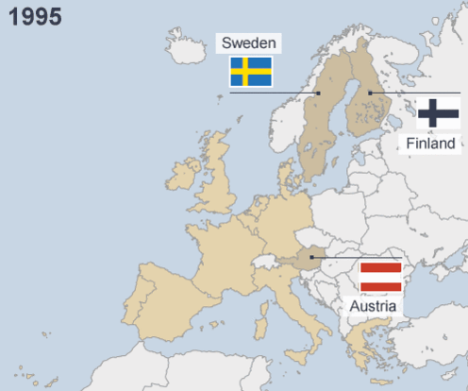
Third Extension (EFTA)
Applications for admission during 1989-1992
Austria, Sweden, Finland, Norway, Switzerland
  Switzerland: application withdrawn
  Norway: failed referendum (47.8 for : 52.2 against)
Accession 1995

Slide 23
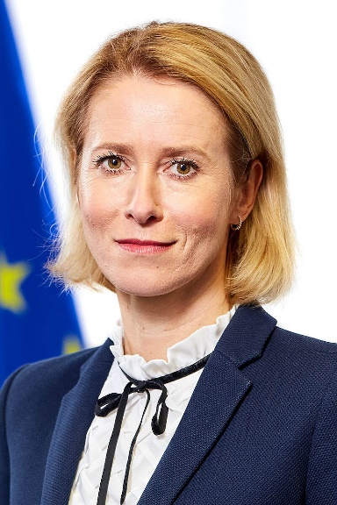
Treaty of Amsterdam
Signed: October 1997
Validity: 1999
Main changes:
  Transfer of most of the III. Pillar into the I. Pillar
  Introduction of a High Representative for CFSP
    Important position (Foreign minister of EU)
    Catherine Ashton, Federica Mogherini, Josep Borrell, Kaja Kallas
Followed by Treaty of Nice

Slide 24
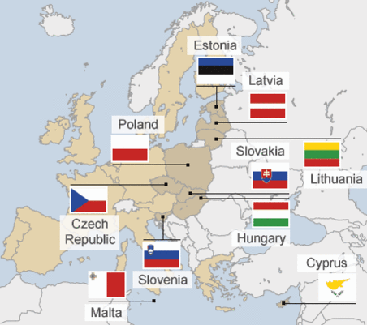
Fourth Extension (East)
Extension 10 + 2
2004 - Czech Republic, Slovakia, Poland, Hungary, Lithuania, Latvia, Estonia, Slovenia, Malta, Cyprus
2007 - Bulgaria, Romania
2013 – Croatia (joined last)

Slide 25
Treaty of Lisbon
First introduced the Treaty establishing a Constitution for Europe (Constitutional Treaty)
  Negative referendums:
    France: 29 May 2005, 54.9% against
    Netherlands: 1 June 2005, 61 % against
  Never accepted
Treaty of Lisbon
  Signed 13 December 2007 in Lisbon
  Retains most of the Constitutional Treaty
  Main differences:
    Did not replace existing treaties
    Just another in a series of treaties (JEA-Maastricht-Amsterdam-Nice)
    Deleted union symbols and constitutional treaty language
    A number of exceptions for the member states
  Problems with ratification in Ireland -> Irish opt-outs
  Validity: 1 December 2009

Slide 26
EU Institutions
7 institutions:
  European Council
  Council of the European Union
  European Commission
  European Parliament
  Court of Justice of the European Union
  European Central Bank
  Court of Auditors
Advisory bodies
  Assisting the Council, the Parliament and the Commission
  Economic and Social Committee
  Committee of the Regions

Slide 27

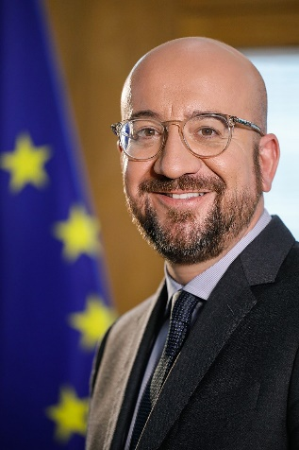
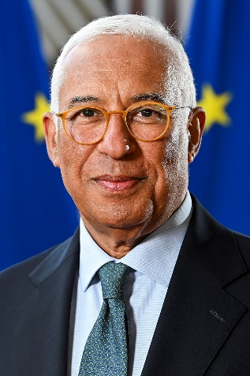
European Council
Establishment 1974 (Paris Declaration)
Institutionalized by the EU only with the Lisbon Treaty (2007/9)
The highest representatives of the Member States
  Presidents
  Prime Ministers
  + President of the European Council, President of the European Comission
Presidents of the European Council
  Herman van Rompuy (2009-2014), Donald Tusk (2014-2019), Charles Michel (2019-2024), António Costa (2024-)
Summit meetings
  Min. 4 times per year+ extraordinary summits
  Issues addressed at intergovernmental level
Located in Brussels

Slide 28
Council of the European Union
The main decision-making body
  Together with the European Parliament
Intergovernmental body
  Member States represented by sectoral ministers
Formations (10):
  Foreign Affairs Council (FAC)
  General Affairs Council (GAC)
  Economic and Financial Affairs Council (ECOFIN), …
Rotating Presidencies: 6 months, Lisbon Treaty: 18 months (trio)
Located in Brussels

Slide 29

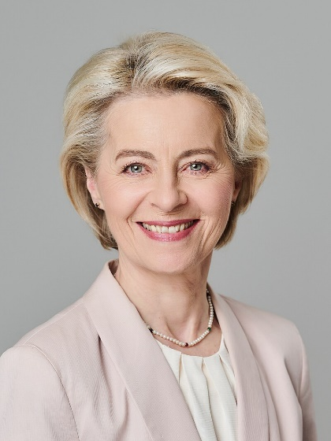
European Commission
Supranational institution
Based on - ECSC High Authority
Each State = 1 Commissioner
Independent of the national government
Headed by the President of the EC
  Ursula von der Leyen + Vice-Presidents
Term of office: 5 years
Located in Brussels
Roles: Proposes new laws, Manages EU policies and allocates EU funding, Enforces EU law, Represents the EU internationally

Slide 30

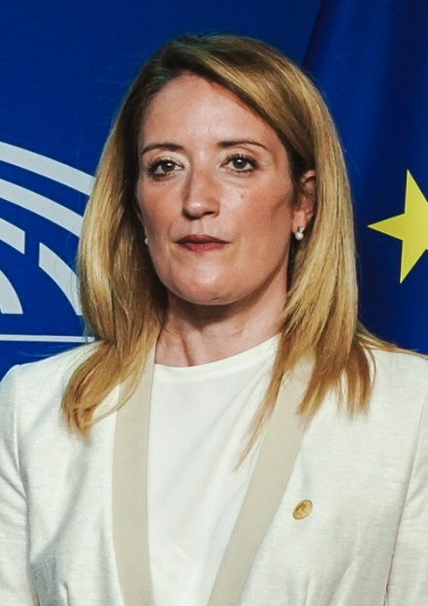
European Parliament
ECSC Assembly
  Representatives of national parliaments
1962 European Parliament
Since 1979 directly elected -> create fractions
Gradual increase in powers
  Treaties of Rome: consultation procedure
  Single European Act: cooperation and consent procedure
  Maastricht Treaty: co-decision procedure
3 main roles: legislative, supervisory, budgetary
Term of office: 5 years (720 MEPs)
Located in Strassbourg, Brussels, Luxembourg
President: Roberta Metsola

Slide 31

Court of Justice of the European Union
1952 ECSC Court of Justice
Two institutions
  Court of Justice
    27 judges + 11 advocates general
  Court of First Instance (JEA)/General Court
    2 judges from each country
  + Civil Service Tribunal (2004) - Dissolution September 2016
Located in Luxembourg

Slide 32
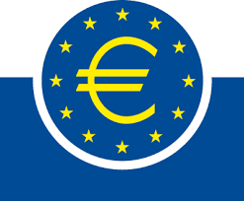

European Central Bank and European Court of Auditors
European Central Bank
Established in 1999
Monetary policy (euro, stable prices,…)
President: Christine Lagarde
Location: Frankfurt
European Court of Auditors
Established in 1975
Checks the EU's management
Each member state has one representative
Located in Luxembourg

Slide 33


Advisory bodies
Economic and Social Committee
  Established by the Treaty of Rome (advisory body to the EEC)
  Around 330 members
  Representatives of workers' organisations, employers, interest groups
  Located in Brussels
Committee of the Regions
  Established by the Maastricht Treaty
  350 members
  Local and regional representatives
  Located in Brussels

Slide 34
The Nature and Competences of the EU
Exclusive powers:
  Common commercial policy
  Customs union
  Competition rules necessary for the functioning of the internal market
  Monetary policy of the Euro area
  Conservation of marine biological resources under the common fisheries policy
Shared powers:
  Internal market
  Social policy
  Economic, social and territorial cohesion
  Agriculture and fisheries
  Environment
  Consumer protection
  Transport
  Trans-European networks
  Energy
  Area of freedom, security and justice
  Public health safety issues

Slide 35
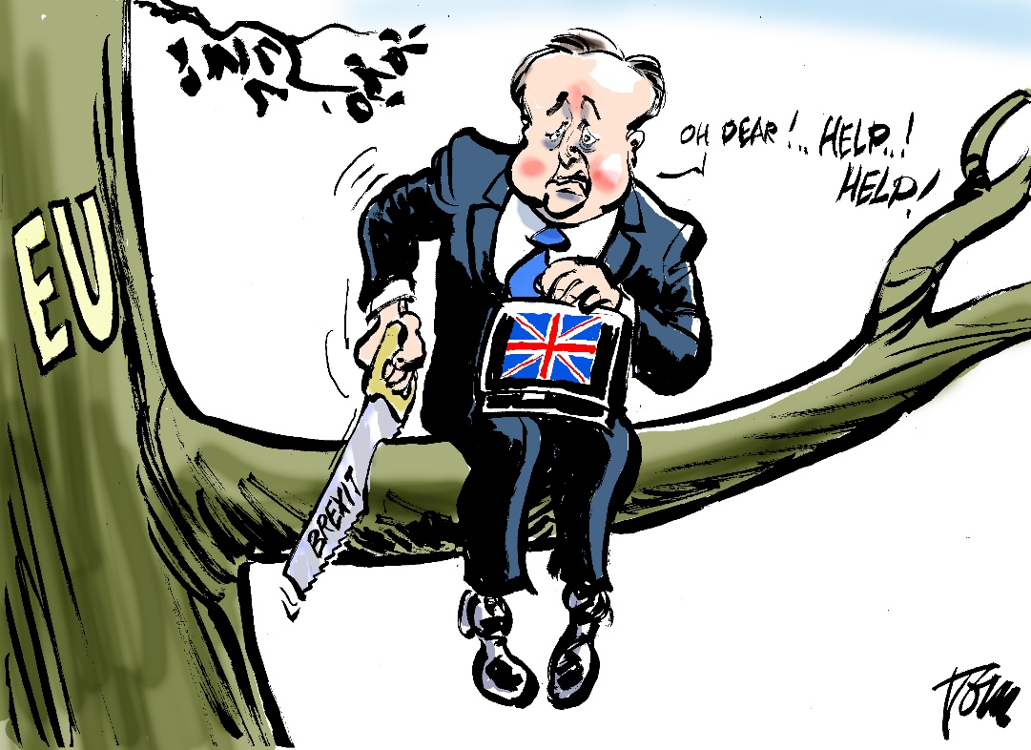
EU and the Third Countries
BREXIT
  23.6.2016 – Referendum – vote to leave
  Eurosceptics
  Populism
  Always special position
  31.1.2020 – officially OUT

Slide 36
EU and the Third Countries
Future possible Member states has to respects the EU's democratic values
Copenhagen criteria: preserve democratic governance and human rights, functioning market economy
Current candidate countries are:
  Albania
  Bosnia and Herzegovina
  Georgia
  Moldova
  Montenegro
  North Macedonia
  Serbia
  Türkiye
  Ukraine
    and Kosovo is a potential candidate.
International development aid (Africa, …

Slide 37
EU as International actor
Trade agreements - promoting international trade
  Bilateral treaties - with the Russian Federation
  Inter-regional treaties - with ASEAN
  Multilateral - with WTO
Changing business environment
  Goods -> services, “intellectual property“
Transatlantic Free Trade Area
Trade protection
  Unfair practices - e.g. dumping, trade barriers
  WTO

Slide 38
Forms of economic integration

Slide 39
Single Market
The Single Market (SM) = an area without internal borders, guaranteeing four fundamental freedoms:
  free movement of goods;
  free movement of services;
  free movement of persons;
  free movement of capital.
  The term "single internal market" or "single European market" is sometimes used.
SM provisions = a turning point in the development of the EU.
SM = backbone of the European integration process.
World's largest market with common rules and supervision (approx. 0.5 billion consumers, approx. 448 million excluding UK).
Still not finished

Slide 40
Single Market – goals and principles
Among the principles on which SM works are:
  Non-discrimination (prohibiting different treatment in the same situation on the basis of country of origin).
  Harmonisation (harmonisation of basic rules; approximation of Member States' laws to the extent necessary for the functioning of the market).
  Mutual recognition (a product manufactured and placed on the market in accordance with the law of one Member State must be accepted in another Member State).
  Market access (SM allow market access to beneficial players).

Slide 41
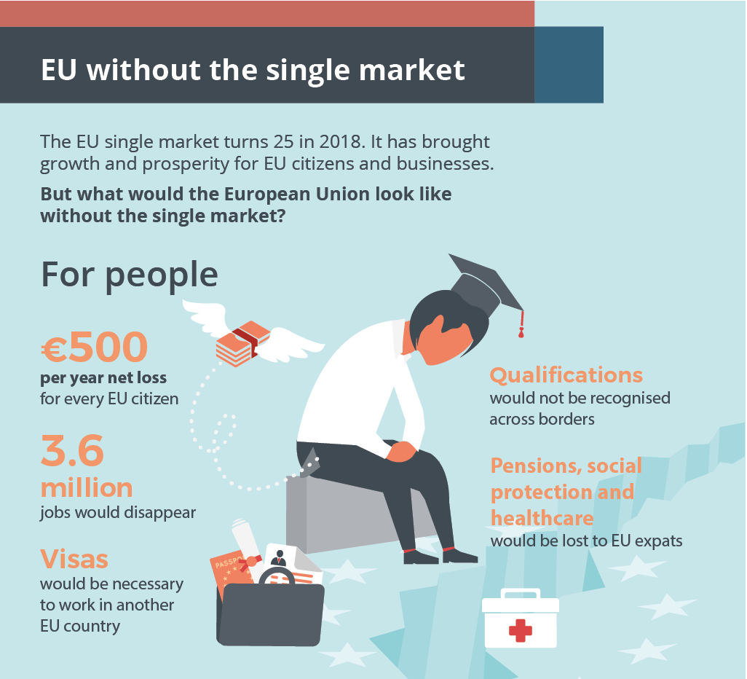
Single Market

Slide 42
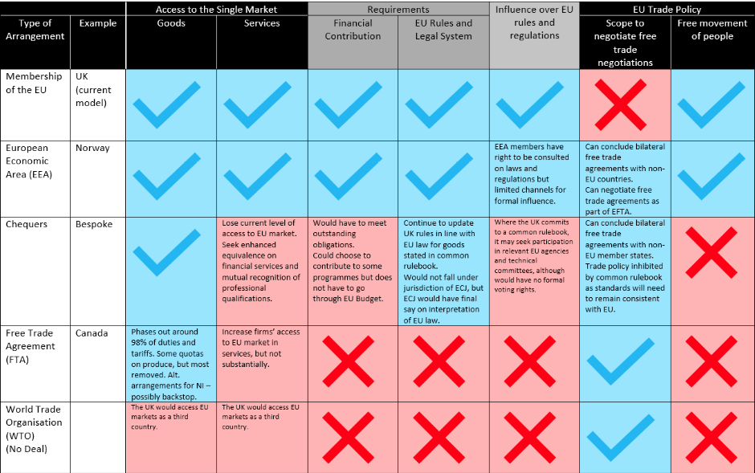

Slide 43
Competition policy
Competition policy (CP) is about applying certain rules to ensure that businesses and companies compete fairly in the marketplace.
It is one of the key and highly influential policies today.
The controversial nature of CP policy.
The results of CP policy can be seen in everyday life.
Major CP cases attract significant media attention.
  See Nestlé/Perrier cases 1992, GE/Honeywell 2001, Ryanair/Aer Lingus 2007, Microsoft (1993-2013), Gazprom, Google, Apple, Facebook, Amazon (present).
Some cases cross EU borders (see GE/Honeywell, Microsoft, Gazprom, Amazon).

Slide 44
Competition policy
Protection of small and medium-sized enterprises = a unique feature of European CP policy.
These firms (previously protected by tariffs and quotas) could otherwise hardly compete successfully with large firms.
Biggest benefits of the Competition policy
  It allows economic actors to compete freely in the market while protecting consumers from abuse by powerful companies;
  Promotes entrepreneurship and efficiency;
  Acts as a driver of innovation activity by companies;
  Expands the range of consumer choice;
  Helps to reduce prices and improve the quality of products and services.

Slide 47
Cohesion policy
Target
  To strengthen economic and social cohesion and reduce disparities between regions
Instruments
  Three 'Objectives' and four Community Initiatives;
    49.5% of the population in the EU-25 live in Objective 1 and Objective 2 areas
  Financial resources
    Approximately €233 billion (EU-25) representing one third of the total EU budget or 0.46% of EU GDP

Slide 48
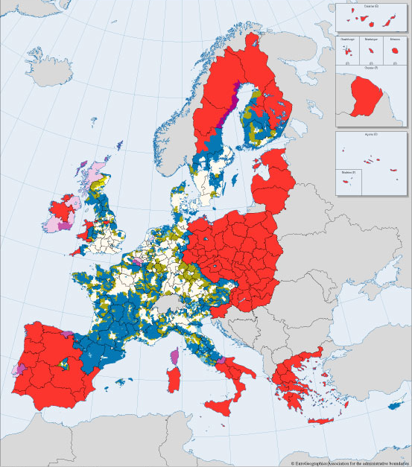
Objective 1 areas
Objective 2 areas

Slide 49
Cohesion policy
Objective 1 - Supporting the development of lagging regions
  Regions with a GDP below 75% of the EU average can benefit from support for sustainable development, in particular through investment in manufacturing. Objective 1 is achieved with the support of resources from all four Structural Funds - ERDF, ESF, EAGGF and FIFG.
Objective 2 - Support for areas facing restructuring
  All areas not covered by Objective 1 which have a long history of high levels of unemployment, crime, poor education or environmental conditions. Objective 2 is implemented by ERDF, ESF, FIFG.
Objective 3 - Support for employment and education policies
  Reduce unemployment through retraining, education and training. The ESF is the only fund used to achieve Objective 3.

Slide 50
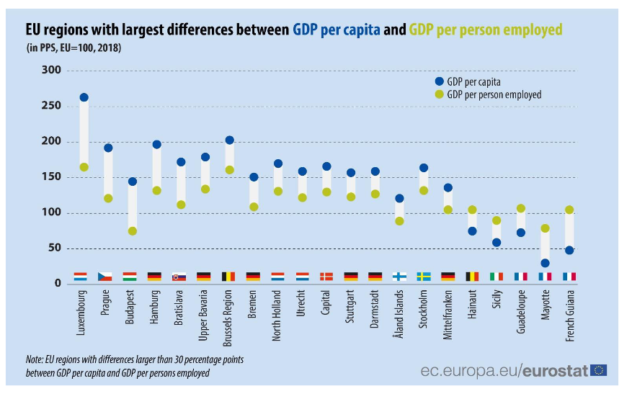

Slide 51
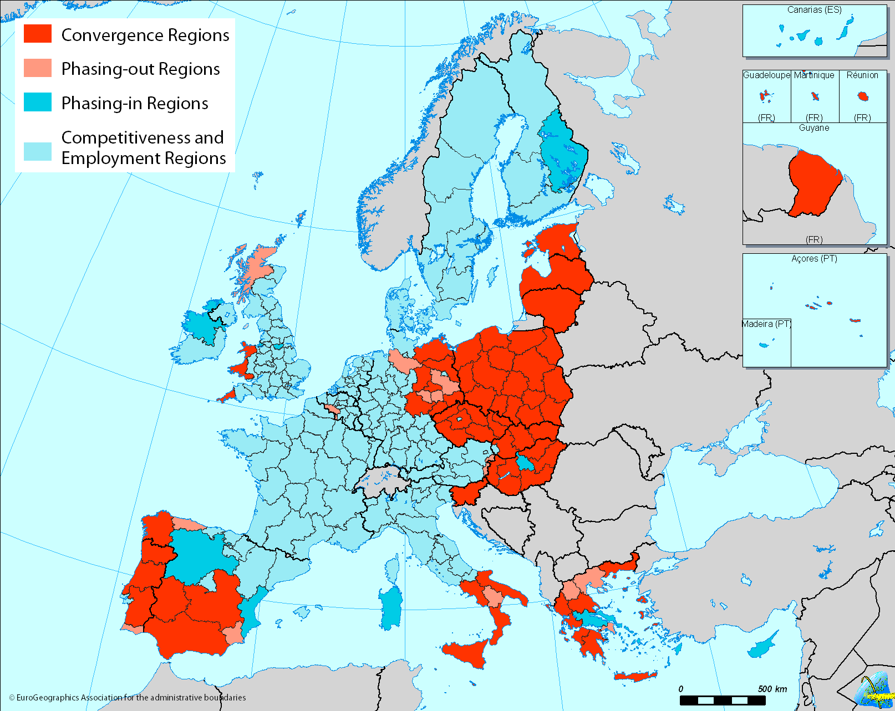

Slide 52
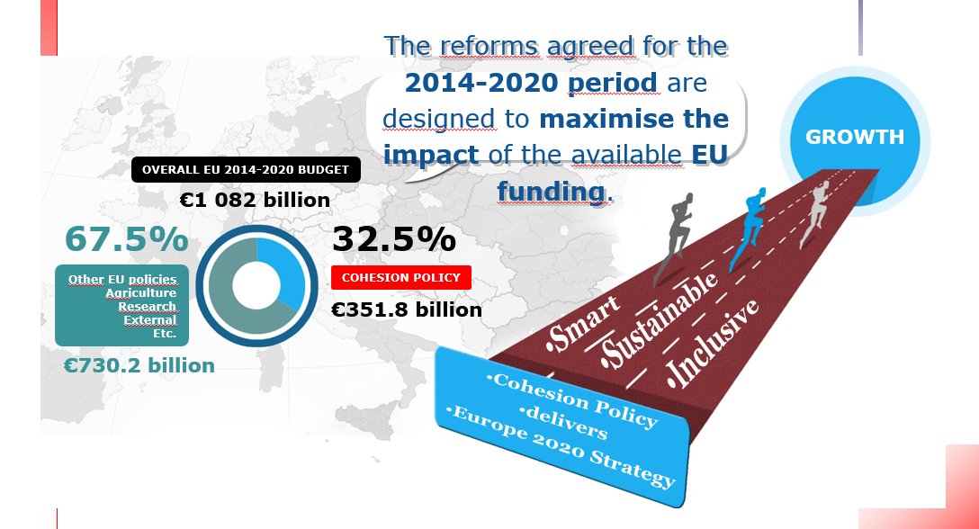

Slide 53
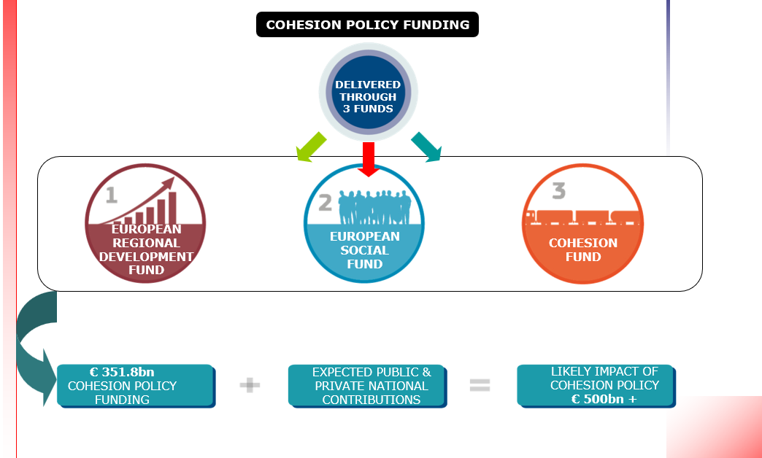
3 funds to invest in growth and jobs

Slide 54
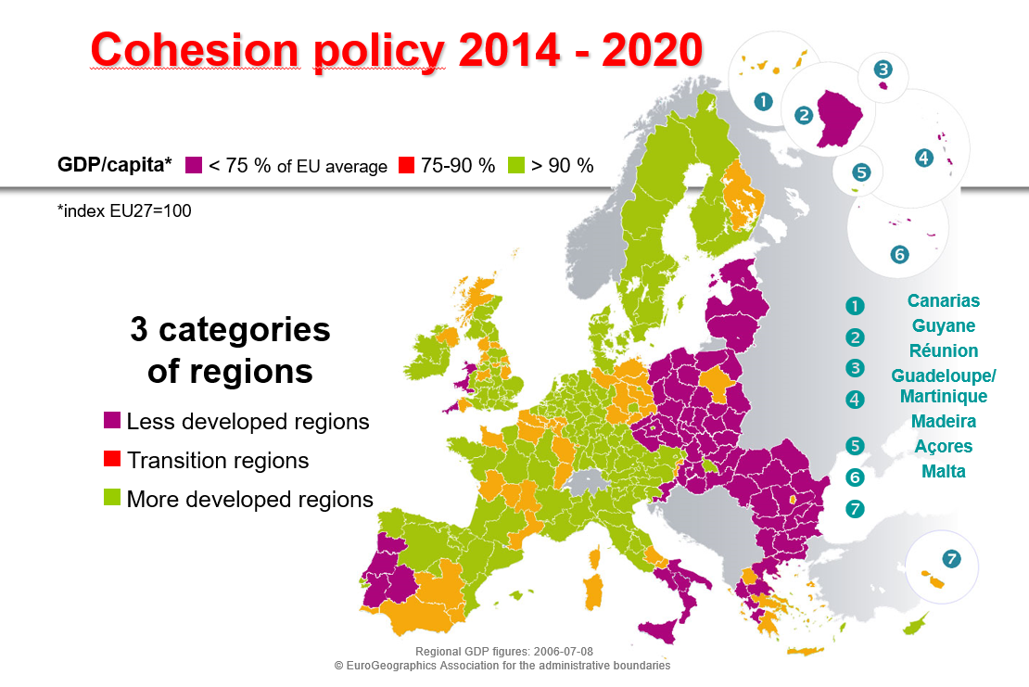

Slide 55
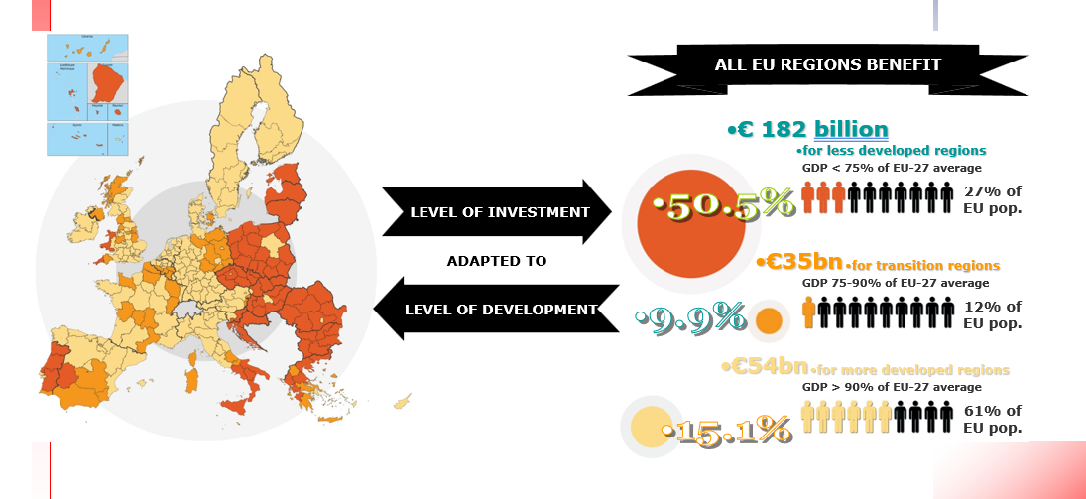

Slide 57
EU funding, grants, subsidies
EU provides funding for a range of projects and programmes
Strict rules, tight controls
EU funding comes in many different forms:
  grants – typically, people apply for grants by submitting ideas for projects following a ‘call for proposals’
  subsidies managed by national or regional authorities
  loans, guarantees and equity as forms of financial assistance to support EU policies and programmes
  loans to EU Member States and non-EU countries
  prizes for winners of Horizon Europe contests.
Cohesion funds x Direct programmes

Slide 58
EU funding
Direct management: EU funding is managed directly by the European Commission
Shared management: the European Commission and national authorities jointly manage the funding
Indirect management: funding is managed by partner organisations or other authorities inside or outside the EU

Slide 59
EU support
Researchers
Farmers & rural businesses
Small & medium-sized businesses
Young people
Public bodies
Non-governmental, non-profit organisations
Other beneficiaries

Slide 60
Structural and Investment Funds
European Regional Development Fund (ERDF)
  It focuses on modernizing and strengthening the economy. It supports investment (infrastructure) projects such as construction of roads and railways, removal of environmental burden, construction of sewage systems, promoting innovation potential of entrepreneurs, development and renovation of sports complexes, reconstruction of cultural monuments, planting regenerating greenery, construction or repairs of infrastructure for the provision of health care, introducing eGovernment services, etc.
European Social Fund (ESF)
  The ESF supports activities in the areas of employment and human resources development. The ESF supports non-investment (non-infrastructure) projects such as retraining of the unemployed, special programmes for people with disabilities, children, youth, ethnic minorities and other disadvantaged groups of citizens, creation of innovative educational programmes for employees, development of employment services institutions, development of educational programmes, etc.
Cohesion Fund (CF)
  Unlike the Structural Funds, the Cohesion Fund is designed to support the development of poorer countries, not regions. Similarly to the ERDF, it supports investment (infrastructure) projects but only those focused on large-scale transport infrastructure (e.g. trans-European networks), environmental protection and the area of energy efficiency and renewable energy resources.
European Agricultural Fund for Rural Development (EAFRD)
  It is a financial instrument to support rural development, which falls under the EU Common Agricultural Policy. EAFRD funds are used to enhance the competitiveness of agriculture and forestry, improve the environment and landscape or quality of life in rural areas, and diversification of rural economy.
European Maritime and Fisheries Fund (EMFF)
  It is a financial instrument to support fisheries, which falls under the EU Common Agricultural Policy. The Fund supports projects leading to higher competitiveness and environmental protection. It finances activities related to marine and inland fishing (e.g removal of silt from lagoons), investment in modernization of the processing industry, modernization of vessels, support for disposal of already inadequate vessels, improving aquaculture, etc.

Slide 61
Other Funds
Solidarity Fund
  The Fund provides speedy and flexible financial assistance during major natural disasters. Assistance may be requested by a Member State if the damages exceed 0.6% of the GDP of the affected country. The Fund may also provide assistance to preventive measures against these natural disasters.
European Globalisation Adjustment Fund
  The European Globalisation Adjustment Fund (EGF) finances projects helping employees made redundant as a result of globalisation. This means e.g. in the case of bankruptcy of a large company or relocation of a factory outside the EU or when many people are made redundant at once in a certain region and sector. Assistance from this Fund may be requested by Member States only.

Slide 62
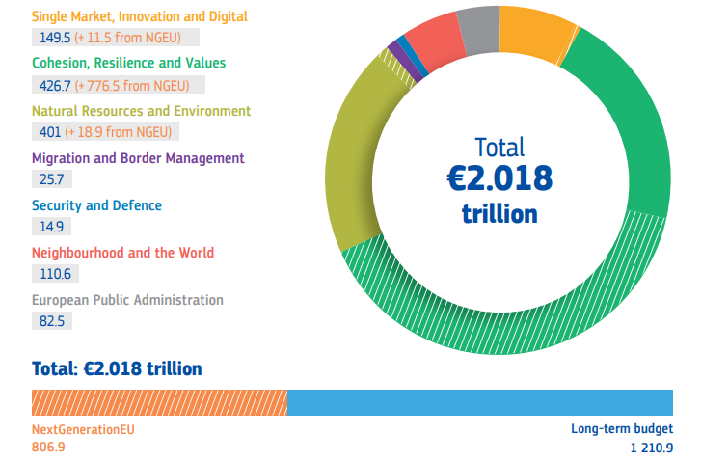
2021 - 2027

Slide 63
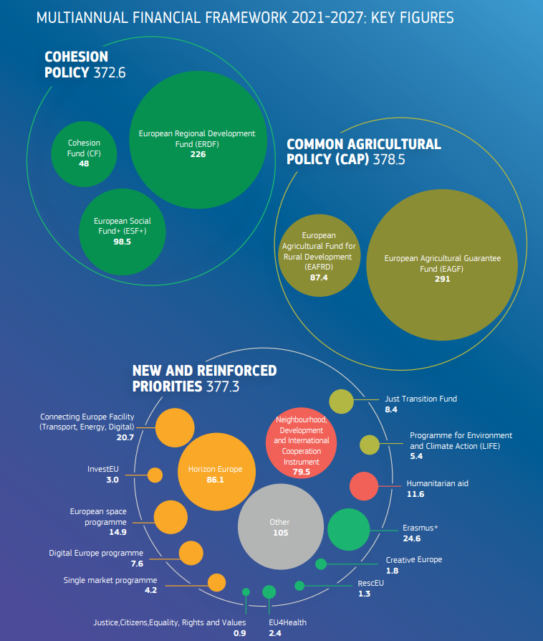
2021 - 2027

Slide 64
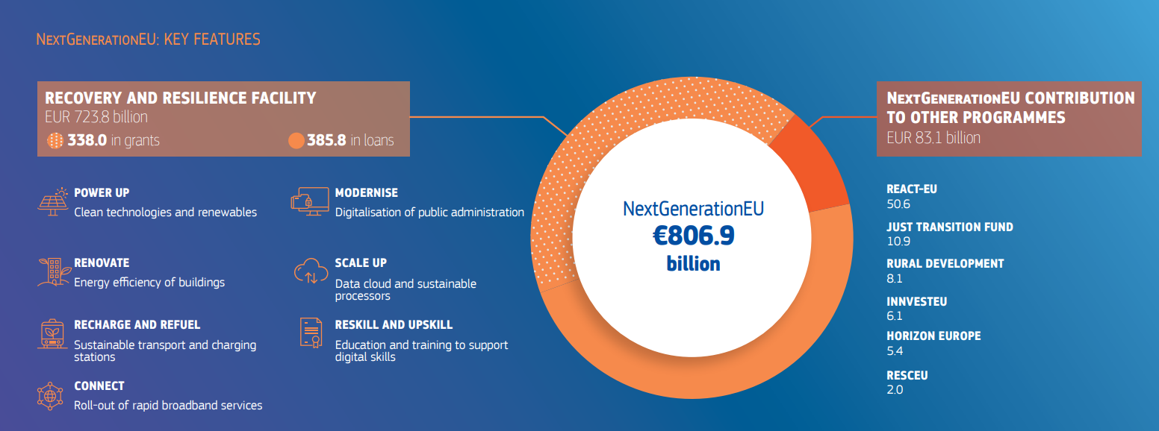
2021 - 2027

Slide 65
