Slide 1

Makroekonomie
21. 03. 2024
Olomouc
Autor: doc. Ing. Magdaléna Drastichová, Ph.D.

Slide 2
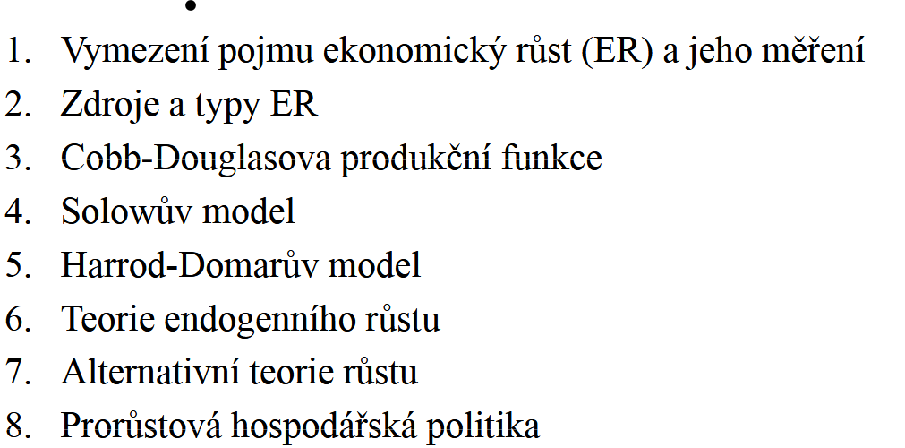
Obsah

Slide 3

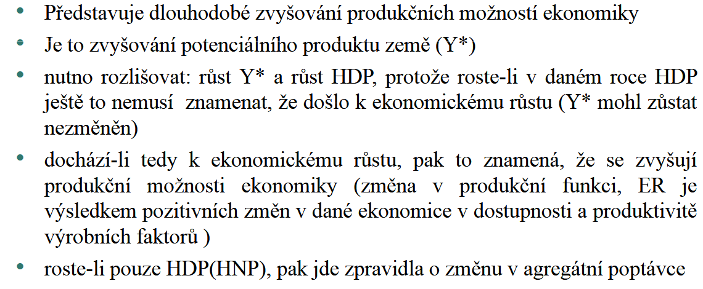
Notes:
Rozšíření: https://www.econlib.org/library/Enc/PhillipsCurve.html
A W Phillips The Relation Between unemployment and the Rate of Change of Money Wage Rates in the United Kingdom, 1861-1957 Vol 25 Issue 100, November 1958

Slide 4

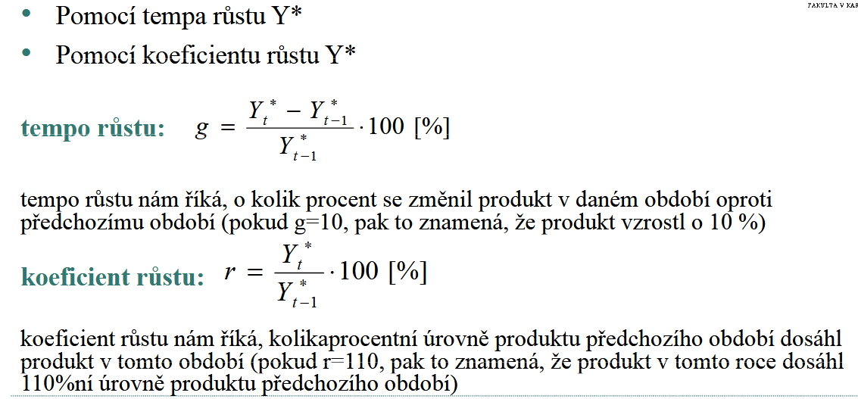
Notes:
Rozšíření: https://www.econlib.org/library/Enc/PhillipsCurve.html
A W Phillips The Relation Between unemployment and the Rate of Change of Money Wage Rates in the United Kingdom, 1861-1957 Vol 25 Issue 100, November 1958

Slide 5
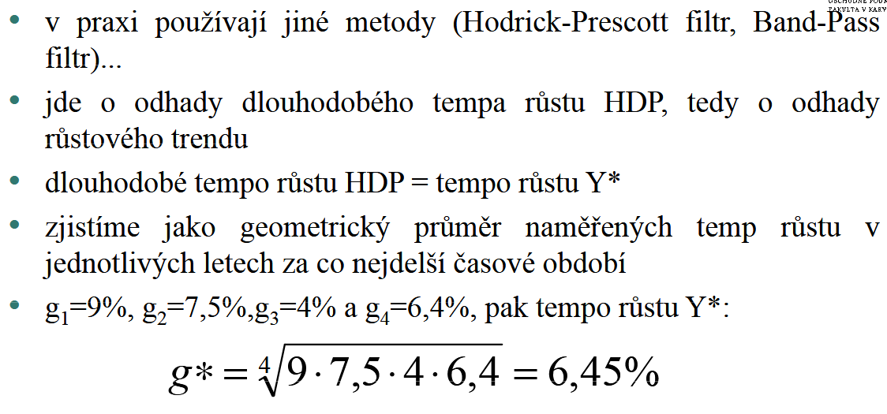
Notes:
Rozšíření: https://www.econlib.org/library/Enc/PhillipsCurve.html
A W Phillips The Relation Between unemployment and the Rate of Change of Money Wage Rates in the United Kingdom, 1861-1957 Vol 25 Issue 100, November 1958

Slide 6

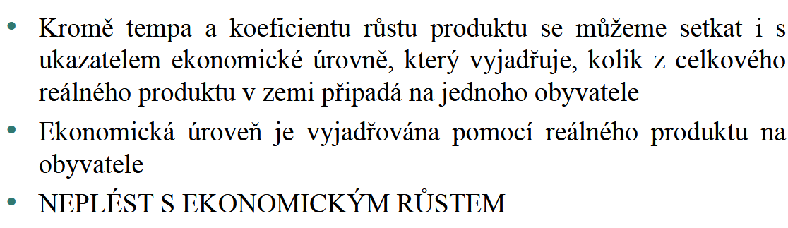
Notes:
Rozšíření: https://www.econlib.org/library/Enc/PhillipsCurve.html
A W Phillips The Relation Between unemployment and the Rate of Change of Money Wage Rates in the United Kingdom, 1861-1957 Vol 25 Issue 100, November 1958

Slide 7
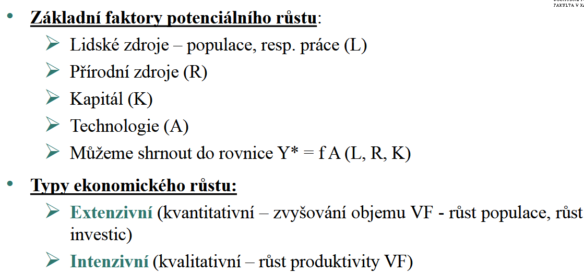
Notes:
Rozšíření: https://www.econlib.org/library/Enc/PhillipsCurve.html
A W Phillips The Relation Between unemployment and the Rate of Change of Money Wage Rates in the United Kingdom, 1861-1957 Vol 25 Issue 100, November 1958

Slide 8
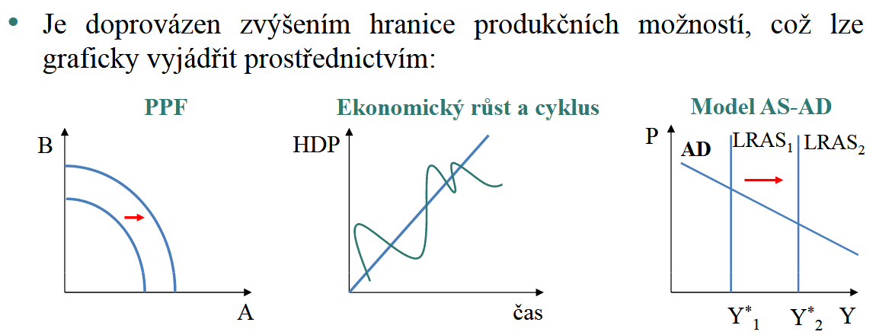

Slide 9
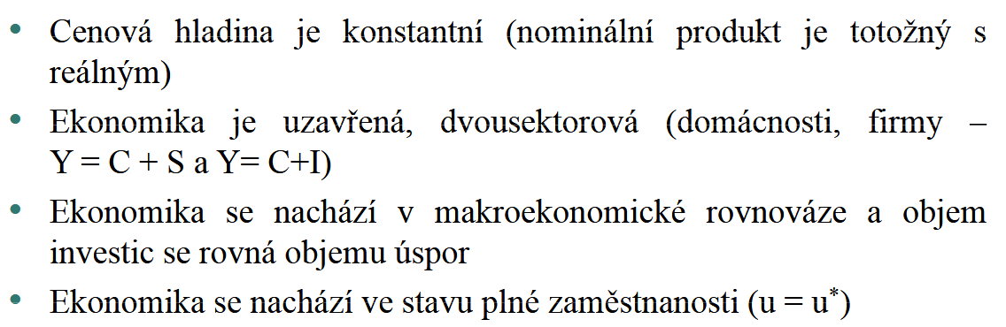

Slide 10
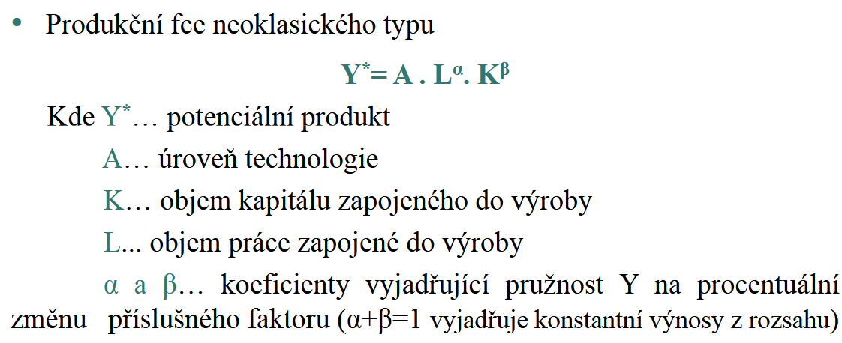

Slide 11
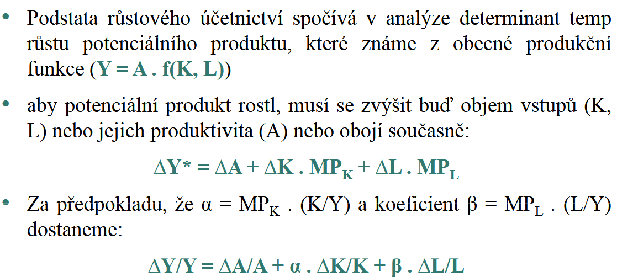

Slide 12
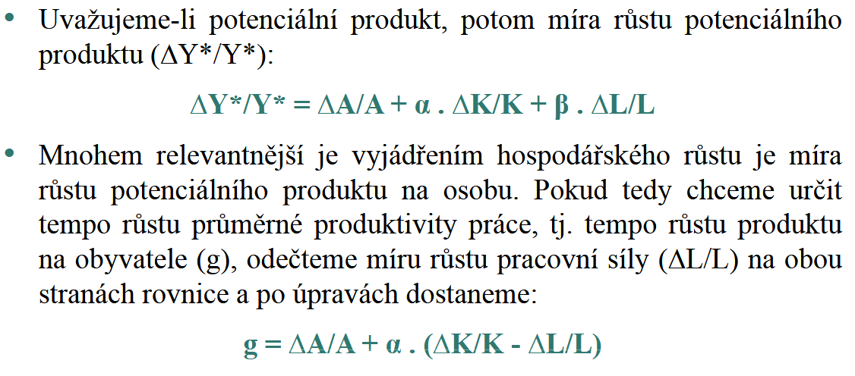

Slide 13
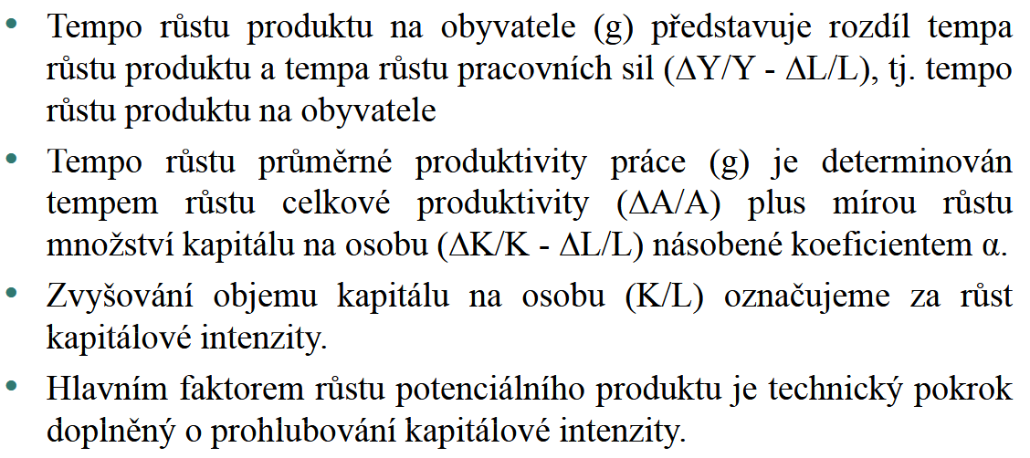

Slide 14
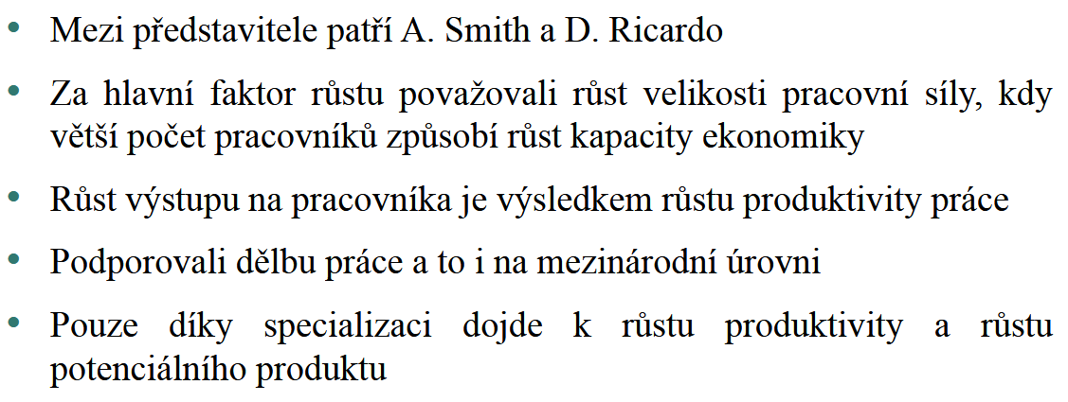

Slide 15

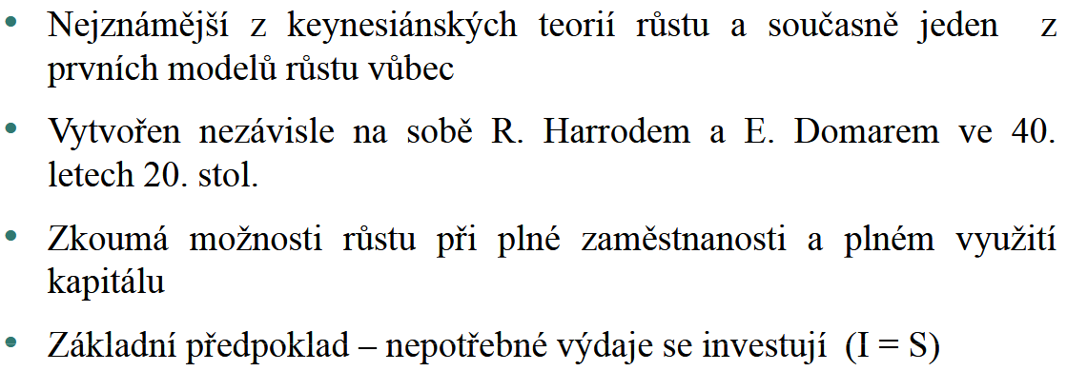

Slide 16
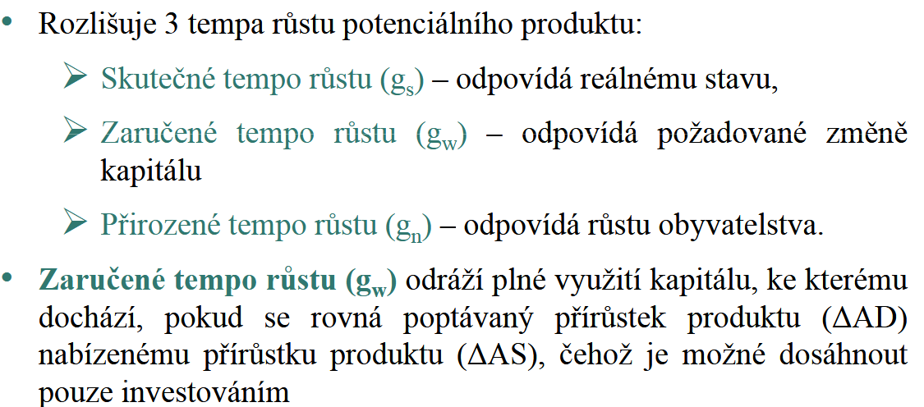

Slide 17
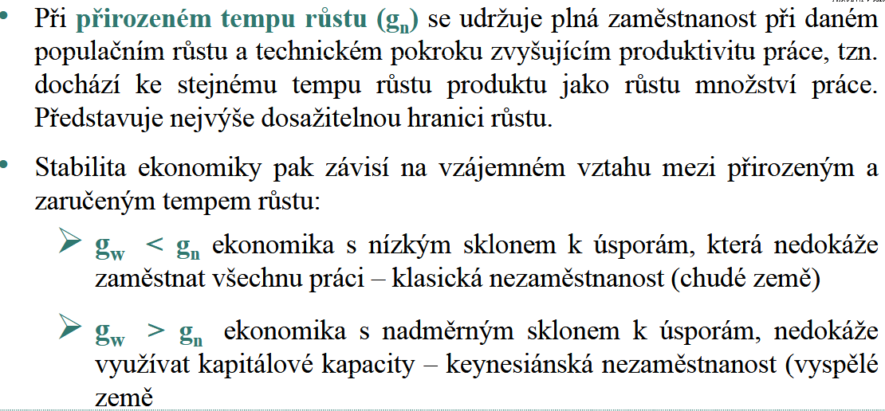

Slide 18
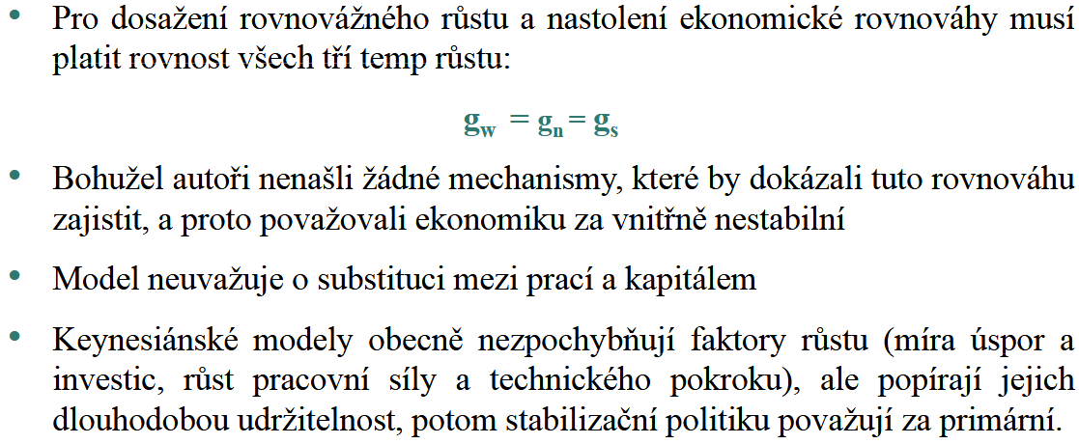

Slide 19

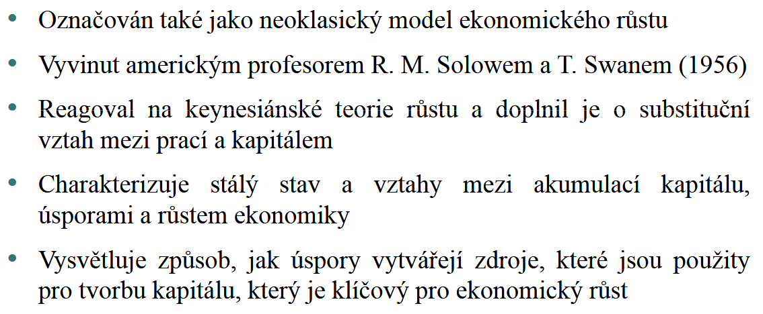

Slide 20
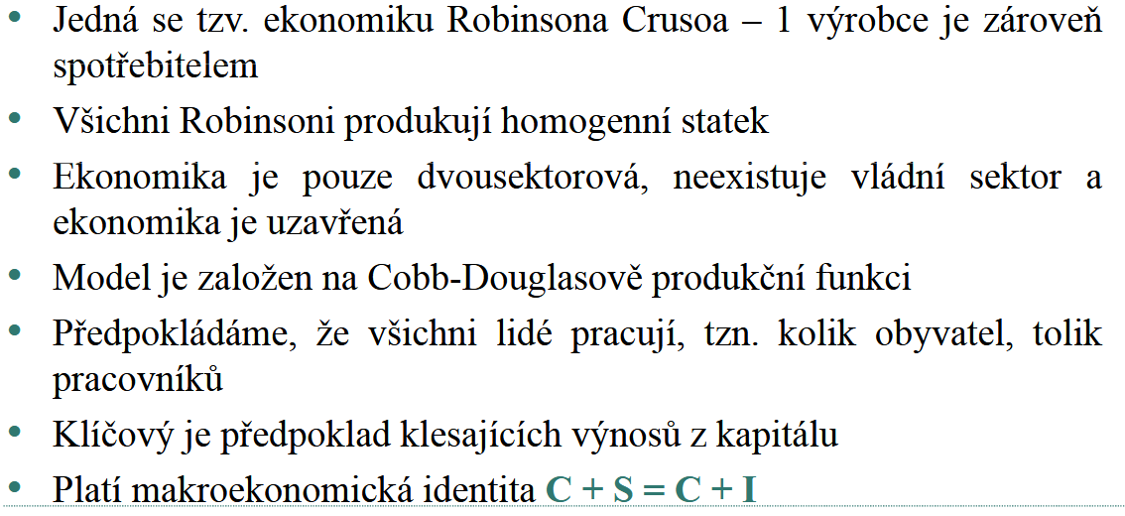

Slide 21
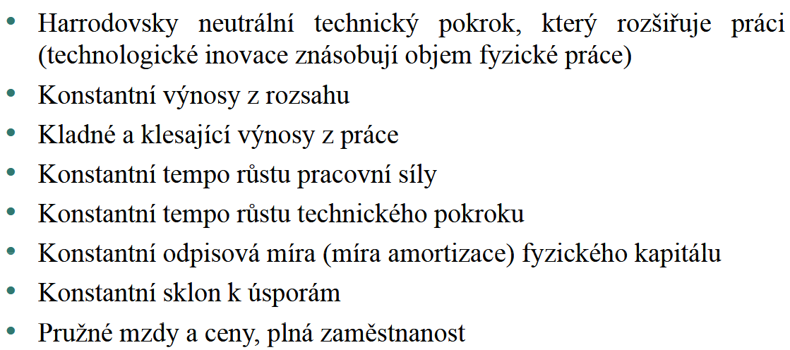

Slide 22
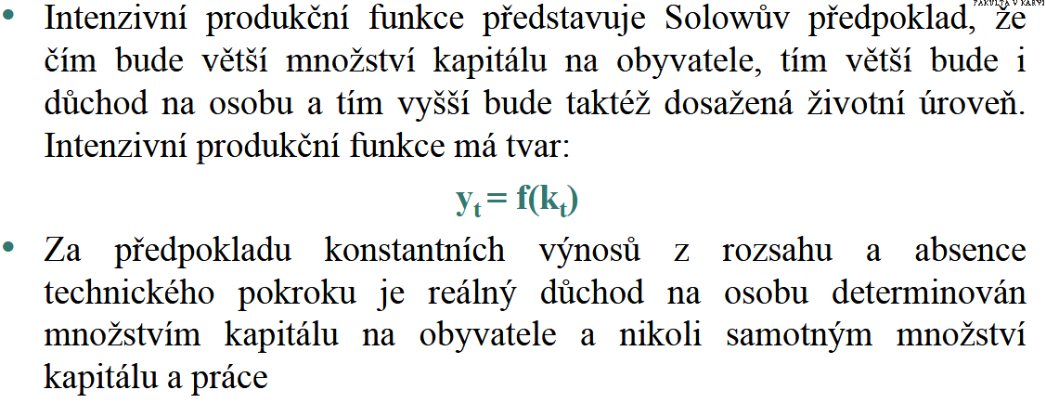

Slide 23
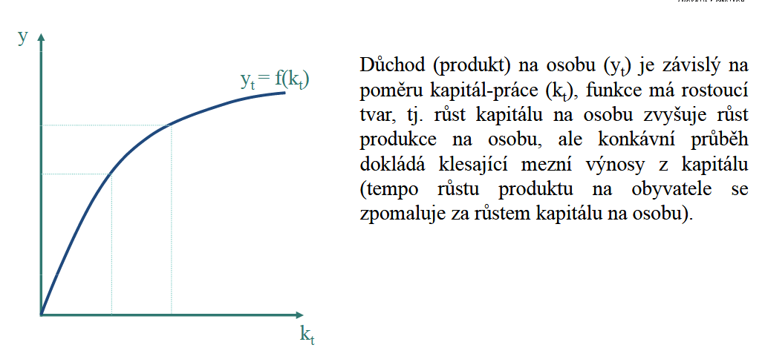

Slide 24
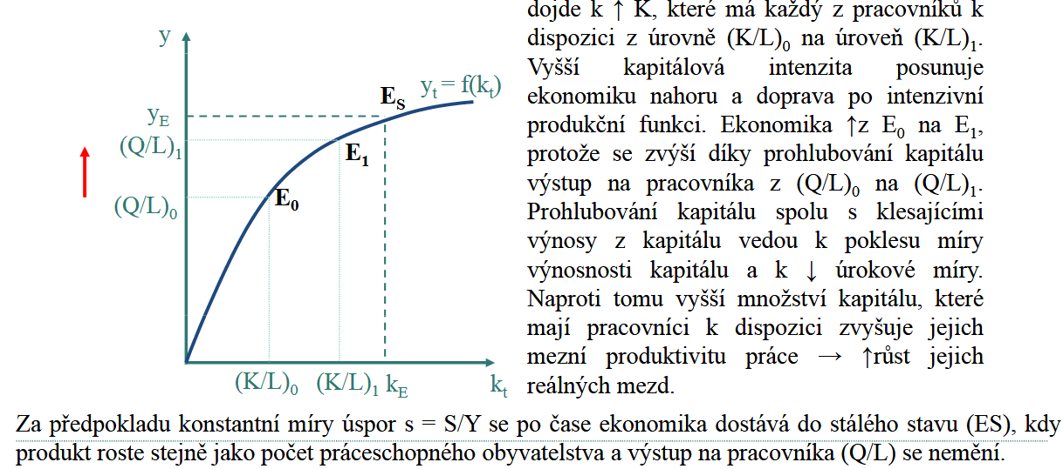

Slide 25

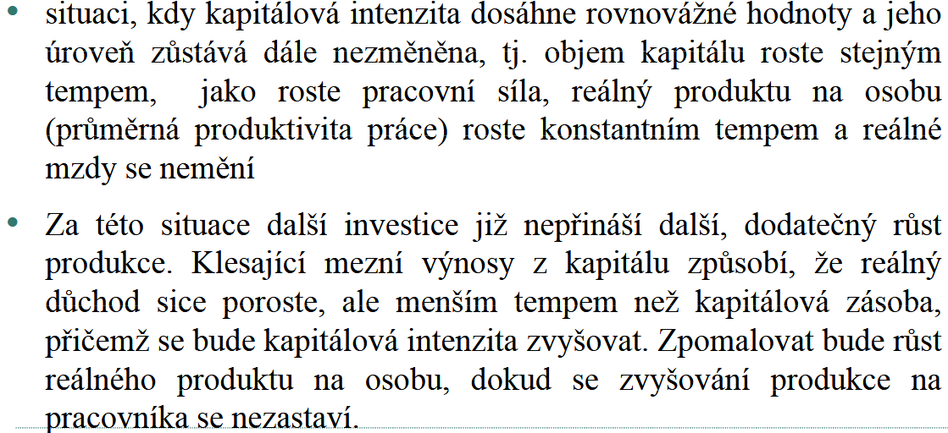

Slide 26
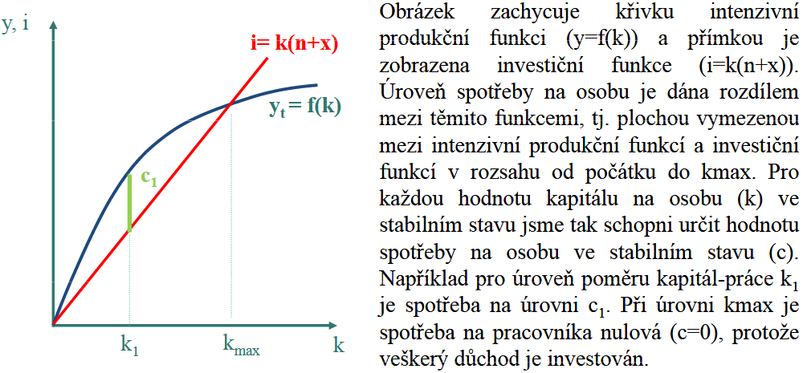

Slide 27
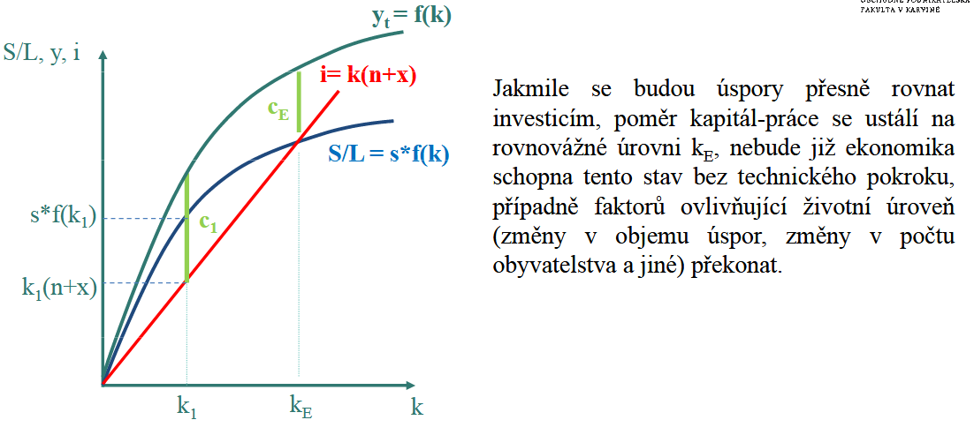

Slide 28
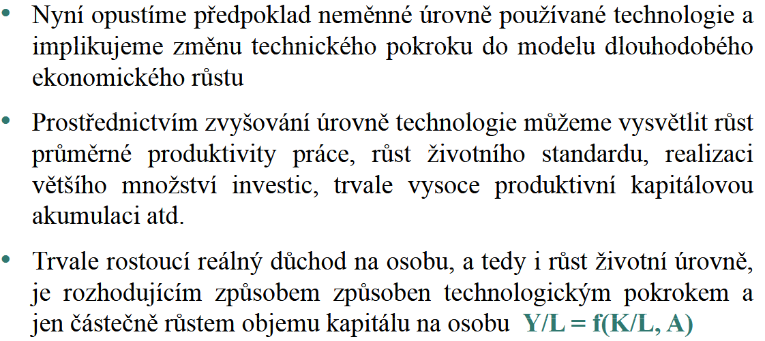

Slide 29
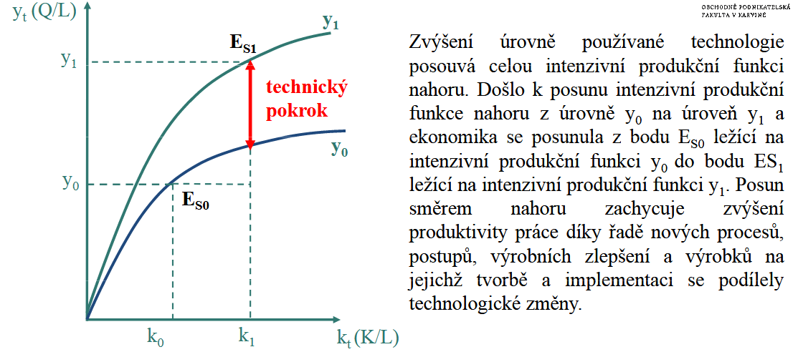

Slide 30
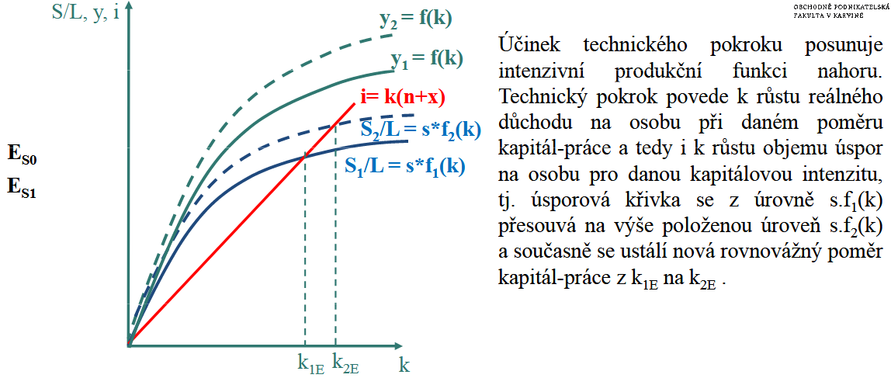

Slide 31

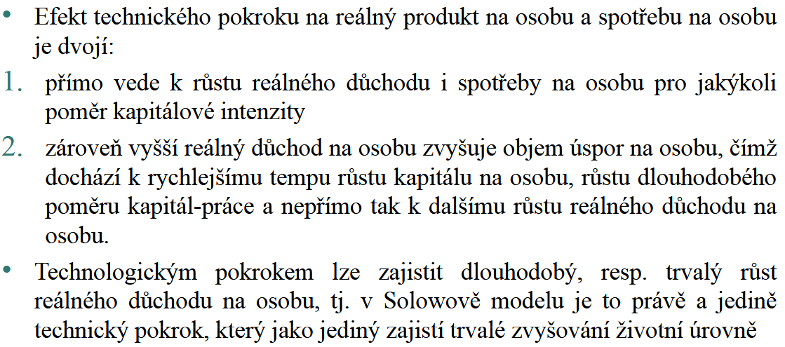

Slide 32
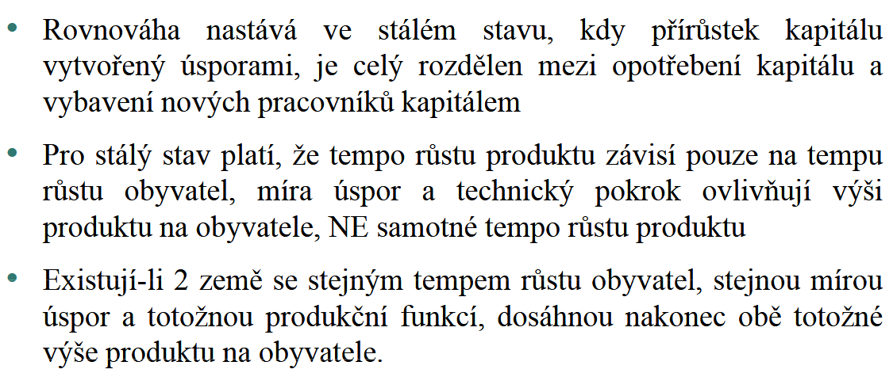

Slide 33
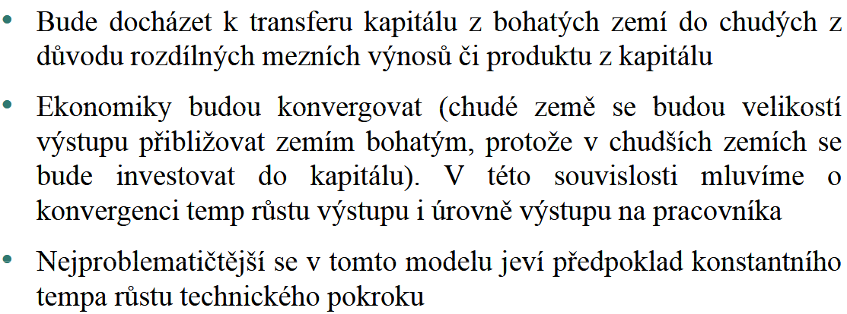

Slide 34

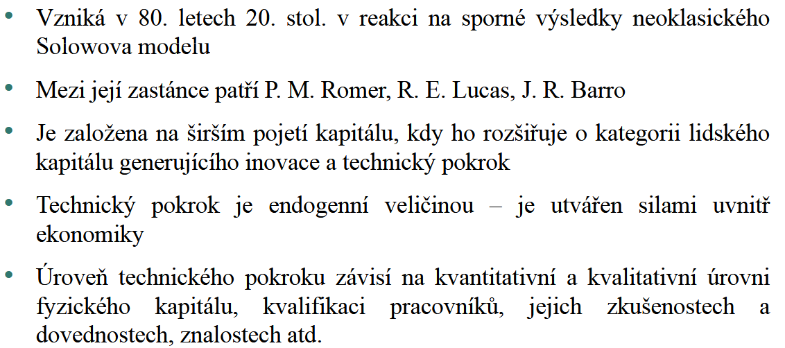

Slide 35
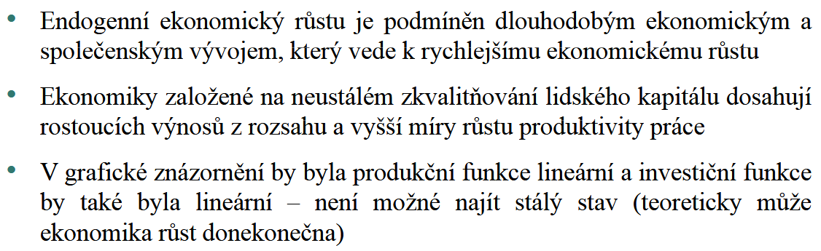

Slide 36

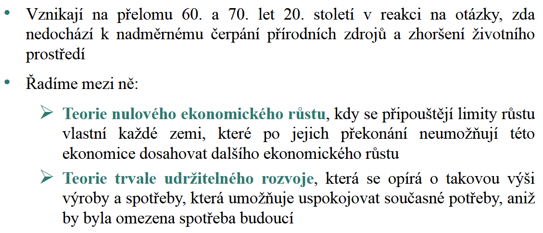

Slide 37
DĚKUJI ZA POZORNOST

