Slide 1
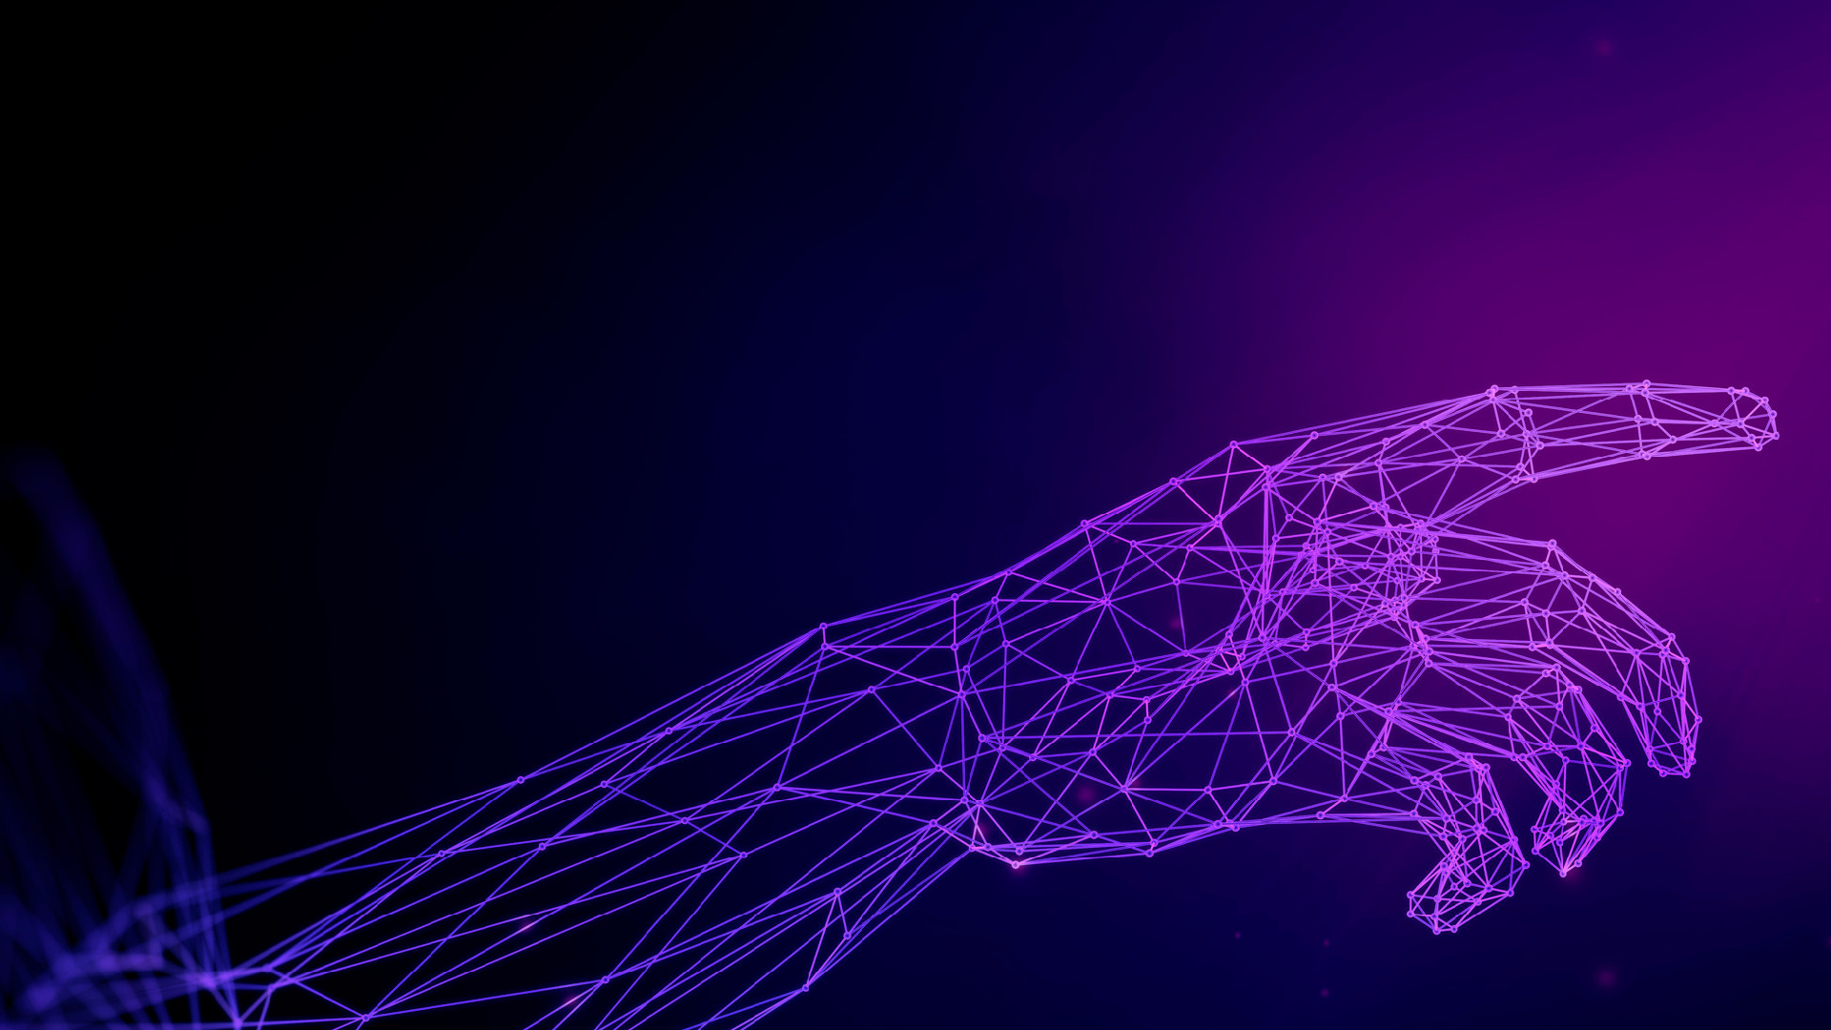
MORAVI AN BUSINESS COLLEGE OLOMOUC
Digital marketing
TRENDS I N ONLINE MARKETI NG

Slide 2
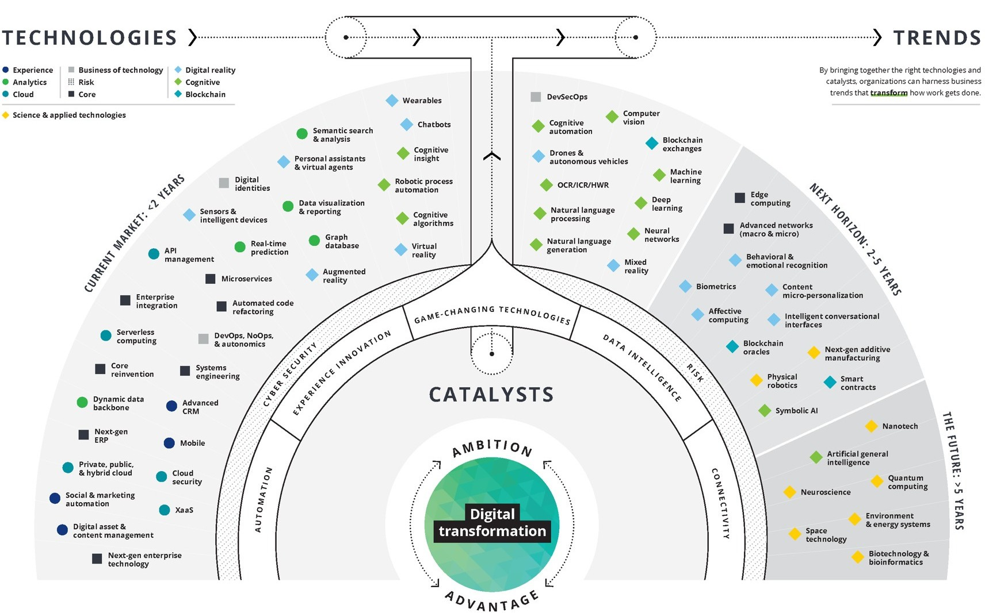

Slide 3
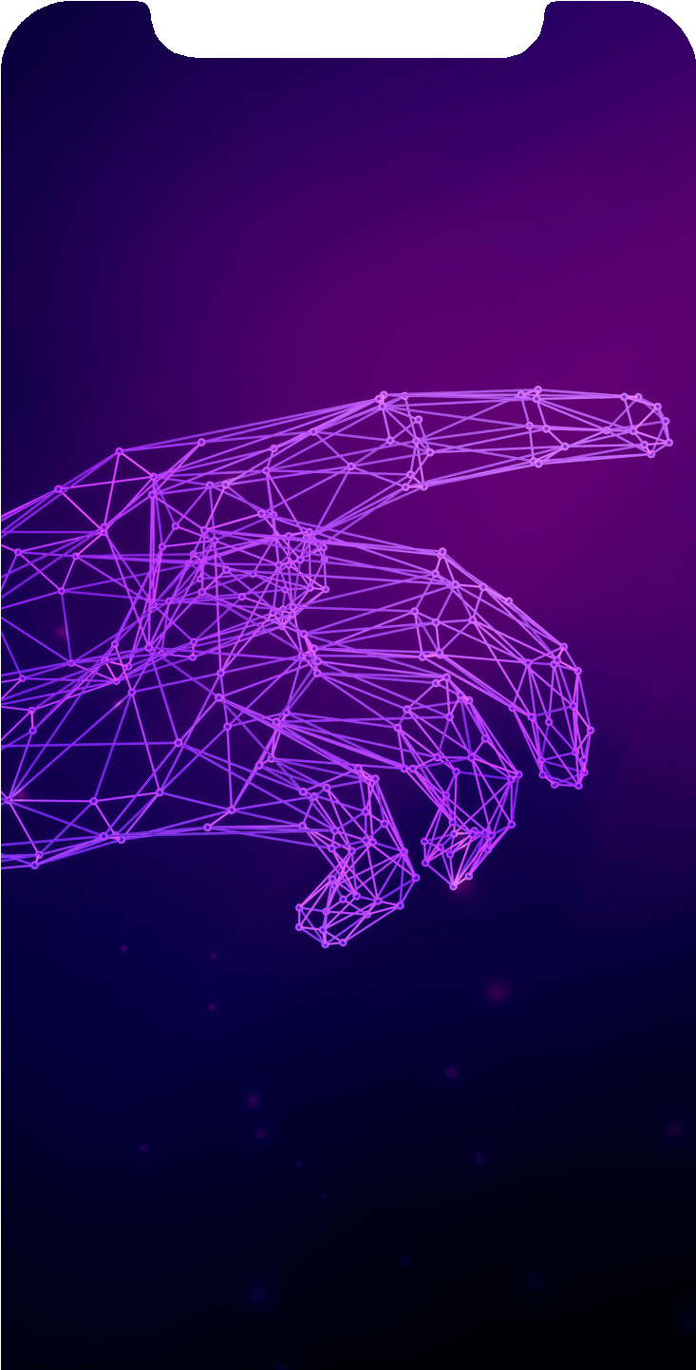
Hypermediation
Multiplication of media elements Targeted emphasis on diversity of forms
Typical e.g. for websites

Slide 4
Immediation
The aim is to remove the medium itself
Example: virtual reality

Slide 5
Artificial Intelligence
Marketing automation Market segmentation Emotional analysis Product recommendation

Slide 6
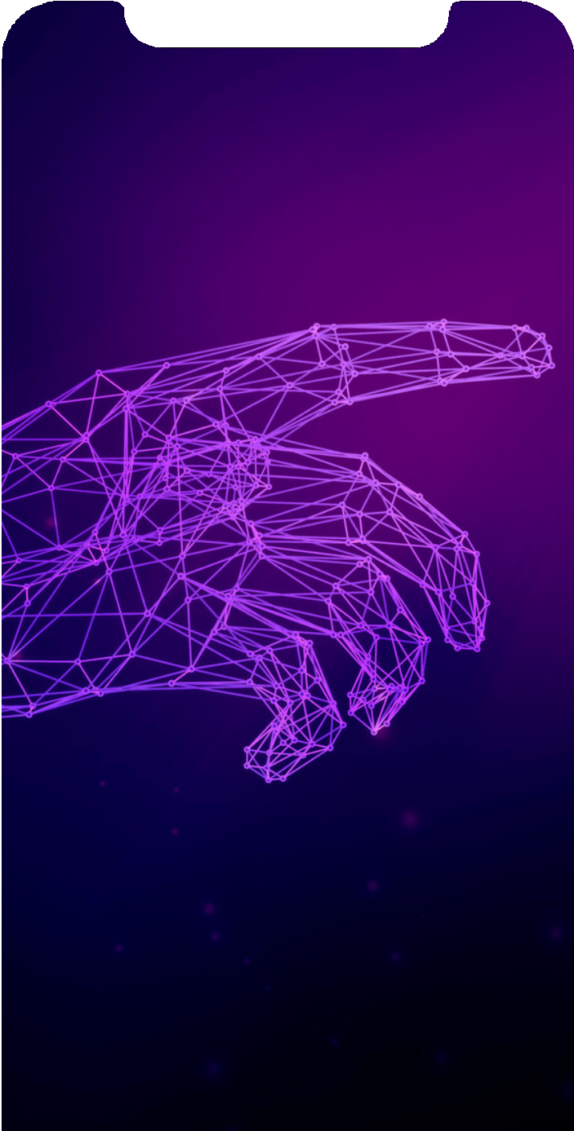
Conversational Marketing
Chatbot Speed Naturality
Fulfilling needs

Slide 7
Video marketing
High engagement
User-generated content Livestream

Slide 8
Influencer marketing
Influencer = affiliate partner Celebrity effect Authenticity

Slide 9
Search engine optimization
Social networks alone won't save you Instagram doesn't use links Facebook penalizes links with less reach
Must have a good SEO setup

Slide 10
Voice search
The increasing intelligence of mobile and computer interfaces The development of conversational voice robots Advanced voice analytics

Slide 11
Omnipresence
The fragmentation of online lives Frequency of online platforms Be everywhere, be seen
The problem? The form of the message (one video for all channels really doesn't work)

Slide 12
Experiential marketing
It replaces traditional digital marketing methods (SEO, content...) Use of analytical and cognitive tools Effective interpretation of customer wishes

Slide 13
E-mailing
Basic DM tool Advantages
high return on investment automation personalisation

