Slide 1

MORAVIAN BUSINESS COLLEGE OLOMOUC
Digital marketing
SOCIAL NETWORKS AND THEIR USE IN MARKETING COMMUNICATION

Slide 2
Facebook
    Relevant by impact, widest range of activities
    Wide range of formats
    Images
    Videos
    360° videos
    Polls
    Stories
    The importance of groups (instead of feed)
    Customer care - the ability to post on messenger
    The most sophisticated advertising system

Slide 3
Instagram
    Age group on Instagram
    18-24 years old (30.8%)
    25-34 years old (30.3%)
    The gender distribution is almost even with 48.2% female and 51.8% male
    990+ mil. active users daily
    Completely visual platform
    Big boom of Stories, Reels - for many users primary channel
    Same targeting and retargeting options
    Functional hashtags - unlike Facebook

Slide 4
LinkedIn
    Business orientation
    Possibility to upload a presentation
    Download links
    Unique targeting options - position, seniority, company size
    HR features!

Slide 5
X/Twitter
    Journalists
    Politicians
    Marketers
    Entrepreneurs
    Limited scope and content of posts
    Direct Messages (daily): limit is 500 messages sent per day.
    Posts: 2,400 per day.
    Changes to account email: 4 per hour
    Minimum number of stable active users in the Czech Republic - tens of thousands
    USA - 105.4 mil. users, 50.5 mil users active daily
    Additional channel to Youtube or Instagram

Slide 6
Communication mix and social media
    Social platforms as mass media
    TV prime time - 3.5 million viewers x Social - 5.7 million regular users (daily)
    A mass hit? TV or Social?
    FB - people over 65 make up 15% of audience
    FB is a strong platform - growing number of posts from brands - more overload in feed
    1 person on FB can consume 300 posts per day
    We see 2,000 posts per day on FB
    At least 95 million photos and videos are posted on Instagram every day of which Reels are the most popular

Slide 7
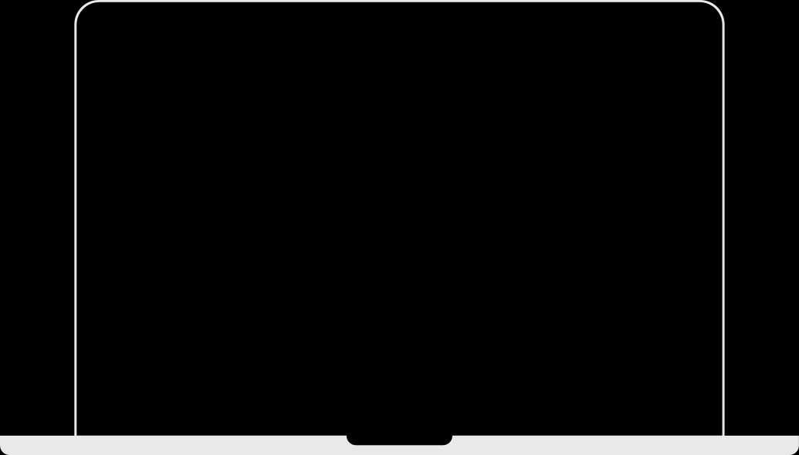
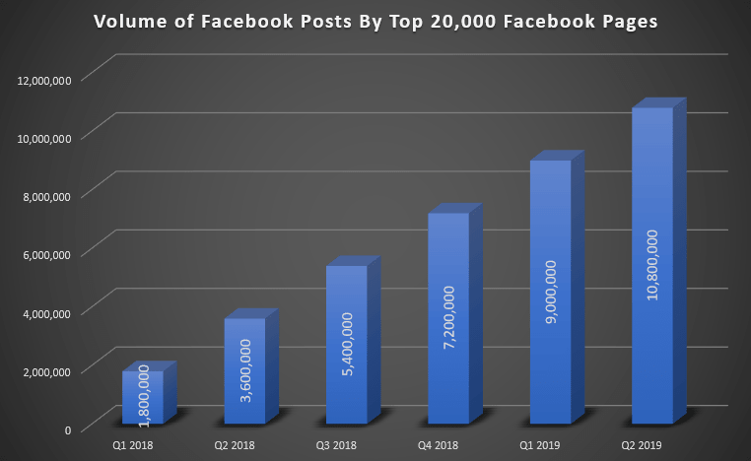
Communication mix and social media
    Greater overpressure
    Selection by relevance
    More content - less involvement
    Moving into groups/ away from mass communication
    1.5 billion users within groups
    1.3 billion on Messenger
    How to work with this?

Slide 8
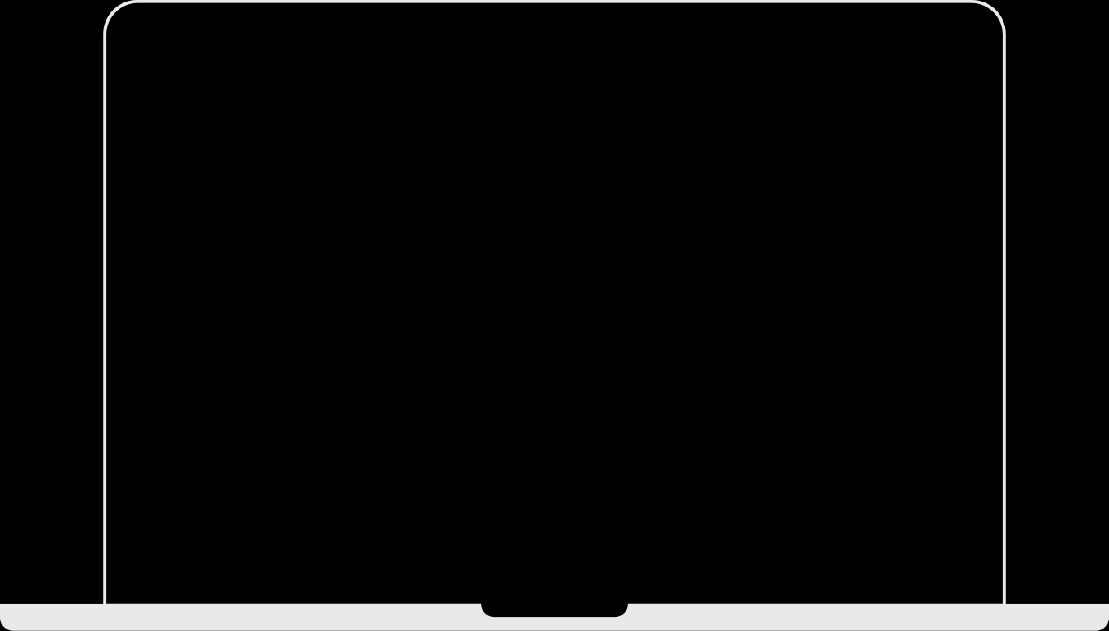
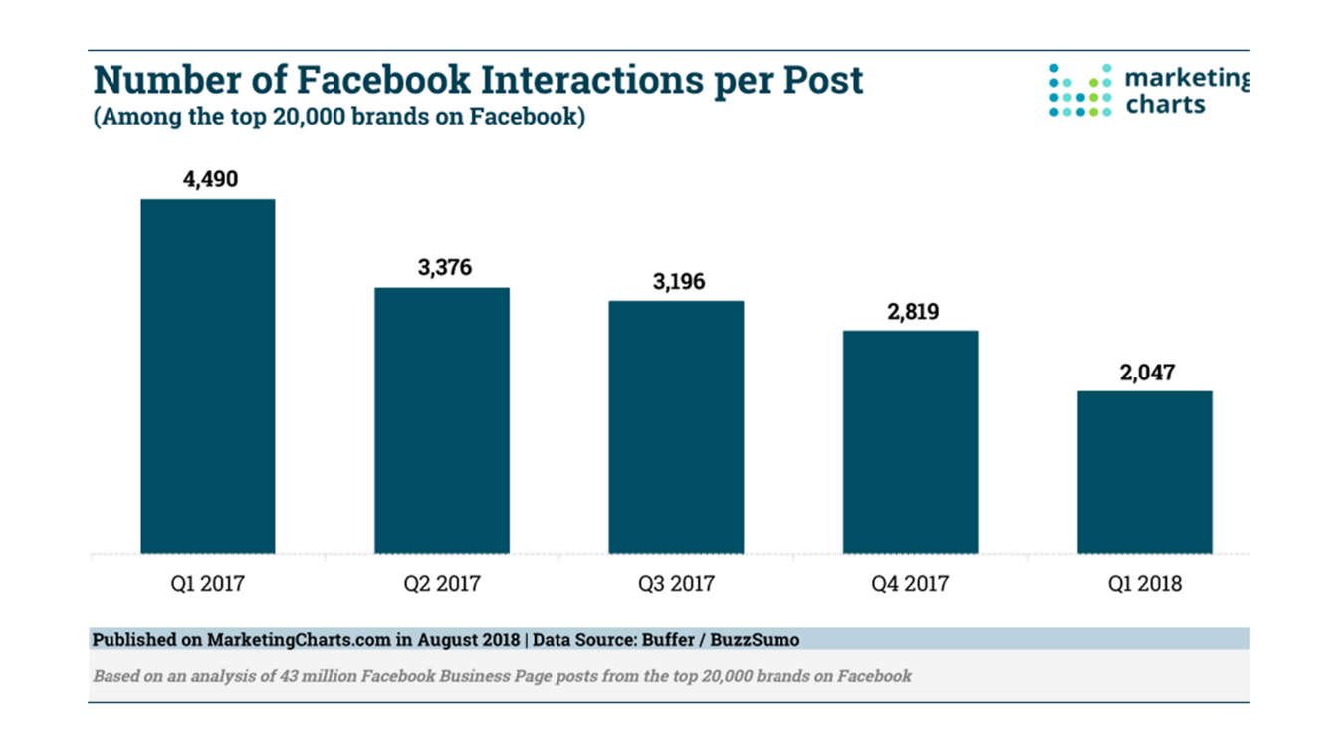
Communication mix and social media

Slide 9
How organic traffic contributes to
building a business?
Are organic posts enough?

Slide 10
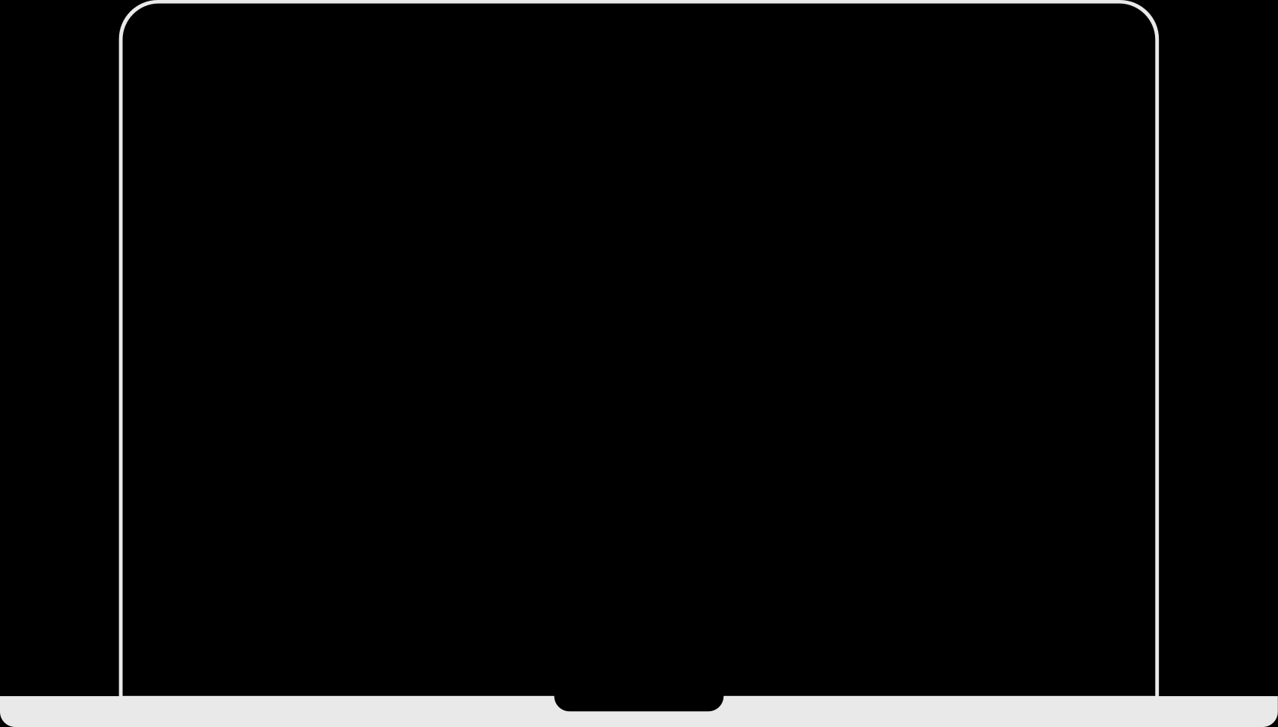
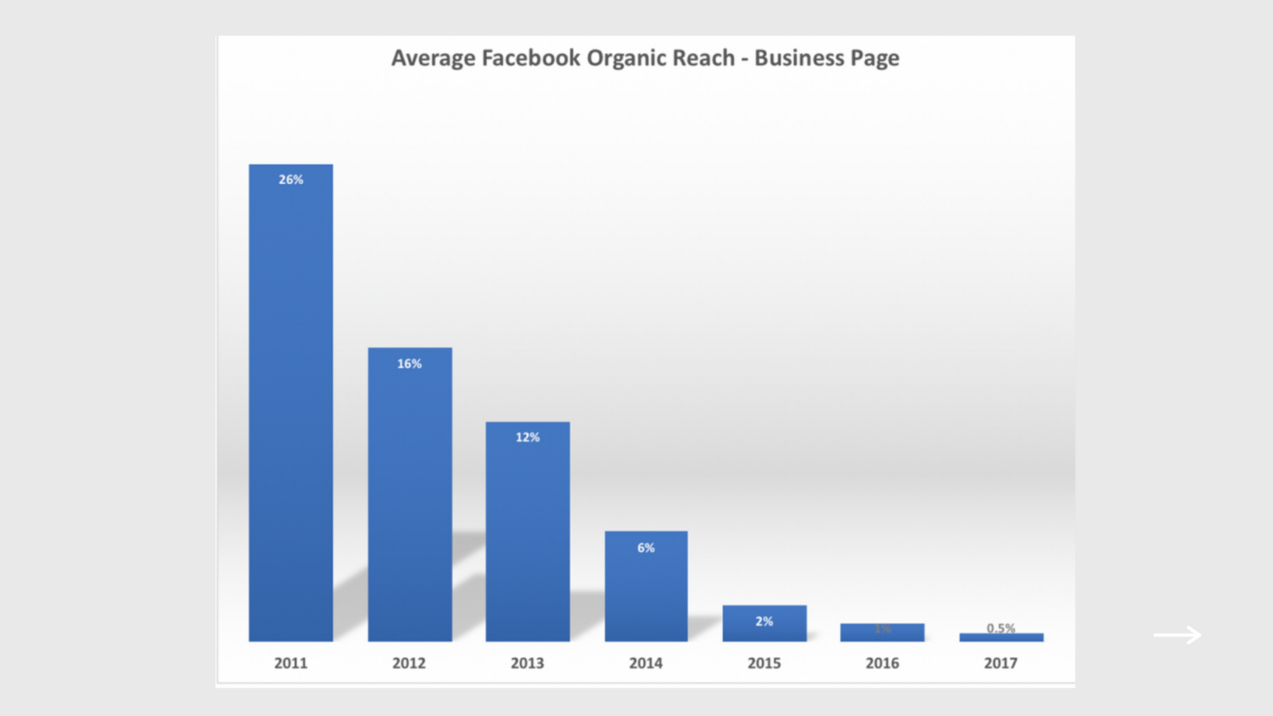

Slide 11
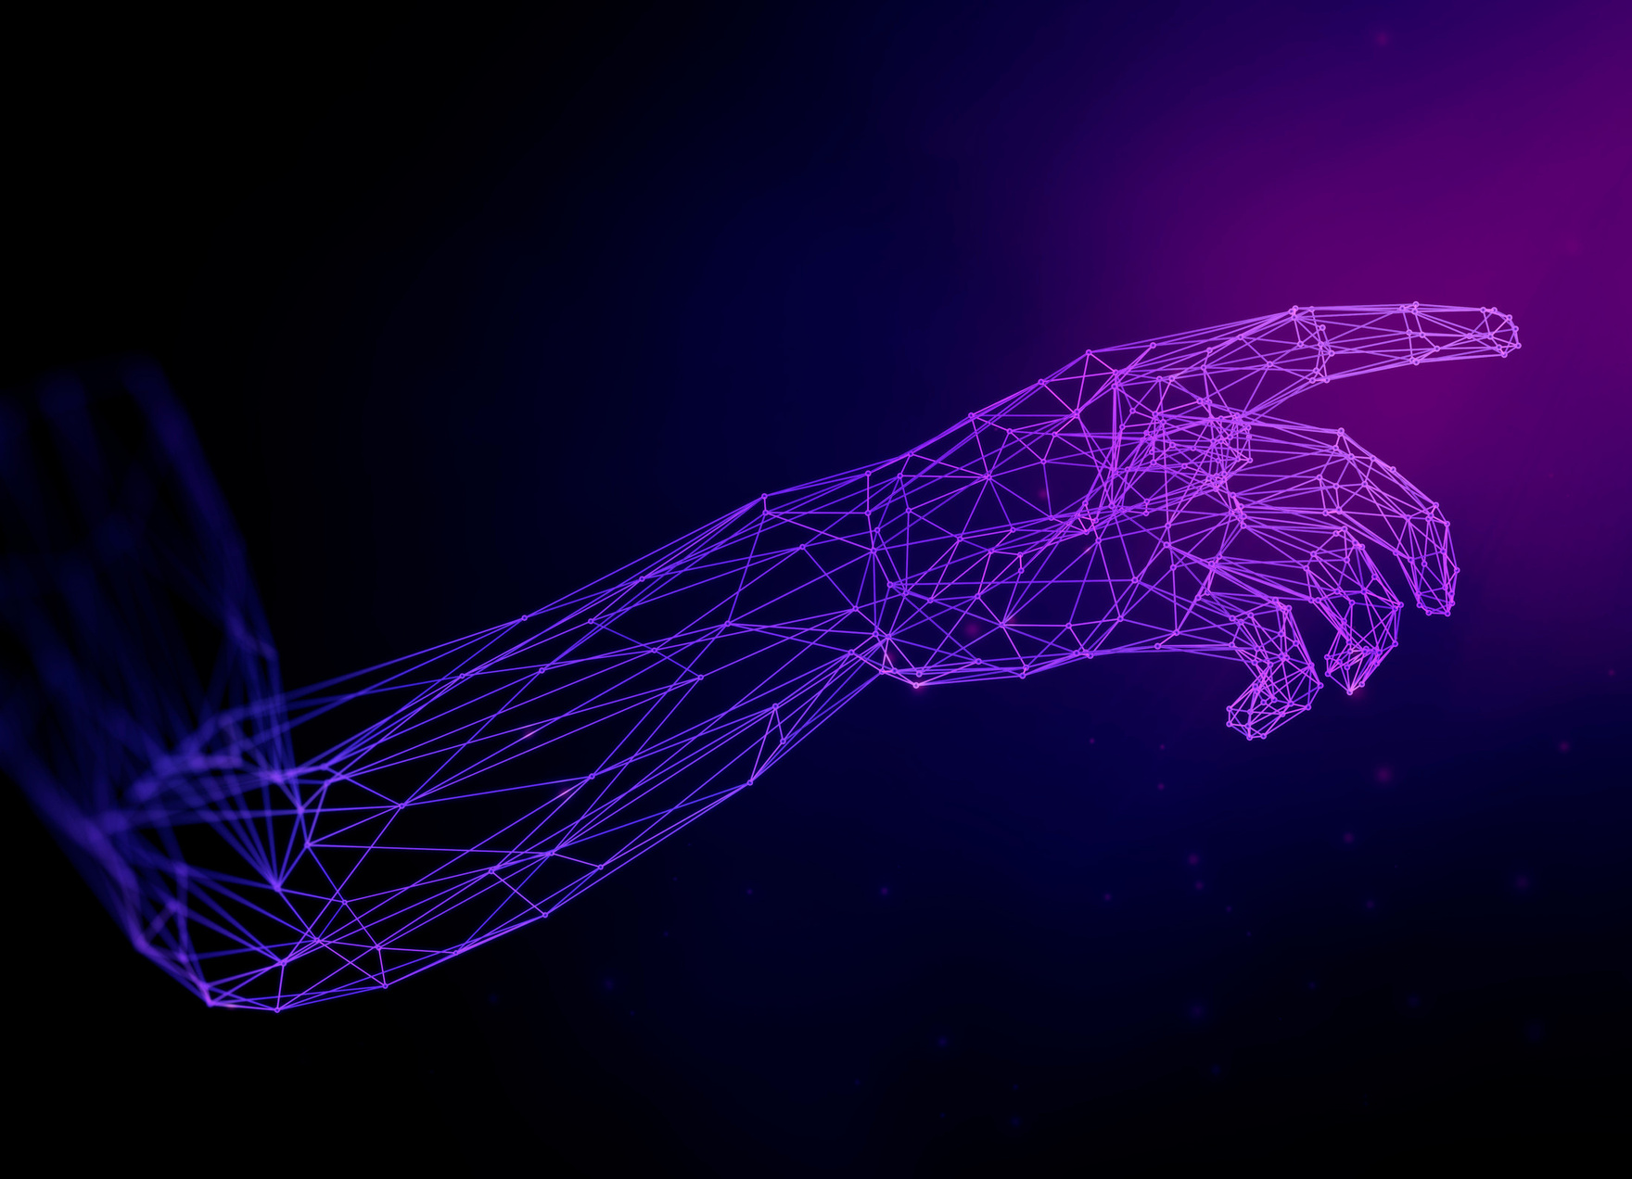
Communities
Groups as a tool for business development
    Beta testing
    Building loyalty
    Organic awareness in the community

Slide 12
How to work with Social Media
What questions do we ask when developing a strategy?
    Why even be on social media?
      They're all there....is that the reason?
    What is the goal?
    What is the target audience?
      How is it behaving
    How should my content look like?
    How to measure the impact on socials?

Slide 13
Social media
Brand awareness - AUDI
    TV spot + social
    Full spot on TV/Segments on social
    Segments as an element of ad recall
    Increase of brand awareness is the key message

Slide 14
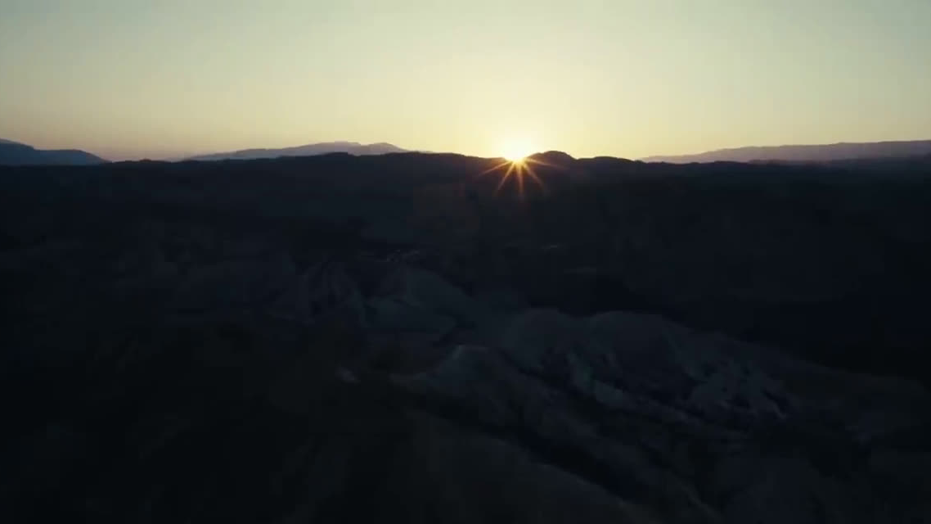

Slide 15
Social media
Traffic on the web
    Redistribution of awareness together with acquisition
    Video with a message + when fulfilling parameters are met
    Advantage?
      Effective attraction of the target group.

Slide 16
Social media
Generating Leads
    Lead add
      User sees post - discount?
      Click and decide...
      Option to pre-fill data based on registration on FB
      Send contact
      Possibility of being contacted by call center/via newsletter...
    Advantages?
      Increased ROI
      Increase in numbers of purchases/contracts/appointments made....

Slide 17
Social media
Offline sales support - KFC
    Location + interest = advertising
    KFC - 2.5 million visits - price 50 cents per visit (approx. 13 CZK)
    Snapchat campaign - 19 million views, 15 million filter usage.

Slide 18
What should not be the goal?

Slide 19

Collecting fans
Bigger engagement

Slide 20
What do people want on social media?

Slide 21


What do people want on social media?
What do they want?
    Contact
    keeping up with the latest news
    entertainment
    sharing interests
    finding inspiration
    education
    Do people want to see ads?

Slide 22
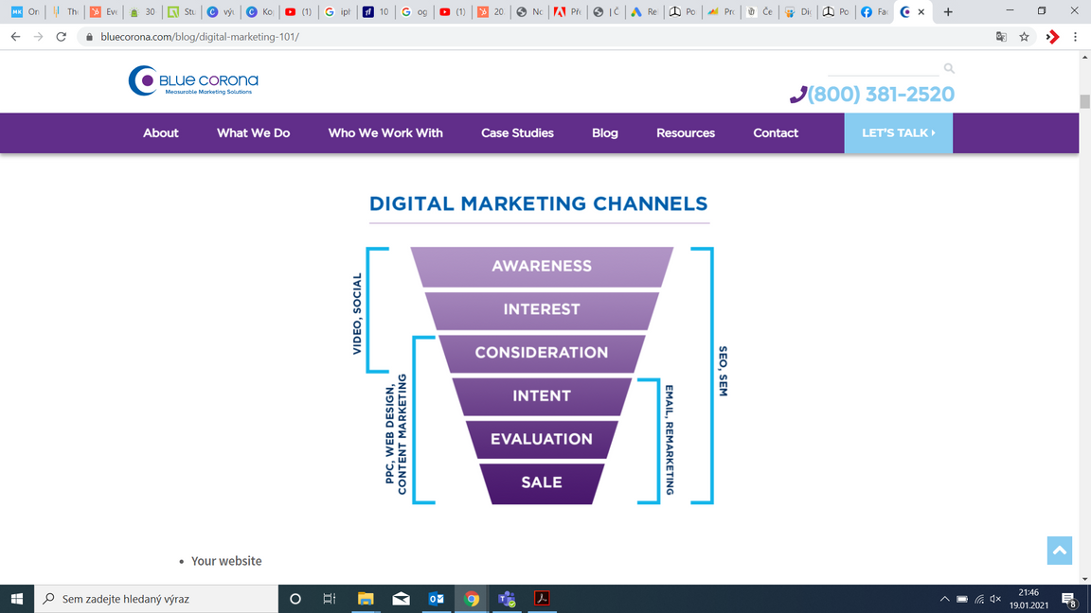
Marketing Funnel
Every path has its place in a marketing strategy

Slide 23
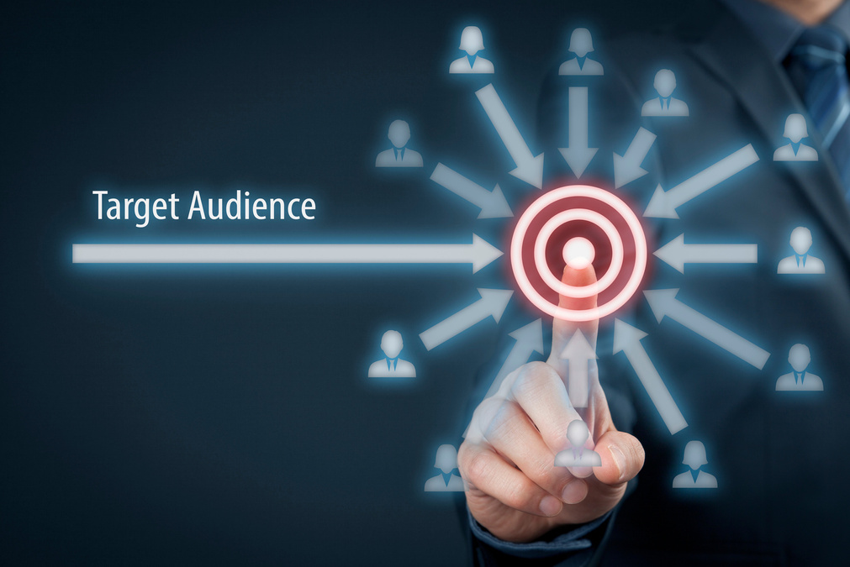
Targeting Option
    Core-audience – FB offer – age, interests, behaviour…
    Custom audience
      Custom list– audience creation based on email – GDPR problem?
      Site traffic
      Interaction with content
    Lookalike audience
      What "qualities" are being repeated by your customers?

Slide 24
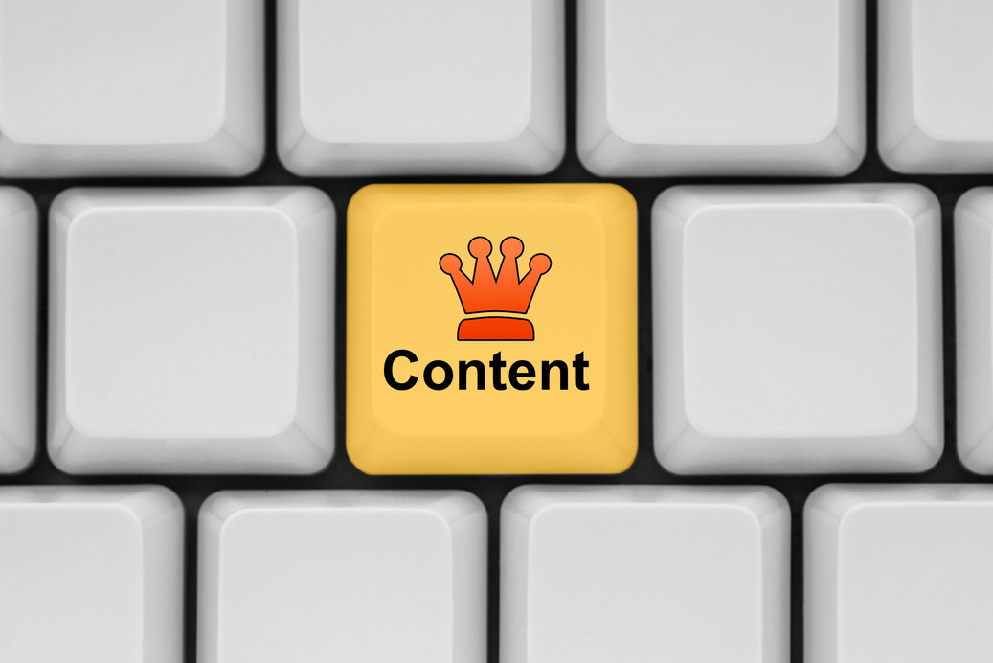
Content Creation
Content is the King
Form is the Queen

Slide 25
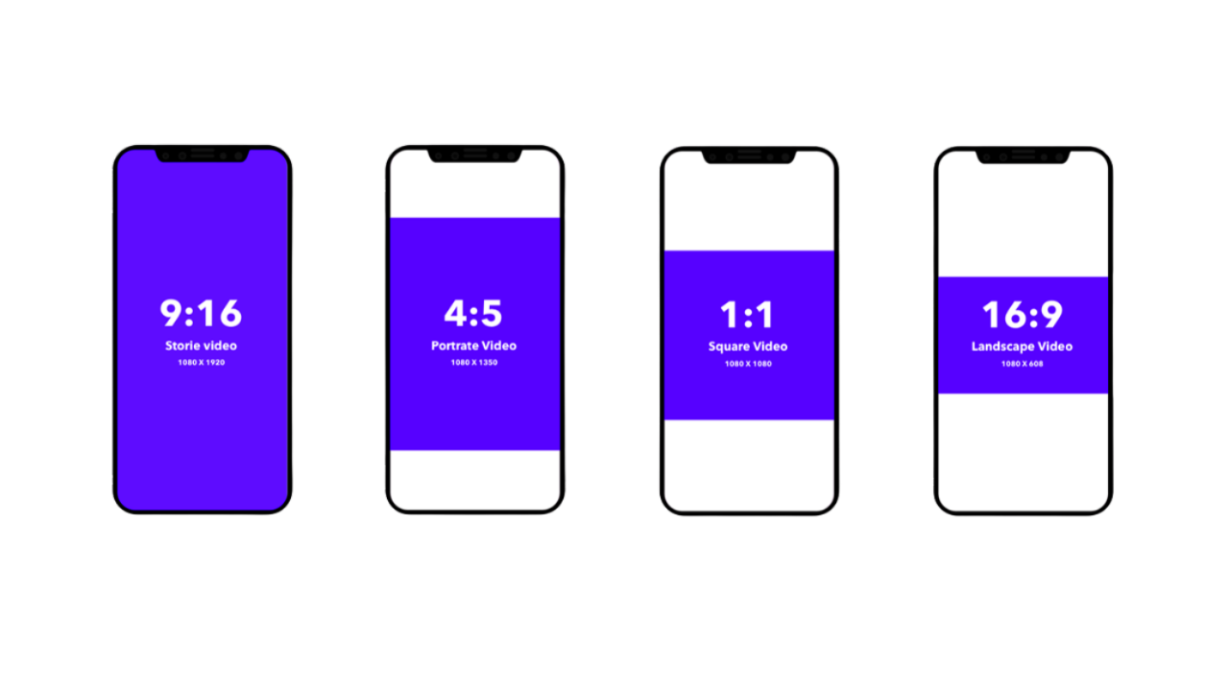

Slide 26
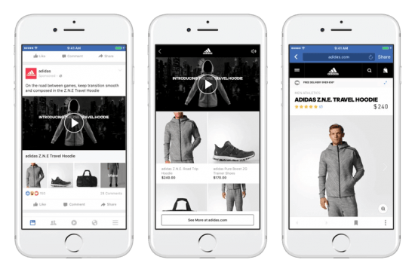
Content TIP - Instant experience
presentation/landing page directly on Facebook

Slide 27
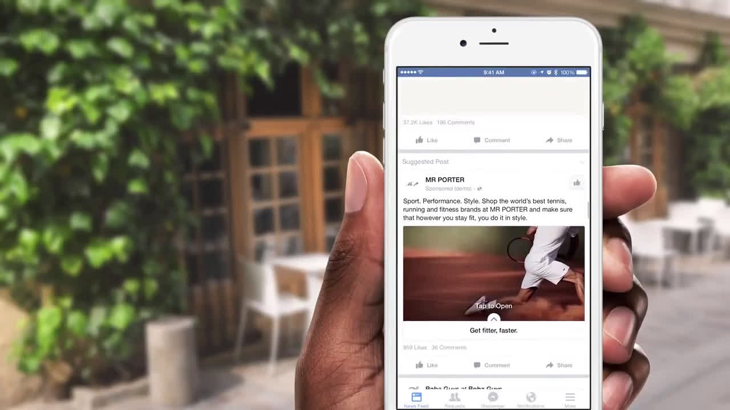

Slide 28
Ratings of advertisements
    There is no connection between the number of fans, likes, awareness and business
    Reach and frequency (approx. 11-12)
    Site visits / Instant experience
    Acquisition of leads/sales

Slide 29
Social / Online
    They work together
    They share audiences
    Ability to retarget in other environments

Slide 30
Social pro ATL
    "ATL" stands for "Above The Line"
    meaning that the advertising is going to be deployed around a wider target audience
    e.g. television (TVC), radio, or billboards.
    Progressive reach - reaching people who don't use TV/radio/newspapers
    Increase awareness among people who use ATL channels

Slide 31
Can Tinder be used in marketing communications?
And how?

Slide 32
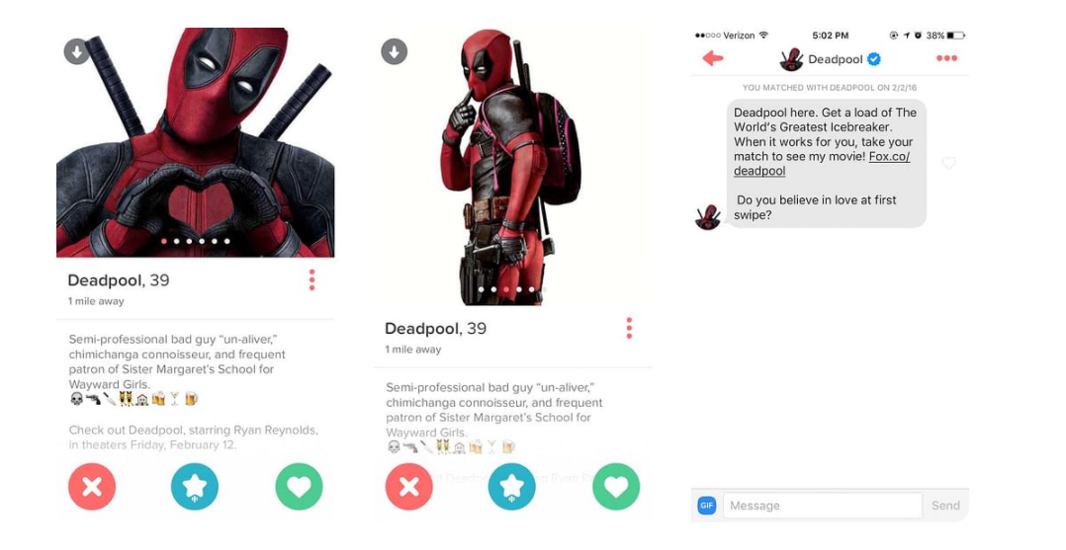

Slide 33
Task
What about TikTok?
    Check out TikTok for Business
    Comment on how advertising is created
    Choose one of the stories TikTok shows as inspiration
    (Optional: comment on how the algorithm is different in Asia, Europe and North America)

