Slide 1

MORAVIAN BUSINESS COLLEGE OLOMOUC
Digital marketing
MARKETING COMMUNICATION ON THE INTERNET

Slide 2
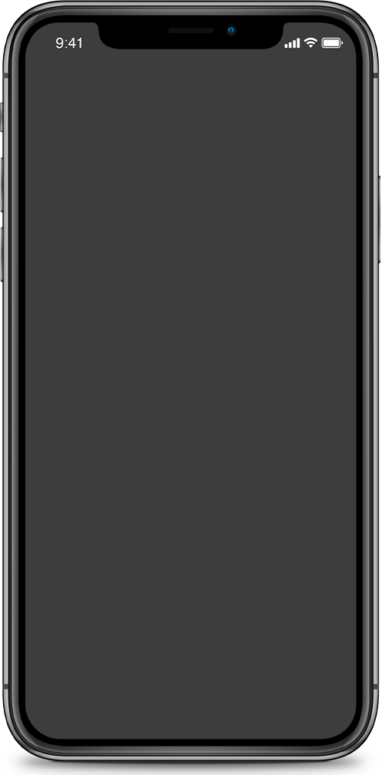

Marketing communication on the Internet
"The goal is to create a specific message that reaches a specific audience in a format and in such a way that the audience accepts the message."

Slide 3
Specifics of marketing communication on the Internet
Global
Two-way
Real-time
Personalised
Cheap

Slide 4
What is communication mix?

Slide 5
What tools would you choose in the communication mix to build your brand?

Slide 6
Communication mix on the Internet
Brand building
Display advertising
Online PR
Microsites
Viral marketing
Community Support Marketing
Buzz marketing
Advergaming

Slide 7

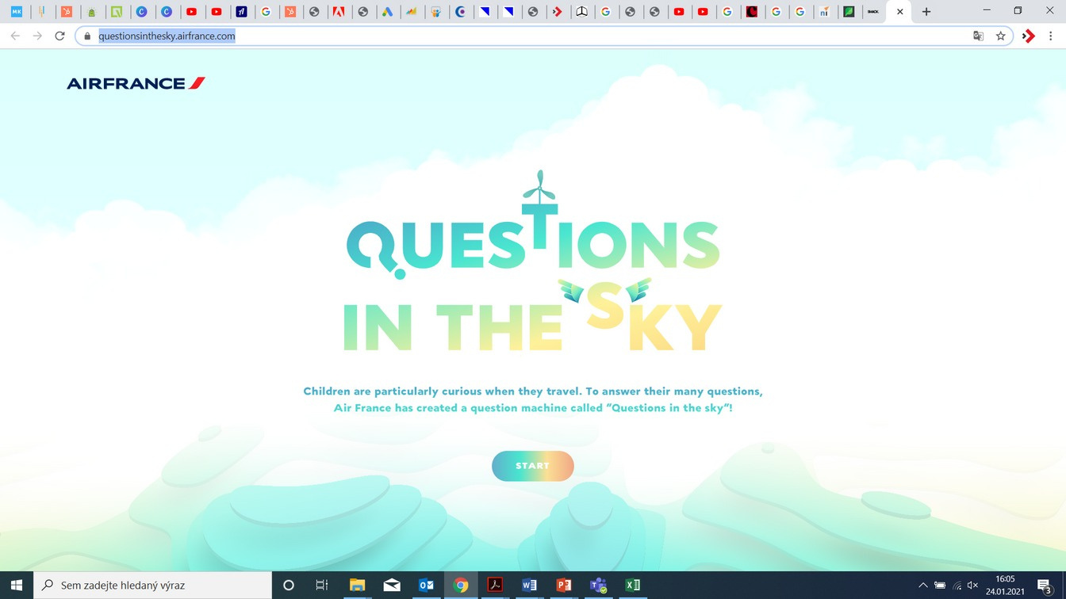
Microsites
Case study: Air France
answers questions
questions are fun
will calm

Slide 8
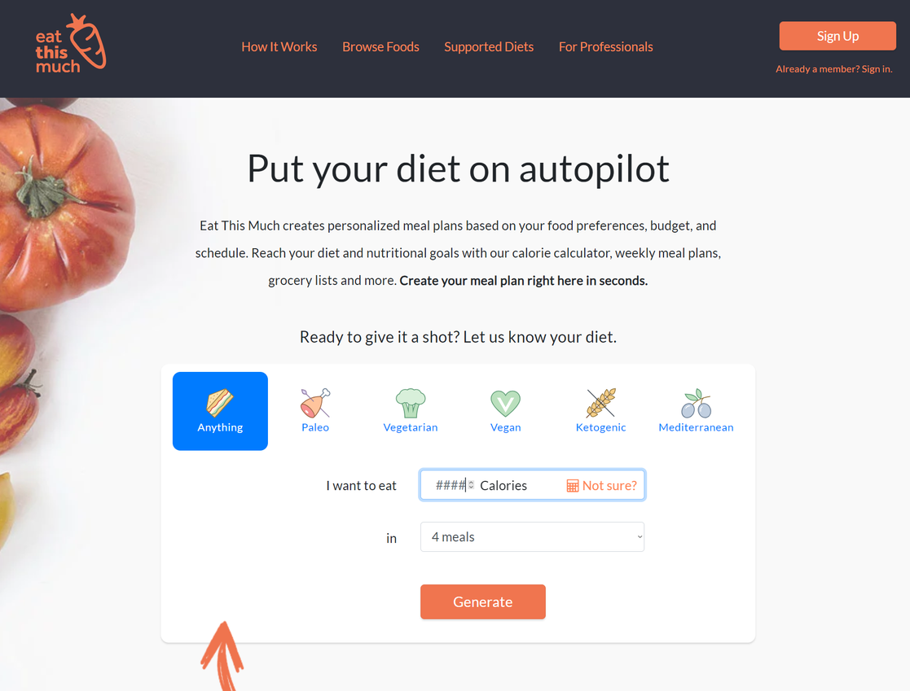
Microsites
Case study:
eatthismuch.com

Slide 9

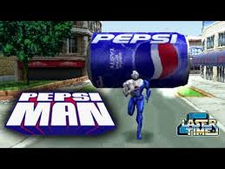

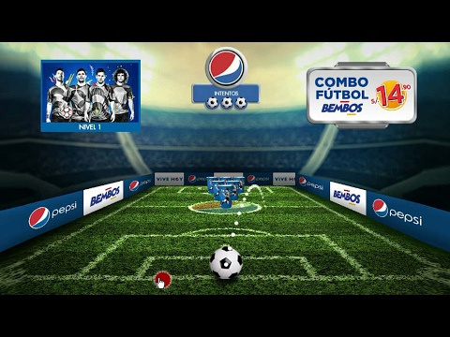
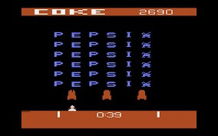
Advergaming Case study: PEPSI

Slide 10

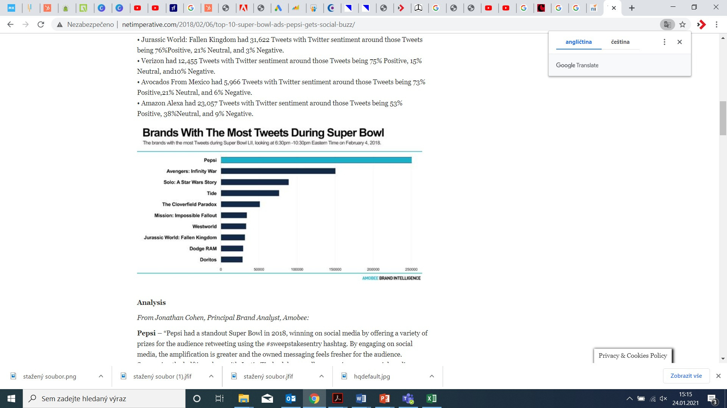
Buzz Marketing Case study: PEPSI
Superbowl 2018 #sweepstakesentry rewards for sharing
Pepsi 254 518 tweets
Coca-Cola 7 954 tweets

Slide 11

Pepsi 2018 Superbowl Commercial

Slide 12
What tools would you choose in the communication mix to support sales?

Slide 13
Communication mix on the Internet
Sales support
Advertising in search engines
Shoppable links
Online consumer competitions
Email marketing
Affiliate marketing

Slide 14
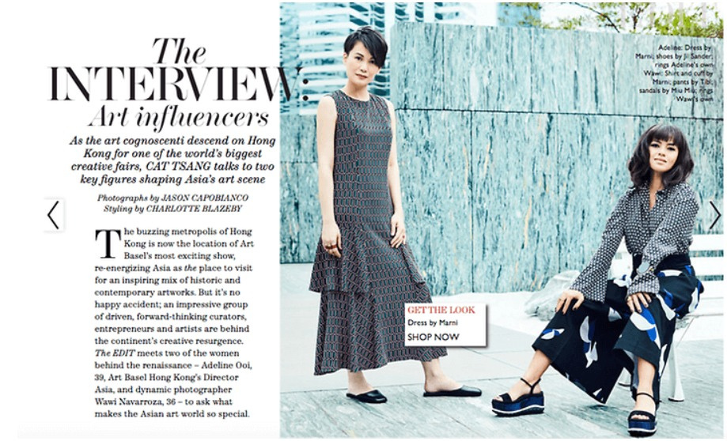
Shoppable links
From Instagram... ...to articles...
...to apps

Slide 15
Can you find an example of a shoppable link within your apps/sites you visit?

Slide 16
Communication plan
Receivers of information
Objectives of communication
Key message
Communication format
Measurement of success
Communication manager

Slide 17

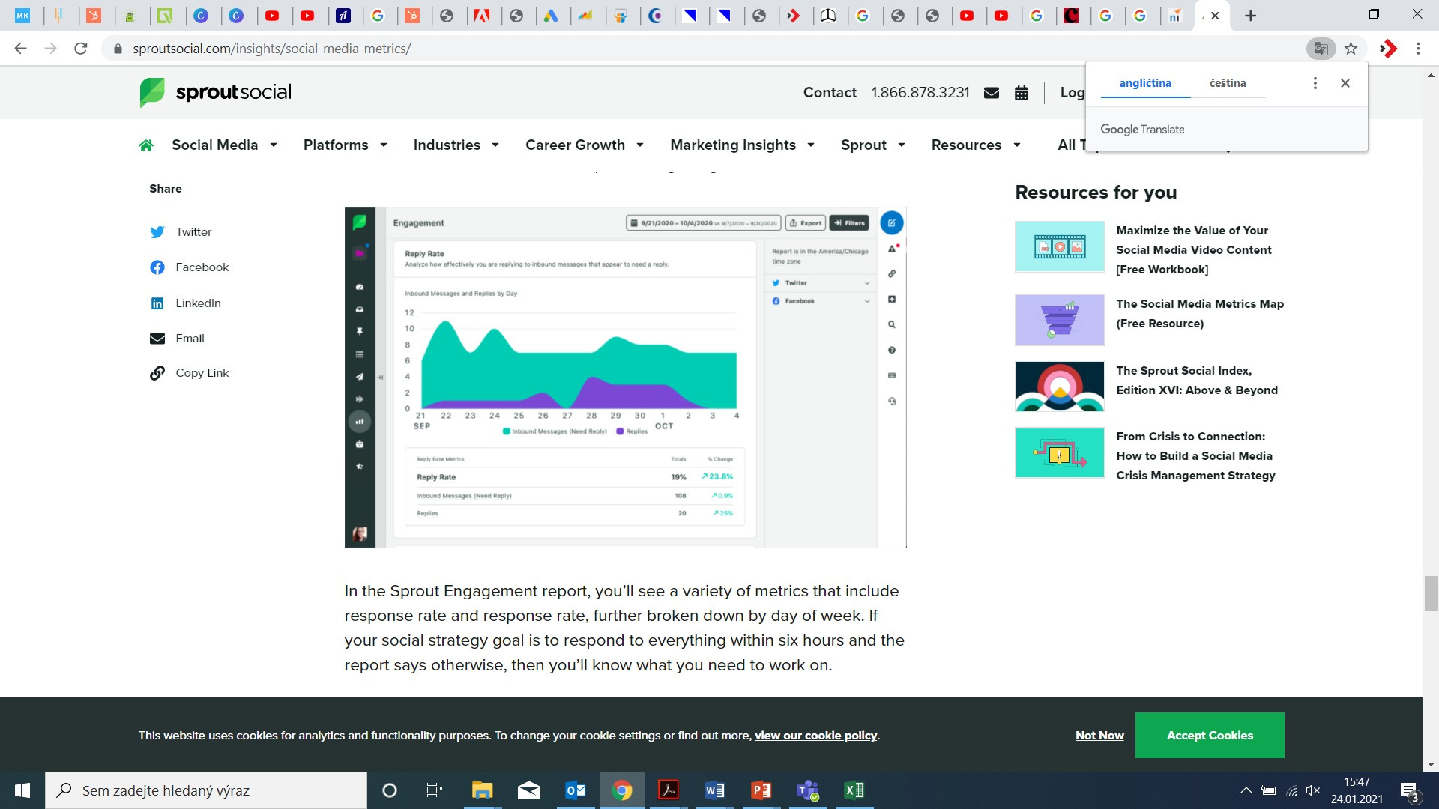
Metrics
What do you think can be measured?

Slide 18
Metrics
Engagement: likes, comments, views, shares
Awareness: impression vs. reach
Market Share: Percentage + Sentiment
ROI: return on channels, campaigns...

Slide 19
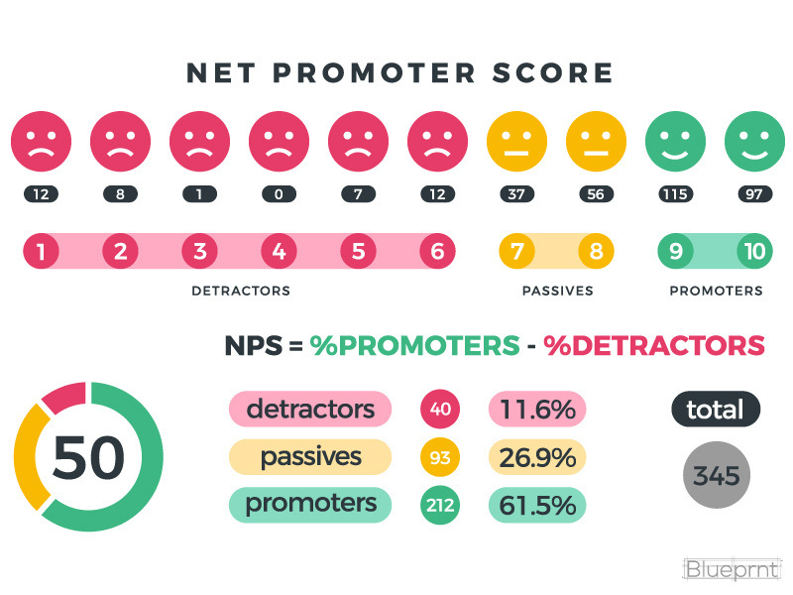
Net promoter score
= % promoters - % detractors

Slide 20
Where do you encounter product reviews?
At what rating do you consider the product to be trustworthy?

Slide 21
What do you imagine by term “Integrated marketing communication”?

Slide 22
Integrated Marketing Communication (IMC)
How to do it?
Setting the goal
Defining the target group
Selection of communication tools
Budget allocation
Creating creativity
Analyses, adjustments, analyses, adjustments...

Slide 23
Task | Prepare a microsite design
Options:
MVŠO students | goal: entertaining/increasing loyalty?
Campus visitors | goal: entertain/inform?
Potential employees of companies on campus | goal: informing?

