Slide 1


MORAVIAN BUSINESS COLLEGE OLOMOUC
Digital marketing
INTRODUCTION
TO DIGITAL MARKETING

Slide 2


COURSE CONTENT
    Introduction to digital marketing
    Marketing communication on the Internet
    Advertising on the Internet
    E-commerce
    Direct marketing on the Internet
    Social networks and the applications of social networks in marketing communication
    Public relations in the Internet environment
    Content marketing
    New forms of marketing communication
    Trends in online marketing
    Analysis and measurement of success
    Marketing research in the Internet environment

Slide 3
COMPLETION OF THE COURSE
    Project presentation (50 points)
    Final test + oral exam (30 points)
    Activity in lectures/seminars - 20 points
    At least 50points are required for successful completion

Slide 4
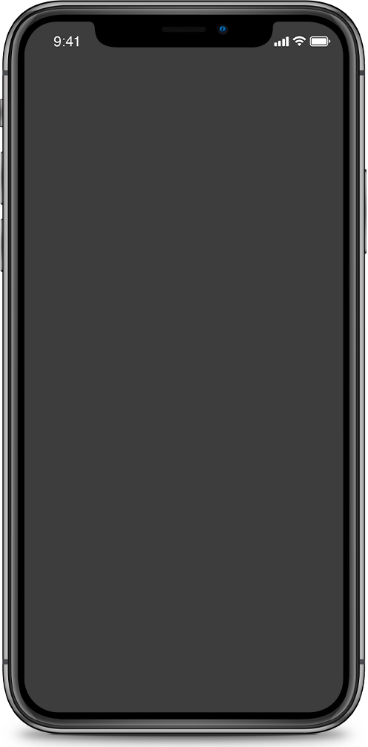

Digital
marketing
"Digital marketing is marketing that uses digital media to communicate with audiences about advertising and information."

Slide 5
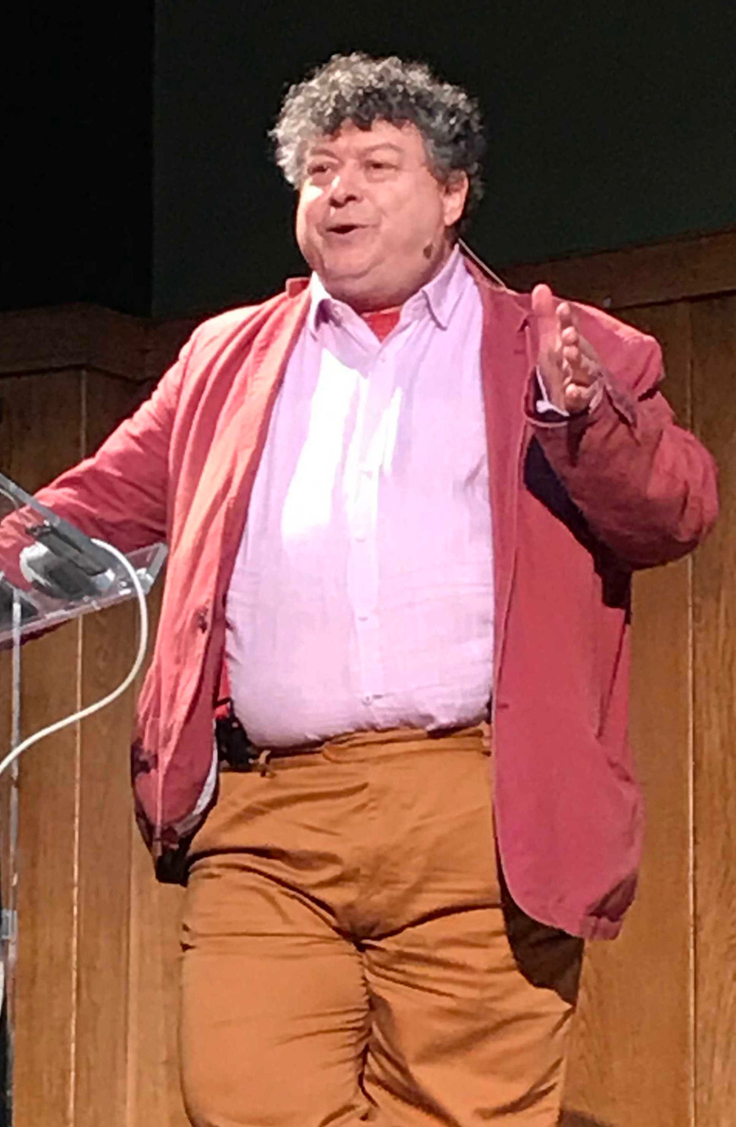

Digital marketing must be trivial and careless.
-Rory Sutherland | Ogilvy-

Slide 6
What is digital marketing all about?
01
New media
02
Digital vs Analog
03
Internet vs Digital

Slide 7
What do you see as the advantages of digital marketing?

Slide 8
Advantages of digital marketing
    Relevance
    Easy content targeting
    Innovation
    Motion integration
    Measurability
    Low entry and operational costs
    Recipient management (lead production)

Slide 9
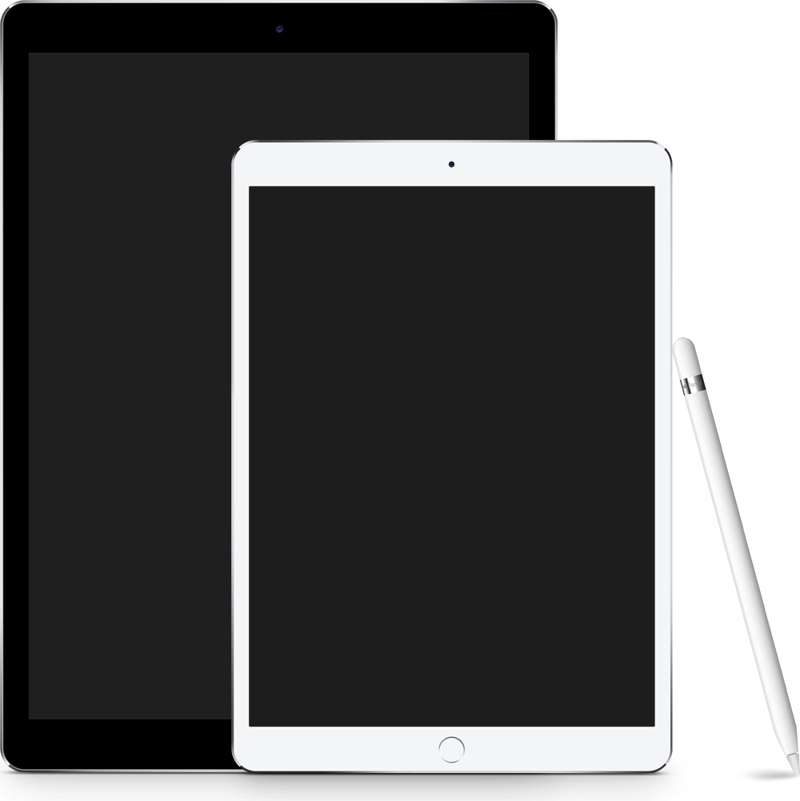
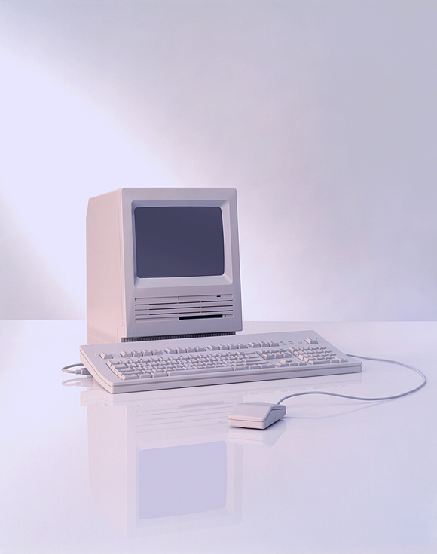
A little bit of history
    Development with the introduction of new media
    Originally an internet-only environment
    1993 - first clickable banner
    1994 - Yahoo, 2nd half of the 90's other search engines (Google, MSN)
    1996 - DoubleClick - predecessor of Google Ad Manager
    Arrival of new Millennium (Y2K) - WEB 2.0

Slide 10
A little bit of history
    Around the year 2010, a massive expansion of smartphones - a new era of DM (Digital Marketing)
    Increasing flexibility - clients becoming more resistant to advertising
    The creation of the mobile marketing industry
    The creation of the digital signage industry
    Today - the combination of digital signage, mobile communications and the potential of the internet

Slide 11
Terms of development
Convergence of media forms
= mixing and transformation of the properties of new and older media (ebook and book/ youtube and television)
Remediation of marketing communication
= evolutionary development of the media form (evolution of telephones)
Digital signage
= transformation of original analogue media into a new form enriched with a motion/sound/interactive component

Slide 12
What examples of remediation can you think of?

Slide 13

VS
direct mailing
print advertising
word-of-mouth
radio
e-mail
digital signage
viral marketing
podcasting

Slide 14
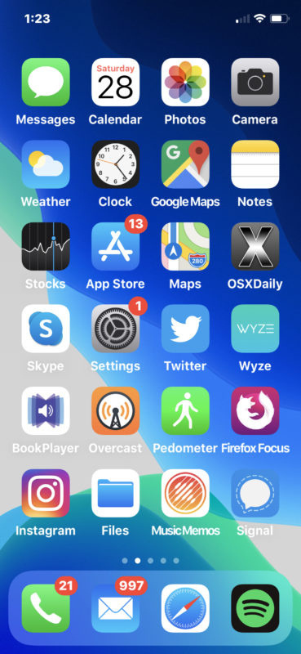
Mobil marketing
    Smartphones = third evolutionary stage
    The origin of mobile marketing as a separate industry
    Original form - SMS marketing
    Current form - equivalent to internet marketing

Slide 15
What is your experience with mobile marketing?
What kind?

Slide 16



Case study: Ogilvy
    Free WiFi for the people of Paris
    Condition? Play a game of scrabble!
    Rule - higher score = more minutes
Result:
110 000
minutes of connection

Slide 17
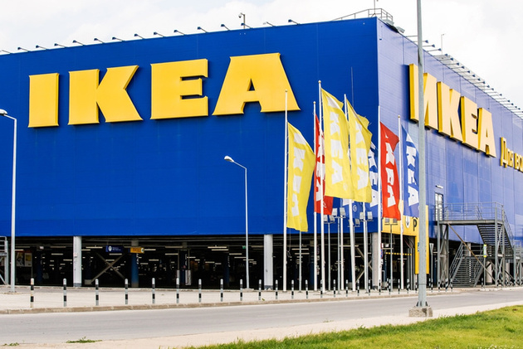
Case study: IKEA
    A virtual tour of your room with new IKEA furniture
    The condition? Download the app
Result:
6,2 millions of downloads

Slide 18
The New IKEA Catalog App: Create Your Space
https://www.youtube.com/watch?v=uaxtLru4-Vw

Slide 19
Forms of digital marketing
Traditional
    Web
    Banner
    Advertising in search engines
    E-mailing
    Internet catalogues

Slide 20
Forms of digital marketing
New
    Affiliate
    Social Media Marketing
    Product microsites
    Video
    Viral
    App Marketing

Slide 21
92 %
93 %
Importance of digital marketing
customers browse the company's website before making a purchase
shopping starts with an internet search
97 %
88 %
people choose products and services online
people trust online reviews as much as personal recommendations

