Slide 1

MORAVIAN BUSINESS COLLEGE OLOMOUC
Digital marketing
ONLINE
ADVERTISING

Slide 2

What kind of advertising
can we encounter?

Slide 3
Forms of Internet
advertising
PPC (Pay per Click)
Social networks
Online PR
Product comparators
Internet catalogues.

Slide 4
Key terms
Keyword = the basis of PPC advertising, through which the advertising message is triggered
Display = display of the advert in the search or content network Clicks = clicks on the advert
CTR = click-through-rate
CPC = cost per click
CPM = cost per thousand views (cost per mille)
Conversion = achievement of the defined goal of the website KPI = Key Performance Indicator

Slide 5
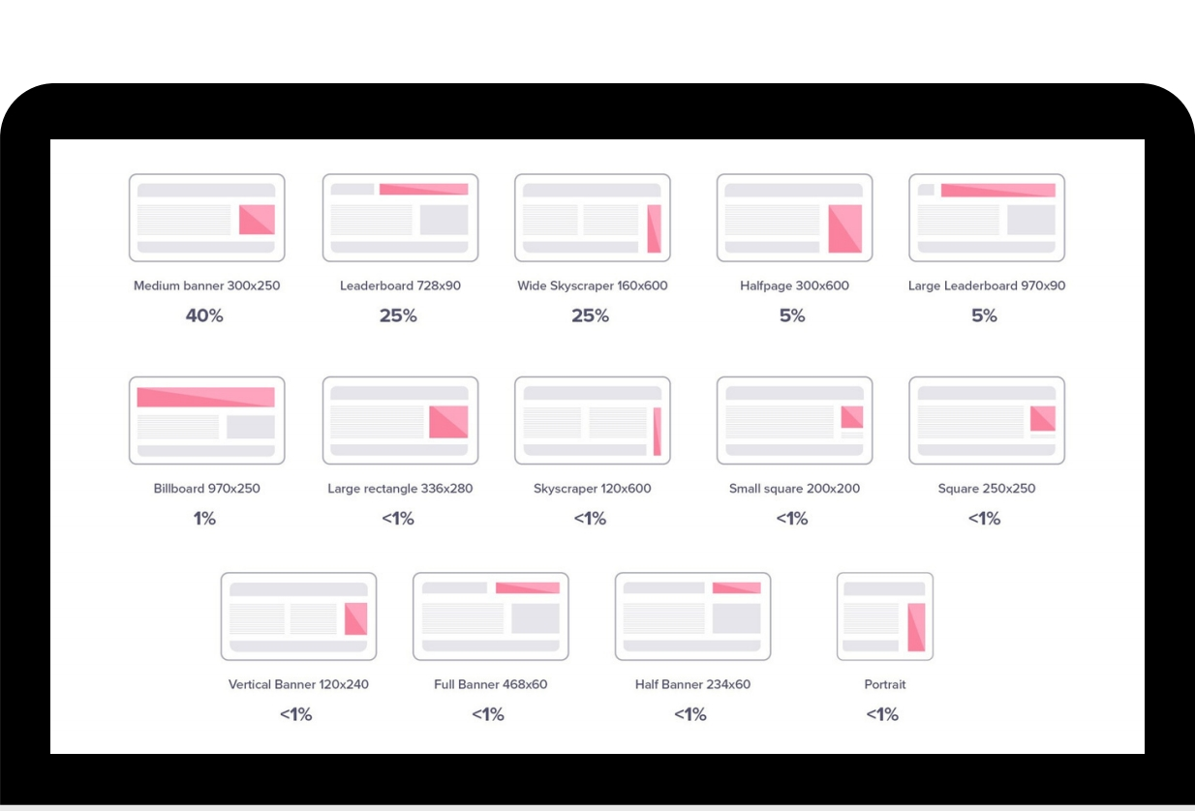


Banner
dimensions250 x 250 – Square
200 x 200 – Small Square
468 x 60 – Full Banner
728 x 90 – Leaderboard
300 x 250 – Medium Banner
336 x 280 – Large Rectangle
120 x 600 – Skyscraper
160 x 600 – Wide Skyscraper
300 x 600 – Half-Page Ad
970 x 90 – Large Leaderboard

Slide 6
Find at least 5 banners of
different formats. Which ones do you think have the highest click-
through rate?

Slide 7
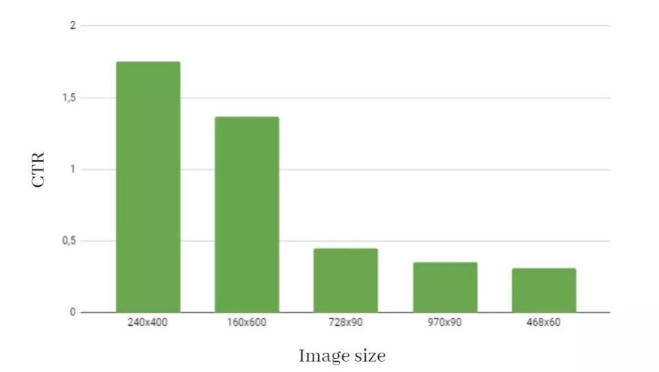
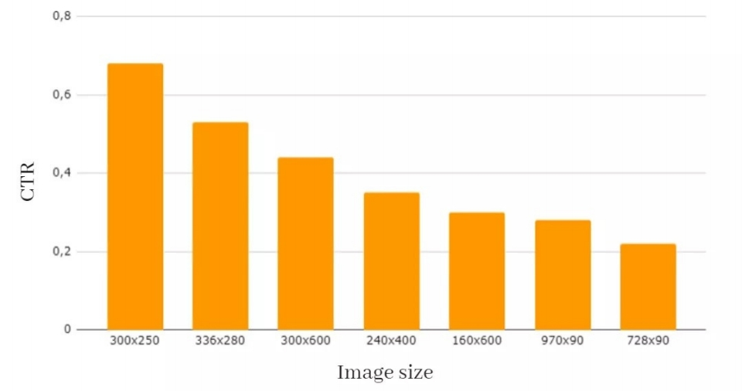
Entertainment
Gardening

Slide 8
As you begin to put together your communication mix, what questions will you ask
when categorizing your
audience?

Slide 9
Segmentation
Key questions
Where? Who? What? How?

Slide 10
Could you answer these
questions based on your
marketing research?

Slide 11
Segmentation
Rules for selection of target groups Differentiation
Size
Availability
Measurability
Profitability

Slide 12
How would you categorize
your audience?

Slide 13

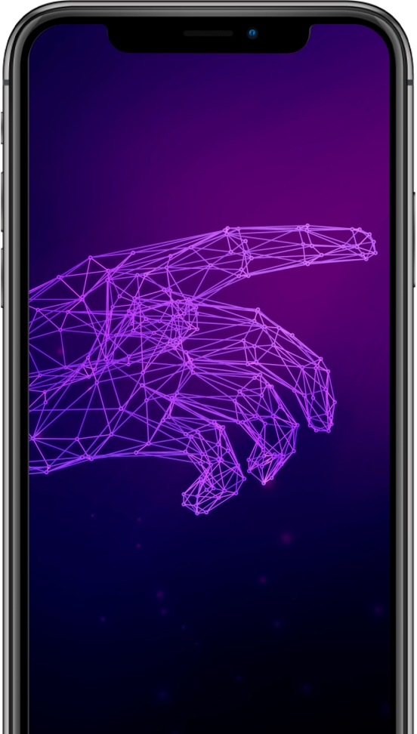
Internet
advertising
models
Flat Fee Model
CPT model
CPM model
Click-Through Based Model
Revenue Based Model

Slide 14
Could you say which models are more efficient/meaningful?

Slide 15
Application of Internet
advertising
Usage:
Search
Content
Max CPC - what is the maximum we are willing to invest per click?
Actual CPC - how much we actually pay for advertising - lower than Max

Slide 16
How to plan?
Use of analytical tools
Keyword Planner, Sklik Planner, Collabim...
Google Analytics
Google Trends - search statistics
Competitive analysis tools - SEM Rush, SE ranking, Serpstat... Relevance
Pairing ad content to keywords in the case of a search engine Targeting to the appropriate landing page

Slide 17
Who benefits from high-quality
advertising?

Slide 18
Task:
How might a banner ad look like in different stages of the acquisition/selling process?
banner as part of the branding
banner to increase awareness
sales banner

