Slide 1

MORAVIAN BUSINESS COLLEGE OLOMOUC
Digital marketing
GOOGLE TRENDS

Slide 2
What does Google Trends do?
Displays keyword/tag search information
Allows comparison of multiple search terms
Shows the most searched related queries
Allows analysis across regions
Eliminates repeated searches by one person

Slide 3


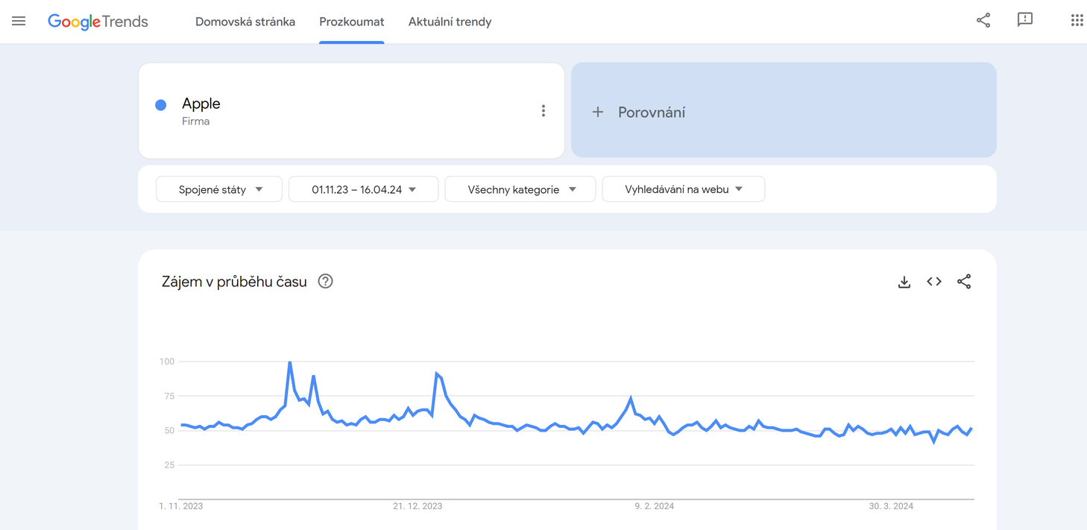
What it might look like:
Apple brand search data
What's behind the significant peak?

Slide 4
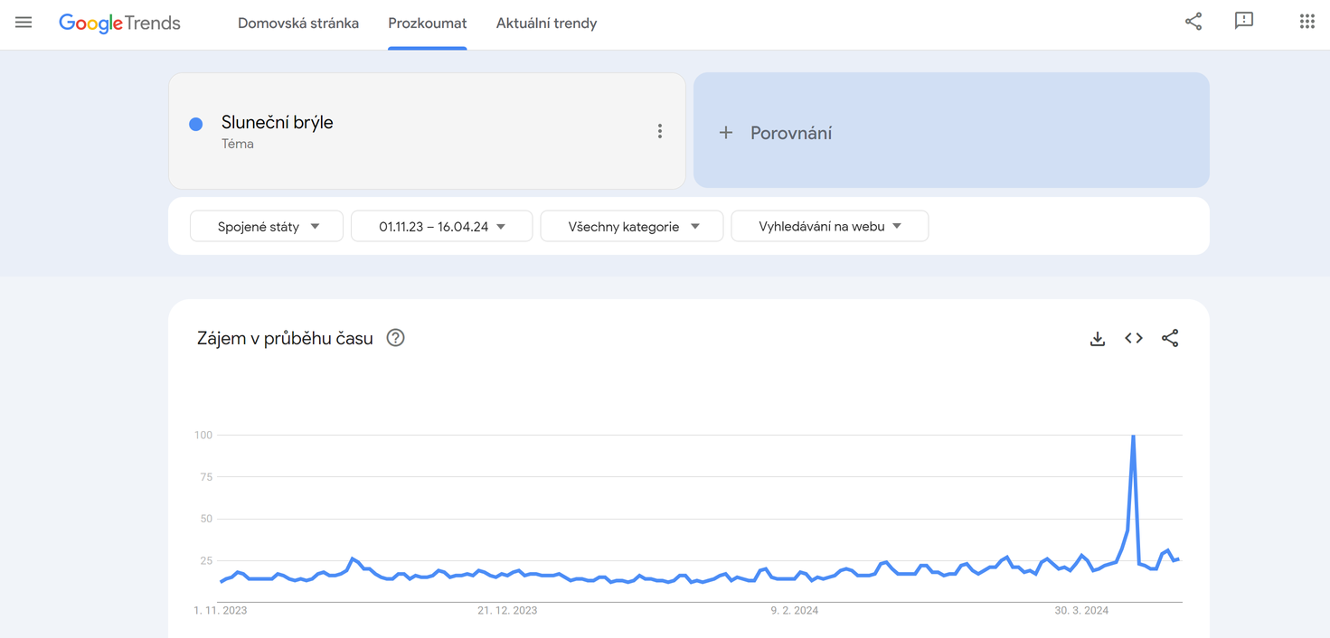
Current trends
Google Trends as inspiration
For seasonal products, the right targeting time is the key to success.

Slide 5
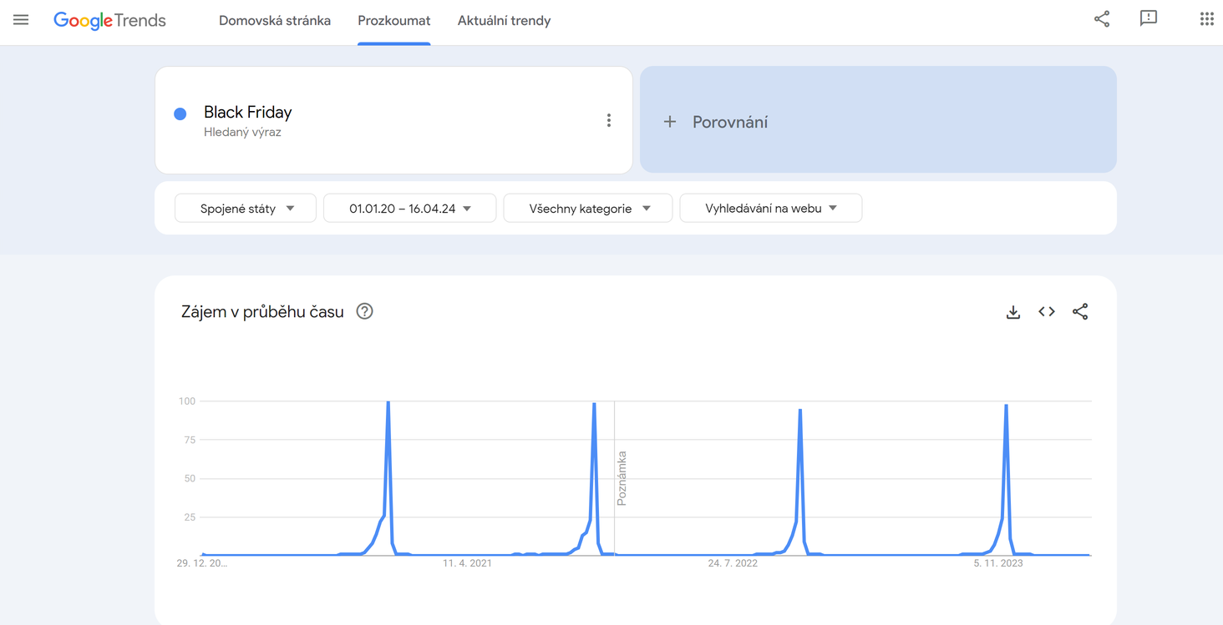
Current trends
And sometimes the opening is really, really small
Regularly recurring events can have very sharp peaks where proper timing is really important.

Slide 6
Share of Search
  Market share prediction and budgeting tool
  SoS can predict developments up to 6 months ahead in cell phones and 9-12 months ahead in automotive

Slide 7

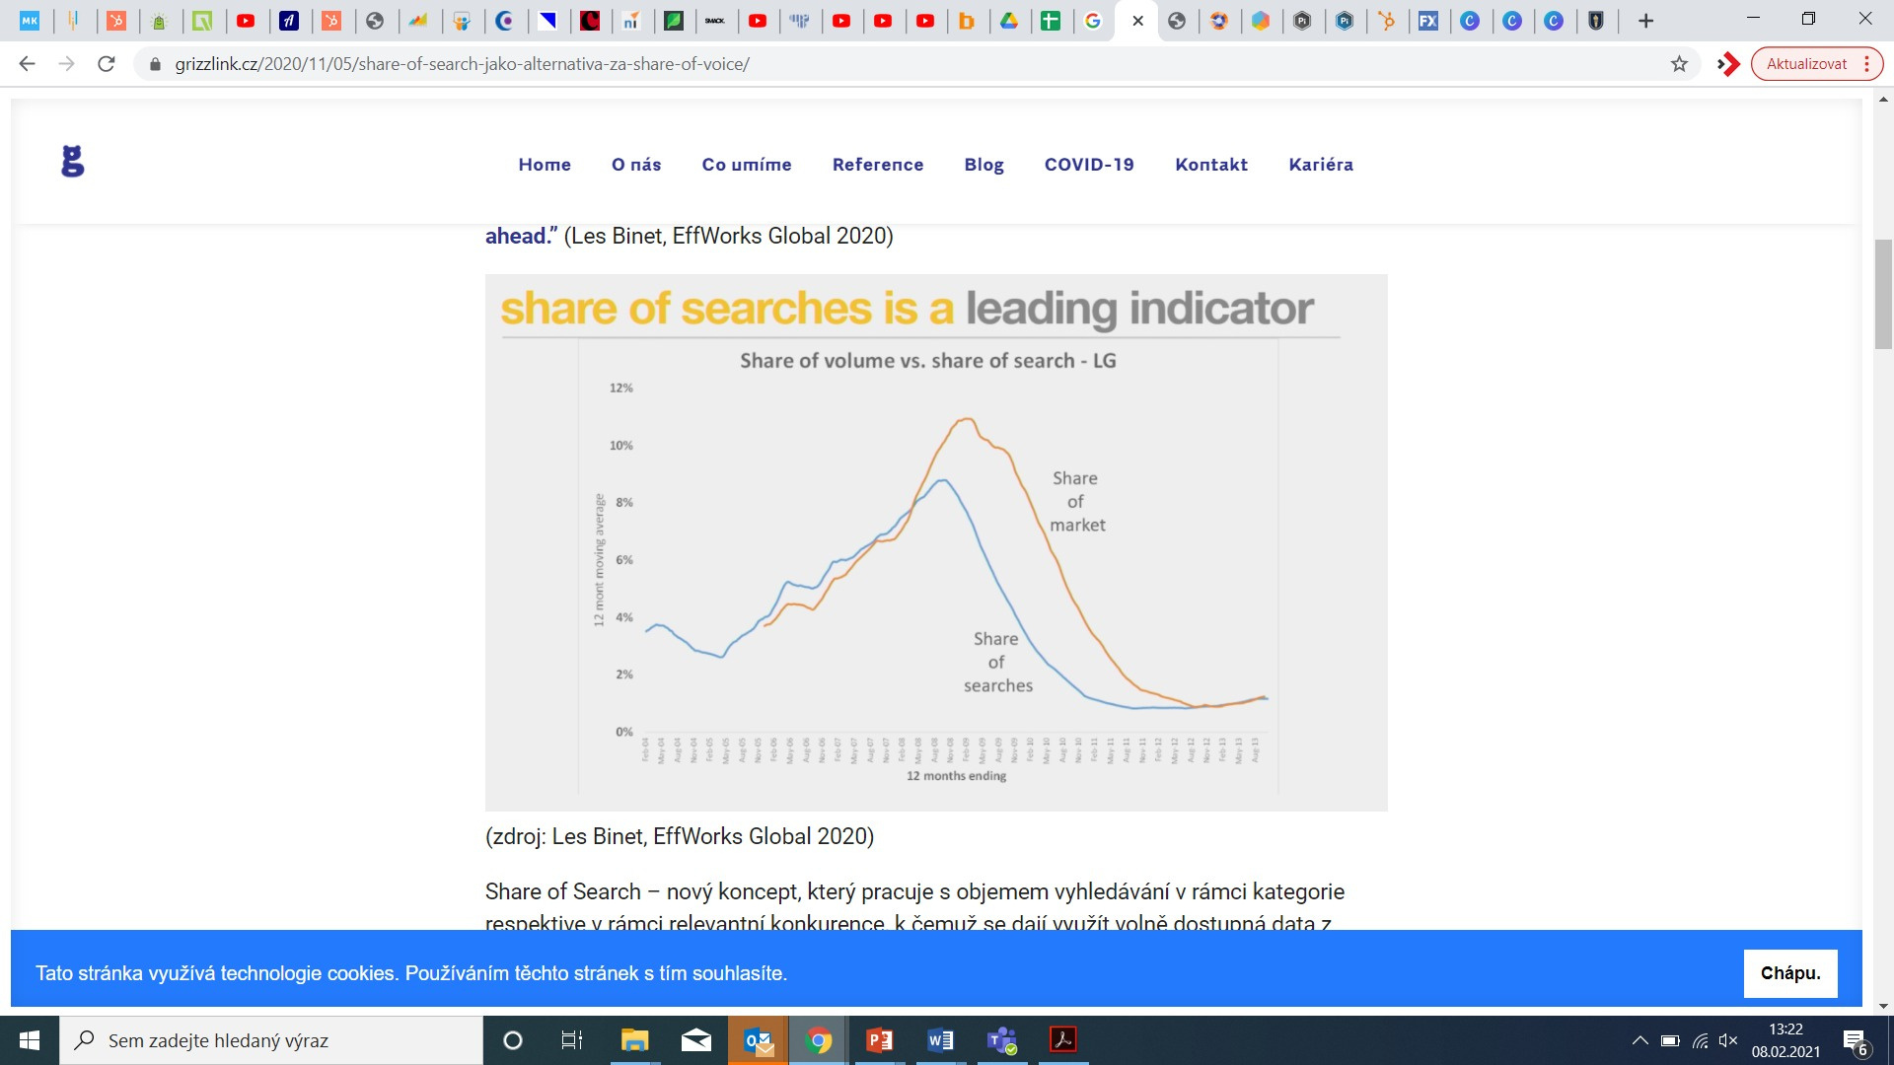
SoS - market share

Slide 8
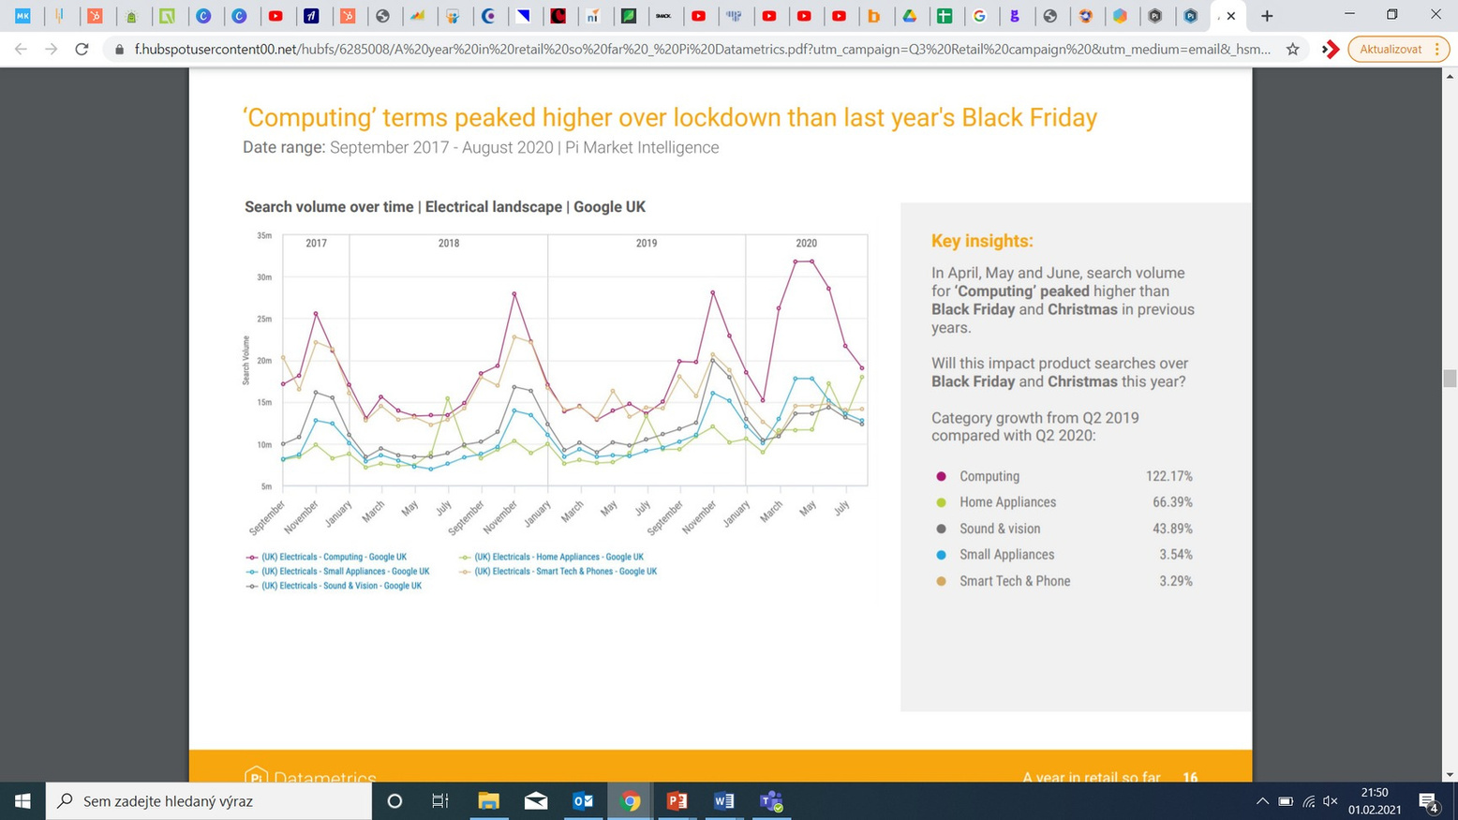
PI Datametrics
= company that offers a Search Intelligence Platform
  helps businesses achieve market-leading success
  features:
    Market Leaderboards
    SEO Tools
    Data Solutions

Slide 9
In your opinion, is Share of Search useful for all businesses?

Slide 10

Share of Search:
Does it always work?
Low search rate
To use SoS properly you need data, if you don't have it or you only have a small amount, it will be very difficult to calculate your market share.

Slide 11
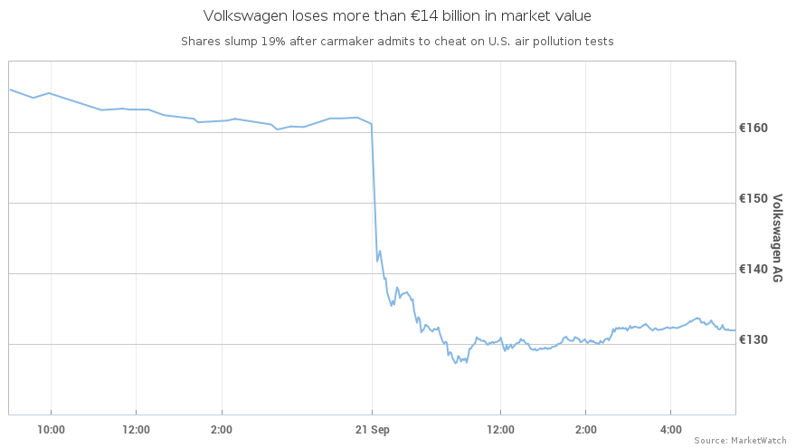
Share of Search:
Does it always work?
The Dieselgate affair
increase in searches but decrease in sales

Slide 12
MORAVIAN BUSINESS COLLEGE OLOMOUC
Digital marketing
SMARTLOOK

Slide 13

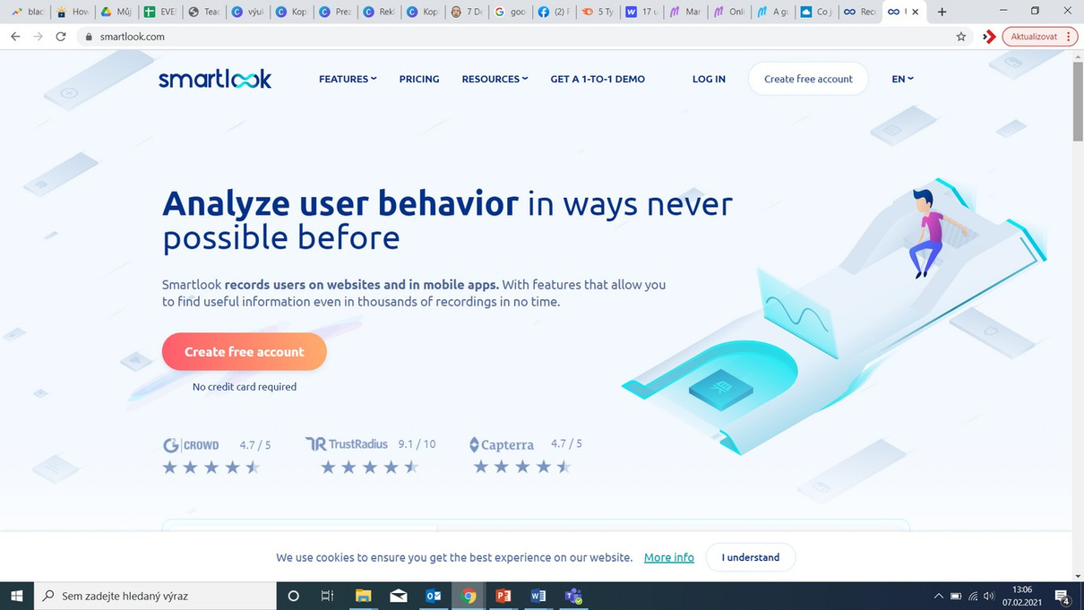
What is Smartlook?
Czech startup
Application that records the movement of website visitors
How can Smartlook help a company?

Slide 14
Task - Google Trends
Select a product where the market is dominated by several major players (automotive, fashion, mobile phones, banking services...)
Describe current trends
Compare your chosen brand with the main players on the market
Try to trace the communication outputs that could be linked to the peaks within the GT statistics

