Slide 1

MORAVIAN BUSINESS COLLEGE OLOMOUC
Digital marketing
E-COMMERCE

Slide 2

Could you explain the
concept of e-commerce?

Slide 3

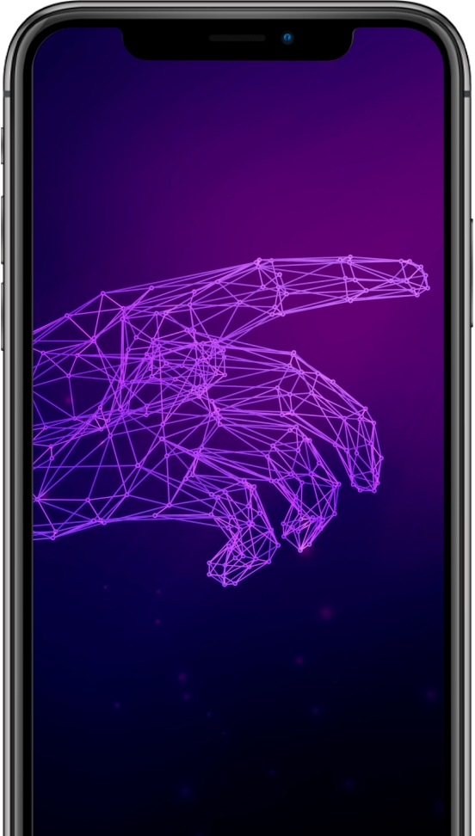
E-commerce
= Doing business by
electronic methods

Slide 4
Creation of a marketing
team
Three steps to
a successful
Choice of marketing
channels, tactics and tools
online
business
Creating an e-commerce
marketing plan

Slide 5
What should you not forget when planning e-commerce?

Slide 6
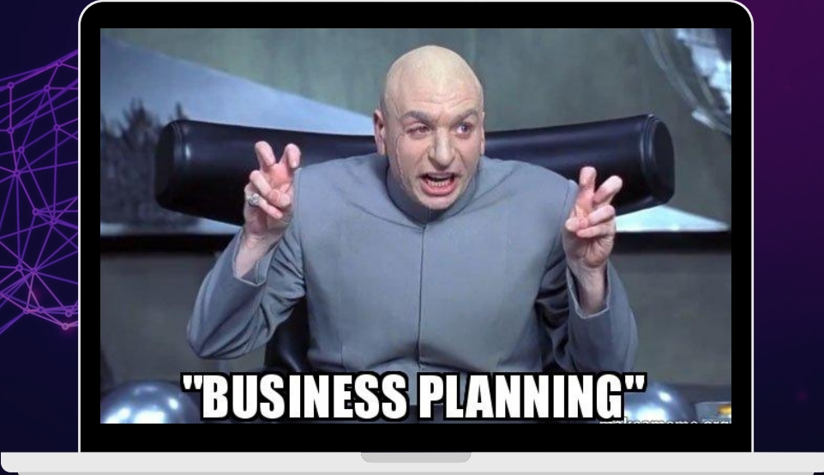
E-commerce planning
Experience
Where is the highest return? (ROI)
How does the competition work?
SMART goals.
What is the purpose of the company?
Target groups
Situational analysis
Pricing and positioning strategy

Slide 7
Do people trust more in
in-store or online
shopping?

Slide 8

Web
development
Option to expand more details
from a marketing
Product and website reviews
perspective
Accept the possibility of exchange or return Chat windows
Mention a recent purchase of the product
Distrust of online acquisition

Slide 9
If you're buying a product online, are you more comfortable buying
on the web or in an app?

Slide 10
App marketing
Extremely competitive environment
2 million iOS + 2.5 million Google Play
What to watch out for?
Keyword analysis
Competitor analysis
Category analysis (rank in specific categories)

Slide 11
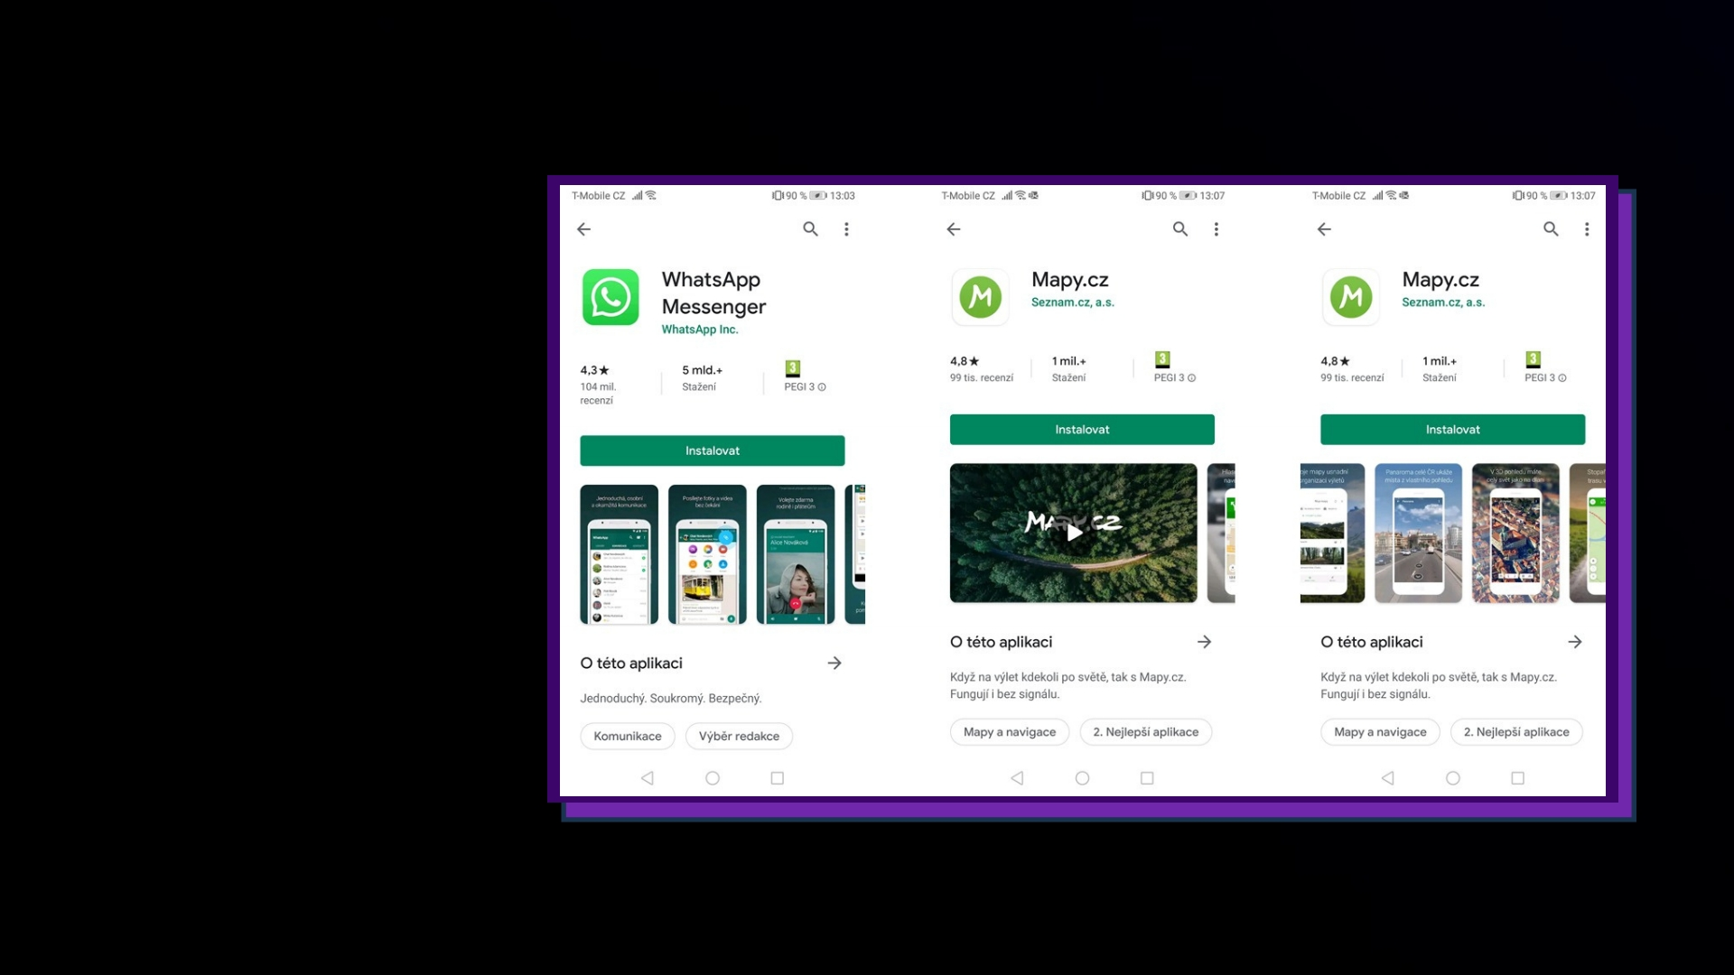
How
might it
look like?

Slide 12


Slide 13
App
marketing
feedback
The evaluation determines the ranking of the application Negative rating - potential
Rating after key moments
Invitation to rate by known users (e.g. beta testers) Responses to ratings

Slide 14
Look for apps that, in your opinion, work efficiently with
these elements.

Slide 15
In your opinion, does offline promotion of an online
application make sense?
Please give examples.

Slide 16
Are users returning within 30 days? Why is this important?
3x higher sales compared to the web After a week, only 11 percent are using
the app of users
Behavioral marketing - the will to use app builds in the first week Reengagement
App
Retargeting
Examples of use
marketing
Personalized interface
Rewards for returning to the app
KPIS
returning
CPO (Cost Per Order)
customers
ROAS (Return on Ad Spend)

Slide 17
Linking web
Marketing activities bring people to the web Need to know user behaviour
and marketing
activities
Need to set goals

Slide 18
Free space
Web
Larger photos
development
High quality product photos
from a
Engaging details
marketing
Usability
Repetition of cross-sell arguments
perspective
Up-sell

Slide 19
Web
development
Speed
from a
Intuition
marketing
Interactivity
perspective
Uniqueness

Slide 20
Can you find examples of websites that work with
these elements?

Slide 21
Task:
Build an e-shop concept for a beershop.
Assignment:
target group: 18-35 years old
Prepare a simple onepager with one product
Include elements that you think will attract the interest of potential customers

