Slide 1

MORAVIAN BUSINESS COLLEGE OLOMOUC
Digital marketing
DI RECT MARKETI NG ON THE I NTERNET

Slide 2
Could you explain the
concept of direct marketing?

Slide 3
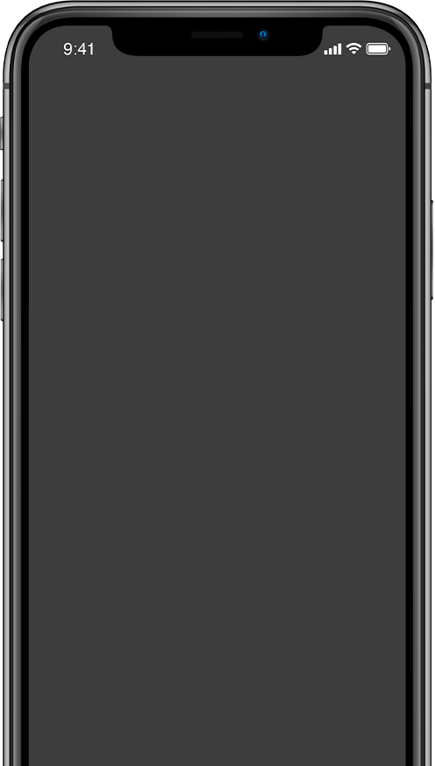

Direct
marketing
= a type of marketing communication based on a concept of direct addressing.

Slide 4
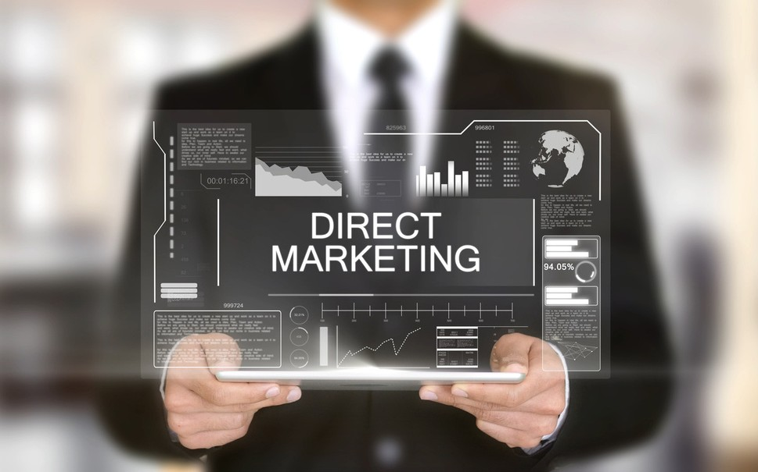
Online direct marketing
Cheap personal sale option
Method targeting individuals or specific segments
High ROI method
Method requiring a good contact database
Great tool for B2B
High immediate response method High response rate method (1-10%)

Slide 5

Direct mailing (offline) Telemarketing (offline) Consumer competitions (on/off) Customer clubs (on/off)
Forms of direct marketing
E-marketing
Mobile marketing

Slide 6
What are the challenges of direct marketing for B2B?

Slide 7
B2B Challenges
01
Recipient of the message?
02
Change of position?
03
Change of email?

Slide 8
What is the goal of direct marketing?

Slide 9




Goals of direct marketing?
Purchase of product
Registration (Newsletter, subscription...) Download brochure
Schedule an appointment Call
Everything goes into winning over customers.

Slide 10
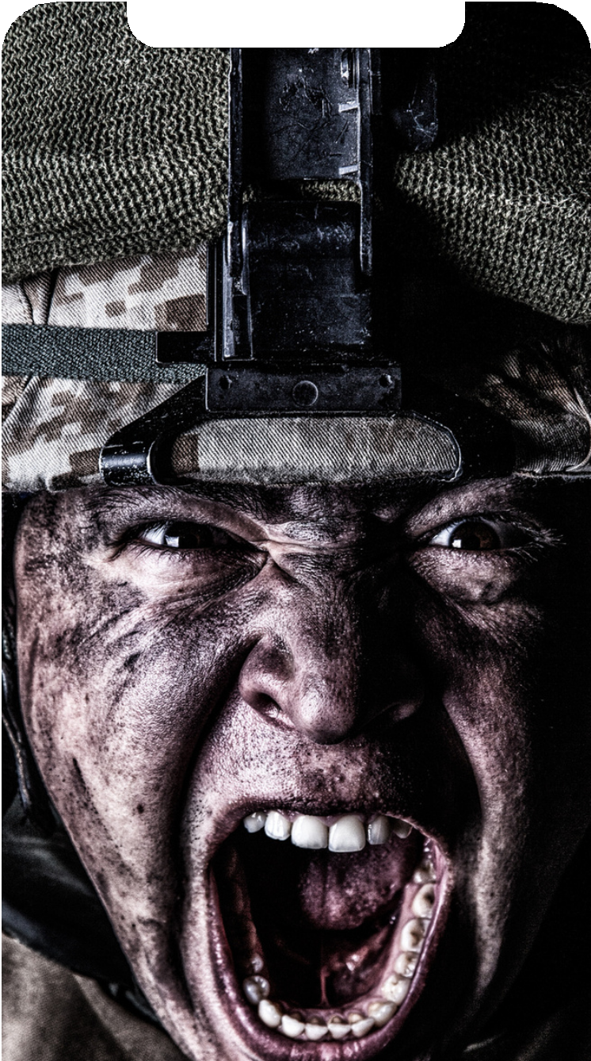

Call to action
Adequacy Urgency Simplicity

Slide 11

When is direct
marketing used?
Direct sales stimulation Cross-selling
Up-selling
Building loyalty (retention)
Brand building?

Slide 12

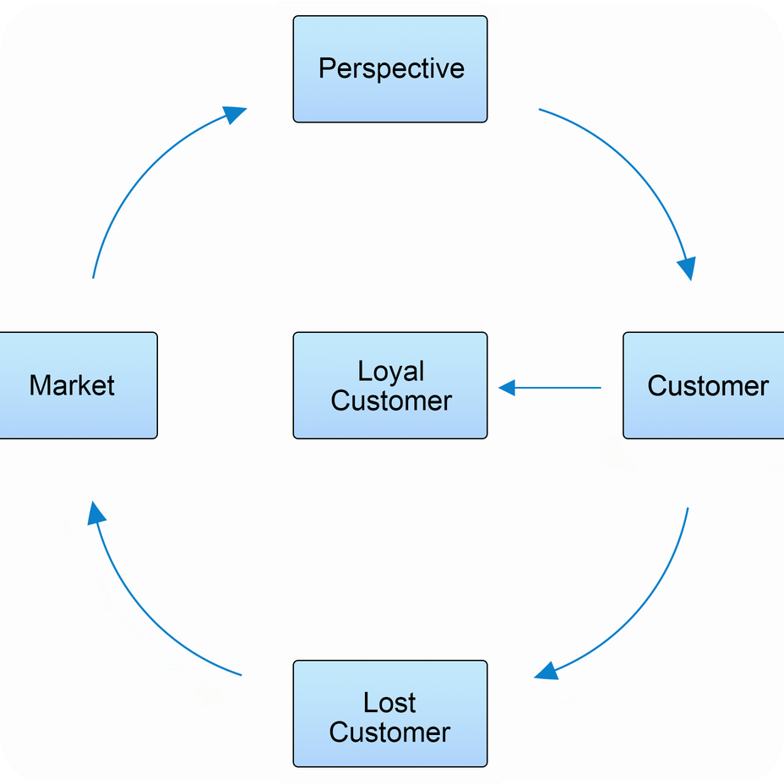



Building a relationship with the customer

Slide 13
Task:
The assignment: you own a microbrewery, which offers a specialty "Cryo Beer" (a frozen beer with an extremely high alcohol content) in addition to the traditional sortiment. Suggest ways to communicate with existing and new clients.
Goal (complete at least 2): Direct sales stimulation Cross-selling
Up-selling
Building loyalty (retention)

