Slide 1
MORAVIAN BUSINESS COLLEGE OLOMOUC
Digital marketing
CONTENT MARKETING & SEO

Slide 2
Have you come across any analytics tools?
Which ones?

Slide 3
Content marketing
Marketing strategy focused on creating and distributing valuable, relevant and consistent content.

Slide 4
What is Content Marketing all about?

Slide 5
Why is CM important?
Brand building Conversion
Saving financial resources High returns in the long term Lovebrand building

Slide 6
Content for users!
It is not the keyword density that matters, but the readability of the article
The key is analysis of readers - who am I writing for? The reader adapts to the form of the article:
Length language captioning
Hamingway App or Read-Able

Slide 7
What is the difference between PPC and SEO?
Pay Per Click vs
Search Engine Optimalization

Slide 8
On-page factors
Meta description Headlines Highlight
ALT attributes URL forms

Slide 9
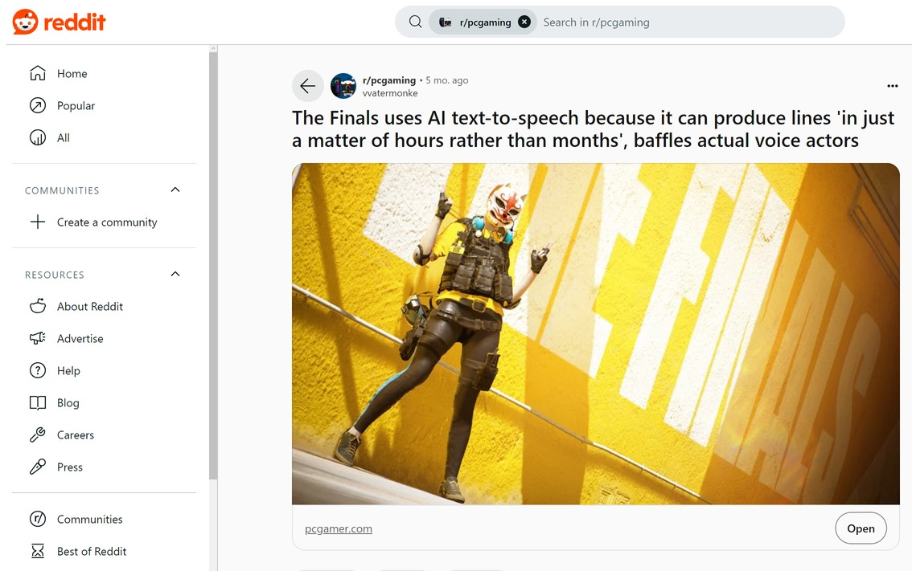
Off-page factors
Backlinks Social networks Credibility
Domain Authority
Anchor text

Slide 10
Before we get down to SEO
Customer analysis Keyword analysis Competitor analysis Product analysis Domain analysis Hashtag/indexing check

Slide 11
Task:
Find at least 10 articles that are about beer.
Compare at least 3 of them and comment on them: headline (attractiveness, factuality...)
use of photos, videos, graphics structure of the article content of the article

