Slide 1


T A N

Slide 2

SYMBOL
The symbol in our logo represents the letter 'T' in the old Göktürk language and also the symbol of lightning represents power.
The meaning of our brand name means "efficiency" in the old Göktürk language.
POWER

Slide 3

VISION
To provide superiority by making a difference and to become a brand that the whole world will recognize.
MISSION
By providing the right quality and price ratio, our products meet both efficiency and expectations of our customers at the highest level.

Slide 4

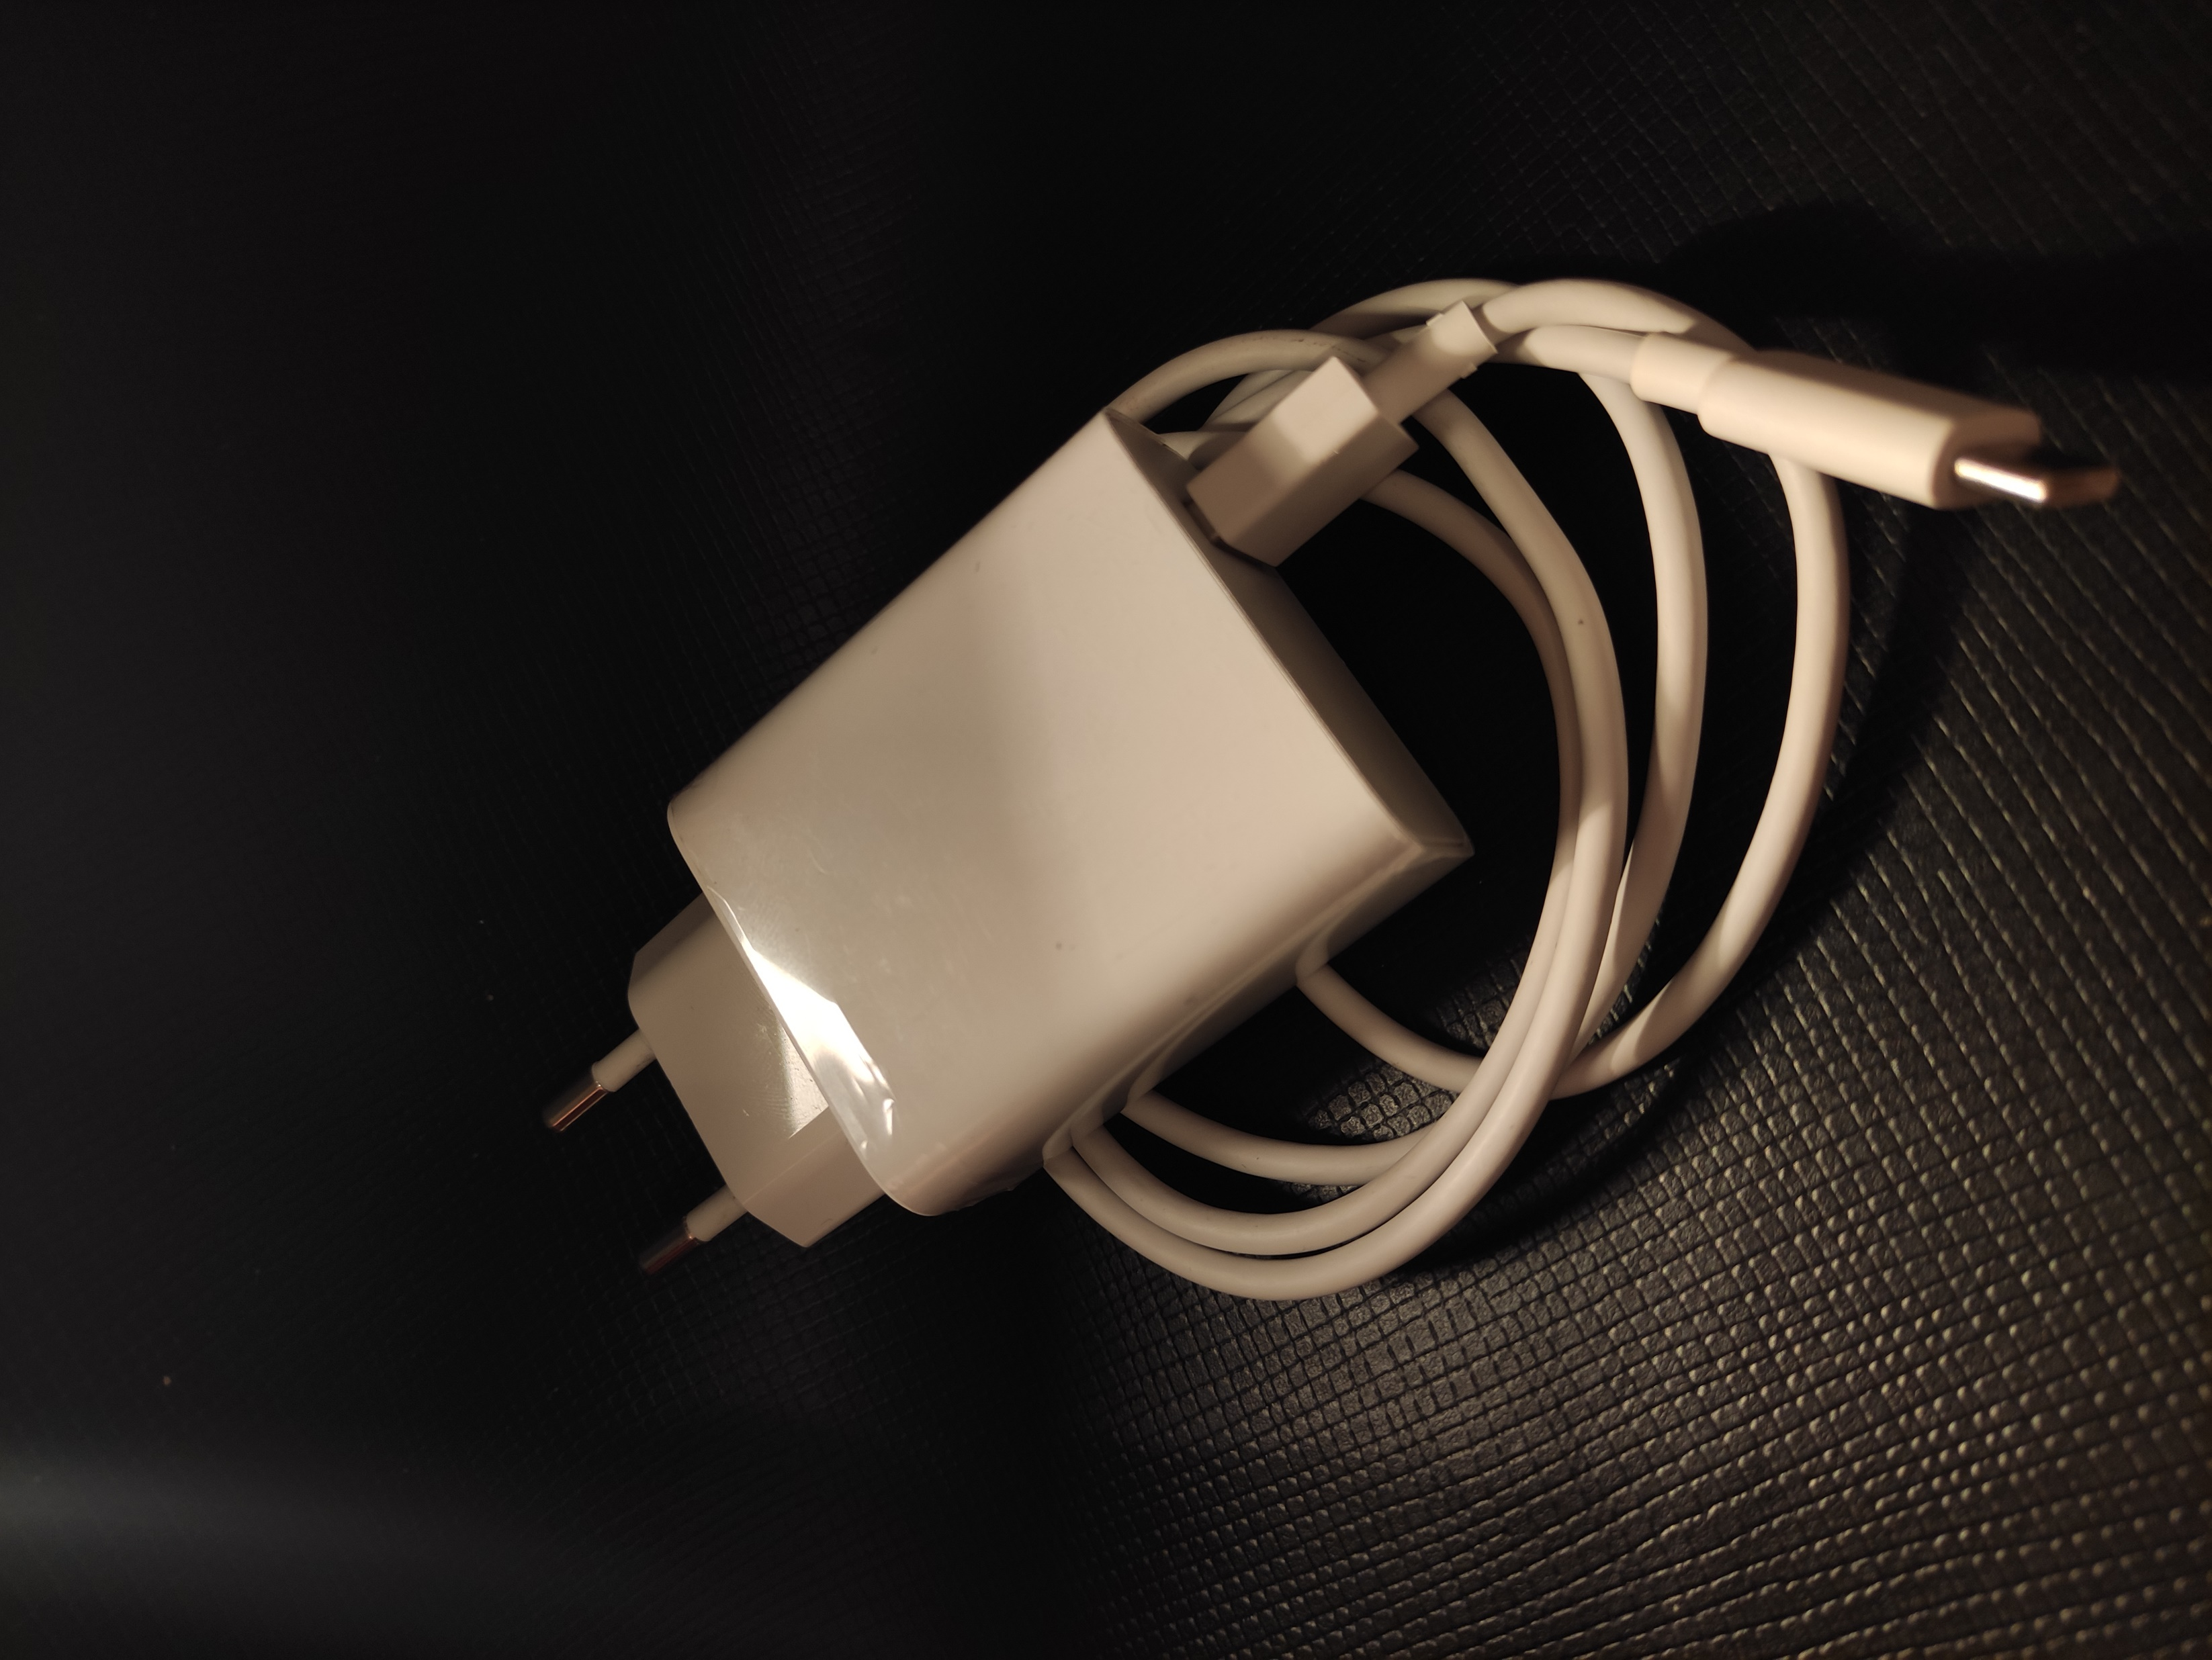
This product combines the role of powerbank and charging adapters on the market.
Inside the adapter, there is a battery like in power banks.
While the adapter is plugged in, the phone will first be charged, and the battery will be charged after the phone is charged. And you will be able to use this adapter as a power bank.

Slide 5
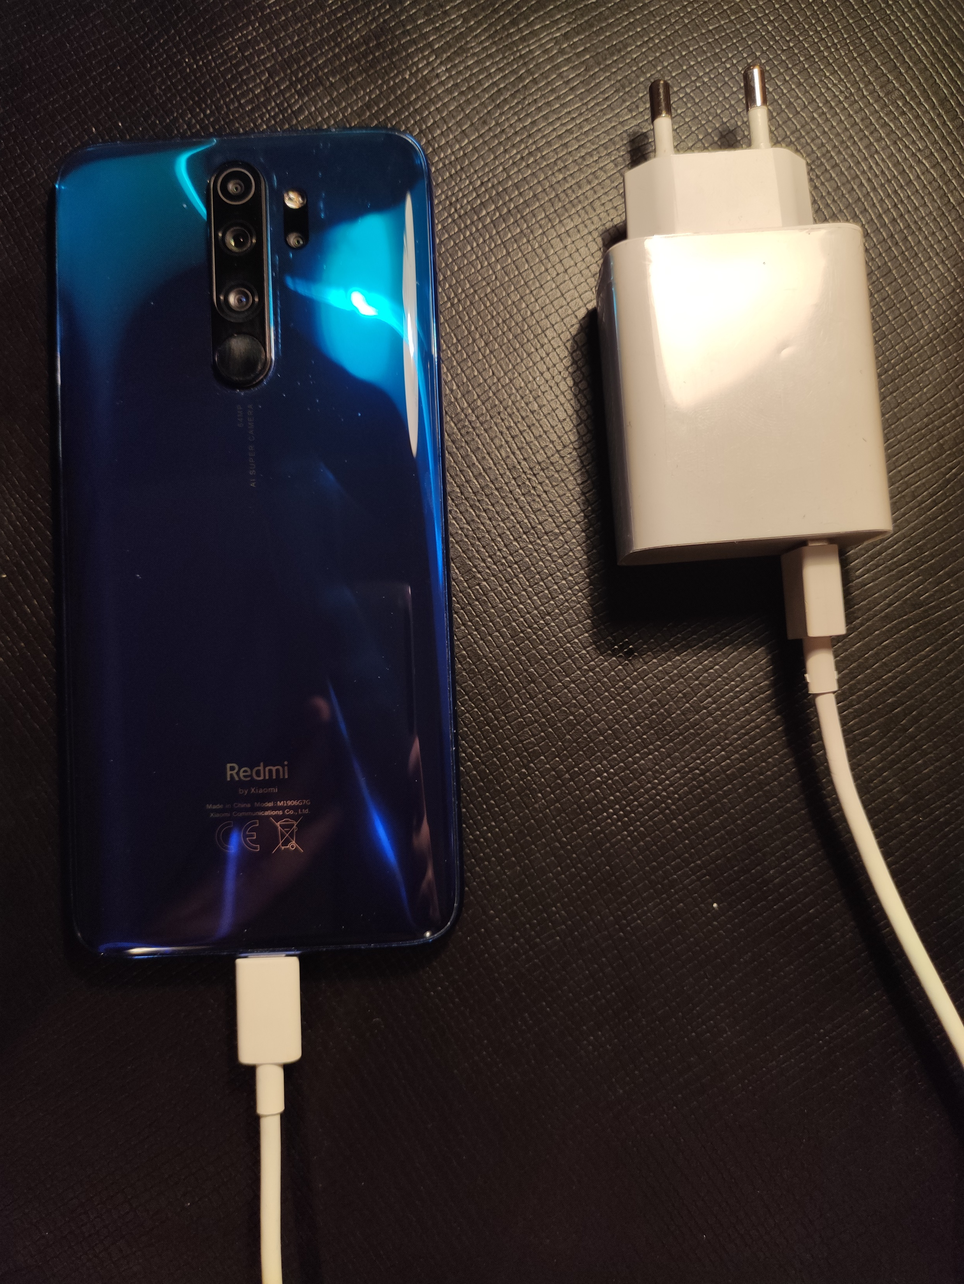
This product is more useful, more compact and more economical than power banks.
When your phone is out of charge, you can use this product if you do not have a power socket nearby.
If your battery is also out of charge and you have a socket near you, you will be able to use this product as a charging adapter. Therefore, you have the opportunity to charge your phone under any condition.
In this way, you will not have to carry large power banks also.

Slide 6
Some studies predict that the powerbank market will grow by 18%. Therefore, the need for powerbank will continue for many years. Some of the big brands that currently produce power banks in the market are;
-Xiaomi
-Huawei
-Asus
-Samsung
-Sony etc.
But our product is not exactly a powerbank. That's why we are not in full competition with powerbank manufacturers.
At this point, our product will become important and people will not have to buy both power banks and adapters.
Our product will be unique in the market and we aim for a completely different audience.
On the other hand, it has been recently announced that there will be no charger in the iPhone 12 boxes. They said that the reason for this was to prevent environmental pollution.
This shows us that in the new phones that will be released, brands can follow this policy for profit.

Slide 7
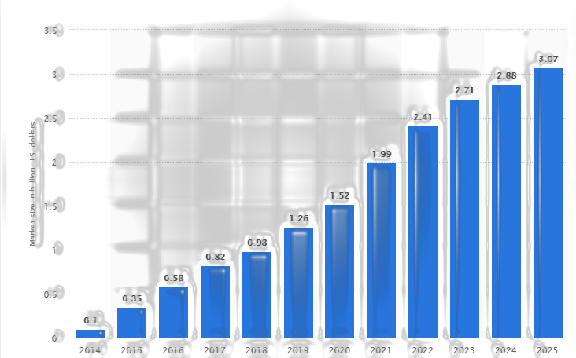
Let's give an example from researching the powerbank market. You see, there is a steady increase until today. And an increase is expected from now on.

Slide 8
To have a trademark in Turkey, primarily "the Turkish Patent and Trademark Agency" should be consulted. Things to do are as follows;
-Applying to the Turkish Patent and Trademark Office.
-To get a research report from the Turkish Patent and Trademark Office.
-Turkish Patent and Trademark Office prepares a report for patent examination.
- A patent certificate is obtained from the Turkish Patent and Trademark Office. (if applicable)
After registering your brand, you must obtain official permission to trade. After that, you have to enroll in several departments. Then you can start to produce, under your trademark.

Slide 9

Target Group;
The 'target group' of our product is the upper and middle segment. Not everyone will be able to buy this product because the materials needed to produce it won’t be cheap.
Culture;
Our product will be released in accordance with the culture of every country in the world. First of all, we aim to be positioned in the Turkish market. That's why we chose our logo and brand name in accordance with Turkish culture. In this way, we can attract people's attention.

Slide 10

BRAND’S CHARACTER

Slide 11
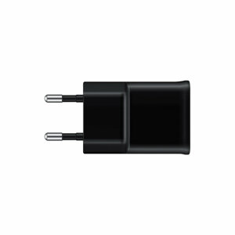
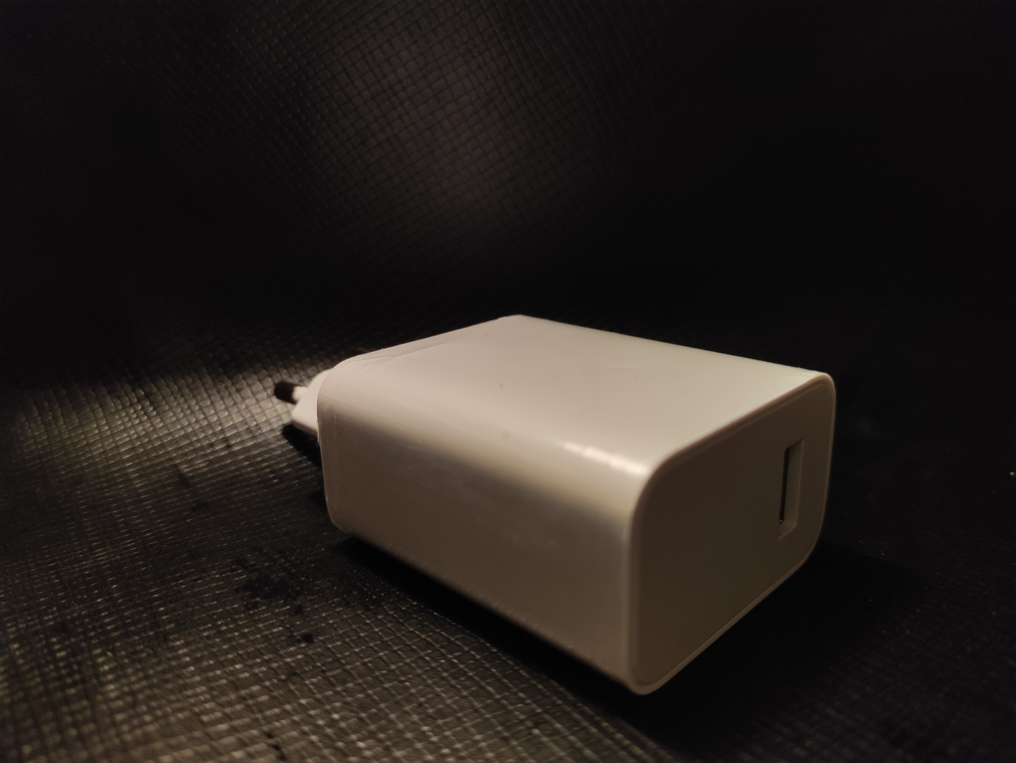
2-Again and again. What we want to explain here is that the product does not remain in the same form all the time. For example, producing black for black color design lovers.
We would like to explain the protection of the value of our product with examples.
1-Design.For example, when buying a phone, the image and frame of the phone can change our decision. That's why the design of our product will be an important point for us. Actually, our aim is to make the customers love the appearance of the product.

Slide 12
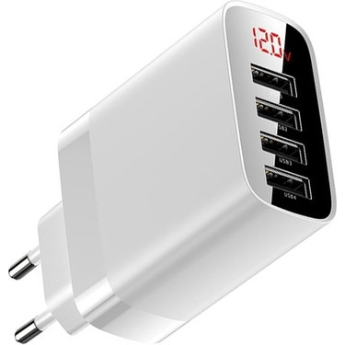

4-Durable and environmentally friendly. The durability of the product is important to us and besides, it is environmentally friendly. The more durable the product, the higher our image. As environmentally friendly, we want to both trust our future and help our world.
3-Update. After producing our product, we will not leave it as it is, and we will make improvements on the charger or the software. For example, putting 2 usb ports instead of 1 usb port.

Slide 13


6-Customers. We want to have a very close relationship with customers. For example, we want to come to a university, organize a big event, entertain the students, and actually introduce our product to them. We must be able to reach out to customers whenever they want to, and always show them that we stand by them.
5-Saving. In this section, we will choose our product materials from the quality but appropriate section. Actually, we want to spread all over the world. We want people to get the idea that I will buy it once and use it for a long time.

Slide 14
Very fine details are required to protect the value of the brand.
In fact, it is the fine details that will elevate a brand. In short, we talked about the methods we will develop.

Slide 15
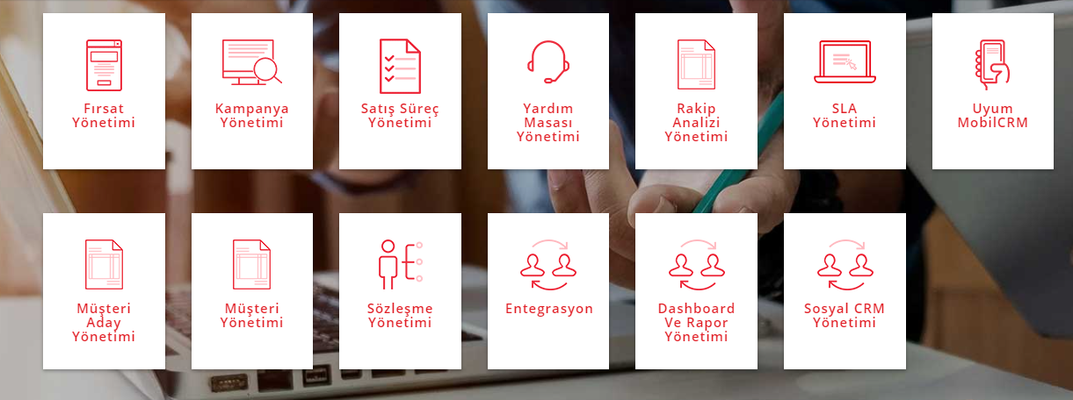
Here we see our CRM interface. Let's see why we prefer CRM and why it is needed.

Slide 16
1-With the Opportunity Management Module, you can track opportunities related to our potential and existing customers and follow up all activities related to offers, documents and processes.
3-With the Sales Process Management Module, you can instantly access offers, orders, opportunities, as well as all actions taken in the past.
4-With the Help Desk Module, your employees can quickly access their customer support accounts, etc. You can increase customer satisfaction and service quality by enabling them to access information, create problem records and answer questions and problems.
2-With the Campaign Management Module, you can classify your potential and existing customers on the basis of channel, product, region and sector, and organize special campaigns according to the customer or customer group. You can also handle transactions such as sending mass mails.

Slide 17
5-With Competitor Analysis Management, you can save your competitor information system for your sales and marketing operations, get detailed reports according to who data pool, region, date and price, and make special campaigns for the relevant customers.
We explained the features with the main basics. Thanks to CRM, we can make detailed analysis both on the internet and on the stores. Analyzing customers in detail is one of the most important points to be able to adopt their thoughts.

Slide 18
Thanks for listening. We apologize for that if we had mistakes.
Burak Kayataş
Sezai Moran

