Slide 1


our brand’S name AND LOGO
BEE

Slide 2
Why did we choose this logo AND NAME?
Our reasons to use the bee logo
Bees are hardworkers.
Bees are known to be the closest insect friend of humans.
Bees are fast.
Also the bees take the shortest route out of the hive to find food. This provides work and energy optimization. Thanks to this feature of bees, "artificial bee algorithm" has been developed.

Slide 3
WHAT ARE WE DOING ?
We are a software company. We produce and sell softwares in many subjects. For example special softwares for individuals, softwares for factories and companies. Let's take a look at what we mean in detail.

Slide 4
An example for personal software;
Special insolse designs with AI
The comfort of the feet is important. People use orthopedic insoles, but these are standard sizes. If a person wants to use an insoles according to their foot shape, that person sends us their foot photos. Our designers model this foot photograph with artificial intelligence and transfer it to the computer. Then we scan it and print it out with a 3D printer. We send this printout to the orthopedicians we cooperate with, and then we send the orthopedic insoles to the customer.

Slide 5
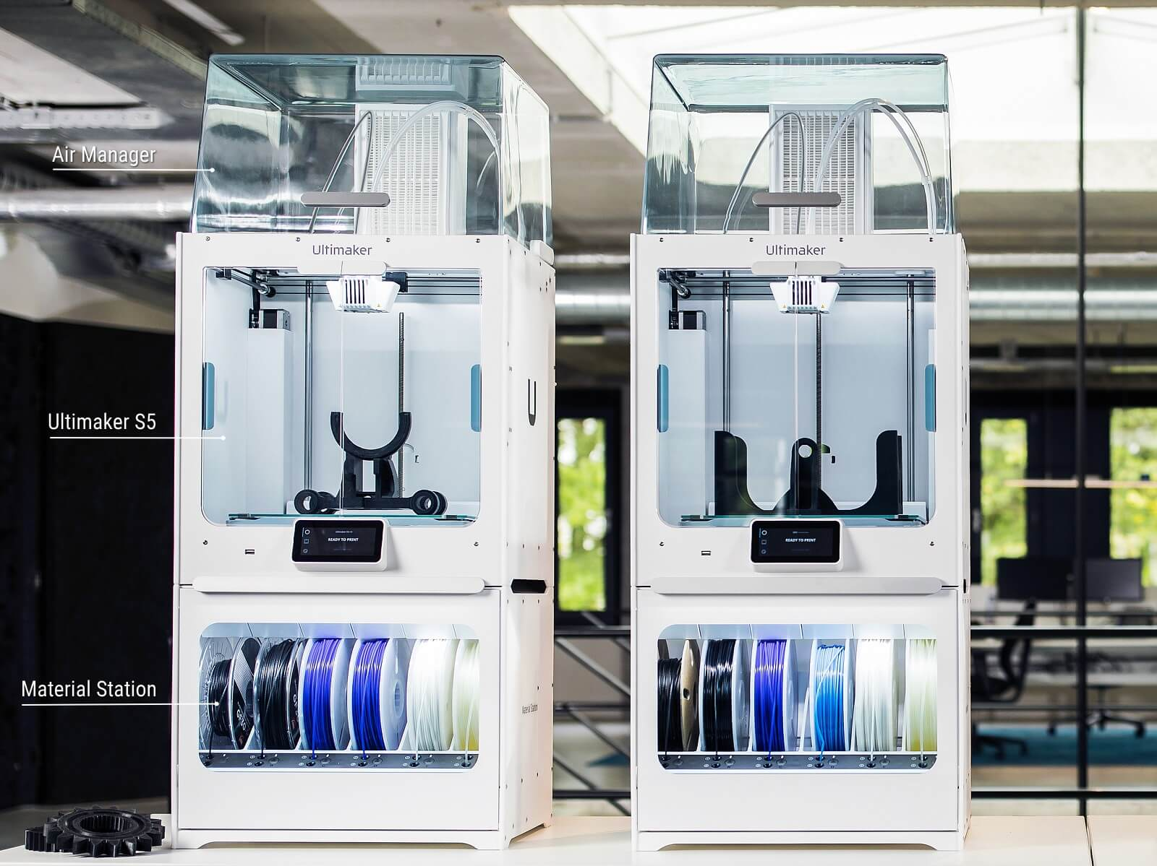
Let's see how we did it.
Printing times and printing quality of 3D printers are very important. We chose a quality printer in the market as we wanted to maximize our time and performance in our company. In addition, we will be able to have many equipment needs of our company.
10.000 Euros

Slide 6
Let's see It closer
For example, a stewardess working at Turkish Airlines communicates with our company. And he sends us pictures of his feet in x, y and z coordinates.
Our designers model the submitted photos in 3D using the application developed by our software developers and transfer them to a 3D printer.
Then we send this printout to orthopedists after a short time.
After the orthopedists make the necessary adjustments, the product is delivered to our customers through our suppliers.

Slide 7
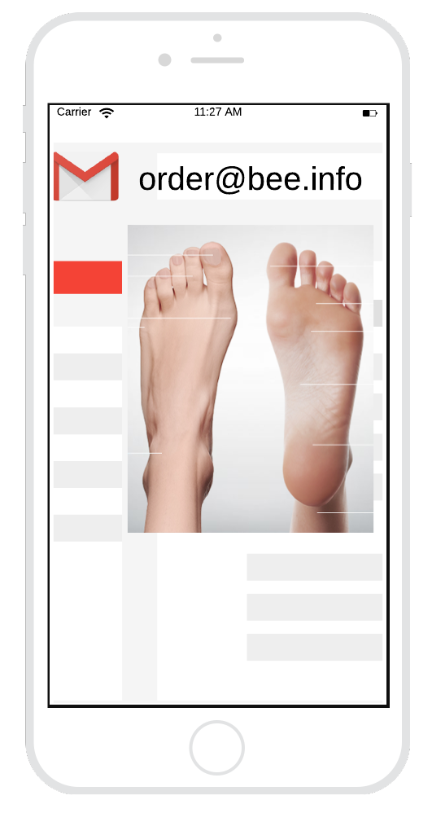
HOW DO COSTUMERS WILL BE ABLE TO ORDER?
Our customers should send us an e-mail (order@bee.info) to place an order. In this mail, there should be a photo of their feet from 4 angles, their names, address information and a receipt of their payment.
They have to make the payments from VakıfBank mobile application.
Our IBAN number is: TR04 0006 4000 0012 5001 5166 04
They have to send us the electronic receipt of the money they send to this IBAN number from the mail.

Slide 8
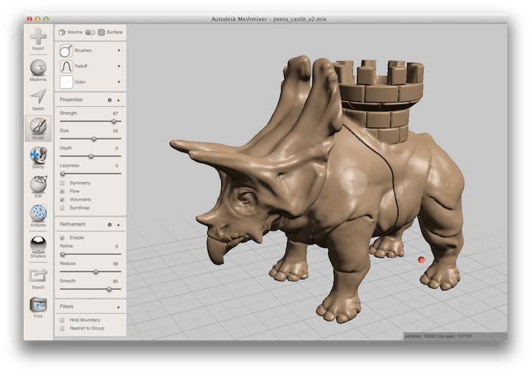
We make millimetric designs with special 3D sites. Then we transfer this design to our 3D printer. We expect e-mails from our customers and quickly fulfill their requests.

Slide 9
Who wıll deal wıth orders ?
3 out of 15 employees working in the production department deal with orders. Their names
-Beyza Murat (Manager of Order Receiving)
-Batuhan Gökçe
-Mert Gör

Slide 10
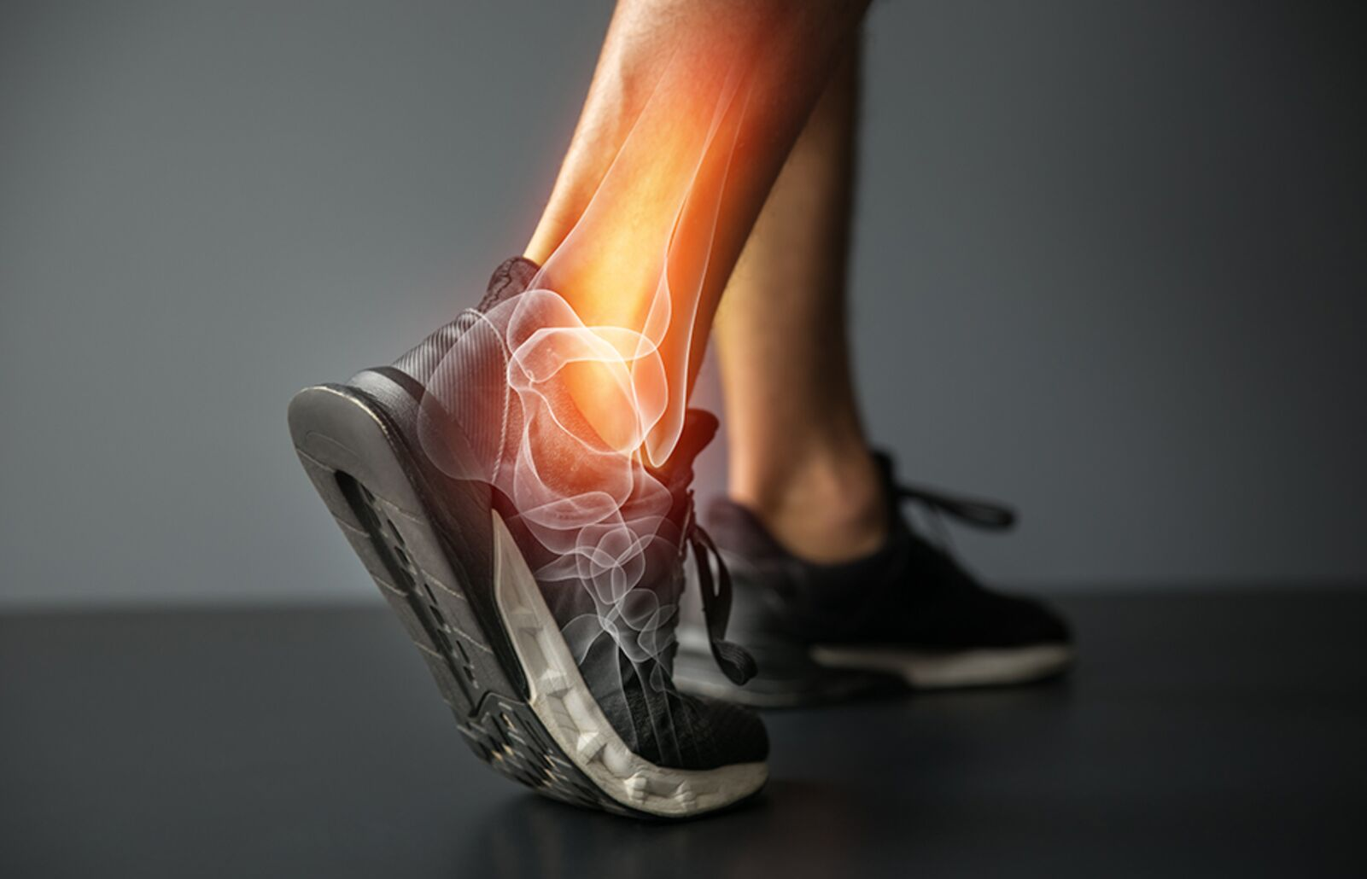
WHY DO PEOPLE NEED IT ?
While the human foot constitutes 25% of the bones in our body, it consists of 33 joints and more than 100 soft tissue elements working together both structurally and functionally; It also includes ligaments, tendons, and muscles.
Studies have found that a person takes an average of 5000 to 10,000 steps per day. With this mobility, the ankle has a high injury risk rate of 15% - 25% among all injuries in our body. In addition, individuals with structural imbalances are much more likely to injure and severity of injury than healthy individuals.
STAY UP!

Slide 11
Another example for personal software;
Personalized cars.
If a customer wants to create a comfort zone by giving commands to his car, we produce special software for him. The thing is, you can open the car windows, close the door or turn on the music with a voice command. Or they can have an automatic driving mode by following the lanes on the road with our software.

Slide 12
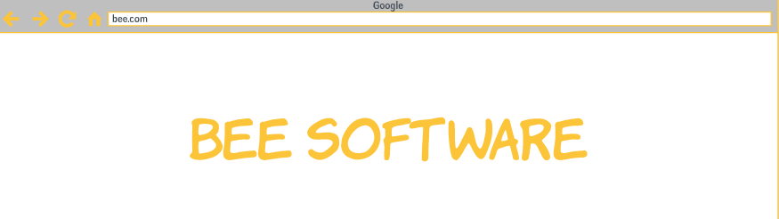
Why do we see ourselves as a monopoly on this issue?
Nowadays, as the price factor plays an important role, software developers save both time and money compared to software development by choosing to buy software that they can sell more productively. But we made a new start by producing 100% domestic software. The taste of eating what it produces or makes is different. We know that.
-Ability to restore software
-3 years warranty
-Refund within 15 days
-Insurance does not change
-End time between 1 and 1.5 hours
-No problems with the warranty of the car
-Professionalism and 7/4 customer support

Slide 13
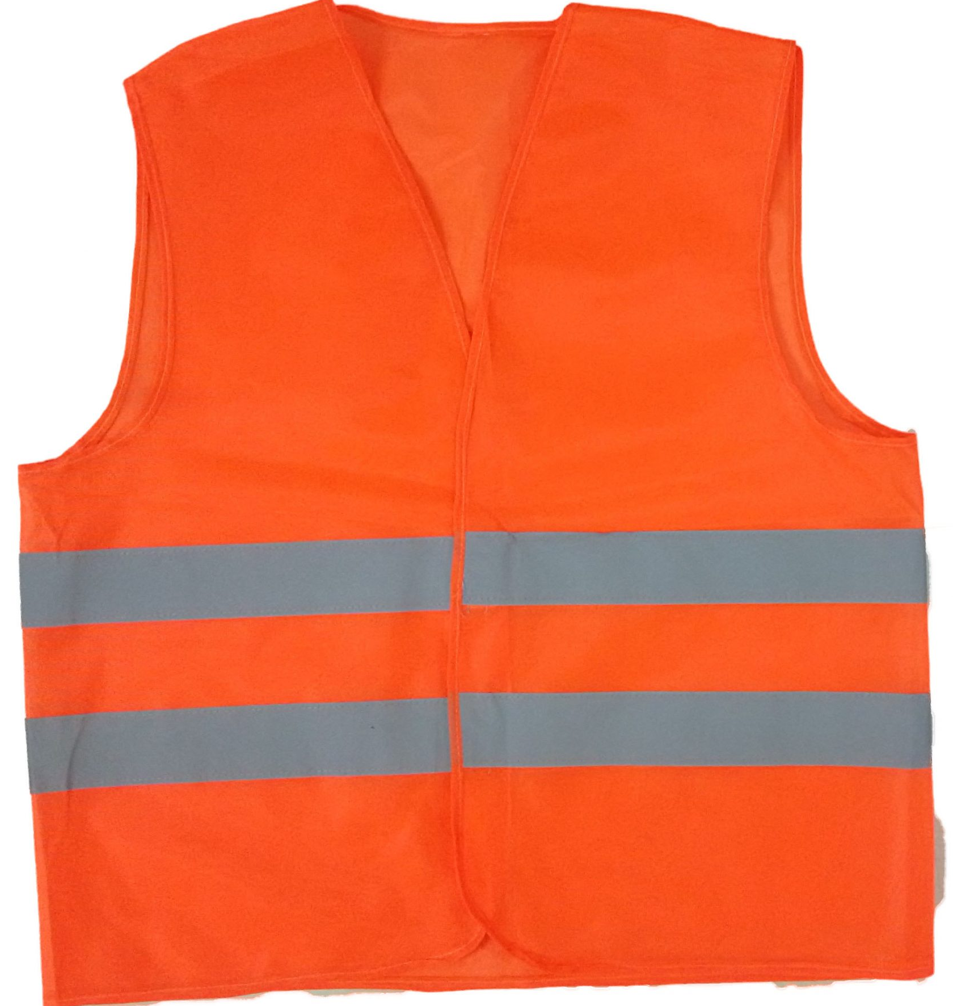
Software for factories and companies;
Information system, security, and artificial intelligence software for a company or factory.
For example, a factory needs software to monitor workers. With an artificial intelligence system that detects orange work vests, we aim to calculate the movements of the workers, their entrance to the factory, the time they stand still.

Slide 14
HOW WILL WE DO IT ?
Image-processing artificial intelligence
The software we have developed detects the workers wearing orange vests using the image from the cameras in the factory. The movements of the workers in this image are recorded and data is obtained. These data are processed and interpreted and the difference between the work that workers have to do and what they do can be determined. These company managers can monitor the productivity of the workers.

Slide 15

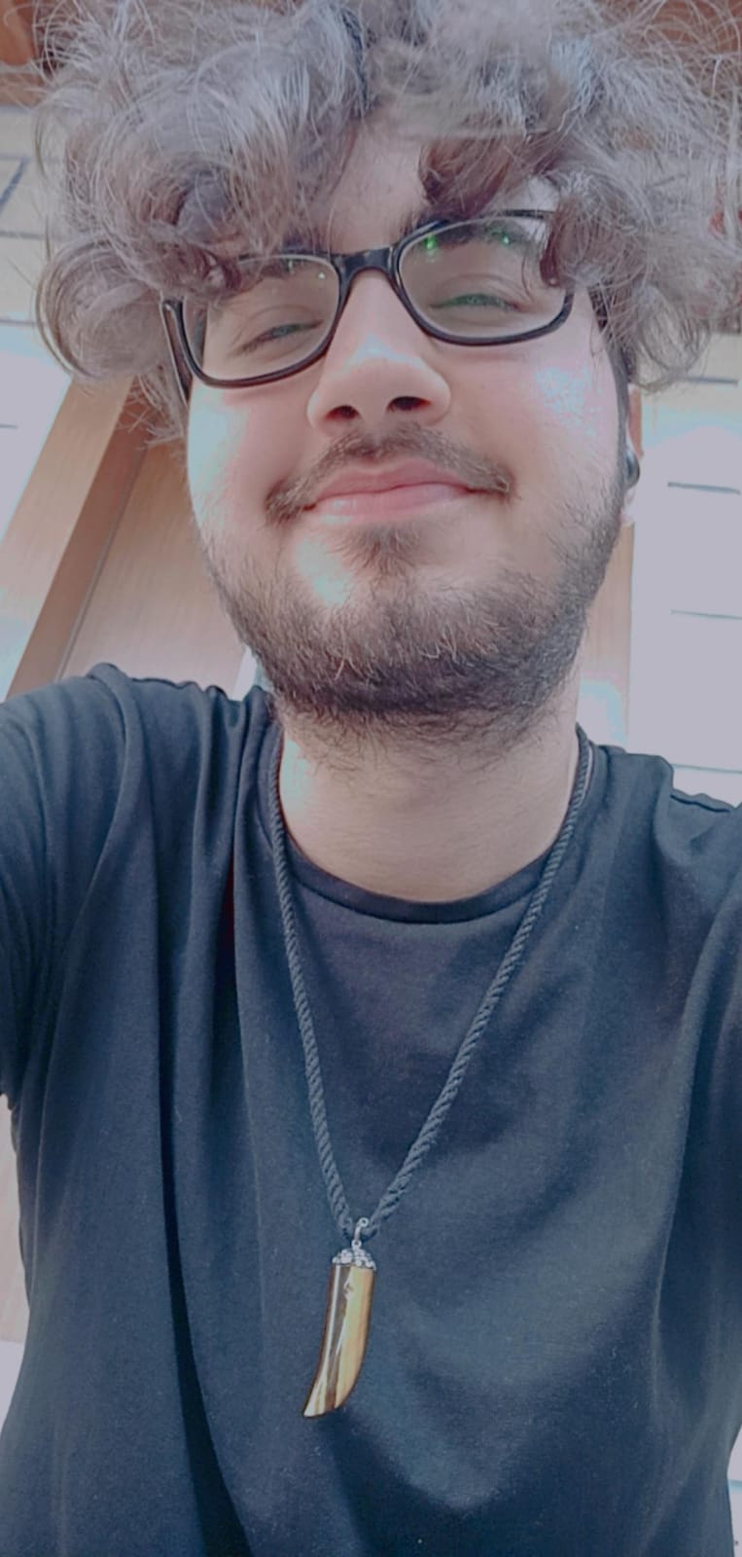
FOUNDERS
Burak Kayataş was born in 1999 in Istanbul.
He finished Secondary and High School in Istanbul.
He is currently studying Management Information Systems at Sakarya University.

Slide 16
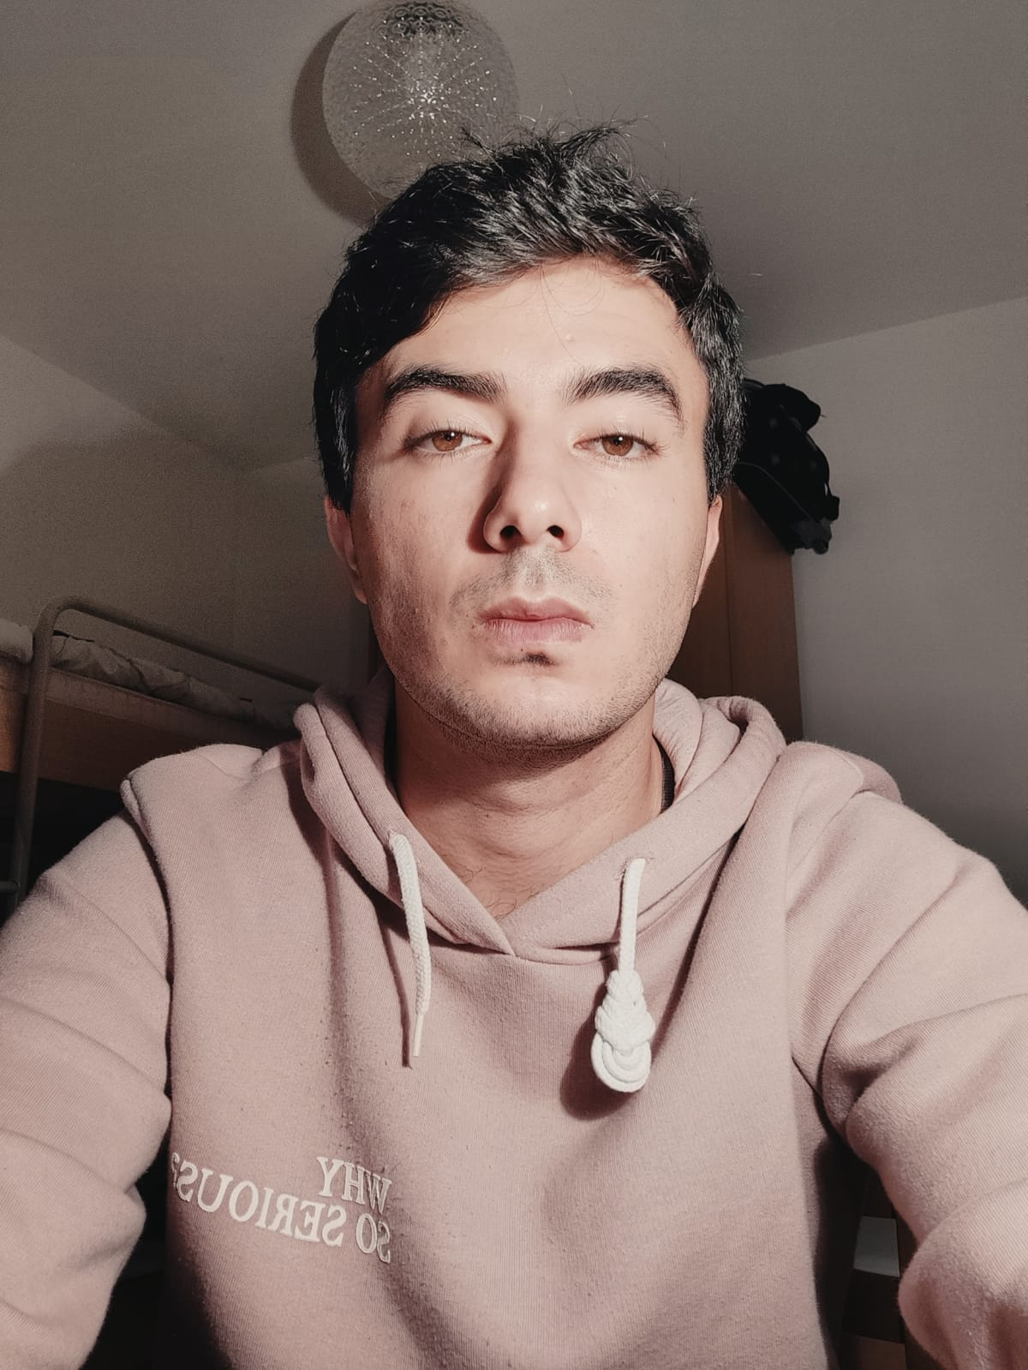
FOUNDERS
Sezai Moran was born in 1999 in Yalova.
He graduated from Secondary School and Primary School in Yalova.
He is currently studying Management Information Systems at Sakarya University.

Slide 17
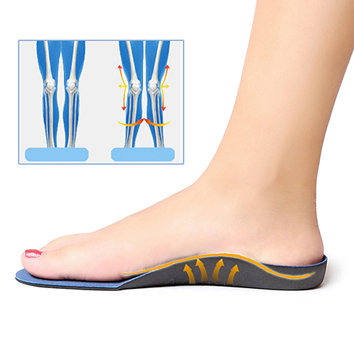
PROTOtypE of ınsolse
The insoles, the product we trust most, look like this.
A healthy foot means a healthy body. A healthy body offers you a healthy life.
And you can use this product for all kinds of shoes.

Slide 18
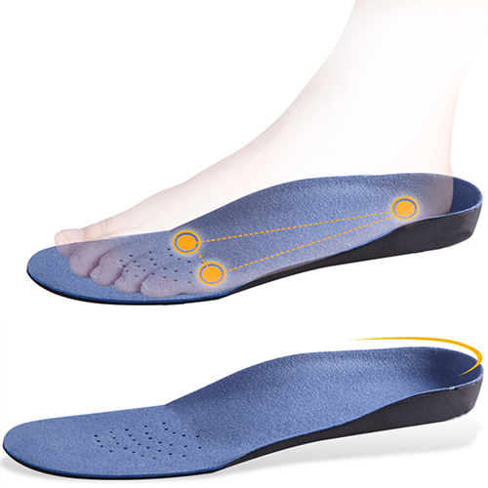
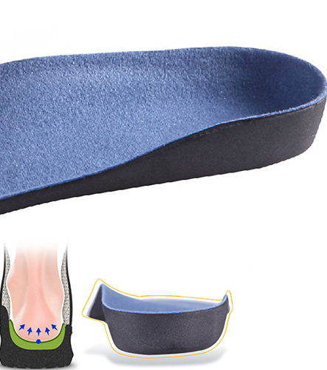
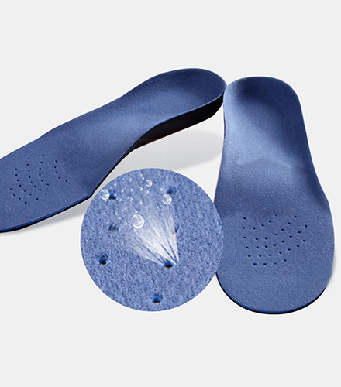

Slide 19
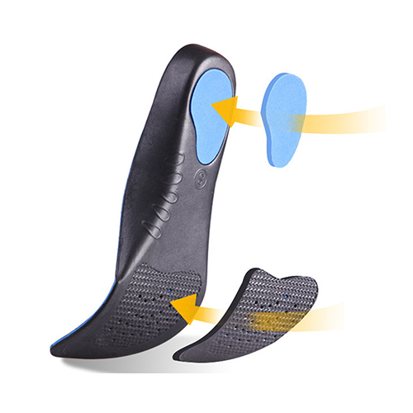
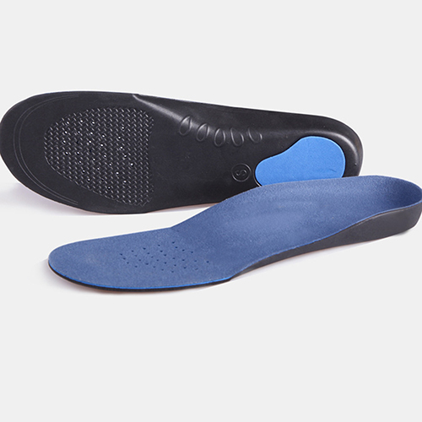

Slide 20
Product’s PRICE
We set the price of this product as 99 Euros. Production cost is 25 Euro. Net profit is 74 euro. Normal orthopedic insoles vary between 15-35 Euros in the market. But the insoles we produce will be completely personalized and we pay high salaries to various software developers and designers for this. The 3D printers used in this production and the materials of these printers are quite costly. The price of the product is high because this price includes more than one production and distribution cost.

Slide 21

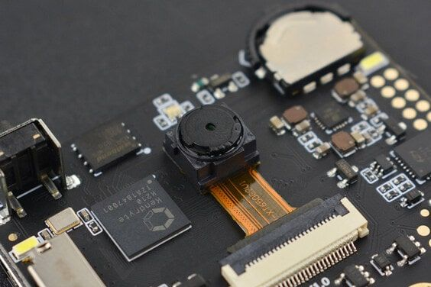
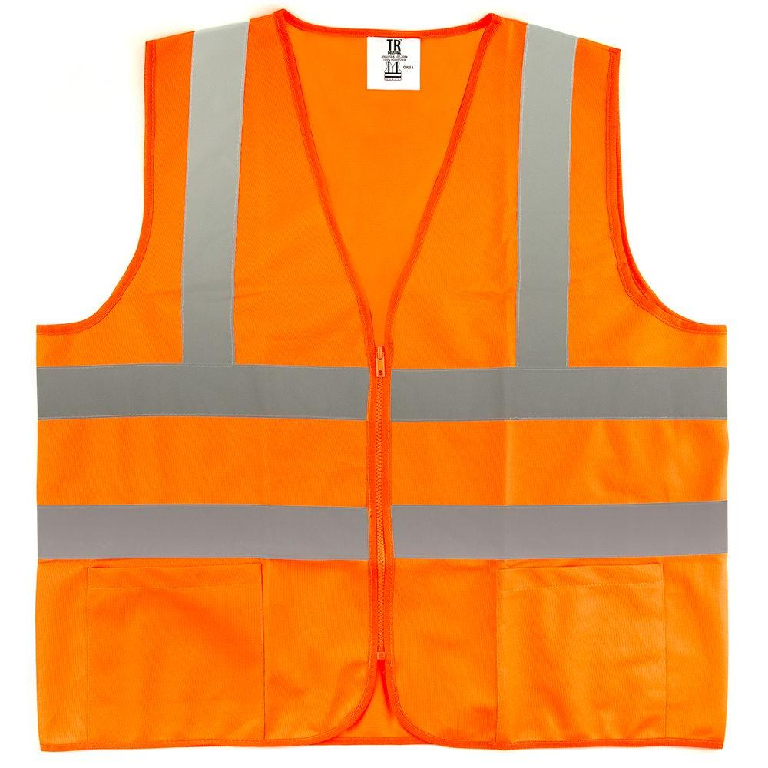
Imagıne proccesıng

Slide 22
We offer 2 options for this software service.
Low price option, the cameras available in the factory store the footage on a cloud. These stored images are processed on a computer using an image processing artificial intelligence system and can be viewed instantly or later. Workers with orange vests in these images are distinguished by the color of the vests and perceived in our software. The movements and entries and exits of these workers are analyzed.
High price option is that we supply our special cameras equipped with various sensors for the factory. While these cameras record the image, they detect the orange vests at that moment and save them in the cloud, and the image coming to the computer comes with the sensors detected.

Slide 23
Prıces of ımagıne proccesıng
In the first option, we only charge for image processing software. System setup costs 1199Euro per camera. Net profif is 1100€ per a camera in this option.
In the second option, we also supply the camera equipped with sensors and install our software on the computer in the enterprise. The price of this is 3299Euros including the camera. Net profit will be 2000Euros per a camera. The camera we put in is very high in terms of image quality and sound recording quality. There is also a motion detection sensor inside. For this reason, the second option is much more expensive.

Slide 24
Destınatıon group
Our target group is not the same for every product.
The target group we have determined for insoles;
-Hostes,
-Travelers,
-Working in a standing position,
-Mobile vendors,
-Physical workers
-Airline companies,
-Workers in the ‘cinema’ industry,
-Athletes and Sports Clubs (Football, Basketball, Volleyball etc.)
Target group for image processing system;
- Factories that attach importance to efficiency and have a large place in the market (Toyota, Ford, Aselsan, Bosch etc.)

Slide 25
competıtıon
Turkey in recent days has increased emphasis on software. The "informatics valley" to be established in the country will make our company more important in the future. There are many software companies in our country that sell systems such as CRM and ERP.
Our software company has differences. According to the market research we have done, there are companies that sell products like us, but they are few and insufficient. The features that distinguish us from others are product quality, customer orientation and orientation to the niche area.

Slide 26
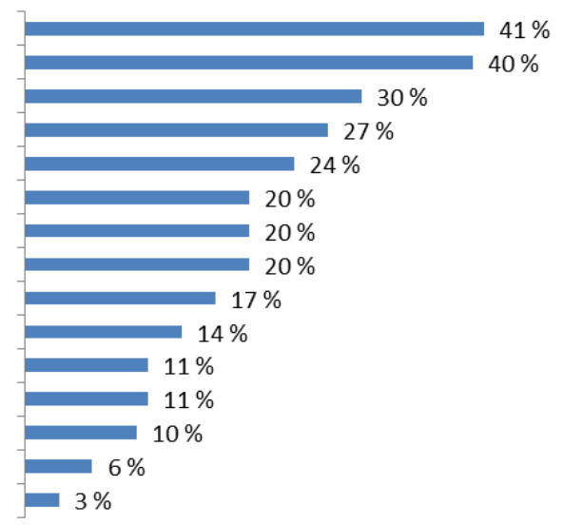
competıtıon
State and foundation funds
Manufacturing and automation
Telecom
Electric-Electronic Production
Finance and banking
Shipping and logistics
Textile
Others
Education
Media and entertainment
Defense industry
Health sector
Agriculture, Law, Energy
Tourism
Construction industry

Slide 27

competıtıon
One of the biggest competitors when we do market research in Turkey, we see that AKINSOFT.
For example, let's look at the slogan of this company. "Software solutions that add value to your business." Our company actually sells software on solutions, comfort and efficiency to individuals or companies. But our difference from this company is that while AkınSoft company focuses on software such as ERP, CRM, SCM, we are more interested in customized and special software.

Slide 28
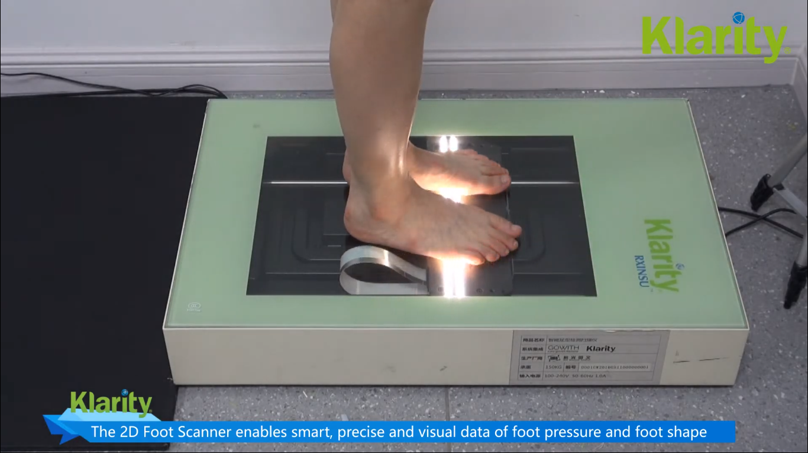
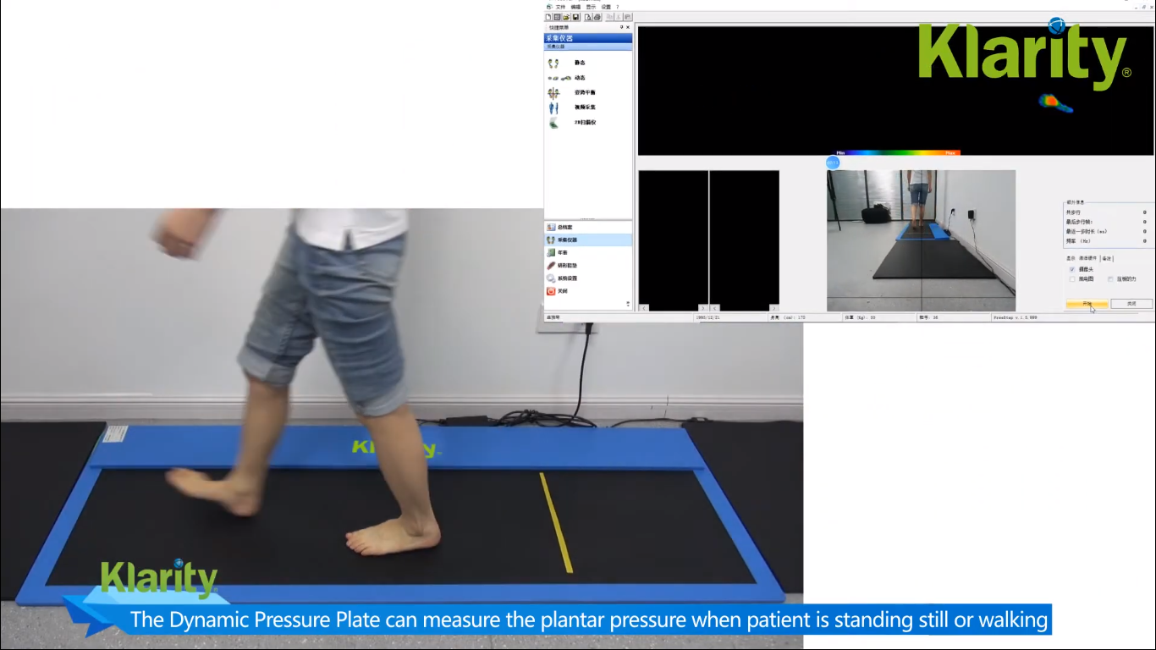
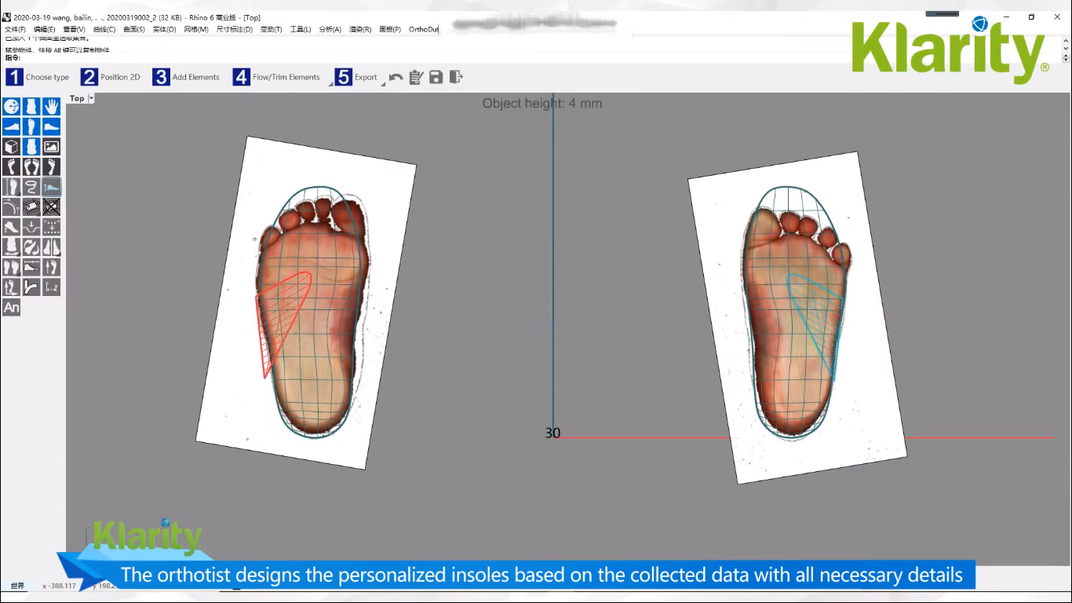
competıtors
One of our biggest competitors in shoe insoles is ‘’Klarity’’.
They are implementing a very ordinary system. Customers have to go to their office and follow some procedures. First, the customer steps on a scanner, then they walk on a carpet with some sensors and they design the shape of their feet on the computer based on this data.

Slide 29
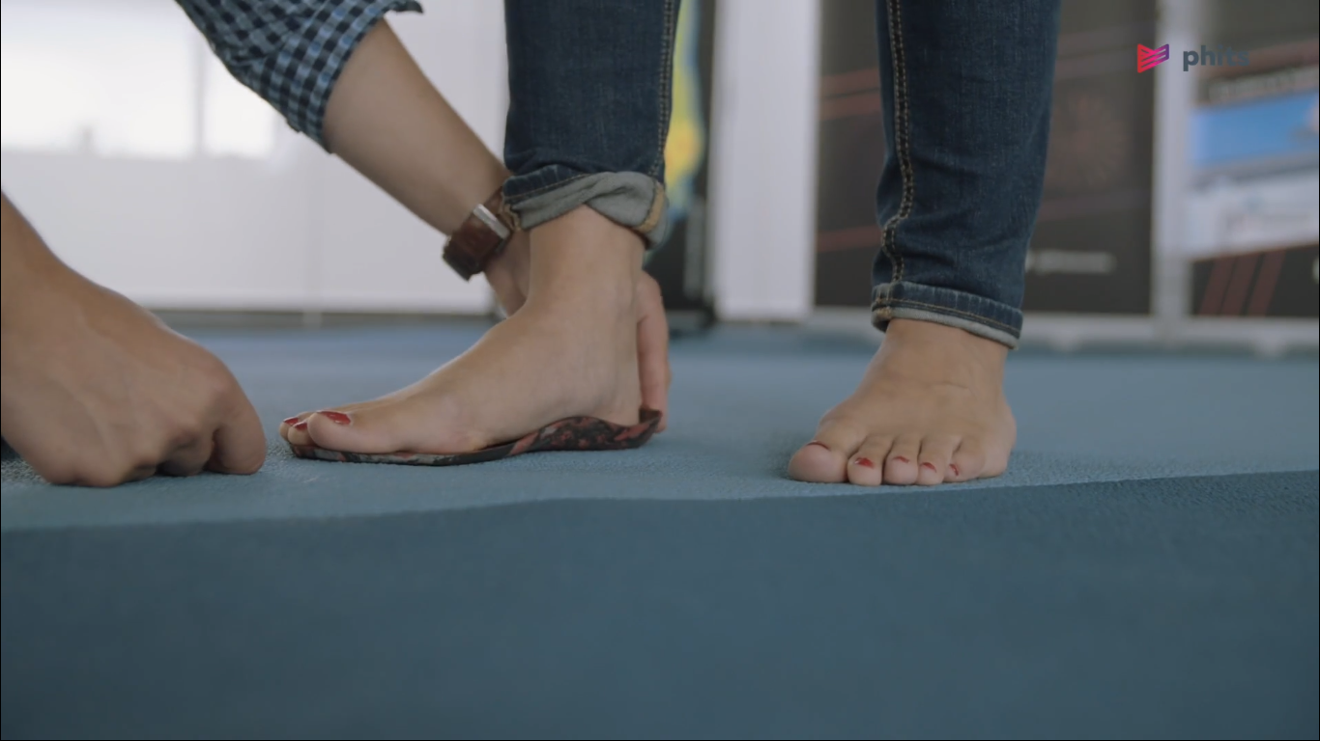
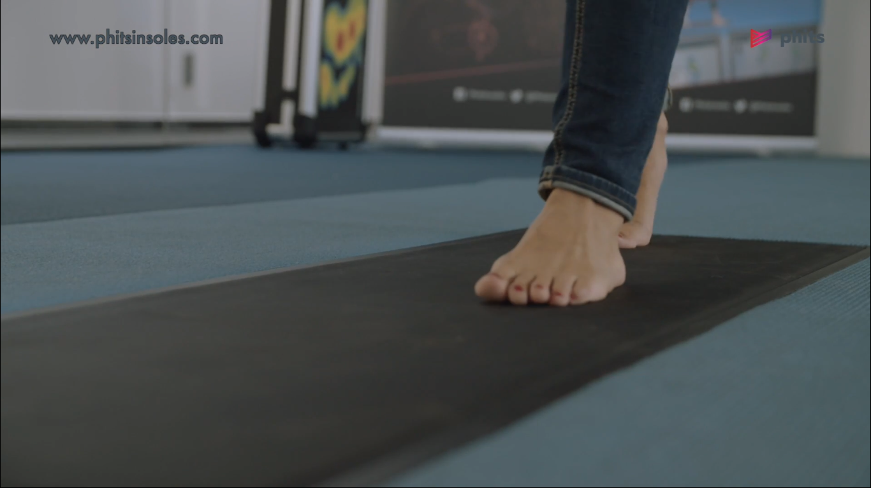
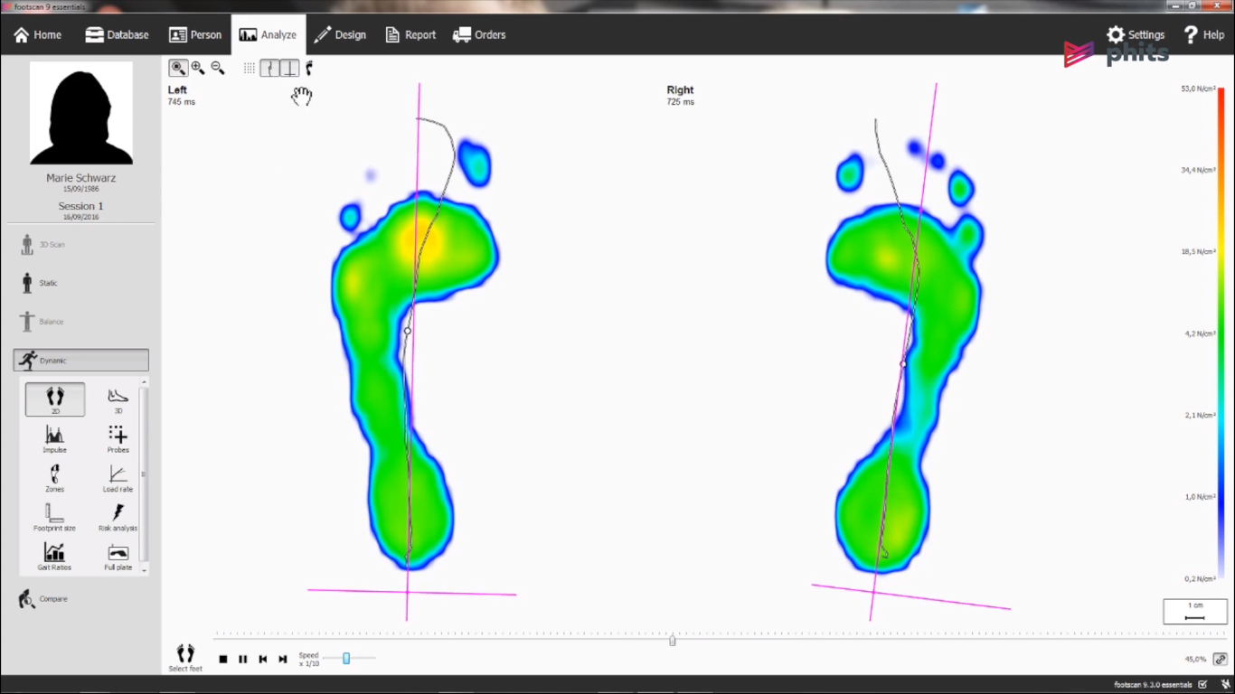
competıtors
Another important competitor is Phits. Phits firm also uses sensor rugs like Klarity. But they don't have a scanner like Klarity. In addition to all these, orthopedists working in-house produce these insoles in the production area. This means extra production machine, extra production cost and extra employee salary.
Therefore, although these products have the same purpose as our products, their prices are higher than ours. This is our advantage.

Slide 30
The differences of our company from these 2 companies are as follows;
We are using technology in a way that makes people more comfortable. Our customers do not have to come to our office or follow certain procedures to have these insoles. These procedures and the customers having to come to our office can be a disadvantage. Our customers will be able to have their own special insoles with just a few photos thanks to our photo modeling software. This brings us to a more advantageous point than these 2 companies.
We also outsource orthopedic insoles production. We send the sample insoles we take from the 3D printer to orthopedic product manufacturers and they produce these insoles in their own environment and deliver them to the customer. Thus, we reduce our production cost.

Slide 31
Managers
Burak Kayataş
Sezai Moran
2
financial and administrative affairs
6
marketing
10
social media
6
15
3
8
4
production
logistics
domestic sales
order receiving

Slide 32
INFORMATIONS ABOUT WORKERS
  The average age of our work team is 26. Especially in our marketing and social media team, most of the workers are recent graduates.
  Our average salaries of workers are 6.000TL (666€).
  We have food and beverage vending machines in our office. In addition, we pay 500 TL(55€) monthly meal allowance to the workers, including the salary
  Generally, we prefer young and inexperienced workers. We prepare these people for the sector. We also take advantage of their determination to succeed. Therefore, we have a young and dynamic team..

Slide 33
EXPEnses
312.000 TL salary expense
50.000 TL office rental expense
67.500 TL fixed production expense
Totally = 47.720€

Slide 34
PROFITS
Our monthly average insoles sales target is 500 units. We get a net profit of 74 euro from each insoles. Therefore, we aim for a profit of 37.000 € from insoles.
With our image processing software, we aim for a monthly profit of approximately 52.000 €.
Our monthly average profit target for personalized vehicle software and other personalization software is 8.000 €.
Total Average = 97.000€

Slide 35
INSIGHT
We actually did research before entering the market. Did people really need a personalized base? Would he want to see changes in his rich cut car? We asked people personally and gave them opportunities to try it out. It was very important for us to get your thoughts after 1 week. Yes I will take this. I will buy it once, but I will. After entering the market, the PR we made with our social media team managed to attract the attention of big companies.
What we discover People this orthopedic sole is too expensive so much money? They think it's expensive just because it has a brand. They think it's the same as a much lower priced orthopedic sole. But we told them to go out of the box and try. We received applications and sent orthopedic soles to a certain number of applicants and asked. Would you buy it? We achieved a 98% success rate.

Slide 36
VISSION
MISSION
Developing the software industry at the level of individuals and moving this sector to a completely different point in the world.
Focusing on the comfort and individual wishes of the people and establishing a direct connection with people

Slide 37


Slide 38
specıfıc
What? adding different valen to with software.
Why? to break the taboos poplu are used to.
Who? anyone who can feel us.
Where? we are everywhere.
When? whenever you need it.
Our goal is to develope the software industry at the level of individuals and moving this sector to a completely different point in the world.
In fact this goal which is the same with our vission based on concrete research. As we mentioned in the title of "insight", we can define this goal as a result of our research with people.

Slide 39
MEASURABLE
We will achieve this goal by the last month of 2027.

Slide 40
attaınable
As we mentioned in our presentation, we have sufficient budget and resources. We gave certain products to certain people to try them out. In this way, we can see that our product is applicable.

Slide 41
RELEVANT
We want to maintain their satisfaction by being in constant communication with our customers.

Slide 42
TIME
We will be Turkey's most valuable software company on December 31, 2027.

Slide 43
Evaluate
We will hold evaluation meetings every 3 months. In this way, we will see where we are on the road to our goals. We will have small reports every week.

Slide 44
reevaluate
We have a target that will advance towards 2027. We make continuous evaluations to accompany our goal in this journey, and when there is any problem, we will quickly solve it and remove obstacles.
We evaluate so that we can appreciate.

Slide 45
PATENT
To have a trademark in Turkey, primarily "the Turkish Patent and Trademark Agency" should be consulted. Things to do are as follows;
-Applying to the Turkish Patent and Trademark Office.
-To get a research report from the Turkish Patent and Trademark Office.
-Turkish Patent and Trademark Office prepares a report for patent examination.
- A patent certificate is obtained from the Turkish Patent and Trademark Office. (if applicable)
After registering your brand, you must obtain official permission to trade. After that, you have to enroll in several departments. Then you can start to produce, under your trademark.
We followed these steps and got our patent.

Slide 46
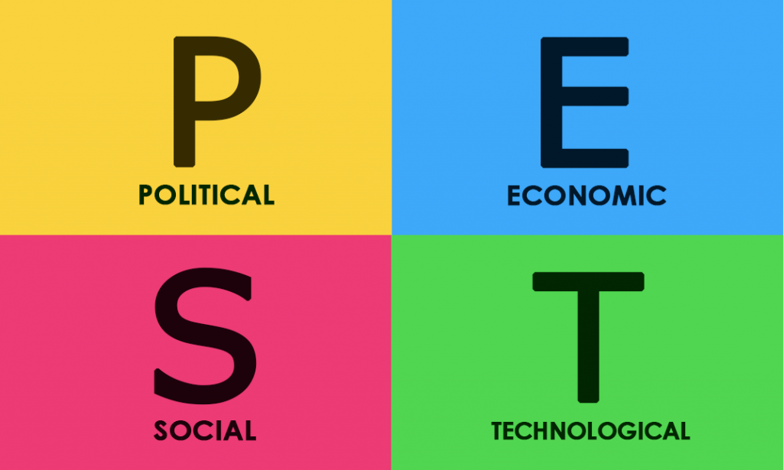

Slide 47
POLITICAL
The government stated that software is very important and that software companies will be given great support. There is no political obstacle in front of us, as we will make national sales in the first place. We have advantages as there are no obstacles. We will take a place in the newly opened 'Software Valley' area.
ECONOMIC
Economically, we are in cooperation with the Turkish Airlines firm, for example. Since the company cares about the health of its hostesses, it wanted mass production for themselves. We have a large audience with solid agreements we have established and, on the one hand, our person-oriented sales. We will appeal to even larger masses with our updated software.
TECHNOLOGICAL
Social media has progressed. People now dominate the internet. We are all over the social media and internet. Thanks to our social media team, we moved our name all over the country. As we mentioned, we use the latest technologies. Because the smallest time loss, malfunctions and similar works mean big losses. That's why we are close followers of technology.
SOCIAL
We are raffling. Handing out gifts and being happy with people being happy makes us happy. In fact, we always spend time with people with our team. We travel with them, we organize fairs with them, we organize conferences with them, we want to be friends with them. Universities are waiting for us and we are happy to visit them every time. It has always been our choice to take big steps with a large audience.

Slide 48
PORTER ANALYSIS
☺
☺
☺
☺
☺

Slide 49
competıtıon ın the ındustry
We will make my analysis with the questions we ask ourselves. So let's start.
How many competitors do we have in the industry?
We talked about our competitors. When we look at the market, we see a software company similar to us. Also, we see 2 more companies doing similar business to us. We differ from these companies on a few issues. For example, as we talked about before, the convenience we provide while producing soles and our ability to do different jobs put us ahead. In short, when we enter the market, we are faced with 3 companies.

Slide 50
How is the quality of their products and services compared to ours?
We do not differ much from our competitors in terms of quality. We stand out with concepts such as price, speed, customer support and pr. We talked about 2 sole manufacturer companies. While these companies are only focused on producing soles, we find medicine for many software diseases.
Effective marketing means everything to us. No matter how intense the competition is, knowing how to sell always brings companies to the fore.

Slide 51
The power of the suppliers
How many potential suppliers do we have?
We talked about 3 production. These are insoles generation, image processing system and car customization software. A company that produces 3D printers, a company that produces special parts for cars, a company that sells software tools such as image processing systems and cameras. We reached agreements with these companies. Especially the reason we reached an agreement with these companies was that we wanted not to be halfway through when we made future analyzes. Determining our suppliers before investing was among our top priorities. We attended conferences, got information, talked to authorized people about price issues. In fact, what we wanted was to build very close relationships with our suppliers and take big steps.

Slide 52
In addition, there is another supplier company to provide company tools and equipment. We potentially have a total of 4 suppliers.
Our suppliers respectively
Ultimaker(3D printer)
Hepsiburada(Car accessories and many parts)
Festo Turkey(Image processing systems)
Avansas(Office equipment)
How unique is the product or service they provide?
For example, ultimaker is one of the best 3D printer brands. We buy machines from our ultimaker supplier, which speed up our business and provide us with great profitability. Our supplier of Hepsiburada can supply us with any equipment. It is an e-commerce store and also our sponsor. Festo Turkey sells quality parts. Avansas, on the other hand, is a major supplier of office equipment.

Slide 53
The power of the customer
Buyers are the driving force of any industry, including the software industry. Buyer behavior is an essential part of marketing strategy, and in-depth research has been done to try to understand buyer behavior.
We are entering the market and we have 3 competitors. For example, our image processing software is unique and we do not have any competitors. This product, which can attract the attention of the buyers, will provide many benefits in terms of both profitability and time, can become popular. Our customers will be able to control us since we do not have a very large customer. We talked about the fact that customer opinions are very important to us even though we already have a few customers. Let's continue with the car example. some wealthy car enthusiasts in Turkey wants to be unique car. We realized this when we researched the instincts of rich people. We have seen this clearly in our audience analysis. We mentioned that our buyers are a rich audience, we touched on the reasons for purchasing. When they send an e-mail to our special e-mail address for car designs, we start the process for the product. Conversations move forward. And we start the process by directing it to the company that has our garage agreement.

Slide 54
threat of substitute products
We talked about 2 sole manufacturer companies. We conducted deep analysis on these two companies before entering the market. We are ahead of them in price, ease of production, customer support, PR studies. Marketing we always say is a very important concept. We believe we are doing this job well. These 2 companies started to produce and sell before us. They are threats to us. But as we talked about before, we know how to stand out.

Slide 55
Threat of New Entrants to the Industry
If it takes little money and effort to enter your industry and compete effectively, or if you have little protection for your core technologies, competitors can quickly enter your market and weaken your position. If there are strong and durable obstacles in your industry against such entries, you can maintain your position and make your profitability sustainable.
The most important concept that emerges here is positioning. We want to give the example of Coca Cola. Pepsi is the biggest competitor of Coca Cola. Pepsi always gets better in blind tasting tests. But Coca Cola is one step ahead as it does its positioning job very well. If we talk about the positioning; Positioning, a product's location is how potential buyers view that product. We will try to do the positioning job well. For example, the mass of the Apple phone brand is hesitant to use android.
We will also successfully fulfill our positioning mission with our pr work, quality products and understanding and many factors.

Slide 56
THANKS FOR YOUR ATTENTION !

