Slide 1
BRAND MANAGEMENT SEMESTER PROJECT
Gizem BEŞER
Özlem AKDENİZ
Sümeyye BAYINDIR

Slide 2
OUR LOGO AND SLOGAN
Our company’s name is BERCESTE. We choosed it because it is an old Turkish word which means beauty, essence, purity.
We choosed this figure at logo because flower’s elegance reminds us woman. Also flower’s nice smell, beauty and herbalism represent our products.

Slide 3
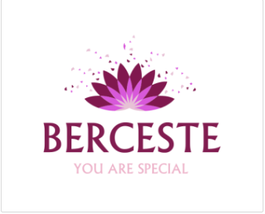
LOGO’S PROPERTIES
Font of ‘’BERCESTE’’ is Albertus Medium and its font size is 50.
Font of ‘’ YOU ARE SPECIAL’’ is Albertus Medium and its font size is 20.
We choosed different tones of pink. Because pink symbolize feminity and purity.

Slide 4
VISION MISSION
Our vision is to be the best cosmetic brand.
Our mission is to make every woman feel beautiful.

Slide 5
MAIN AND SUB GOALS
MAIN GOAL
Our main goal is to be the best cosmetic brand all around the world.
SUB GOALS
Prices which everybody can buy
Opening new branches all around the world
To reach women of all ages
Producing products that have good quality

Slide 6
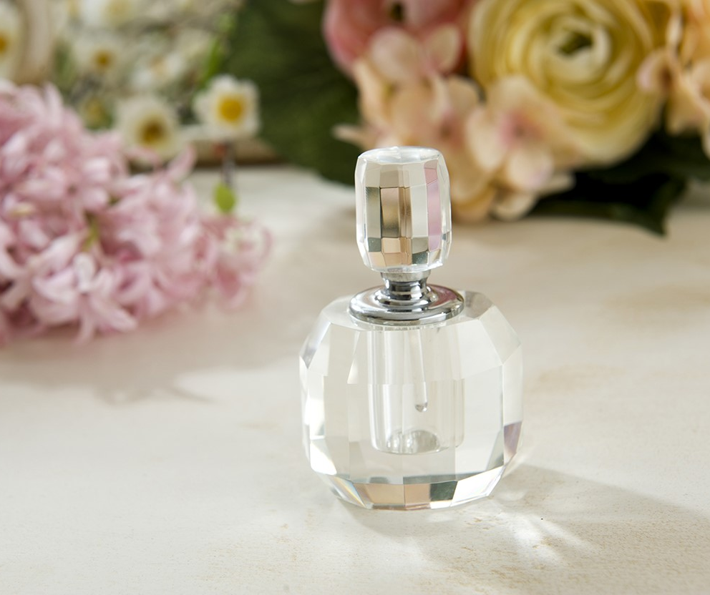
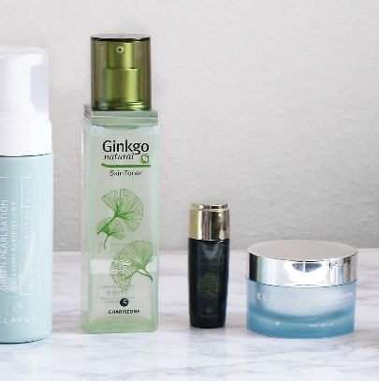
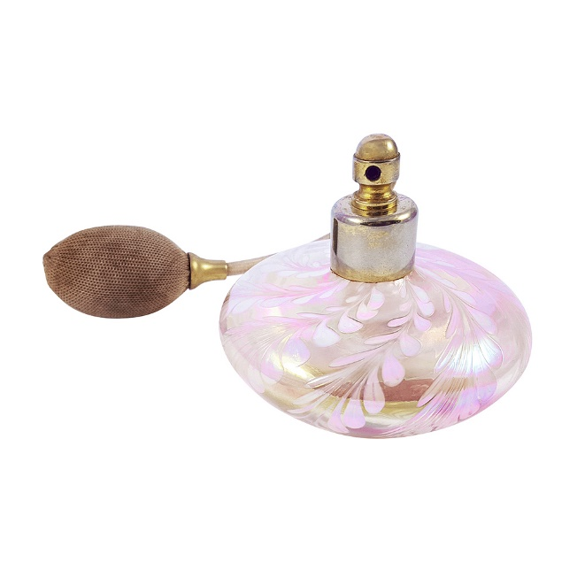
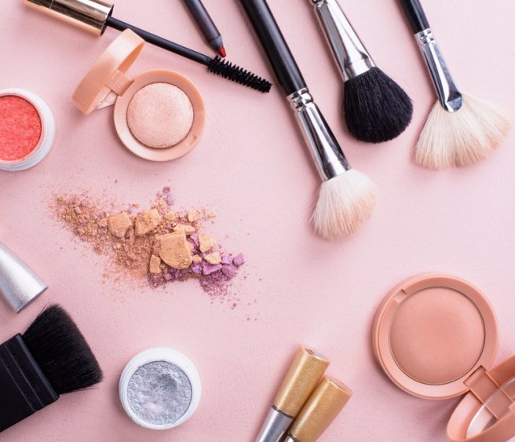
OUR PRODUCTS
Make Up Products
Perfume
Skin Care Products

Slide 7
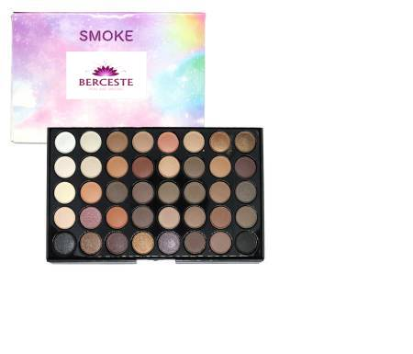
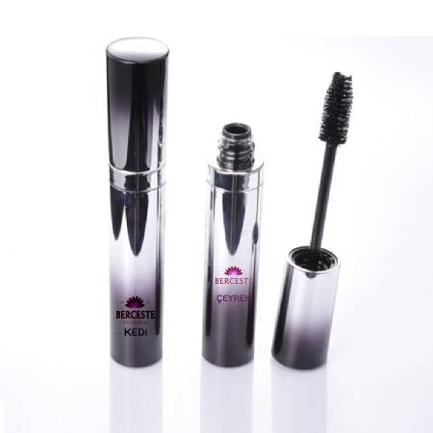
OUR MAKE-UP PRODUCTS
Our mascara ’s name is ‘’ÇEYREK’’.
Mascara’s properties are to provide extra volume and natural appearance.
Our eye shadow’s name is ‘’SMOKE’’.
It provides smoky appearance.So it helps us have mysterious looks.
Our eyeliner’s name is ‘’KEDI’’.
It provides you have eyes like cats.

Slide 8
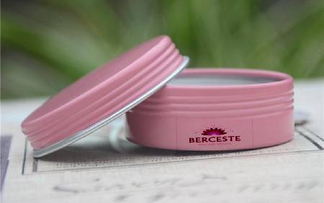
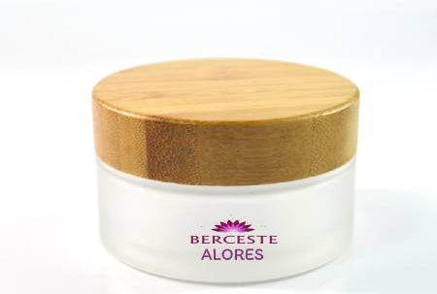
OUR SKIN CARE PRODUCTS
Face cream: Our face cream’s name is Alores. It includes Aloe Vera. It is an herbal cream. It makes your skin smooth like a baby.
Hand cream: Our hand cream’s name is Gül. It includes rose.It smells good.It revives your skin.
Make-up cleaner tonic : Our make-up cleaner tonic’s name is Pure.It includes grape seed oil for the best cleaning.Also it includes lavender for the beautiful smell.
Face mask: It aims reducing the blackheads in your face.It includes clay for this purpose and cucumber for the feeling of freshness.

Slide 9
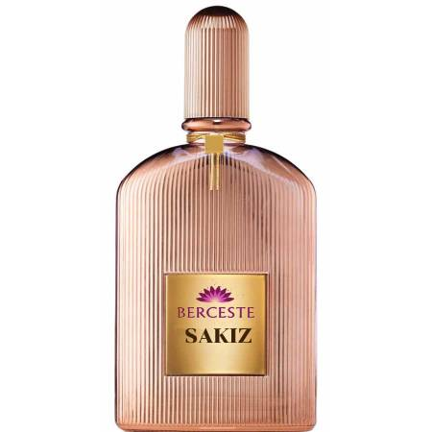
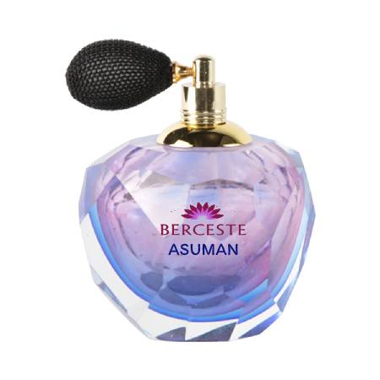
OUR PERFUMES
Asuman : Our perfume’s name is Asuman. It is combining floral scents like bergamot, rose, sandalwood.
Sakız : Our perfume’s name is Sakız. It is combining jasmine, musk, citrus.

Slide 10
ADDED VALUE FOR CUSTOMERS
Our products are precious for our customers.Because;
They feel beautiful after they use our products.
Our products are harmless and herbal.
Our products are feeder and skin friendly.

Slide 11
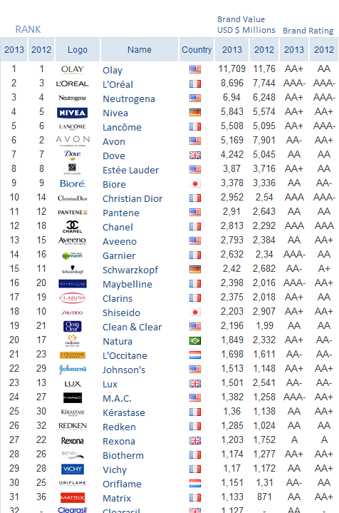
MARKET AND BRAND RESEARCH
We have a lot of competitor at this market like Golden Rose, Pastel, Flormar, Avon, M.A.C, Farmasi etc.
According to researches people like the Olay cosmetic brand the most. The second is L’Oreal.
We have 3250 competitor just in Turkey.

Slide 12
TRADEMARK CONDITIONS IN TURKEY
To have an unique logo,name,slogan,etc.
The goods should be distinguished from other brands.
Goods or services need to be selected.
It must be shown in the register.

Slide 13
BRAND CHARACTER
The innocent: Safety, sense of wonder, purity, trust, honesty
The magician: Power, intuition, cleverness, charisma, highly evolved
The caregiver: Service, altruism, compassion, patience and empathy.
The lover: Intimacy, faithfulness, passion, sensuality and vitality.
BRAND PERSONALITY
Sophistication: It represent upper class; glamorous, good looking and charming; femine and smooth.
BRAND CHARACTER AND PERSONALITY

Slide 14
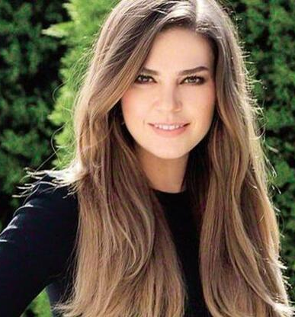
TARGET GROUP
Our target group is women of all ages.
Our brand’s face is Aslı Enver. She is actress in Turkey. We choosed her because she looks innocent and pure. Also Turkish women like her.

Slide 15
MAINTAINING OF VALUE
DETERMINE WHAT THAT BRAND INCLUDES:
We have trademark and brandname.Its name is BERCESTE.
We have logo and brand colors.
We have unique marketing strategy.It is producing harmless,herbal and reachable products.
We have offical accounts and license for salesforce.
We mind our customers’ satisfication so our brand loyalty is high.
We follow changing fashions and requirements of women. So we are innovative company.

Slide 16
MAINTAINING OF VALUE
COST-BASED BRAND VALUATION
We allocate 3% of our budget to advertisements and promotion.
We are making seasonal campaigns. Generally discount is 5% of our products prices. So our sales are increasing to 2.4 times. As a result the cost of campaigns creation is 4%.
We are paying rent for license fees annually. Thus, we allocate 1.2% of our budget here.
Generally in Turkey, cost of trademarks is approximately between 150 to 200€. It makes between 900 – 1200 TL.

Slide 17
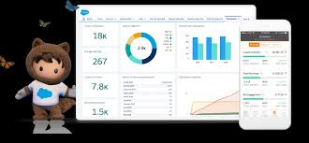
CRM SYSTEMS
SALES FORCE
We have a license to use this system. We can reach to our customers from this system and find new customers over this system.
We can follow flow of our money by system.
This system offers our datas by graphs.
We can organize events over this platform.
OUR FACEBOOK AND INSTAGRAM ACCOUNTS
We use these online platform to introduce our products.
OFFICIAL WEBSITE

Slide 18
https://www.photopea.com/
http://www.yasemin.com/foto-galeri/46555-en-iyi-ve-kalici-29-kadin-parfumu/p9
https://www.farmasi.com/

Slide 19
THANK YOU FOR YOUR ATTENTION…

