Slide 1





Business planning
Selected chapters
Doc. Ing. Adam Pawliczek, Ph.D.

Slide 2
Business Plan Outline - Example
Executive Summary: Introduction and Summary, What is Power Source of the Project? Competitive Advantages, Potential of Business Success, Financial Challenge for Investors.
Project and Company Description: Characteristics of Proposer, Company Legal Status, Work Team, Organization and Management, Product Description, Contribution and Profitability, Recent Product Conditions, IP Rights, Development Phases, Vision, Mission, Project Strategic Goals Statement.
Market Search and Analysis: Macro surrounding (PESTLE), Micro surrounding – Market Size and Potential, Customers, Providers, Competitors, Substitutes (Porter 5 Forces).
Technology and Production Plan, Research and Development: Production Process Step-by-step Definition, Production Demand Factors, Structure and Calculation of Production Costs, Factors of General Neighborhood, Legal and Safety Standards, Research and Development, Quality Management Systems, Environmental Management systems.
Personal Resources and Business Allocation: Expected Skills and Qualification of Employees, Office and Production Rooms and Space.
Goals and Strategy of Marketing (Proposal Part): Setting Goals and Time Milestones, Sales and Marketing Strategy (Product, Price, Promotion, Place – Distribution; Processes, People).
Finance Analyses – Project Budget: Costs Calculation in All Project Phases (Investment Phase, Realization Phase), Expected Profit – Break Even Point Location, Assets and Liabilities Projection, Cash Flow Projection – Financing Sources, Return of Invested Capital.
Project Realization Timeline: Gantt diagram.
SWOT Analysisis: Summation of technical and economical feasibility of project.
Identification of Success Factors, Risk Analyses, BP Addenda.

Slide 3

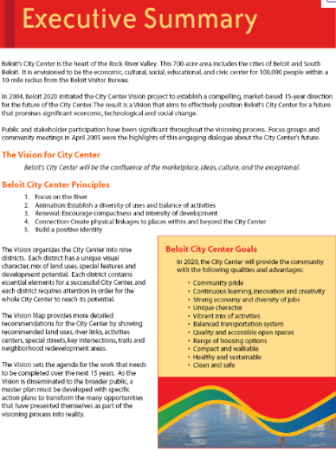
Executive Summary
Summarization and Explanation of Important Project Information
Range: 1 sheet A4; Motivational, Reasonably Emotive Form
Attractive Project Title
Introduce Yourself:… Education, Experiences, Achievements
Product, Price – Show the Prototype
Market: Destination Group, Competition
Financial Demanding of Project (Costs, Turnover, Profit)
Your Deposit (Efforts, Time, Know-how, Own Investment)
Time Demanding – First Insight
Contact Information
Disclaimer – Responsibility Refusal
Proposal to the Investor – Equity Position:
how much and what for?

Slide 4

Company Characterization;
Project Description and Goals
  Characteristics of Proposer (Names, Addresses, Contact)
  Company Description
  (Legal Form, History, Professional Certificates)
  Work Team (Age, M/F, Qualifications, Personality)
  Management (Structure, Competences, Responsibility)
  Vision and Mission
  Project Strategic (SMART) Goals Statement
  Aiming and Prime Activities of the Project (Processes)
  Product Description (Prototype) and Contribution
  (Added Value) for Customer
  Profitability of the Product (Market Estimation)
  Recent Product Conditions, Development Phases,
  IP Rights (Patent)
Specific, Measurable, Attainable, Relevant, Time-bound; Evaluate, Reevaluate

Slide 5
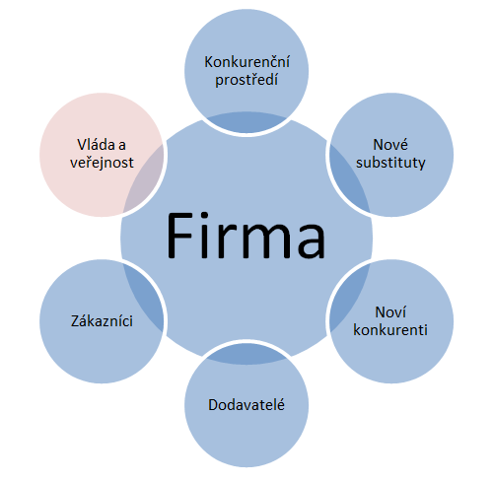
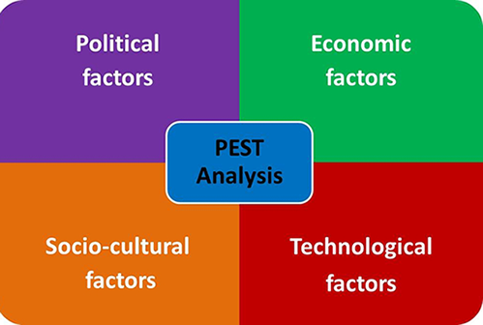

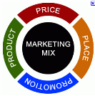
Market Research and Analyses
Methods of Marketing Analysis:
Enterprise Micro surrounding
Porter 5 (6) Forces analysis
Enterprise Macro surrounding
PEST(LE) analysis
geographic and morphologic
structure
Competitive
surrounding
Government and public
New substitutes
quality
price
innovations
Enterprise
Enterprise
Customers
New
competitors
segmentation
focus
needs
purchase power
market ratio
strategy
capital
technologies
competitive advantages
Suppliers
key
alternative

Slide 6
Market Research and Analyses II
PEST(LE) analysis of Enterprise Macro surrounding
Political and legislative factors:
Political stability
Business and work laws, labour code
Tax policy
Antimonopoly law
Consumer protection
Environmental legislative
Foreign trade regulations
Law enforceability and corruption
EU integration policy
Technical norms and regulations
Health and safety
Economic factors:
Economic cycles
Macroeconomic trends, GDP
Inflation
Interest rates
Currency exchange rates
Purchasing power
Average wage
Energy prices trends
Tax burden
Foreign investment amount
Amount g money in circulation
Socio-cultural factors:
Demographic population trends
Lifestyle, free time activities
Mobility and migration
Level of education, income distribution
Unemployment, labour approach
Population health, religion
Technologic factors:
Government support, spendings on of R&D
Infrastructure, ICT
Technology transfer
Speed of obsolescence
New materials, nanotechnologies
New discoveries, technology change

Slide 7
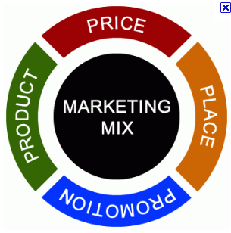
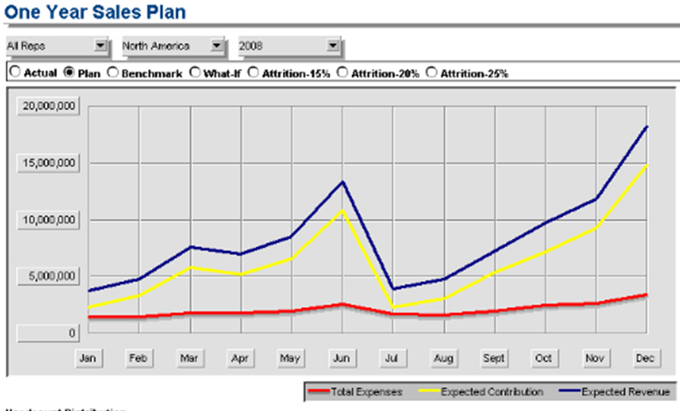
Project Marketing Proposal
  Sales and Marketing Mix (Product, Price, Place, Promotion, Distribution, Processes, People)
  Ways and Costs of Promotion (Internet, FB, Press, Radio, TV, Billboards, Direct Marketing, …)
  Ways and Costs of Distribution (Packings, B2B vs. B2C, Retail Chains, Shops, Internet)
  Setting of Margin and Product Prices, Calculations:
    Variable Costs (direct, operational) and Fix Costs (investments, overheads)
    Down Limit – Costs; Up Limit – Competition
  Definition of Goals and Milestones of Success in Time:
    Prognosis of Sales (Revenues); Market Share

Slide 8
Final Test
Is written business plan important for success of business?
What functions of business plan do you know?
What is an Executive summary?
What does mean the acronym SMART?
What tools for analyses of the market do you know?
What quality management systems do you know?
What components contain 4P Marketing mix?
What methods for evaluation of BP payback do you know?
What methods are most often used to plan project activities in time?
What are often frequent business risks?

Slide 9

Good Luck
Thank you for your attention
MBCO - Department of Business Economics and Management
adam.pawliczek@mvso.cz

