Slide 1






Business planning
(Writing the Business plan)
Doc. Ing. Adam Pawliczek, Ph.D.

Slide 2
A business plan is a formal statement of:
a set of business goals,
the reasons why they are believed attainable, (fasibility) and
the plan for reaching those goals.
It should also contain background information about the organization and team attempting to reach those goals.
Notes:
Entrepreneurship is the act of being an entrepreneur, which can be defined as "one who undertakes innovations, finance and business acumen in an effort to transform innovations into economic goods". This may result in new organizations or may be part of revitalizing mature organizations in response to a perceived opportunity. The most obvious form of entrepreneurship is that of starting new business (referred as Start-Up Company); however, in recent years, the term has been extended to include
social and political forms of entrepreneurial activity.

Slide 3
Basic Business Plan Characteristics
Project Phases
  Preparatory – Investment – Realization – Sustainability
Project Types
  „Soft“ (e.g. Educational) vs. Investment Projects
  Production vs. Services
Business Plan Function
  Inner vs. Outer
  Stakeholders
Business Plan Codification
  Non written (tacit) – Written Concise – Written Detailed
Hard knowledge vs.
Soft knowledge

Slide 4
Business Plan Vertical Levels
Good business plan must be thoroughly considered in next three vertical levels,
touching each part of business plan:
Don’t forget you are a team and your potential in synergy.
Remember dynamics of business plan (continuous improvement).
Analytical study of realistic premises (inner, outer) | Enterprises’ invention and added value | Expected and attained goals (inner, outer)
⇒ Competitive Advantage

Slide 5
Business Plan Outline - Example
Executive Summary: Introduction and Summary, What is Power Source of the Project? Competitive Advantages, Potential of Business Success, Financial Challenge for Investors.
Project and Company Description: Characteristics of Proposer, Company Legal Status, Work Team, Organization and Management, Product Description, Contribution and Profitability, Recent Product Conditions, IP Rights, Development Phases, Vision, Mission, Project Strategic Goals Statement.
Market Search and Analysis: Macro surrounding (PESTLE), Micro surrounding – Market Size and Potential, Customers, Providers, Competitors, Substitutes (Porter 5 Forces).
Technology and Production Plan, Research and Development: Production Process Step-by-step Definition, Production Demand Factors, Structure and Calculation of Production Costs, Factors of General Neighborhood, Legal and Safety Standards, Research and Development, Quality Management Systems, Environmental Management systems.
Personal Resources and Business Allocation: Expected Skills and Qualification of Employees, Office and Production Rooms and Space.
Goals and Strategy of Marketing (Proposal Part): Setting Goals and Time Milestones, Sales and Marketing Strategy (Product, Price, Promotion, Place – Distribution; Processes, People).
Finance Analyses – Project Budget: Costs Calculation in All Project Phases (Investment Phase, Realization Phase), Expected Profit – Break Even Point Location, Assets and Liabilities Projection, Cash Flow Projection – Financing Sources, Return of Invested Capital.
Project Realization Timeline: Gantt diagram.
SWOT Analysisis: Summation of technical and economical feasibility of project.
Identification of Success Factors, Risk Analyses, BP Addenda.

Slide 6
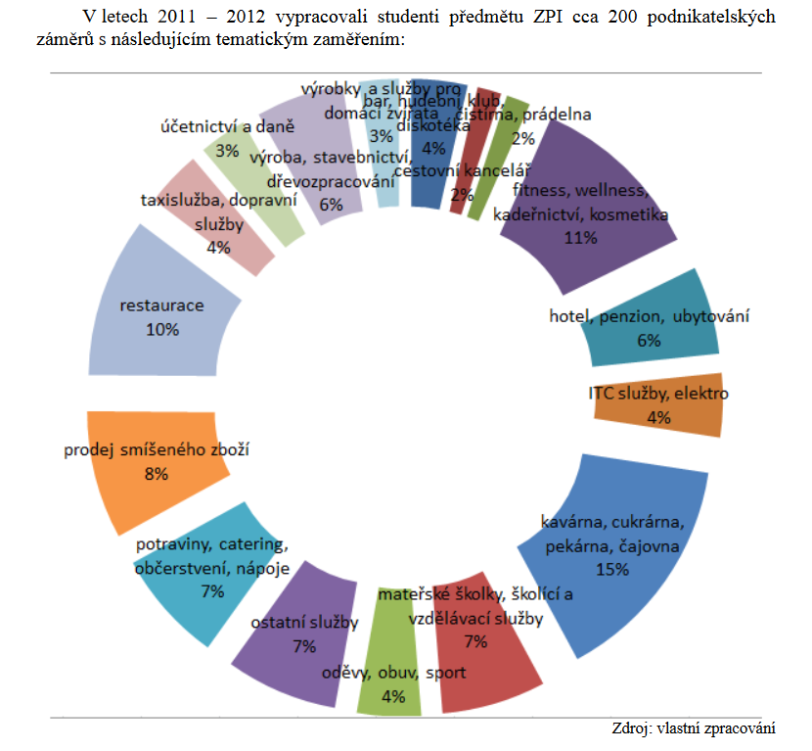
Examples of most popular student BP topics
11 % fitness, wellness, hairdresser, cosmetics
10 % restaurant
8 % general store
15 % café, patisserie, bakery, tearoom

Slide 7

Good Luck
Thank you for your attention
MBCO - Department of Business Economics and Management
adam.pawliczek@mvso.cz

