Slide 1
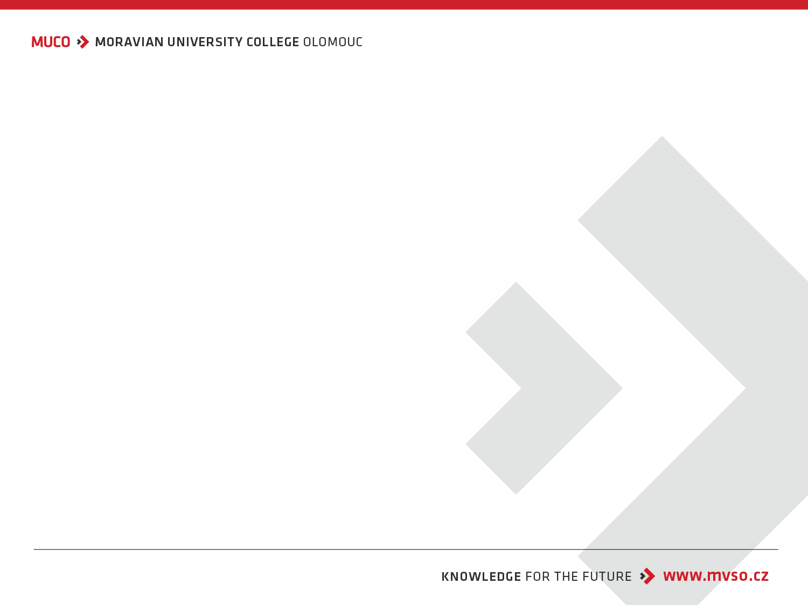


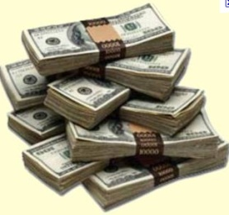





Brand management
Introduction
Doc. Ing. Adam Pawliczek, Ph.D.

Slide 2
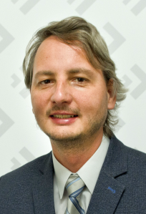
Let me introduce myself…
Assoc. prof. Adam PAWLICZEK, Ph.D.
Habilitation: T. Bata University in Zlín, FAME
Master and Ph.D. Degree: VŠB – TU Ostrava, FMMI
Fellowship: Southern Illinois University at Carbondale, CAFS
Jobs (20 years): VŠB – TU Ostrava; CI4GM, WPM Group; Statutory City of Ostrava; SU Opava, OPF Karviná; MŠMT (VaVpI)
Current Job: MBCO, VŠE FM J. Hradec
H-index (WoS/SCOPUS): 5
Family status: Married, Two children
Hobbies: Family, Outdoor Sports, Garden

Slide 3
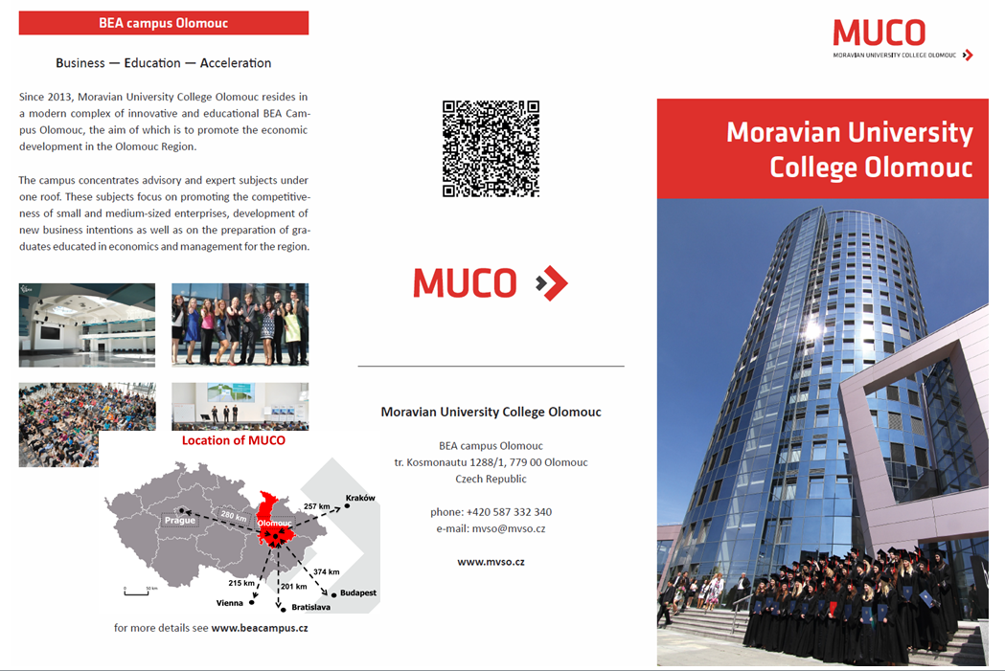
About MBCO I

Slide 4
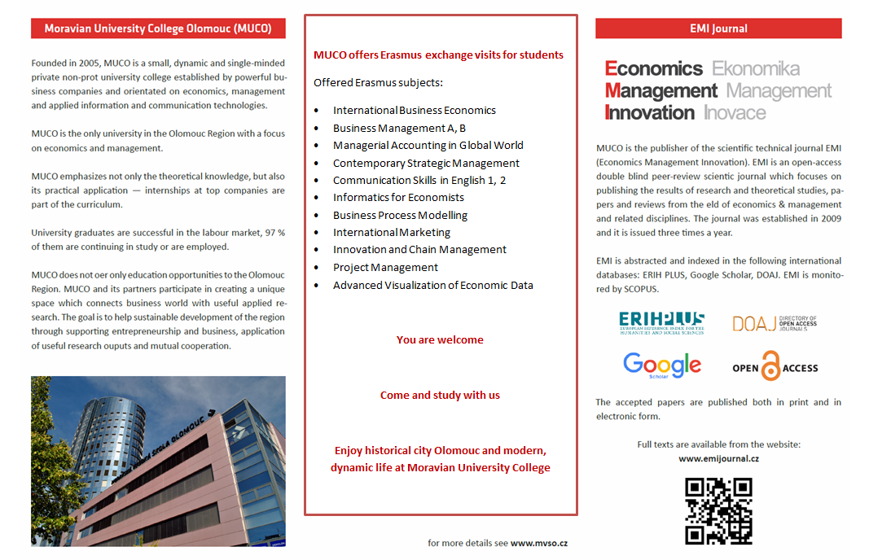
About MBCO II

Slide 5
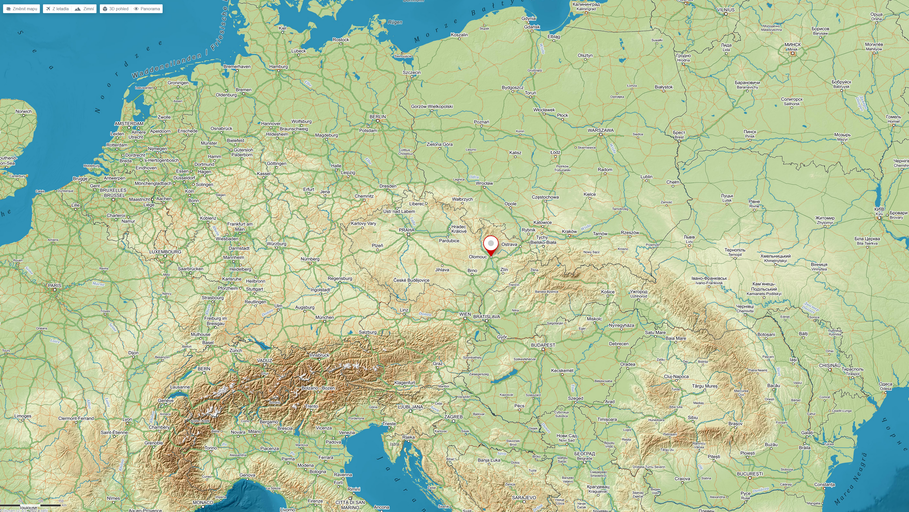
Map

Slide 6
Introductory questions for students: (10 min.)
Introduce yourself:
  Name, surname
  Where are you from?
  What are you interests, hobbies?
Why did you decided to study in the Czech Republic?
  What do you expect from your stay in CR?
  What places in CR and central Europe do you already visited?
  What places in CR and central Europe would you like to visit?
Did you study management earlier?
  If yes, what subjects?
  Are you interested in management? Which topics most?
Do you or your family lead any business?
  If yes, what kind?
  Would you like to continue it?
Would you like to start your own business?
  If yes, in what branch? What kind of business?
  If not, what would you like to do in future/ after finishing your studies?
Did you ever prepare a business plan?
  If yes, what kind? What for?
  What should a business plan contain?

Slide 7
Initial questions for on brand:
What is a brand?
What world brands are most popular?
What Czech brands do you know?
What Turkish/ Greek/ Spanish brands are most popular?
How can you build and manage your brand?

Slide 8
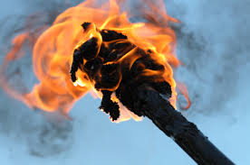
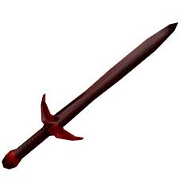
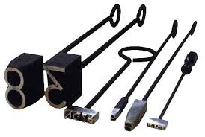
What is a brand?
Brand (original meaning) is:
: a charred piece of wood
: firebrand
: something (such as lightning) that resembles a firebrand
: sword
: a mark made by burning with a hot iron to attest manufacture or quality or to designate ownership
: a mark put on criminals with a hot iron
: a mark of disgrace

Slide 9
Initial questions for students:
What is a brand?
What world brands are most popular?
What Czech brands do you know?
What Turkish/ Greek/ Spanish brands are most popular?
How can you build and manage your brand?

Slide 10
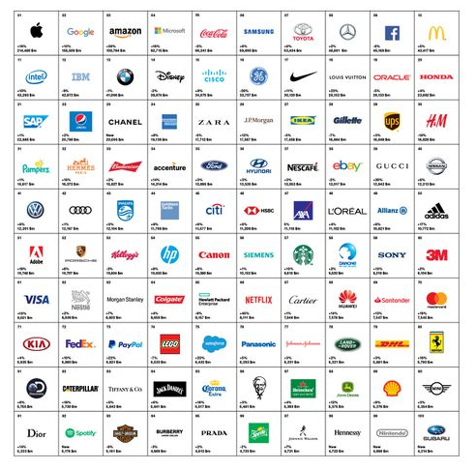
Best global brands in
2018

Slide 11
Initial questions for students:
What is a brand?
What world brands are most popular?
What Czech brands do you know?
What Turkish/ Greek/ Spanish brands are most popular?
How can you build and manage your brand?

Slide 12










What Czech brands do you know?

Slide 13
Initial questions for students:
What is a brand?
What world brands are most popular?
What Czech brands do you know?
What Turkish/ Greek/ Spanish brands are most popular?
How can you build and manage your brand?

Slide 14


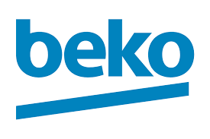


What Turkish brands are most popular?

Slide 15
What Greek brands are most popular?

Slide 16
What Spanish brands are most popular?

Slide 17
Initial questions for students:
What is a brand?
What world brands are most popular?
What Czech brands do you know?
What Turkish/ Greek/ Spanish brands are most popular?
How can you build and manage your brand?

Slide 18

Good Luck
Thank you for your attention
MBCO - Department of Business Economics and Management
adam.pawliczek@mvso.cz

