Slide 1
3. Multicriteria decision making
Situations commonly arise when a person has more than one criterion to consider while deciding.
Consider, for example, a situation in which acquisition of weapons is being planned.
Obviously, weapons for acquisition should be evaluated according to several criteria, e.g., suitability to own forces, maintainability and cost.
Such problems can be classified as multicriteria decision making problems.

Slide 2
Several algorithms have been developed to solve such problems:
  Weighted Average Method
  Decision trees
  Scenarios…

Slide 3
Weighted average method
Steps:
1. defining of criteria C1, C2, …, Ck and their weights
2. describing of the variants with respect to the criteria
3. evaluations of variants with respect to the criteria
4. final evaluations and comparison of the variants

Slide 4
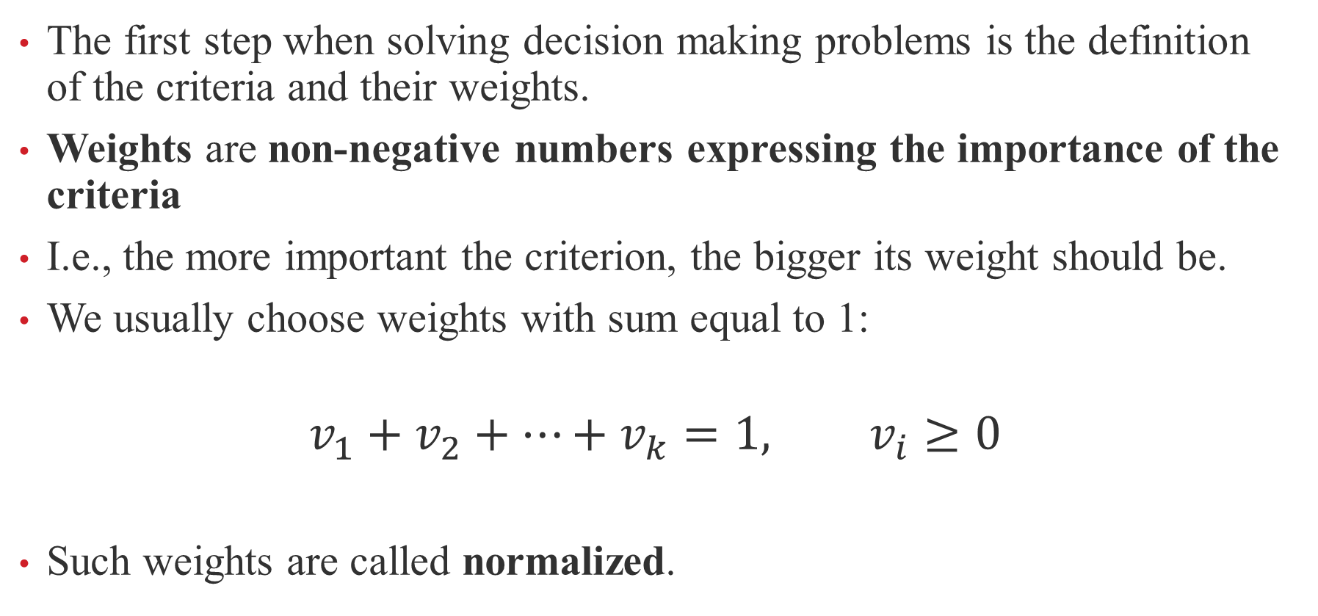
The first step when solving decision making problems is the definition of the criteria and their weights.
Weights are non-negative numbers expressing the importance of the criteria
I.e., the more important the criterion, the bigger its weight should be.
We usually choose weights with sum equal to 1:
$$v_{1}+v_{2}+…+v_{k}=1, v_{i}≥0$$
Such weights are called normalized.

Slide 5
Types of criteria:
quantitative criterion of maximalization type - the criterion with numerical values satisfying “the more the better”; a typical example of such a criterion is profit
quantitative criterion of minimalization type - the criterion with numerical values satisfying “the less the better”, e.g., costs
qualitative - the criteria with non-numerical values, e.g., color.

Slide 6
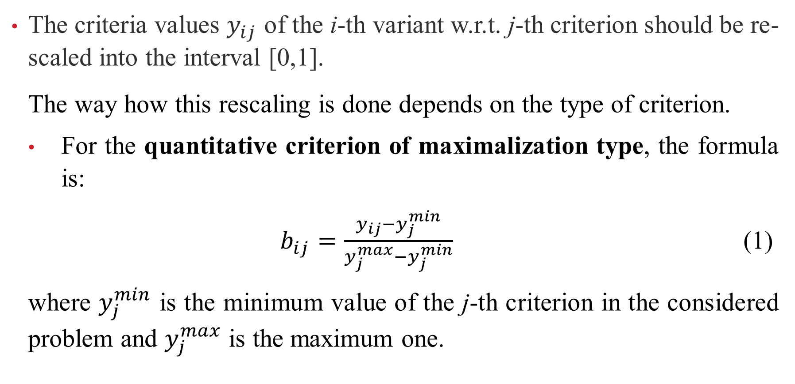
The criteria values $y_{ij}$ of the i-th variant w.r.t. j-th criterion should be re-scaled into the interval [0,1].
The way how this rescaling is done depends on the type of criterion.
For the quantitative criterion of maximalization type, the formula is:
$b_{ij}=\frac{y_{ij}−y_{j}^{min}}{y_{j}^{max}−y_{j}^{min}}$ (1)
where $y_{j}^{min}$ is the minimum value of the j-th criterion in the considered problem and $y_{j}^{max}$ is the maximum one.

Slide 7
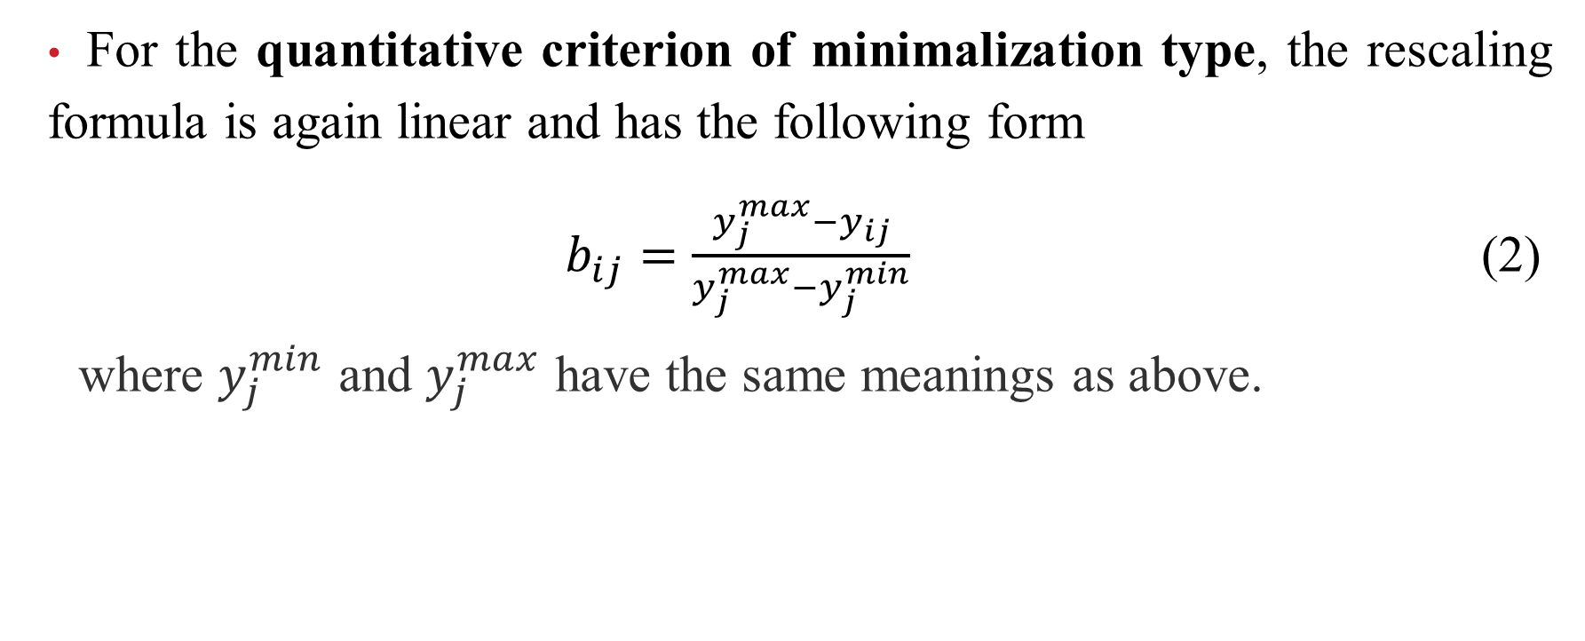
For the quantitative criterion of minimalization type, the rescaling formula is again linear and has the following form
$b_{ij}=\frac{y_{j}^{max}−y_{ij}}{y_{j}^{max}−y_{j}^{min}}$ (2)
where $y_{j}^{min}$ and $y_{j}^{max}$ have the same meanings as above.

Slide 8

The values $b_{ij}$ for the qualitative criteria are generally set by the experts directly on the scale [0,1], where 0 is standardly assigned to the worst possible variant and 1 to the best possible one.

Slide 9
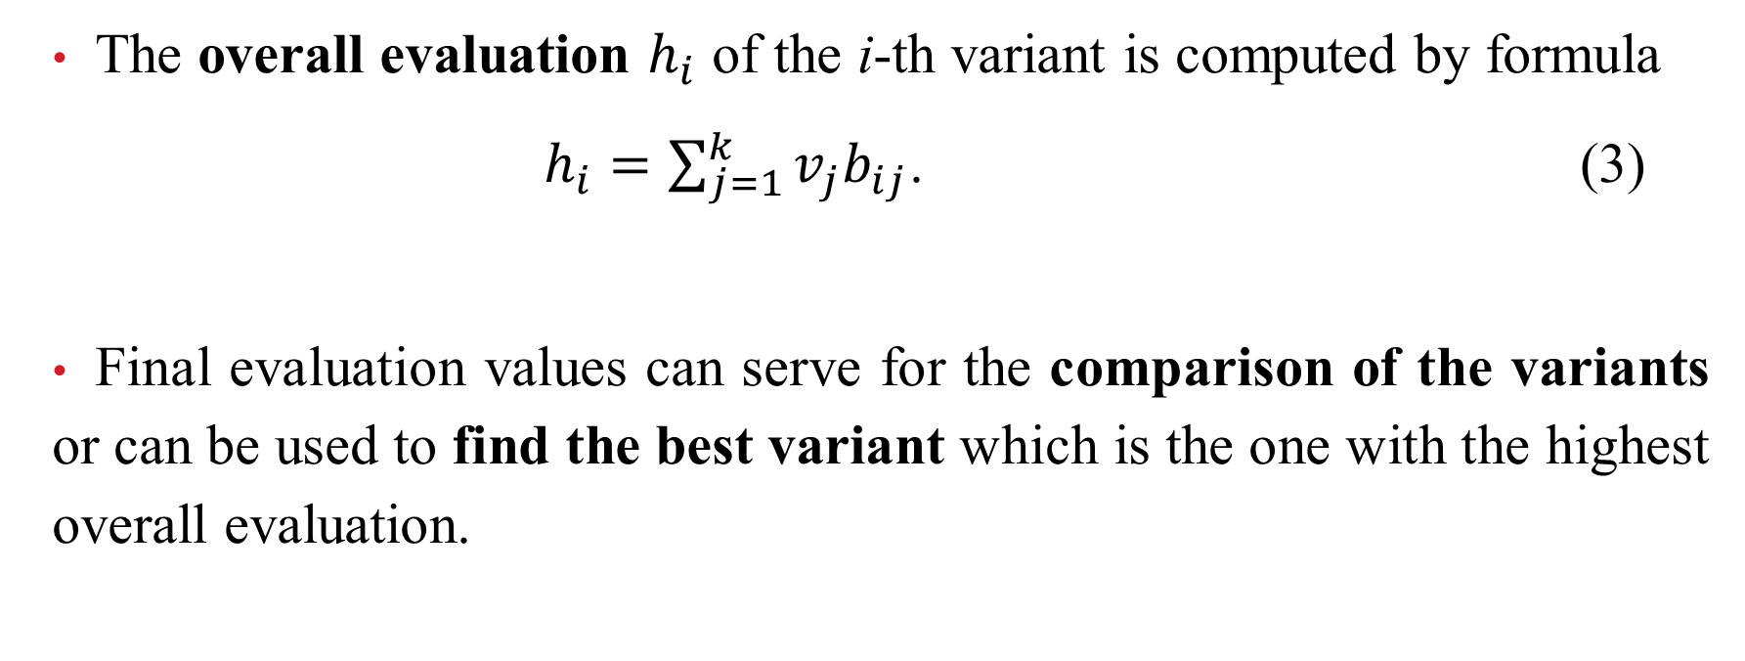
The overall evaluation $h_{i}$ of the i-th variant is computed by formula
$h_{i}=\sum_{j=1}^{k}{v_{j}b_{ij}}$. (3)
Final evaluation values can serve for the comparison of the variants or can be used to find the best variant which is the one with the highest overall evaluation.

Slide 10
Example: The Department of Defence desires to select a contractor for development and delivery of a military hardware.
The Department has identified the following criteria for evaluation of various proposals:
(a) Cost
(b) Lead time
(c) Competence of the contractor
(d) Dependability of the contractor

Slide 11
Determine the normalized weights corresponding to the criteria, determine the types of the criteria and compare the following variants:
 | Cost | Lead time | Competence | Dependability
Contractor 1 | 10 000 | 100 | Very high | High
Contractor 2 | 12 000 | 90 | High | Very high
Contractor 3 | 13 000 | 80 | Medium high | High
Contractor 4 | 11 000 | 95 | Medium | High

Slide 12
Remark: Saaty method = different way of setting normalized weights
Saaty matrix S = (sij) consists of numbers 1, 3, 5, 7, 9 and 1/3, 1/5, 1/7, 1/9
sij = 1 if Ci and Cj have the same importance
sij = 3 if Ci is slightly preferred over Cj
sij = 5 if Ci is strongly preferred over Cj
sij = 7 if Ci is very strongly preferred over Cj
sij = 9 if Ci is absolutely preferred over Cj
sji = 1/sij

Slide 13


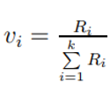
Remark: Saaty method
After creating the Saaty matrix, it is necessary to
1. in each row compute
2. in each row compute
The weights are finally computed by the formula

Slide 14
Example: In your own multicriteria decision making problem and find the best variant when using the Saaty method for defining the weights.

