Slide 1
IT for Military Decision Making
Lecturer: Martina Pavlačková

Slide 2
1. The shortest path problem
Inputs:
  undirected (directed) graph with non-negative edge ratings
  starting point
  target point
Output: the „shortest“ path between the starting and target point
Application: identifying an optimal route for military aircraft or vehicle

Slide 3
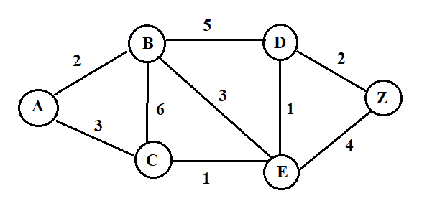
Example:

Slide 4
Remark: Complex calculation of edge rating
Edge rating = D * FC * FP + T * DS + D * TR,
D indicates the distance,
FC fuel consumption per kilometre in litres,
FP price of litter of fuel,
T estimated travel time in hours,
DS driver´s salary per hour,
TR is toll rate per kilometre.

Slide 5
Remark: The most popular and used algorithm for solving this problem is the Dijkstra's algorithm that finds the shortest path problem with non-negative edge rating.

Slide 6
Remark: The shortest path algorithms are applied to find directions between locations, such as driving directions on web mapping websites like Google Maps.
Remark: Finding the shortest path "on paper" is very difficult in more complicated cases. Therefore, it is appropriate to use some application to search for it.
One of applications for finding the shortest path can be found at
https://www.easycalculation.com/operations-research/shortest-path-calculator.php

Slide 7
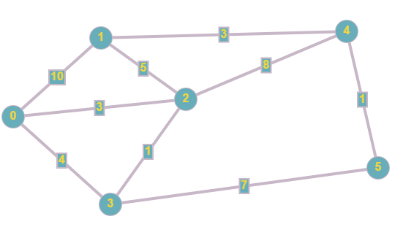
Example: Find the shortest path from 0 to 5.

Slide 8
Example: Let us consider the tank with the following attributes
Vehicle | FC = fuel consumption per kilometre in litres | FP = price of litter of fuel in Euros | DS = driver´s salary per hour in Euros | MS = maximum speed
T-72M4CZ | 3,5 l/km | 1,32 | 10,38 | 61 km/hour

Slide 9
And let the possible paths (in kilometers) from the starting point A to the target point G be described by the following table:
Assume that there are no toll rates.
 | A | B | C | D | E | F | G
A |  | 10 | 8 |  | 11
B | 10 |  |  | 3 |  | 10
C | 8 |  |  | 7
D |  | 3 | 7 |  | 3 | 2 | 1
E | 11 |  |  | 3 |  |  | 4
F |  | 10 |  | 2 |  |  | 1
G |  |  |  | 1 | 4 | 1

Slide 10
Compute the edge ratings if the tank is traveling at maximum speed. (Round to natural numbers)
Find the shortest path

Slide 11
Example: How the shortest path is changed if we would consider instead of the tank the infantry fighting vehicle?
Moreover, assume that because of the complicated terrain, the vehicle can drive at maximum speed 15 km/hour between A and B, B and D, and D and G
Vehicle | FC = fuel consumption per kilometre in litres | FP = price of litter of fuel in Euros | DS = driver´s salary per hour in Euros | MS = maximum speed
BVP-2 (BMP-2) | 1,4 l/km | 1,32 | 9,96 | 65 km/hour

Slide 12
2. Travelling salesman problem
Inputs: undirected (directed) graph with non-negative edge ratings, starting point
Output: the shortest path between the starting point and all other points
Application: the shortest path (e.g., for a business traveller) from a certain starting point to the given points of sale (every once) and finally to return to the original place.

Slide 13
Remark: The travelling salesman problem is one of the NP-difficult problems, which means that it uses mainly heuristic algorithms that give an approximate solution.
Remark: Finding the solution of the travelling salesman problem is much more difficult than of the shortest path.
One of applications for solving the travelling salesman problem can be found at https://www.easycalculation.com/operations-research/traveling-salesman-problem.php

Slide 14
Example: Lunches are cooked in the garrison (denoted by 1) and further distributed to smaller deployed units without kitchens (marked with numbers 2-6).
Matrix of the distances (in kilometres) between the places is given by
Find the shortest path for lunch delivery from 1 to all other places (and back to 1)
 | 1 | 2 | 3 | 4 | 5 | 6
1 | 0 | 6 | 8 | 1 | 10 | 20
2 | 6 | 0 | 14 | 9 | 11 | 25
3 | 8 | 14 | 0 | 9 | 6 | 10
4 | 1 | 9 | 9 | 0 | 2 | 17
5 | 10 | 11 | 6 | 2 | 0 | 15
6 | 20 | 25 | 10 | 17 | 15 | 0

Slide 15
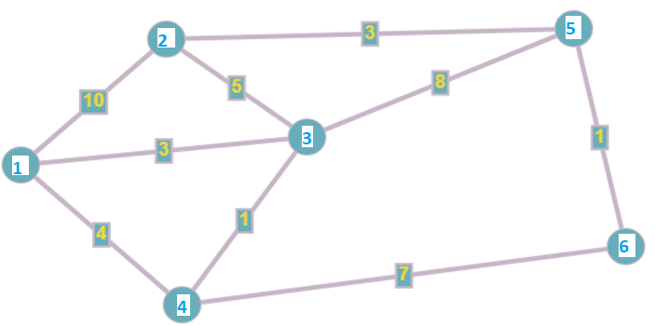
Example: Find the shortest path from 1 to all other points.

