Slide 1
Decision making 101
Michal Menšík

Slide 2
Content of the lecture
How and why
What is decision making
Structure of DM
DM7
PACED
SWOT

Slide 3
How and why do people make decisions
We make decisions every day (realize it or not)
Big (university, life partner, medical treatment) and small (color of shoes, meal, summer holydays …), sometimes small become big (unhealthy food)
Decision-making is natural
„Not to do something“ is also decision
Since we are doing it – lets do it right …
Notes:
Big or small decision is determined by the impact / consequences and possibility to change / reverse them
Small decision can turn into the lifa-changing decision (going into a certain restaurant and meeting life partner etc.)

Slide 4
What we need to understand (basic terms)
Alternative: One of many choices or courses of action that might be taken in a given situation.
Benefit: Monetary or non-monetary gain received because of an action taken or a decision made.
Choice: Decision made or course of action taken when faced with a set of alternatives.
Cost: An amount that must be paid or spent to buy or obtain something. The effort, loss or sacrifice necessary to achieve or obtain something.
Decision: A conclusion reached after considering alternatives and their results.
Opportunity cost: The second-best alternative (or the value of that alternative) that must be given up when scarce resources are used for one purpose instead of another.
Scarcity: The condition that exists because human wants exceed the capacity of available resources to satisfy those wants; also a situation in which a resource has more than one valuable use. The problem of scarcity faces all individuals and organizations, including firms and government agencies.

Slide 5
What is decision making
Decision making is the process of making choices by identifying a decision, gathering information, and assessing alternative resolutions.
In psychology, decision-making (also spelled decision making and decisionmaking) is regarded as the cognitive process resulting in the selection of a belief or a course of action among several possible alternative options.
A decision-making process is a series of steps taken by an individual to determine the best option or course of action to meet their needs.
Decision making in management is the process of making a choice between two or more options.

Slide 6
Based upon various definitions …
We need to see, understand and comprehend
We have a problem
There are various solutions to the problem
We need to choose one
We need to know or believe the one we have chosen is the best
We need to verify (not 1 – 5 but all)

Slide 7
Decision making – basic elements
It is a process and every decision is unique
However – since it is a process – there are tools, techniques and procedures that refine, structure, visualize etc. … decision making
Goal is to improve decision making and thus improve the outcomes – decisions
It is not exact science – culture, experience, history, fear… fake news, hoax, marketing / propaganda …
Learning by doing – Yom Kippur War (1973) and Israeli decision making – Devil's Advocate element

Slide 8
Structure of DM
DM has been done many times
Several methods how to structure (to make it algorithmic) decision making
7 STEPS
PACED
SWOT
Six thinking hats
…

Slide 9
Structure of DM – 7 steps method
7 Steps
Identify the decision
Gather information
Identify the alternatives
Weigh the evidence
Choose among alternatives
Take action
Review your decision

Slide 10
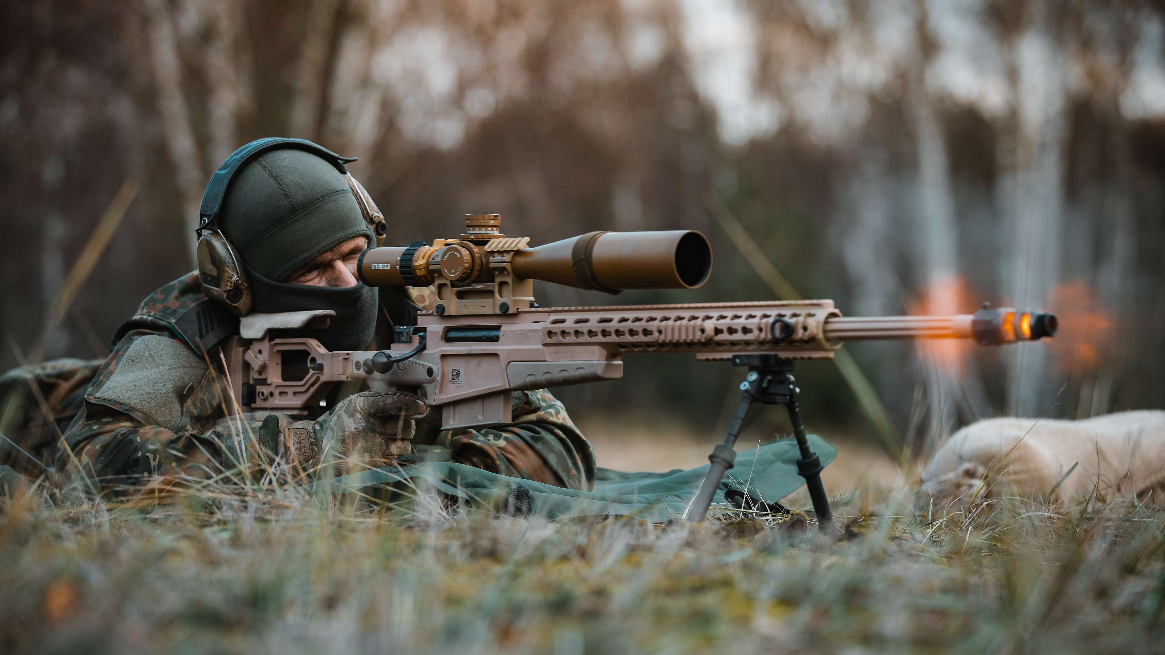
DM7 – Identify the decision
Most important part of decision making
Understanding the problem / decision to be made
How we define the problem will affect our decision
We need new sniper rifle system / We need new way how to engage at short range

Slide 11
Canadian Caper / Argo
Using a cover story to save hostages from Iran in 1980
Cover story was …
… shooting a movie called Argo in Iran exteriors
Successful
https://en.wikipedia.org/wiki/Argo_(2012_film)

Slide 12
DM7 - Gather information
Information which are
Relevant
Accurate
Reliablie
Measurable
Problem of today is
Lack of quality information
Information overwhelming – low quality garbage
How to distingusih between the two

Slide 13
DM7 - Identify the alternatives
Gathering information provides us with various alternatives how to solve the problem
We can create / project new yet unidentified
Make a list and organise them

Slide 14
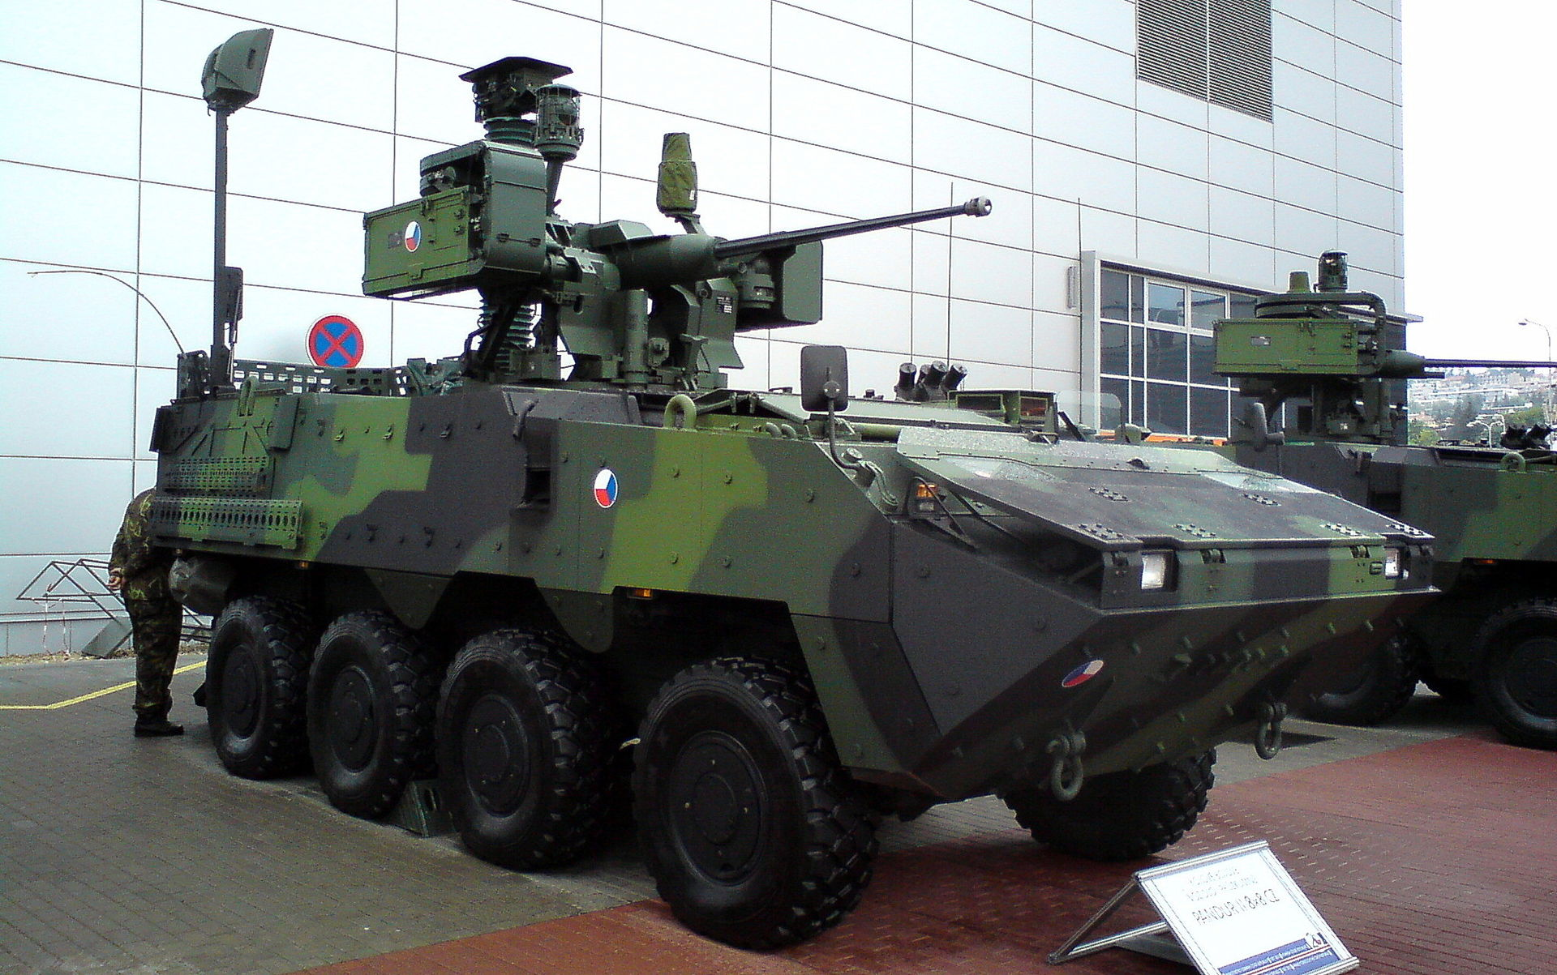
DM7 – Wiegh the evidence
What will be the real outcome of each alternative?
What are the costs?
What are the benefits?
What are the disadvantages?
How do we measure attributes / parameters of alternatives
How to compare incomparable? Armament/ weight of new APC / price / Operational range

Slide 15
DM7 – Choose among alternatives
Based upon the criteria and evaluation, we choose the „best“ option
It may be combination of options / alternatives
„APC from STEYR with engine provided by domestic producer TATRA and service provided by UNIPOL“

Slide 16
DM7 – Take action
Just do it …
When to start
How to start
What is next
What can be sacrificed
When „it is done“

Slide 17
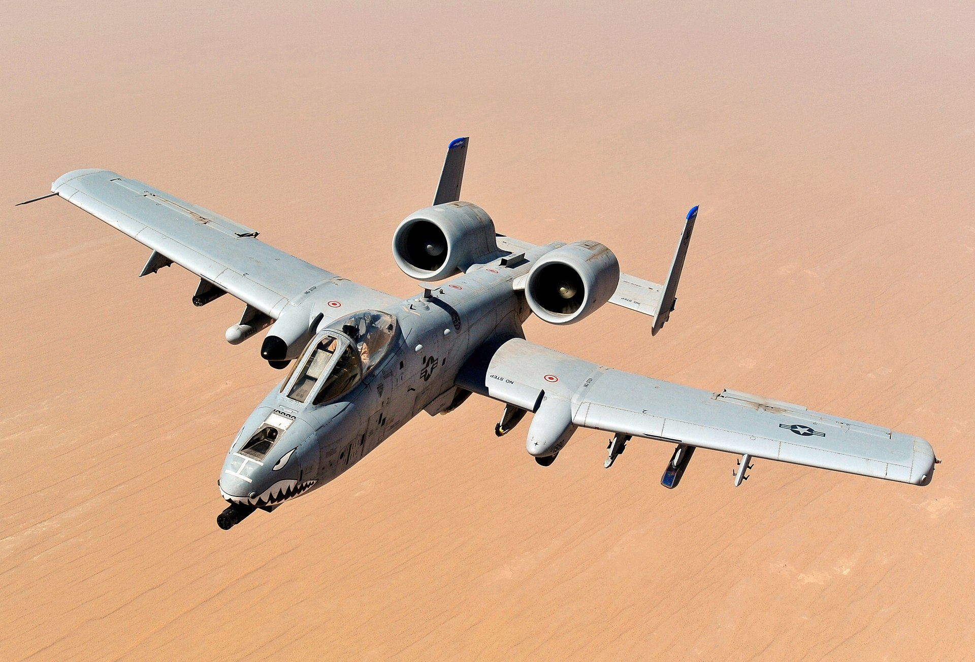
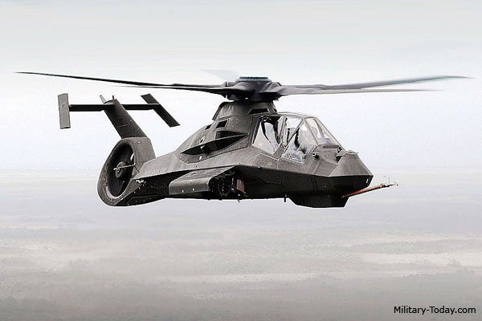
DM7 – Review the decision
Was it really as planned?
Was it really the best decision?
What have we learned?

Slide 18
Alternative DM7
Step 1. Fully analyse the problem and identify the decision purpose.
Step 2. Try to collect all the information and stakeholders related to the problem.
Step 3. Set up the criteria for judging the alternatives.
Step 4. Brainstorm all the ideas and evaluate them.
Step 5. Choose the best one among alternative
Step 6. Carry out the decision.
Step 7. Review your decision and its consequences

Slide 19
PACED method
Problem I am hungry
Alternatives / solutions Cook for myself x going to the restaurant
Criteria Price, Time, Taste, Health, Energy
Evaluate Budget constraint, time pressure, …
Decide Going to McDonald … (Just kidding ☺ …)

Slide 20
SWOT analysis
Origin in Lockheed 1967
SWOT stands for
Strengths
Weaknesses
Opportunities
Threats

Slide 21
SWOT
Observing from the perspective of
internal and external factors
positive and negative factors
Matrix 2 x 2 = 4 fields

Slide 22
Internal factors
Unique / specific for entity (person, company, hospital, …)
Positive – strenghts
Negative - weaknesses

Slide 23
External factors
Common for the whole market / group / industry
Positive – opportunities
Negative – threats

Slide 24
SWOT matrix
 | Positive | Negative
Internal | Strengths | Weaknesses
External | Opportunities | Threats

Slide 25
SWOT is always
Purpose oriented
Focused on most important / crucial / key elements
Too many – lack of focus
Too few – missing out

Slide 26
Prepare short SWOT for yourself
State Your future goal
Prepare short SWOT of yourself

Slide 27
Improved SWOT
Including the importance of elements
Weights
Including the degree of elements
Points

Slide 28
Example – advanced SWOT I
S | Points | Weight | W | Points | Weight
Language skills | 5 | 0,5 | Glasses | -2 | 0,2
Education | 4 | 0,2 | Criminal record | -1 | 0,4
Financial stability | 3 | 0,3 | Commuting | -3 | 0,4
O | Points | Weight | T | Points | Weight
Ph.D. studies | 3 | 0,2 | Legislative regulation | -4 | 0,4
Military career | 5 | 0,3 | Political instability | -2 | 0,4
Private medical practice | 2 | 0,5 | Epidemics | -5 | 0,2

Slide 29
Example – advanced SWOT II
Our position / situation
Weighted average 5*0,5+4*0,2+3*0,3-2*0,2-1*0,4-3*0,4 = 2,2
Result is positive value
We are well equipped,
Suggests aggressive / proactive / expansive approach
Market / environment situation
Weighted average 3*0,2+5*0,3+2*0,5-4*0,4-2*0,4-5*0,2 - -0,3
Result is negative value
Market / Environment / Options are rather unpleasant
Cautious approach / Survival
Always evaluate together – internal and external values

Slide 30
Your semestral assignment
Prepare 10 page report
Use methods / tools / techniques gathered through the course
Present your conclusions at the end of semester
Apply on military decision making

