Slide 1
Criteria or criterion?

Slide 2
Single criterion x multi-criteria
Single criterion – we make decision based upon one parameter
Multi-criteria – we make decision while balancing more than one parameter

Slide 3
Single criterion I
Decision is when looking for best solution ….
Best
  Max / Min (extreme)
  Average (Mean value)
  Within / outside certain values

Slide 4
Single criterion II
In reality these types of decision are very rare …
Sport (score, speed, time, goals, points … )
Usually constraints (no doping, no fouls, no corruption)

Slide 5
Single criterion III
Try to find out single criterion decision making in your life, is there any?

Slide 6
MCDA I
Balancing multiple criteria
Trying to find the best solution while considering different perspectives
Probably 99,99% of decisions are MCD

Slide 7
MCDA Imagine …
You are on a shooting competition
There are various disciplines
Your goal is to win …
… or at least find the winner

Slide 8
Shooting disciplines
Target shooting – Bigbore 10
Target shooting – Rifle 10
Steel shooting – 4 and 4

Slide 9
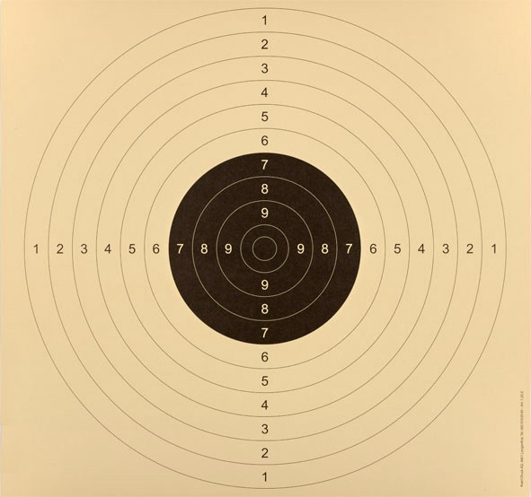

Bigbore 10
10 rounds (shots)
Target „50/20“
25 meters
Max is 100
10 is 50 mm

Slide 10
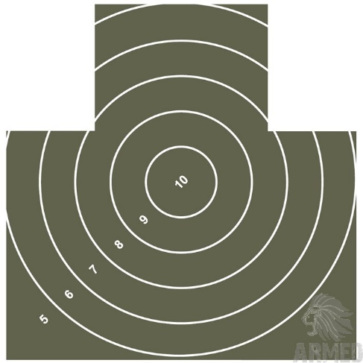
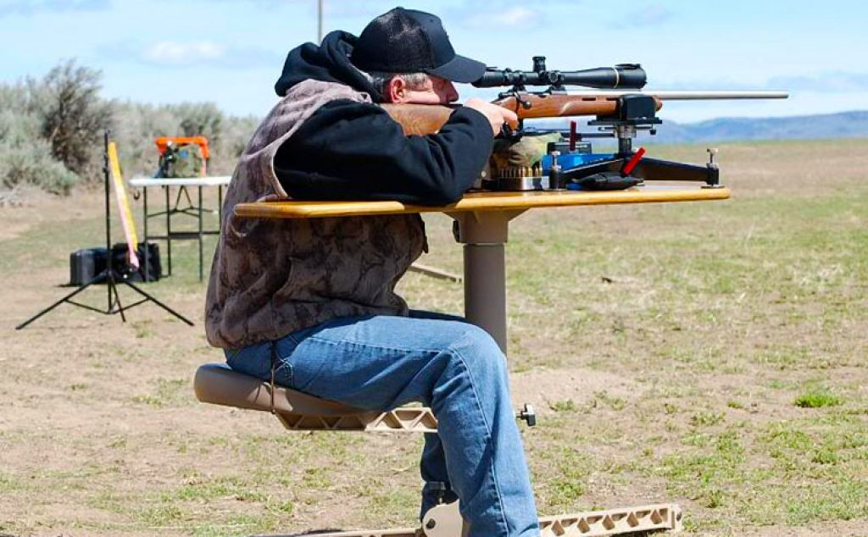
Rifle 10
10 rounds (shots)
Target „Green buddy“
100 meters
Max is 100
10 is 135 mm

Slide 11
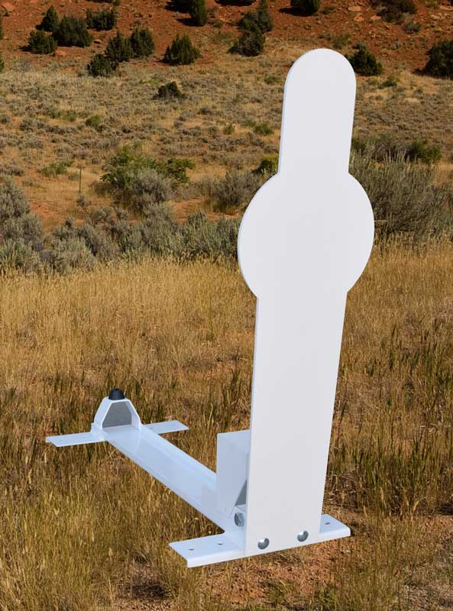
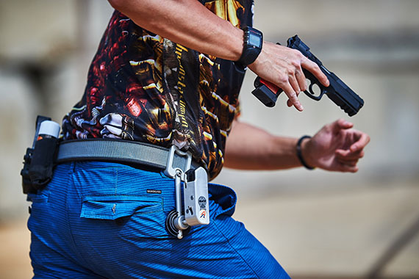
Steel shooting
4 targets (two times)
Speed shooting
Better time is evaluated
Best shooters around 5 seconds

Slide 12
At the end of the day …
Who is the best shooter?
Different targets
Different distances
Different scoring

Slide 13
MCDA II
Methodological problem is, how to measure and how to compare various metrics and measures
Some metrics are positive, some are negative
Some have limited values, some have unlimited values
How to determine the winner?

Slide 14
Let's see our results table …
 | Big bore | Rifle | Steel
Name | Points | Points | Time
Petr Sova | 82 | 74 | 7,70
Dalibor Horák | 60 | 65 | 11,54
Jiří Vyhlídal | 67 | 78 | 6,73
Dalibor Hroza | 80 | 80 | 12,07
Marie Macháňová | 6 | 46 | 14,85
Martin Bureš | 93 | 78 | 7,86
Jiří Štork | 93 | 92 | 8,81
Vilém Novotný | 86 | 87 | 9,05
David Vančík | 86 | 80 | 11,20
Josef Michalec | 49 | 54 | 9,05
Libor Bata | 47 | 83 | 7,53
Vladimí Beneš | 0 | 18 | 13,99
Jan Trávníček | 64 | 64 | 11,34
Zdeněk Polášek | 86 | 91 | 6,20
Jaromír Vicher | 75 | 64 | 6,81
Rostislav Hrdlička | 56 | 76 | 8,45
Martin Večeřa | 85 | 89 | 4,63
Danuše Jakšová | 61 | 61 | 8,50
Augustýn Spurný | 54 | 45 | 14,58
Jan Vlček | 0 | 64 | 9,54
Vladimír Jonáš | 13 | 13 | 7,56
Ivo Táborský | 25 | 35 | 9,79
Věra Poštulková | 76 | 86 | 11,28
Václav Skrejval | 88 | 92 | 9,95
Antonín Král | 89 | 94 | 6,62
25 shooters …

Slide 15
Measure A - ranking
Calculate rank
Sum of all ranks, the lower the sum the better
 | Big bore | Rifle | Poppers |  | RANK
Name | Points | Points | Time | Big bore | Rifle | Poppers | SUM | Final rank
Antonín Král | 89 | 94 | 6,62 | 3 | 1 | 3 | 7 | 1
Zdeněk Polášek | 86 | 91 | 6,20 | 5 | 4 | 2 | 11 | 2
Martin Večeřa | 85 | 89 | 4,63 | 8 | 5 | 1 | 14 | 3
Jiří Štork | 93 | 92 | 8,81 | 1 | 2 | 12 | 15 | 4
Martin Bureš | 93 | 78 | 7,86 | 1 | 11 | 9 | 21 | 5

Slide 16
Points
Each position is evaluated by points (12 – 10 – 8 – 6 – 4 – 2 – 0 – 0 – …)
Sum of all points gained, the higher the better
Name | Big bore | Rifle | Poppers | Sum | Final rank
Antonín Král | 8 | 12 | 8 | 28 | 1
Jiří Štork | 12 | 10 | 0 | 22 | 2
Zdeněk Polášek | 4 | 6 | 10 | 20 | 3
Martin Večeřa | 0 | 4 | 12 | 16 | 4
Václav Skrejval | 6 | 10 | 0 | 16 | 4

Slide 17
Point calculation
Rank | Points
1 | 12
2 | 10
3 | 8
4 | 6
5 | 4
6 | 2
7 or more | 0

Slide 18
Alternative point scoring
How many ranks are evaluated?
Difference? (1, 2, 3, … points per rank difference)
Scale – linear, exponential, …

Slide 19
Percents
Leader in each area is 100%, others in relation
Sum of all percents, the higher the better
Name | Big bore | Rifle | Steels | Sum | Final rank
Martin Večeřa | 91,4% | 94,7% | 100,0% | 286,1% | 1
Antonín Král | 95,7% | 100,0% | 69,9% | 265,6% | 2
Zdeněk Polášek | 92,5% | 96,8% | 74,7% | 264,0% | 3
Jiří Štork | 100,0% | 97,9% | 52,6% | 250,4% | 4
Martin Bureš | 100,0% | 83,0% | 58,9% | 241,9% | 5

Slide 20
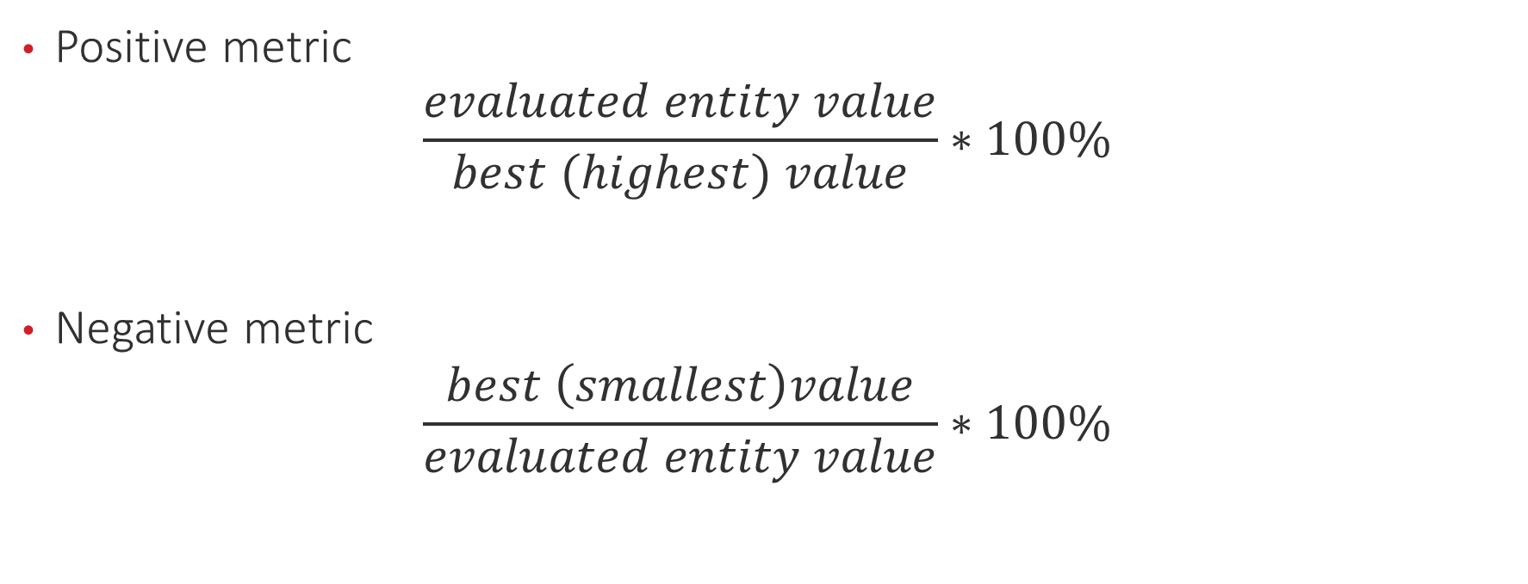
Percent calculation
Positive metric
$$\frac{evaluated entity value}{best (highest) value}∗100\%$$
Negative metric
$$\frac{best \left(smallest\right)value}{evaluated entity value}∗100\%$$

Slide 21
Summary
 | Rank | Point | Percent
Martin Večeřa | 3 | 4 | 1
Antonín Král | 1 | 1 | 2
Zdeněk Polášek | 2 | 3 | 3
Jiří Štork | 4 | 2 | 4
Martin Bureš | 5 | 6 | 5
Vaclav Skrejval | 6 | 4 | 6

Slide 22
What have we learned?
Measurement is not neutral
Various measures, various results
Methods of measurement should reflect our needs, preferences, values, etc.
To represent sets of parameters by one measure is tricky

Slide 23
KPI – what we measure?
Airport story
Rat problem

