Slide 1
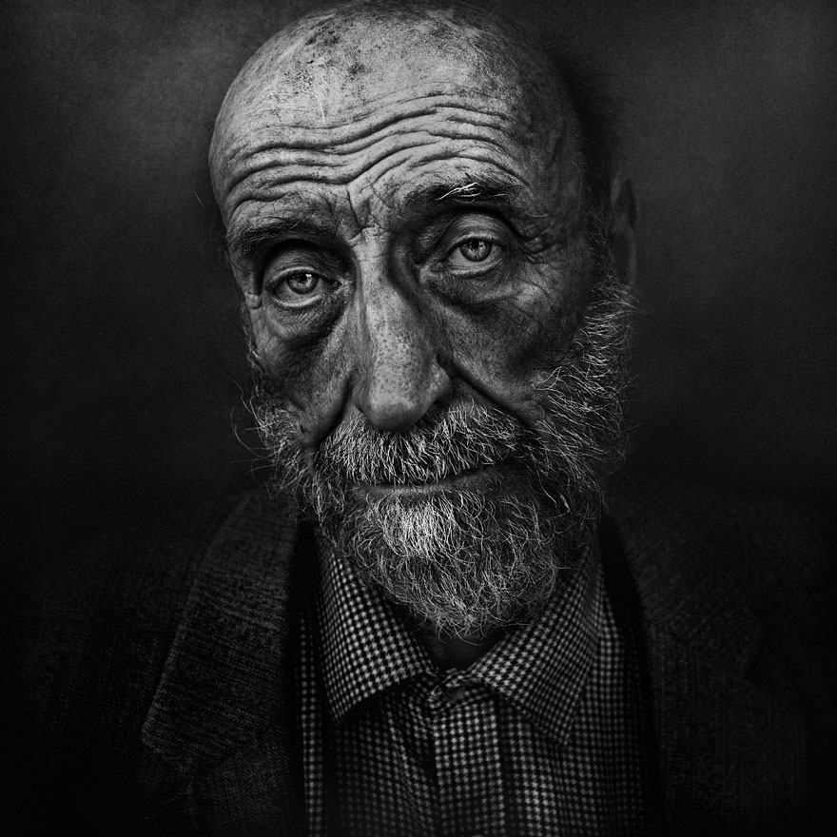

The Story of the UNKOWN
A businessplan made by
Juhas,Fhr gsaxner,fhr thaller,fhr

Slide 2
“The poverty of being unwanted, unloved, and uncared for is the greatest poverty. We must start in our own homes to remedy this kind of poverty.”
– Mother Teresa

Slide 3
Agenda
The Team
The Idea
The Content
The Goals
The Costs
The Market

Slide 4
The Team
CEO & Founder – Julian JUHAS
Co-Founder – Simon GSAXNER
CTO – Christoph THALLER
Co-Workers – 3-5 Teams, Skills, Experiences, Students

Slide 5
The Idea
Unique Idea
With people
Bring a message to people
Earn money
Change the mindset of the broad mass
Support young students
Close the gap between the classes (in the mind)

Slide 6
The Content
A Book (Paperback book)
Different stories
Different opinions
The incentive (Social media)
The creating of the first book (vienna only)
The creating of other books (federal state wide)

Slide 7
The Goals
First goal social media
Second goal creating the first book
Third goal achieving 22.500 selled books
Fourth goal the second edition

Slide 8
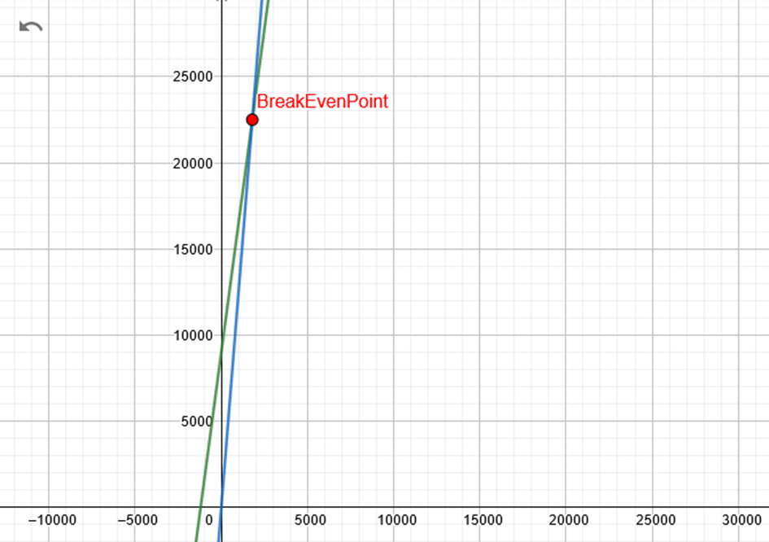
The Costs
Turnover for 1000 books | 20.000€
Costs for Publisher | 4.000€ (20%)
Costs for writing | 1.500€ (7,5%)
Costs for Print | 2.500€ (12,5%)
Taxes | 1.000€ (5%)
Earnings | 11.000€ (55%)

Slide 9
The Market
Some Books
Some Organzations
A Diploma thesis
Volume
Growth
Potential

Slide 10
Thank you

