Slide 1


Heimdalls Hall –Army Shop Business Plan

Slide 2
Table of Contents
01
02
03
Business Overview
Market Analysis and Competition
Sales and Marketing Plan
04
05
06
Management Plan
Operating Plan
Financial Plan

Slide 3


Our Company
Heimdalls Hall – Army Shop is an upcoming top seller in the area of weapons, survival, military and clothing. Our partners are well known brands that guarantee the highest quality and service

Slide 4

Vision
Mission
To be the top seller of our products in the region
To sell products everywhere in Austria

Slide 5

Business Overview
01

Slide 6
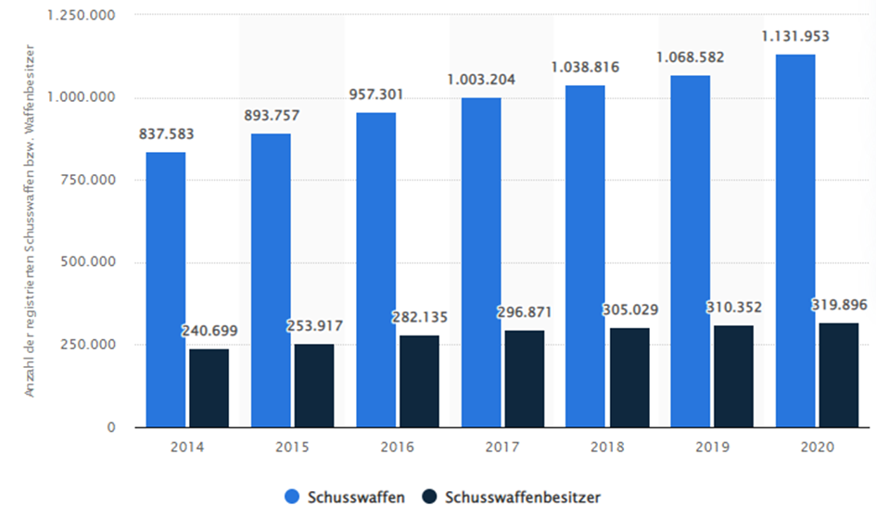
Market Trends
If you want to modify this graph, click on it, follow the link, change the data and replace it

Slide 7

Problem
Solution
Most stores are very limited in terms of their products. They are either focused on firearms, or survival or equipment for emergency organizations.
Heimdalls Army Shop offers comprehensive solutions for all these areas. Best service, best advice and a comprehensive range of products characterize us

Slide 8




Competitors
Black Shadow
Steinadler
Kettner
Fischak
Our biggest competitor.
Located in Neunkirchen
Distance: ~20km
Offers Survival Equipment, weapon accessories and clothing
Located in Vienna and Graz.
Distance: ~50km or 140 km
Offers Survival Equipment, weapon accessories and clothing
Located in Vösendorf.
Distance: ~45km
Offers survival Equipment, Hunting products and weapons for hunting
Located in Wr. Neustadt
Offers weapons, weapons accessories and survival gear

Slide 9

Market Analysis and Competition
02

Slide 10

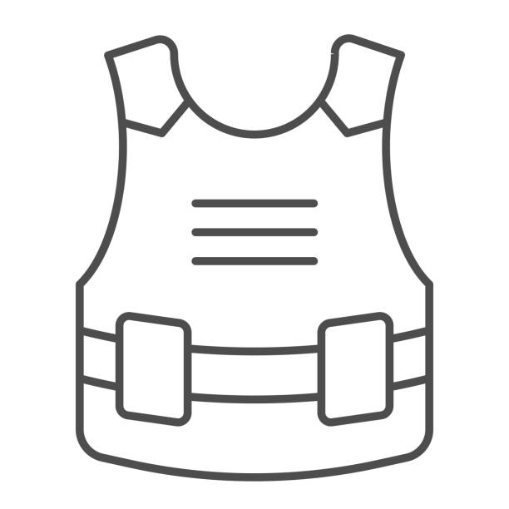



Target
Average Spend per Customer
Gender
€200
Male
Female
Interests
Age
Military Equipment
Weapons & accesories
Clothing/Boots
Survival & Hunting
90%
10%
20-50 years
20-30 years

Slide 11



Market Share
25%
1. Black Shadow 50%
10%
25%
10%
2. Steinadler 25%
15%
3. Fischak 15%
15%
4. Kettner 10%
50%

Slide 12

Sales and Marketing Plan
03

Slide 13





Our Services
Weapons
Survival & Hunting
Military/Police Equipment
Clothing/Boots

Slide 14

Break-even Analysis
1. Year
High Profit 400 000€
Operational Costs/Year
1. Year | 300 000€
2. Year | 250 000€
3. Year | 250 000€
Profit
350 000€
Break-even Point 300 000€
Estimated Sales/Year
1. Year | 250 000€
2. Year | 300 000€
3. Year | 350 000€
Loss 250 000€
Big Loss 200 000€

Slide 15

Our Plans
1. Year
2. Year
3. Year
Finding our way into the market. Build up customer base
Increase sales with targeted offers and advertising. Slight increase in employees as well as assortment
Dominance in the region. Extended expansion of the product range. No. 1 Austria-wide seller on the web

Slide 16
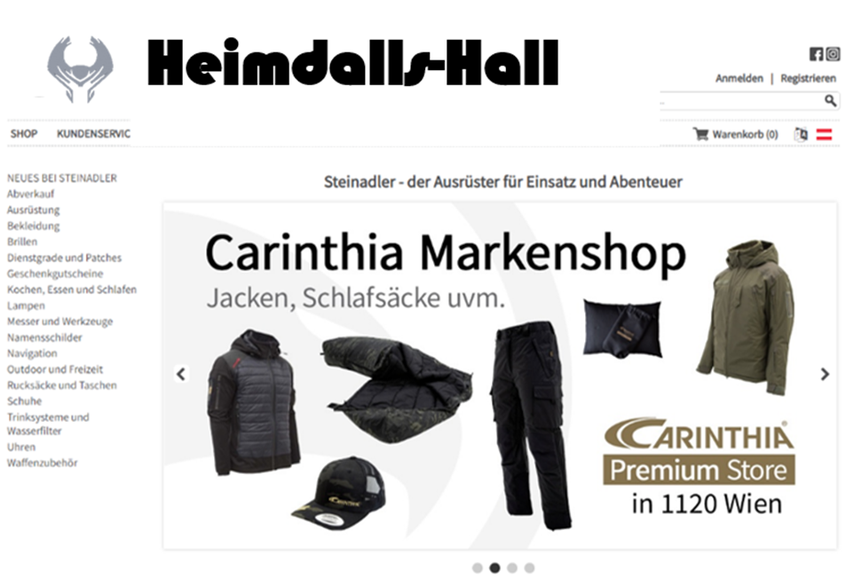
Webshop
Search bar
Own profile
Categories
Special offers / Advertisement

Slide 17

Advertising and Promotion
Advertising
PR
Online
Targeted advertising on three Social Media platforms: Facebook, Instagram and TikTok
Targeting as well as discounts from operation organizations. Advantages for bulk orders for companies and military classes.
Exclusive webshop with countless offers as well as online discounts

Slide 18

Management Plan
04

Slide 19
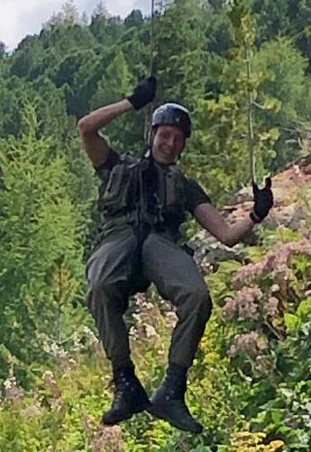
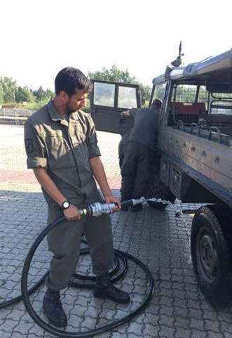
Our Team
BINNER Daniel; 23 Years
Military & Business experience
You can replace the image on the screen with your own
DAUD Benjamin; 27 Years
Military & Business experience

Slide 20
Organizational Chart
Quality Management & PR
Business/Finance & Sales/Distribution
BINNER
DAUD
Employee 1: Sales & Webshop
Employee 2: Sales & Social Media
Employee 3: Warehouse
Team 4

Slide 21




Our Main Partners
Carinthia
Hanwag
Heimplanet
Walther
Best clothing for outdoor & survival
Finest shoes for military, police & outdoor
Maximum safety for special tent solutions
Best supplier for weapons & tools

Slide 22

Operating Plan
05

Slide 23
Our Process
2022
June
September
December
Contract with Suppliers
Storage
Online going of our Website
Opening of the Shop

Slide 24

Financial Plan
06

Slide 25
Balance Sheet
Assets
Liabilities
Equity
100 000€
200 000€
100 000€
Own Investment
Bank
Difference

Slide 26

Thanks
Does anyone have any questions?
Heimdall‘s Hall Army Shop
Burgplatz 1, Wr. Neustadt
Heimdall-armyshop@gmail.com

