Slide 1

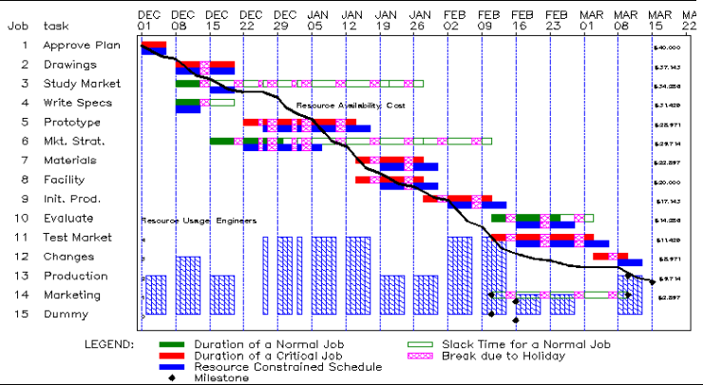
Project Timeline – Gantt Diagram
  Horizontal Line Chart
  Covers Time Period of Whole Project:
  (Pre-investment Phase, Investment Phase,
  Realization Phase)
  Contains All Important Activities of the Project
  and Information about Time Duration
  Depicts Time Consequences (Continuity) of Activities
  Have to be Enough Detailed and Accurate
  Software: MS Project, MS Visio, (MS Excel), others…

Slide 2
Gantt Diagram Example

Slide 3
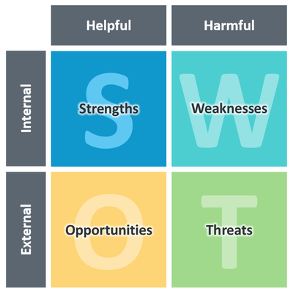
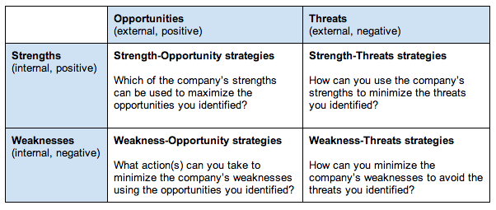
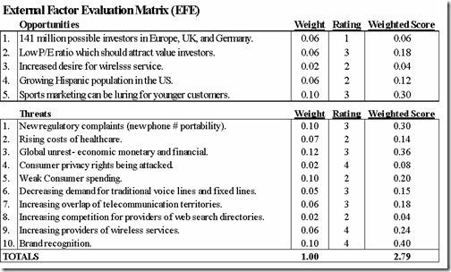
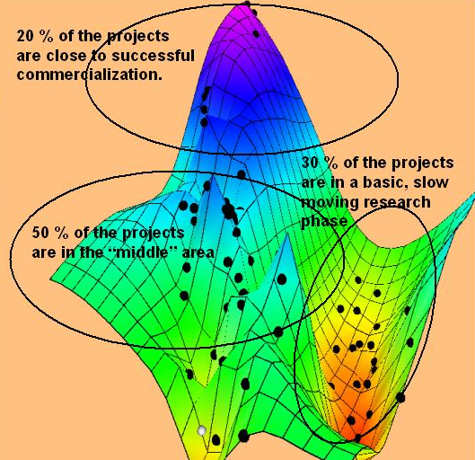
Summation SWOT analysis

Slide 4



Identification of Success Factors,
Risk Minimizing Actions,
BP Addenda
Key Contracts, Investments, Sales, Earnings,
Assets Growth, Technological Development
Share of Market, Strategic Partnership, Exit
Strategic Planning, Reasonable Debt
Capital Distribution (Portfolio), Specific Provisions (Production, Safety, Fire, …)
CVs, Personal Certificates, Trainings, Registry Transcripts (registers, cadastre)
Project Documentation, Visualizations,
Patents, Product Certificates
Financial Statements (Balance Sheet, Profit and Loss Account, CF)
Contracts, Information about Competition, Market Search

