Slide 1


Project Personal Provision
Human Resources (Employees, Outsourcing of Services)
Number of Employees, Shifts, Even Opportunities
Expected Qualifications of Employees (Drivers License, ICT, English Skills, Certificates) and Other Skills (Practical Experiences)
Job Description
Competences, Responsibilities, Motivation, Remuneration
Personal Agencies, Brigade-work, Fluctuation
Labor Code (CZ Act. No. 262/2006 Coll.)

Slide 2
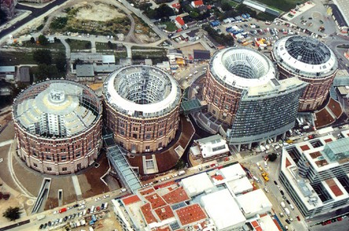
Project Area (Site) Provision
Office Room and Production Area (Purchase/Lease)
Project Dimensions, Facility Conversion (Adaptation)
Locality, Traffic Accessibility, Parking Places, Public Traffic, Neighborhood
Networks (Electricity, Gas, Water, Waste, Internet), Territory Devel. Plan
Brownfields, Business Zones and Parks, Incubators
Real Property Operational Costs, Facility Management, RES

Slide 3

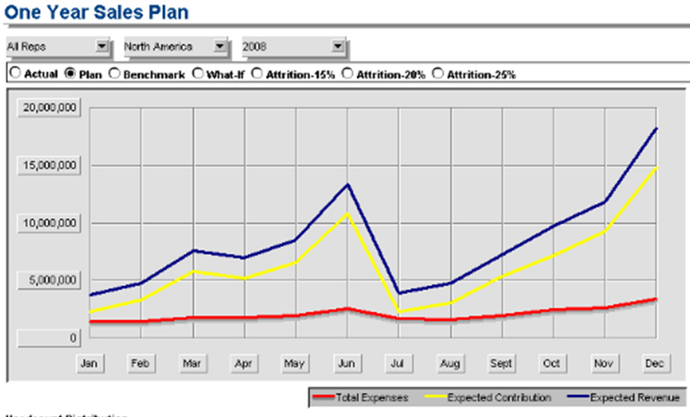
Project Marketing Proposal
  Sales and Marketing Mix (Product, Price, Place, Promotion, Distribution, Processes, People)
  Ways and Costs of Promotion (Internet, FB, Press, Radio, TV, Billboards, Direct Marketing, …)
  Ways and Costs of Distribution (Packings, B2B vs. B2C, Retail Chains, Shops, Internet)
  Setting of Margin and Product Prices, Calculations:
    Variable Costs (direct, operational) and Fix Costs (investments, overheads)
    Down Limit – Costs; Up Limit – Competition
  Definition of Goals and Milestones of Success in Time:
    Prognosis of Sales (Revenues); Market Share

Slide 4

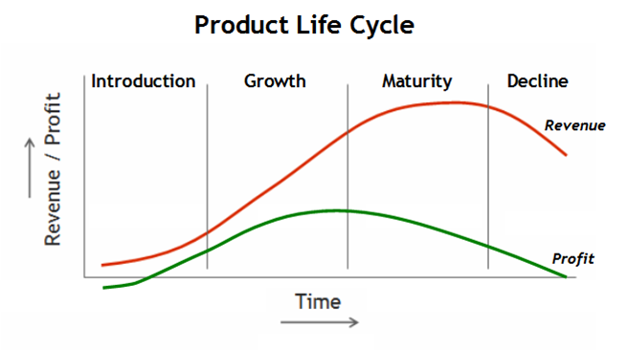
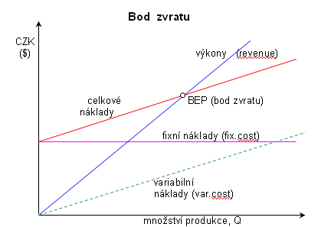
Financial Analysis – Project Budget
Calculation of Costs in All Phases of Project:
  Prior Project Initiation (Investment)
  During the Course of Project (Operation)
Expected Earnings – Break Even Point Location,
Assets and Liabilities Projection (Balance)
  Finance Sources
  How will be Investor’s Capital Evaluated? Interests
  Return of Invested Capital
  (Payback Period, NPV, ROI, IRR)
Cash-flow Projection
Sensitivity Analysis, Software: Comfar (UNIDO), Stratex R

Slide 5
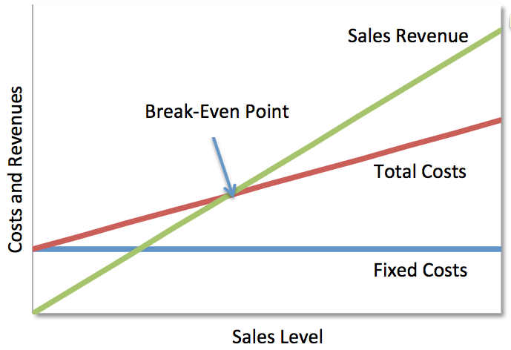
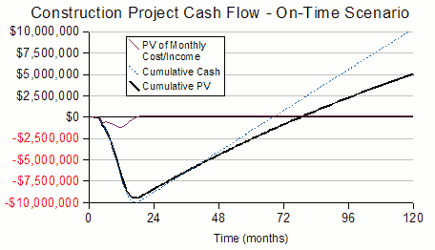
Čas (měsíce)
The payback period is the time required for the amount invested in an asset to be repaid by the net cash flow generated by the asset.
Net Present Value (NPV) is the difference between the present value of cash inflows and the present value of cash outflows.
The internal rate of return (IRR) is the discount rate at which the net present value of future cash flows is equal to the initial investment, and it is also the discount rate at which the total present value of costs equals the total present value of the benefits.

Slide 6
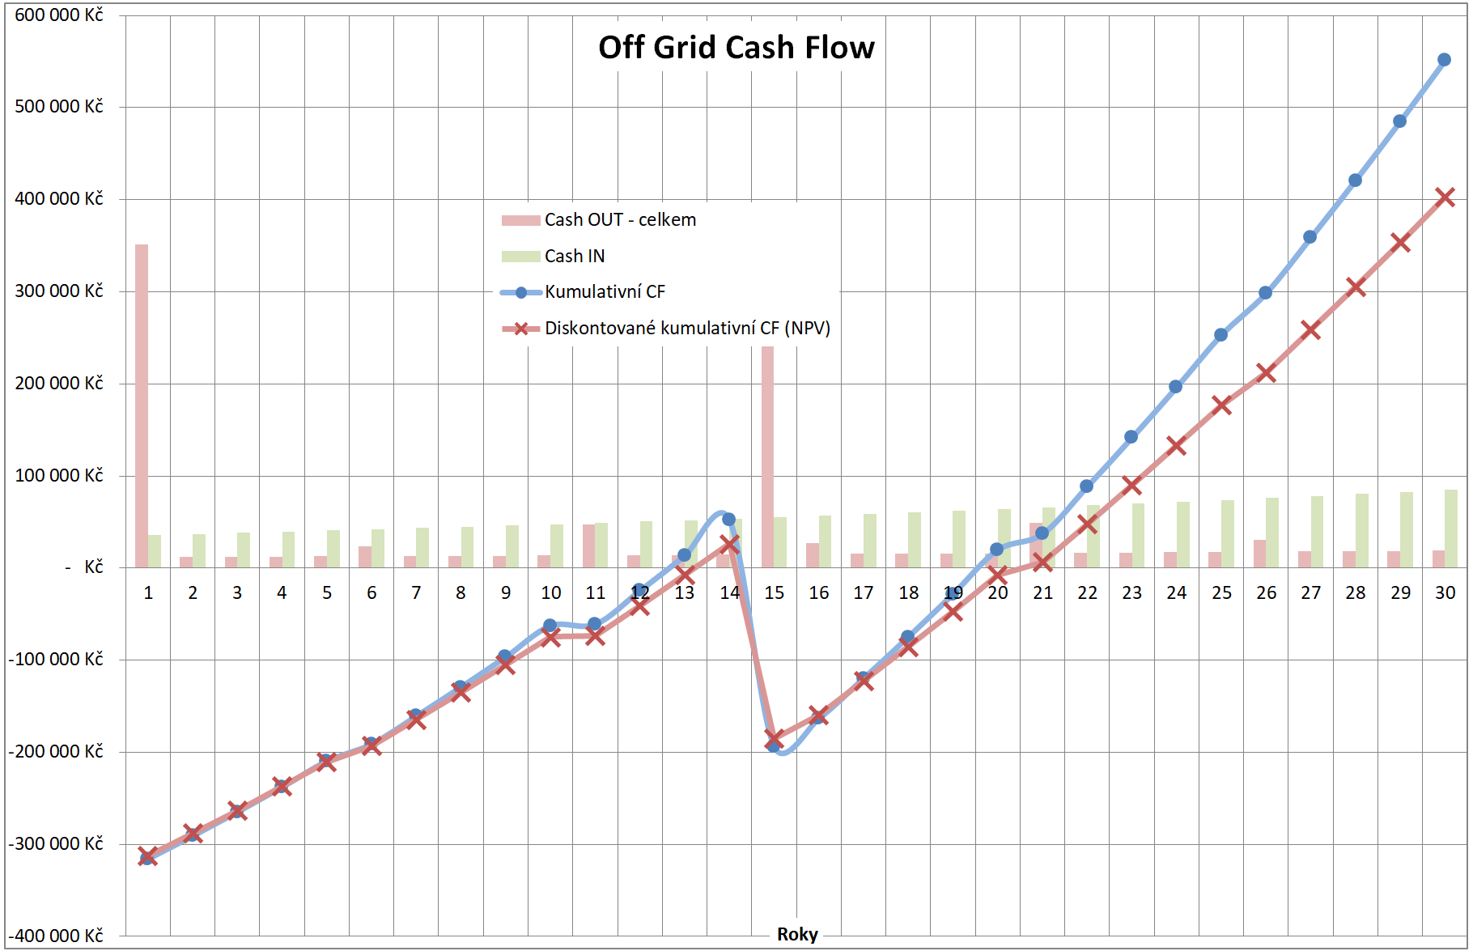
Cash Flow Example
Cumulative CF
Discounted cumulative CF

