Slide 1


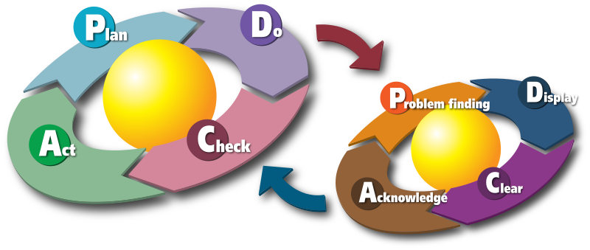
Technology and Production Plan,
Innovation, R&D
Technology, Production Processes, Automated Control Systems
Production Demand (Space, Background, Machinery, Equipment, Inputs – Material, Energy, Work); Time Demand of Production
Transportation and Logistics, Industrial Logistics
Production Costs – Structure, Calculations; Controlling
Outer Factors (Legislative, Production Standards ČSN EN ISO)
Product Certification, Conformity Declaration
ISO 9000, ISO 14000, TQM, EFQM (6σ, Kaizen,…)
Work Safety (Plan) and Fire Protection (Risk Analysis)
Innovation, Research and Development, University Cooperation
IPR Protection, Patent, Technology Transfer

Slide 2

Project Personal Provision
Human Resources (Employees, Outsourcing of Services)
Number of Employees, Shifts, Even Opportunities
Expected Qualifications of Employees (Drivers License, ICT, English Skills, Certificates) and Other Skills (Practical Experiences)
Competences, Responsibilities, Motivation, Remuneration
Personal Agencies, Brigade-work, Fluctuation
Labor Code (CZ Act. No. 262/2006 Coll.)

Slide 3
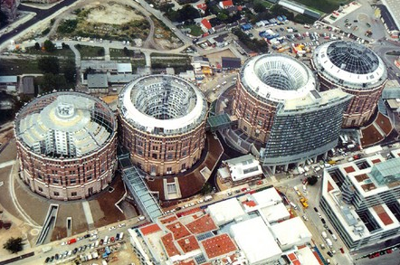
Project Area (Site) Provision
Office Room and Production Area (Purchase/Lease)
Project Dimensions, Facility Conversion (Adaptation)
Locality, Traffic Accessibility, Parking Places, Public Traffic, Neighborhood
Networks (Electricity, Gas, Water, Waste, Internet), Territory Devel. Plan
Brownfields, Business Zones and Parks, Incubators
Real Property Operational Costs, Facility Management, RES

Slide 4
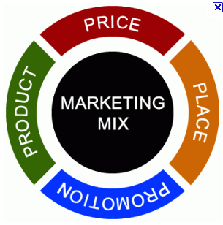
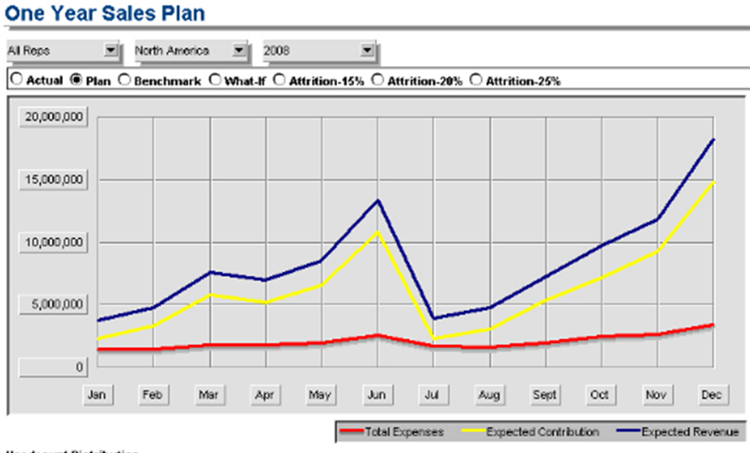
Project Marketing Proposal
  Sales and Marketing Mix (Product, Price, Place, Promotion, Distribution, Processes, People)
  Ways and Costs of Promotion (Internet, FB, Press, Radio, TV, Billboards, Direct Marketing, …)
  Ways and Costs of Distribution (Packings, B2B vs. B2C, Retail Chains, Shops, Internet)
  Setting of Margin and Product Prices, Calculations:
    Variable Costs (direct, operational) and Fix Costs (investments, overheads)
    Down Limit – Costs; Up Limit – Competition
  Definition of Goals and Milestones of Success in Time:
    Prognosis of Sales (Revenues); Market Share

