Slide 1


Executive Summary
Summarization and Explanation of Important Project Information
Range: 1 sheet A4; Motivational, Reasonably Emotive Form
Attractive Project Title
Introduce Yourself:… Education, Experiences, Achievements
Product, Price – Show the Prototype
Market: Destination Group, Competition
Financial Demanding of Project (Costs, Turnover, Profit)
Your Deposit (Efforts, Time, Know-how, Own Investment)
Time Demanding – First Insight
Contact Information
Disclaimer – Responsibility Refusal
Proposal to the Investor – Equity Position:
how much and what for?

Slide 2

Company Characterization;
Project Description and Goals
  Characteristics of Proposer (Names, Addresses, Contact)
  Company Description
  (Legal Form, History, Professional Certificates)
  Work Team (Age, M/F, Qualifications, Personality)
  Management (Structure, Competences, Responsibility)
  Vision and Mission
  Project Strategic (SMART) Goals Statement
  Aiming and Prime Activities of the Project (Processes)
  Product Description (Prototype) and Contribution
  (Added Value) for Customer
  Profitability of the Product (Market Estimation)
  Recent Product Conditions, Development Phases,
  IP Rights (Patent)
Specific, Measurable, Attainable, Relevant, Time-bound; Evaluate, Reevaluate

Slide 3
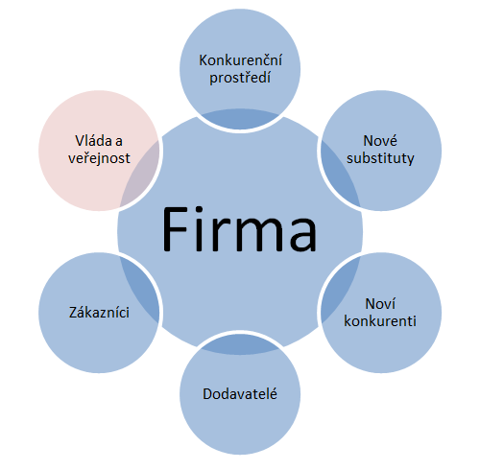
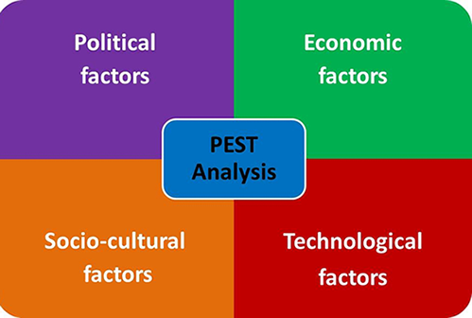

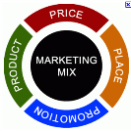
Market Research and Analyses
Methods of Marketing Analysis:
Enterprise Micro surrounding
Porter 5 (6) Forces analysis
Enterprise Macro surrounding
PEST(LE) analysis
geographic and morphologic
structure
Competitive
surrounding
Government and public
New substitutes
quality
price
innovations
Enterprise
Enterprise
Customers
New
competitors
segmentation
focus
needs
purchase power
market ratio
strategy
capital
technologies
competitive advantages
Suppliers
key
alternative

Slide 4
Market Research and Analyses II
PEST(LE) analysis of Enterprise Macro surrounding
Political and legislative factors:
Political stability
Business and work laws, labour code
Tax policy
Antimonopoly law
Consumer protection
Environmental legislative
Foreign trade regulations
Law enforceability and corruption
EU integration policy
Technical norms and regulations
Health and safety
Economic factors:
Economic cycles
Macroeconomic trends, GDP
Inflation
Interest rates
Currency exchange rates
Purchasing power
Average wage
Energy prices trends
Tax burden
Foreign investment amount
Amount g money in circulation
Socio-cultural factors:
Demographic population trends
Lifestyle, free time activities
Mobility and migration
Level of education, income distribution
Unemployment, labour approach
Population health, religion
Technologic factors:
Government support, spendings on of R&D
Infrastructure, ICT
Technology transfer
Speed of obsolescence
New materials, nanotechnologies
New discoveries, technology change

