Slide 1
„Strategic Management“ (English 3 – A2)
Author: Milan Rajtár, DiS.
Personal number: Mxxxxx
Field of study: PEM
Study form: combined
Year: 2nd year
E-mail: m1xxxx@studenti.mvso.cz
Academic year: 2015/16

Slide 2
Strategic management is the most important and difficult topic of TOP MANAGEMENT
in our today´s life!

Slide 3
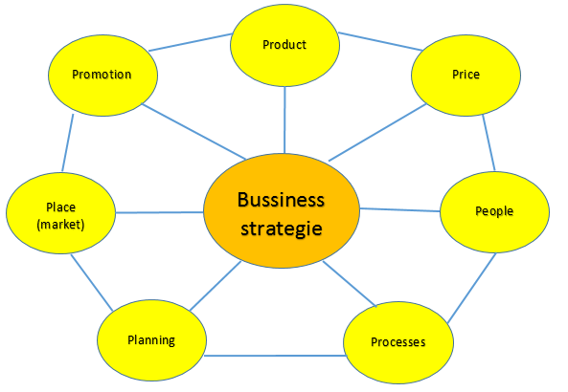
Strategic management means to have:
Clear strategy (incl. more variants):

Slide 4
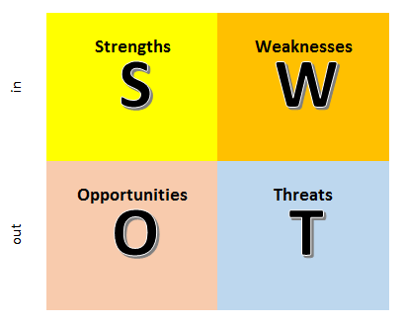
ATTENTION!!
Before the preparation of a strategy, it is very important to make
a SWOT analysis!

Slide 5
Sources:
Odagiri, Hiroyuki. Growth Through Competition. Oxford: OUP, 1994.
Management study guide, 2016. Accessed October 28, 2015.
http://managementstudyguide.com/strategic-management.htm

Slide 6
Thank you
for your attention!

